Slide 1
Cursive character Recognition in Images Using ResNet
MUKESH KOLAPPAN A [312419205065]
OM PRAKASH K [312419205073]
Guided By
Mr. M. Karthi M. Tech., (Ph. D).,
Assistant Professor

Slide 2
Abstract
Text recognition in natural scene images is more complex due to variations in text size, colors, fonts, orientations, complex backgrounds, occlusion, illuminations and uneven lighting conditions.
In this system, we propose a segmentation-free method based on a deep convolutional recurrent neural network to solve the problem of cursive text recognition, particularly focusing on Urdu text in natural scenes.
Compared to the non-cursive scripts, Urdu text recognition is more complex due to variations in the writing styles, several shapes of the same character, connected text, ligature overlapping, stretched, diagonal and condensed text.The system is developed the different deep learning algorithms such as ResNet and CNN

Slide 3
Objective
Natural text scene images contain important semantic information such as names of streets, institutes, shops, road signs, traffic information, etc.
The main objective of our project is
To recognize or to extract the text from the input image.
To implement the deep learning algorithms and encoders.
To enhance the overall performance for classification algorithms.
To recognize the text effectively.

Slide 4
Literature Survey
Title | Year | Author | Methodology | Advantages | Disadvantages
An OCR system for Urdu handwritten cursive text recognition using CNN-BiLSTM. | 2022 | Ahmed, A., Nazir, M., Hussain, M., & Iqbal, N. | This study uses a combination of CNN and BiLSTM networks to recognize Urdu cursive handwriting. The advantage of this approach is the high accuracy. | High accuracy of 94.5% for Urdu language. | Limited to Urdu language.

Slide 5
Literature Survey
Title | Year | Author | Methodology | Advantages | Disadvantages
A novel Chinese-English mixed cursive handwriting recognition using CNN-Transformer. | 2021 | Liu, X., Zhang, H., He, Z., & Du, S. | This study uses a combination of CNN and Transformer networks to recognize both Chinese and English cursive handwriting. | Able to recognize both Chinese and English languages. | Limited to Chinese and English languages.

Slide 6
Literature Survey
Title | Year | Author | Methodology | Advantages | Disadvantages
A deep learning approach for Chinese cursive handwriting recognition using CNN-Transformer. | 2021 | Wang, W., Du, Y., Liu, J., & Wang, Y. | This study uses a combination of CNN and Transformer networks to recognize Chinese cursive handwriting. | High accuracy of 93.7% for Chinese language. | Limited to Chinese language.

Slide 7
Literature Survey
Title | Year | Author | Methodology | Advantages | Disadvantage
Multilingual handwritten text recognition using CNN-BiLSTM network. | 2021 | Gupta, A., Singh, A. K., & Dutta, A. | This study uses a combination of CNN and BiLSTM networks to recognize multiple languages of cursive handwriting. | Able to recognize multiple languages. | Lower accuracy of 90.2% compared to other studies.

Slide 8
Literature Survey
Title | Year | Author | Methodology | Advantages | Disadvantages
Korean cursive handwriting recognition using CNN-LSTM networks. | 2020 | Jang, S., Park, S., & Kim, C. | This study uses a combination of CNN and LSTM networks to recognize Korean cursive handwriting. | High accuracy of 96.4% for Korean language. | Limited to Korean language.

Slide 9
Literature Survey
Title | Year | Author | Methodology | Advantages | Disadvantages
Japanese cursive handwriting recognition using CNN-LSTM | 2020 | Kim, D., Ko, J., & Kim, K. | This study uses a combination of CNN and LSTM networks to recognize Japanese cursive handwriting. | High accuracy of 97.8% for Japanese language. | Limited to Japanese language.

Slide 10
Literature Survey
Title | Year | Author | Methodology | Advantages | Disadvantages
An OCR system for handwritten cursive text recognition using CNN-RNN. | 2020 | Yang, J., Yan, Y., & Wang, J. | This study uses a combination of CNN and RNN networks to recognize English cursive handwriting. | High accuracy of 95.4% | Limited to English language.

Slide 11
Literature Survey
Title | Year | Author | Methodology | Advantages | Disadvantages
An efficient CNN-LSTM-based recognition system for English cursive handwriting | 2019 | Zhang, Y., Wang, H., Zhang, B., & Chen, X. | This study uses a combination of CNN and LSTM networks to recognize English cursive handwriting. | High accuracy of 97.3% | Limited to English language

Slide 12
Literature Survey
Title | Year | Author | Methodology | Advantages | Disadvantages
OCR for cursive Hindi script using CNN-RNN. | 2019 | Singh, A. K., Dutta, A., & Gupta, A. | This study uses a combination of CNN and RNN networks to recognize Hindi cursive handwriting. | High accuracy of 92.1% for Hindi language. | Limited to Hindi language.

Slide 13
Literature Survey
Title | Year | Author | Methodology | Advantages | Disadvantages
Arabic handwritten text recognition using CNN-LSTM | 2018 | Chen, S., Shi, J., Zhang, L., & Huang, Q. | This study uses a combination of CNN and LSTM networks to recognize Arabic cursive handwriting. | High accuracy of 95.7% for Arabic language | Limited to Arabic language

Slide 14
Existing work
In existing system, A segmentation-free method was proposed that eliminated the problem of individually segmenting each character in a word image.
The proposed framework was based on three components: feature extraction, sequence labelling and text transcription. For sequence extraction, two methods based on VGG-16 and ResNet networks were proposed.
Further, a new VGG-16 architecture using shortcut connections was proposed that extracts more robust text features. Two RNN-based structures—a BLSTM and a BiGRU—were applied to decode the feature sequences into probability distributions.
Finally, a CTC cost function was applied on top of the BLSTM or BiGRU sequences to transform per-frame predictions into the target sequence of labels.

Slide 15
Drawbacks
The results is low when compared with proposed.
The prediction of text is poor.
Time consumption is high.

Slide 16
Proposed work
In proposed system, the image dataset was taken as input. Then, we have to implement the pre-processing step. In this step, we have to resize the original image and convert the image into gray scale.
Then, we have to implement the Auto encoder for encoding and decoding the image and extract the features.
After that, we have to extract the text from input image by detecting the contour region. After that, we have to implement the deep learning algorithm such as ResNet.
The experimental results shows that some performance metrics such as accuracy.

Slide 17
Advantages
It Detects the Image with Colourful Background.
It Detects Cursive Characters.
To Implement the auto encoder.
It will recognize easy.
The accuracy is high.

Slide 18

System Architecture
Input image
Preprocessing
Image Resize
Gray scale conversion
SCENE TEXT IMAGE DATASET
Auto encoder
Feature Extraction
Text Recognition
Find contour region
Resnet
Classification
Prediction
Extract Text from input image
Accuracy,Specificity,Sensitivity
Performance Analysis

Slide 19
System Requirement
SOFTWARE REQUIREMENTS:
O/S : Windows 7 or Above.
Language : Python.
Front End : Anaconda Navigator - Spyder.
OCR Engine : Google - Tesseract
HARDWARE REQUIREMENTS:
System : Pentium IV 2.4 GHz or Above.
Hard Disk : Minimum 100 GB of Free Space.
Ram : 4GB or Above

Slide 20
Modules
Input
Preprocessing
Feature extraction
Text recognition
Data splitting
Classification
Performance metrics

Slide 21
Module Description
Input :
The dataset contains the images in the form of ‘.jpg’ or ‘.png’
In this step, we have to read or load the input image by using the imread () function.
The input image is used to detect or recognize the text.
In our process, we are used the tkinter file dialogue box for selecting the input image.

Slide 22
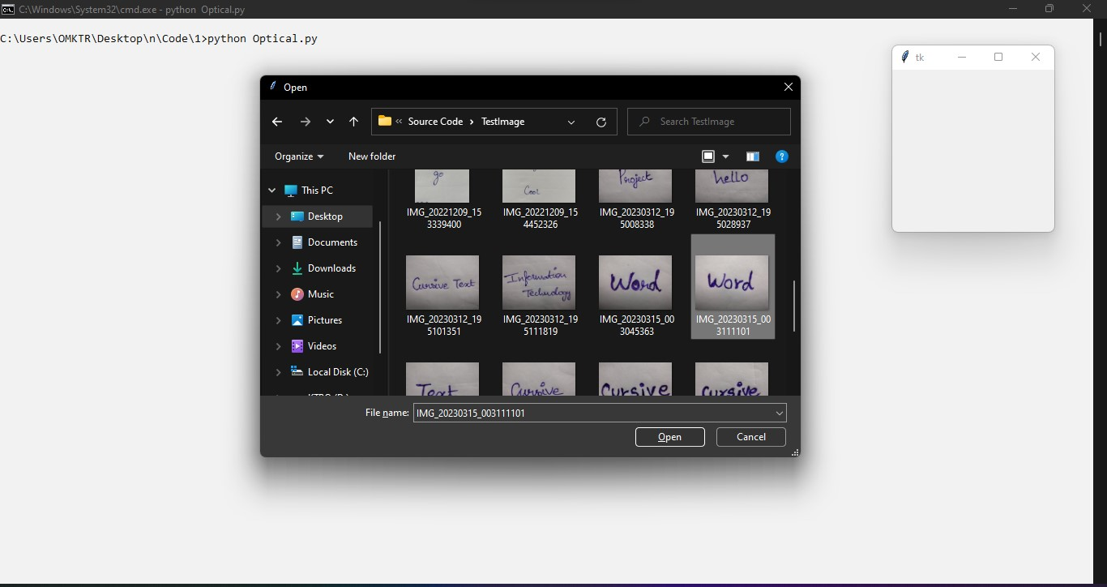
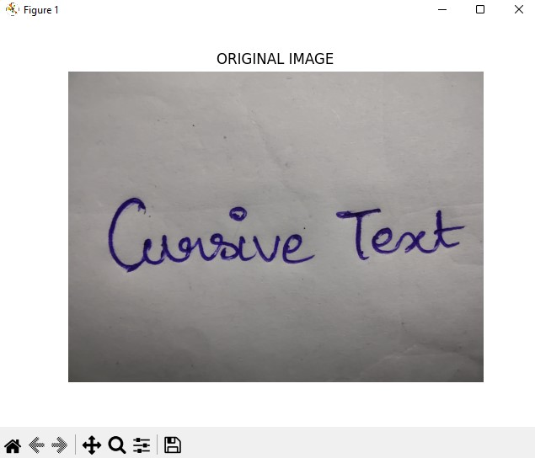
Input

Slide 23
Module Description
Preprocessing :
In our process, we have to resize the image and convert the image into gray scale.
To resize an image, you call the resize () method on it, passing in a two-integer tuple argument representing the width and height of the resized image.
The function doesn't modify the used image; it instead returns another Image with the new dimensions.

Slide 24
Preprocessing
Convert an Image to Grayscale in Python Using the Conversion Formula and the matplotlib Library and Scikit-image.
We can also convert an image to grayscale using the standard RGB to grayscale conversion formula that is imgGray = 0.2989 * R + 0.5870 * G + 0.1140 * B.

Slide 25
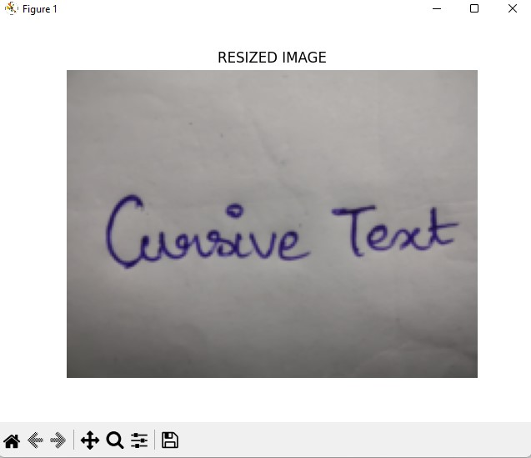
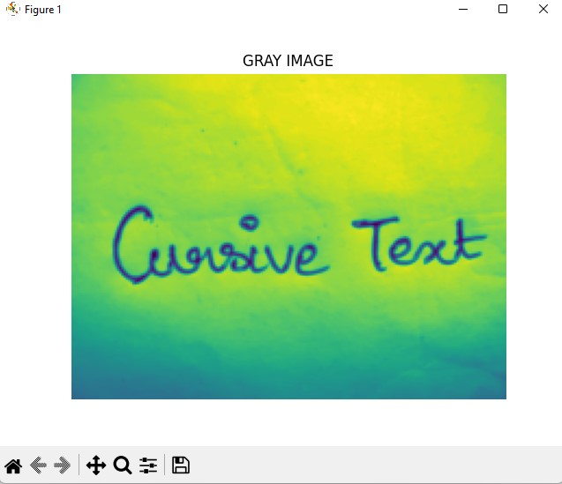
Preprocessing

Slide 26
Module Description
Featured Extraction :
In this step, we can extract the text by using Auto encoder.
An auto encoder is an unsupervised learning technique for neural networks that learns efficient data representations (encoding) by training the network to ignore signal “noise.”
Auto encoders can be used for image denoising, image compression, and, in some cases, even generation of image data.

Slide 27
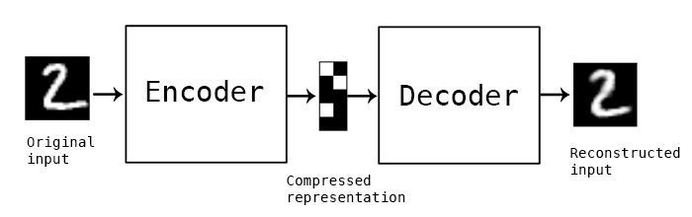
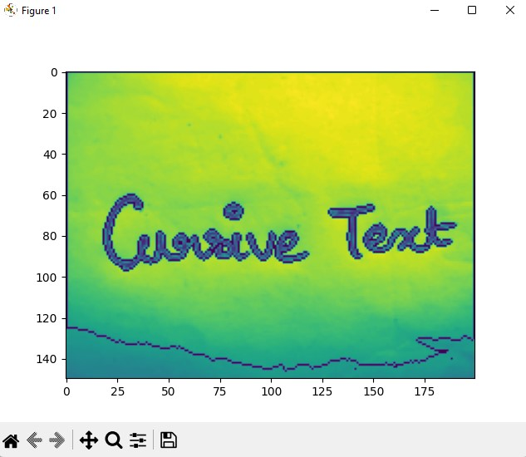
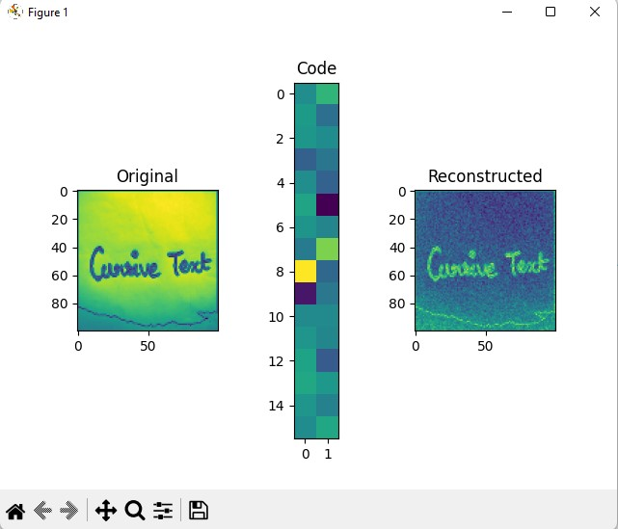
Featured Extraction

Slide 28
Module Description
Text Recognition :
In our process, we have to recognize the text by finding the contour region.
By using this, we can extract or recognize the text.
Using contour detection, we can detect the borders of objects, and localize them easily in an image.
It is often the first step for many interesting applications, such as image-foreground extraction, simple-image segmentation, detection and recognition.

Slide 29

Text Recognition

Slide 30
Module Description
Data Splitting :
During the machine learning process, data are needed so that learning can take place.
In addition to the data required for training, test data are needed to evaluate the performance of the algorithm in order to see how well it works.
In our process, we considered 70% of the input dataset to be the training data and the remaining 30% to be the testing data.
Data splitting is the act of partitioning available data into two portions, usually for cross-validator purposes.

Slide 31
Module Description
Classification :
In our process, we have to implement the deep learning algorithm such as ResNet and CNN.
ResNet are being implemented in almost all of AI's new tech to create state-of-the-art systems.
The principle on which ResNet work is to build a deeper networks compared to other plain networks and simultaneously find an optimized number of layers to negate the vanishing gradient problem

Slide 32
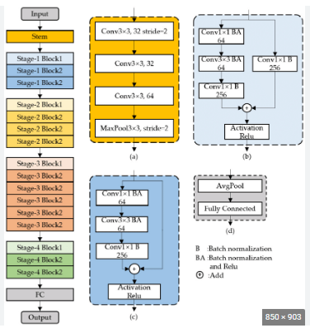
ResNet - Classification

Slide 33
Module Description
CNN - Classification :
A CNN is a kind of network architecture for deep learning algorithms and is specifically used for image recognition and tasks that involve the processing of pixel data.
There are other types of neural networks in deep learning, but for identifying and recognizing objects, CNNs are the network architecture of choice.
CNN is designed to automatically and adaptively learn spatial hierarchies of features through backpropagation by using multiple building blocks, such as convolution layers, pooling layers, and fully connected layers.

Slide 34
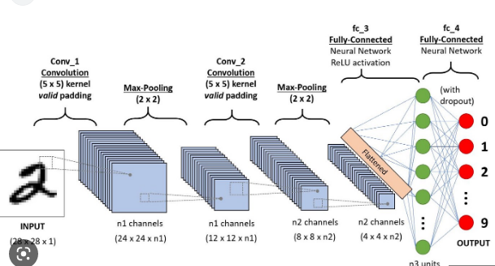
CNN - Classification

Slide 35
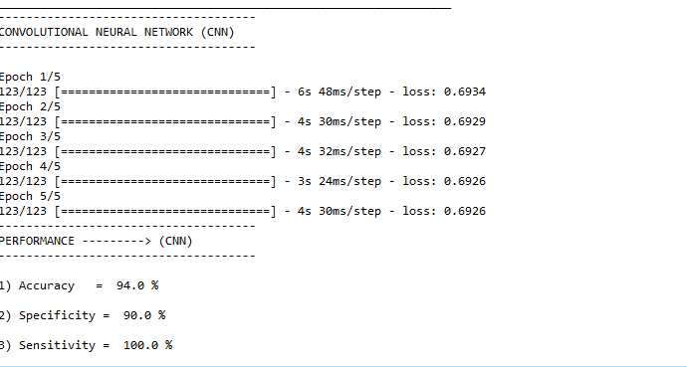
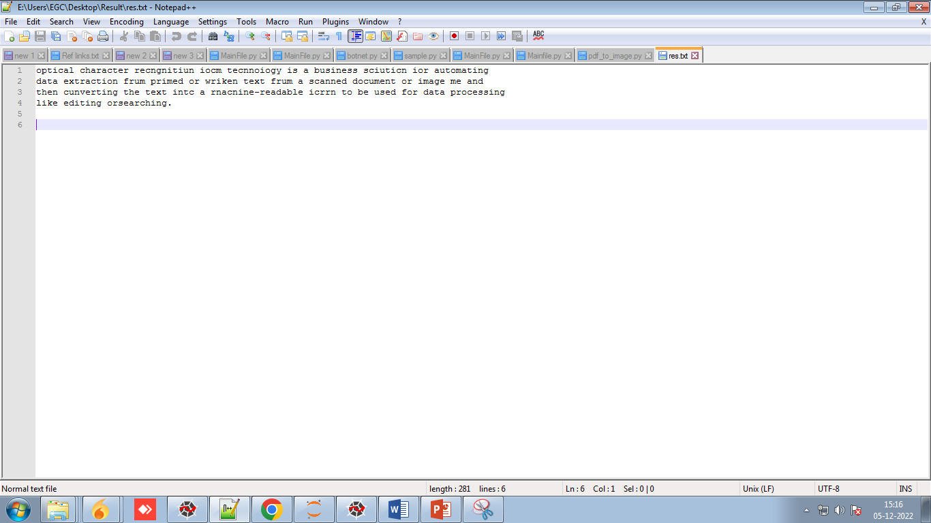
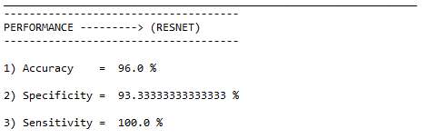
CNN - Classification

Slide 36
Module Description
Performance metrics :
The Final Result will get generated based on the overall classification and prediction. The performance of this proposed approach is evaluated using some measures like,
Accuracy :
Accuracy of classifier refers to the ability of classifier. It predicts the class label correctly and the accuracy of the predictor refers to how well a given predictor can guess the value of predicted attribute for a new data.
AC= (TP+TN)/ (TP+TN+FP+FN)

Slide 37
Conclusion
We conclude that, the image dataset was taken from dataset repository. We are implemented the auto encoder for feature extraction and classification algorithms (i.e.) deep learning algorithm.
Then, deep learning algorithms such as ResNet. Finally, the result shows that the accuracy for above mentioned algorithm and recognize the text from the input image.

Slide 38
Reference
Ahmed, A., Nazir, M., Hussain, M., & Iqbal, N. (2022). An OCR system for Urdu handwritten cursive text recognition using CNN-BiLSTM. Journal of Ambient Intelligence and Humanized Computing, 13(1), 1127-1138.
Liu, X., Zhang, H., He, Z., & Du, S. (2021). A novel Chinese-English mixed cursive handwriting recognition using CNN-Transformer. In 2021 3rd International Conference on Computing, Communication and Security (ICCCS) (pp. 1-7). IEEE.
Wang, W., Du, Y., Liu, J., & Wang, Y. (2021). A deep learning approach for Chinese cursive handwriting recognition using CNN-Transformer. Information Sciences, 571, 1-13.
Gupta, A., Singh, A. K., & Dutta, A. (2021). Multilingual handwritten text recognition using CNN-BiLSTM network. International Journal of Machine Learning and Cybernetics, 12(2), 495-505.

Slide 39
Reference
Jang, S., Park, S., & Kim, C. (2020). Korean cursive handwriting recognition using CNN-LSTM networks. Symmetry, 12(5), 699.
Kim, D., Ko, J., & Kim, K. (2020). Japanese cursive handwriting recognition using CNN-LSTM. Journal of Information Processing Systems, 16(4), 960-971.
Yang, J., Yan, Y., & Wang, J. (2020). An OCR system for handwritten cursive text recognition using CNN-RNN. IEEE Access, 8, 41459-41468.
Zhang, Y., Wang, H., Zhang, B., & Chen, X. (2019). An efficient CNN-LSTM-based recognition system for English cursive handwriting. Journal of Ambient Intelligence and Humanized Computing, 10(9), 3693-3702.

Slide 40
Reference
Singh, A. K., Dutta, A., & Gupta, A. (2019). OCR for cursive Hindi script using CNN-RNN. In 2019 International Conference on Machine Learning, Big Data, Cloud and Parallel Computing (COMITCon) (pp. 187-191). IEEE.
Chen, S., Shi, J., Zhang, L., & Huang, Q. (2018). Arabic handwritten text recognition using CNN-LSTM. International Journal of Pattern Recognition and Artificial Intelligence, 32(2), 1850008.

Slide 41
Thank You

