Slide 1

DRIVER’S DROWSINESS DETECTION SYSTEM BY USING MACHINE LEARNING
Mukesh Kolappan A (312419205065)
Om Prakash K (312419205073)
Guided By
Mr.M.Karthi M.Tech.,(Ph.D).,
Assistant Professor

Slide 2
INTRODUCTION
Drowsiness of the drivers is one of the key issues for majority of road accidents. Drowsiness threatens the road safety and causes severe injuries sometimes, resulting in fatality of the victim and economical losses.
Drowsiness implies feeling lethargic, lack of concentration, tired eyes of the drivers while driving vehicles.
Performance of the driver gradually deteriorates owing to drowsiness.
To avoid this anomaly, we will build a system using Python, Tensorflow, OpenCV, and Keras which detect the drowsiness nature of the driver and alert him immediately. when he feels sleepy.

Slide 3
ABSTRACT
In this Driver Drowsiness Detection System, the driver is continuously monitored through webcam. This system captures images as a video stream through a camera, detects the face and localizes the eyes. .
This model uses image processing techniques which mainly focuses on face and eyes of the driver. The model extract the drivers face and predicts the blinking of eye from eye region.
We use an Eyes blinking concepts for measuring eyes closure duration to verify the driver vigilance state. If the blinking rate is high then the system alerts the driver for drowsiness through an alarm system.
To achieve this application, three main steps are required :
(i) Face and eyes detection
(ii) Classification and eyes tracking
(iii) Measurement of eyes closure duration.

Slide 4
OBJECTIVES
The purpose of the drowsiness detection system is to aid in the prevention of accidents passenger and commercial vehicles.
The system will detect the early symptoms of drowsiness before the driver has fully lost all attentiveness and warn the driver that they are no longer capable of operating the vehicle safely.

Slide 5
PROBLEM STATEMENT
To Develop the Driver Drowsiness Detection System, To Detect Drowsiness of the Driver while Driving the Vechile. Use the Camera to monitor the driver live. Extracted data is used to analysis the status of the driver.

Slide 6
LITERATURE SURVEY
Paper | Algorithm | Demerits
“Driver Drowsiness Detection which is the best till now” | (i)HOG Algorithm for Detecting face . (ii)Face detection algorithm | Aurdino design ,sensors are attached to the driver's body which may affect the driver.
“Driver drowsiness detection and warning system for critical infrastructure” | AdaBoost algorithm by using opencv (face detection). | Damage of sensor cannot be detected Lag in initialization of GPS module
“Algorithm approach to driver drowsiness detection for ensuring safety in autonomous car” | HAAR cascade algorithm. | Careleness is not admitting when the driver is too tired .

Slide 7
LITERATURE SURVEY
Paper | Algorithm | Demerits
“Driver Drowsiness Detection system based on visual features” | (i) Calibaration of MC-KCF algorithm (ii)HAAR FACE DETECTION algorithm. | Light ,infront of driver face is compulsory all the time.
”Learning based Driver Drowsiness Detection” | Face detection colour based algorithm. | It cannot predict or detect the sleepiness in advance
“Driver Safety Development: Real-Time Driver Drowsiness Detection System Based on Convolutional Neural Network” | CNN based algorithm. | Using CNN , Large training data needed, don't encode the position and orientation of face.

Slide 8
SYSTEM REQUIRMENT
The requirements for an effective drowsy driver detection system are as follows:
A non-intrusive monitoring system that will not distract the driver.
A real-time monitoring system, to insure accuracy in detecting drowsiness.
A system that will work in both daytime and nighttime conditions.
The requirement for this project is a webcam through which we will capture images. You need to have Python (3.6 version recommended) installed on your system, then using pip, you can install the necessary packages.
OpenCV – pip install opencv-python (face and eye detection).
TensorFlow – pip install tensorflow (keras uses TensorFlow as backend).
Keras – pip install keras (to build our classification model).
Pygame – pip install pygame (to play alarm sound).

Slide 9
HARDWARE REQUIREMENTS
Processor : intel i5 x64 and above.
Storage : A Minimum of 12GB of available space.
RAM : A Minimum of 8GB.
Sensor : High Resolution IR-Camera.

Slide 10
EXISTING SYSTEM
The existing system does not detect the face of a driver with a spectacles.
It cannot detect the yawn (ie) it cannot predict the sleepness in advance.
The current drowsiness detection systems include the usage of the devices that detect the respiration rate, heart rate, blood pressure, etc.
These devices can cause the driver to be uncomfortable for driving. Cannot be assured that the drivers wear these devices all the time while driving.
The existing system does not produce good results in low light conditions. If the light conditions are dark or too low it is unable to detect the face and eyes of the driver which results in lower accuracy.

Slide 11
PROPOSED SYSTEM
The drowsiness detection based on eye state has been done accurately based on the varying features and factors, and also with the help of expert’s knowledge. Predicting the facial landmarks and detecting the eye-state and displaying the driver status on the screen is the most necessity ingredient for drowsiness detection.
Generally, the driving person feels drowsy due to continues driving for long hours or Physical illness or might be drunken and this leads to major road accidents. Our aim is to detect the drowsiness, make them alert to prevent accidents and generate an alarm sound.

Slide 12
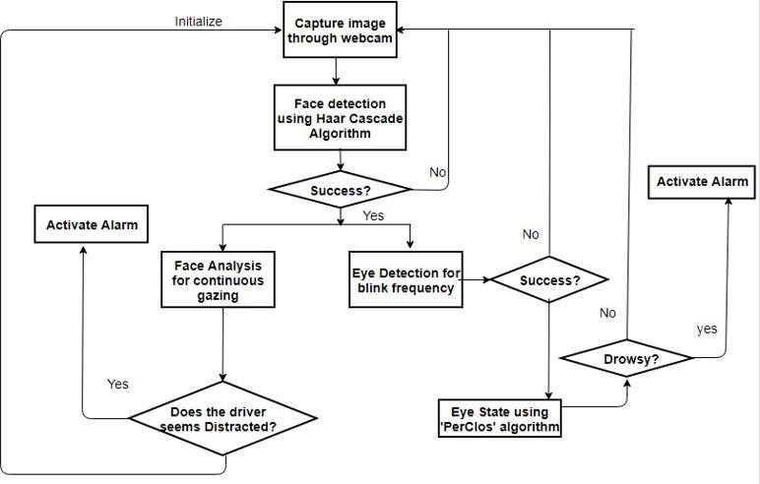
SYSTEM ARCHITECTURE

Slide 13
COMPONENTS OF ARCHITECTURE
Detection Stage.
Tracking Stage.
Warning Stage.
Alerting Stage.

Slide 14
Detection Stage
This is the initialization stage of the system. steps include:
extracting driver’s skin color and using that information to create custom skin color model
collecting a set of open/closed eyes samples, along with driver’s normal head position.

Slide 15
Tracking Stage
the system enters the regular tracking (monitoring) stage.
A key step in this stage is the continuous monitoring of the driver’s eyes within a dynamically allocated tracking area.
the system will determine the size of the tracking area based on the previous history of eye movements.
During this stage, the system must also determine the state of the eyes.

Slide 16
Warning Stage
If the driver keeps his eyes closed for prolonged period of time or starts to nod, alertness has to be raised.
The key step within this stage is close monitoring of drivers eyes.
The system must determine whether the eyes are still closed, and what is the eyes’ position relative to previously established thresholds.

Slide 17
Alerting Stage
Once it has been determined that the driver appears to be in an abnormal driving state, the system has to be proactive and alert the driver of potential dangers that can arise.
Combination of audio/visual alerts are used to attract the driver’s attention and arise their alertness level.
Alerting has to be implemented in such a way as not to cause the opposite effect of intended and startle the driver into causing an accident.

Slide 18
METHODOLOGY
In this Python project, we will be using OpenCV for gathering the images from webcam and feed them into a Deep Learning model which will classify whether the person’s eyes are ‘Open’ or ‘Closed’. The approach we will be using for this Python project is as follows :
Step 1 – Take image as input from a camera.
Step 2 – Detect the face in the image and create a Region of Interest (ROI).
Step 3 – Detect the eyes from ROI and feed it to the classifier.
Step 4 – Classifier will categorize whether eyes are open or closed.
Step 5 – Calculate score to check whether the person is drowsy.

Slide 19
LIST OF MODULES
Import packages.
Import dataset.
Applying face detection.
Code for face detection.
Calculate ROI (Region of Interest).
Classify the eye tracking using ROI.
Obtaining the score .

Slide 20
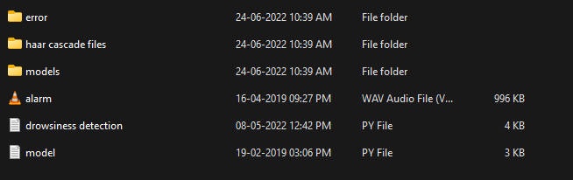
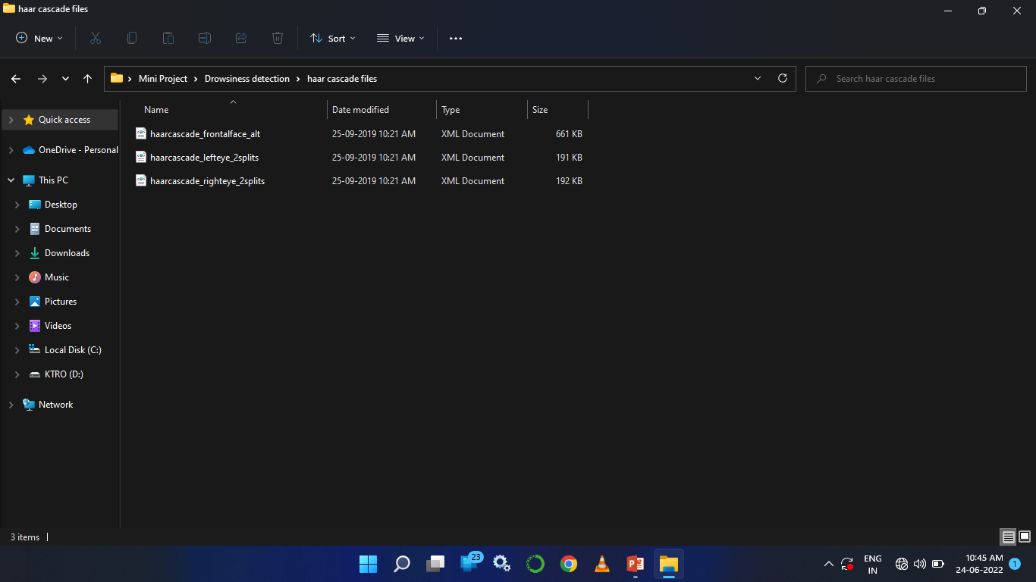
Dataset
Dataset Reference : Dataflair (https://www.kaggle.com/serenaraju/yawn-eye-dataset-new)

Slide 21
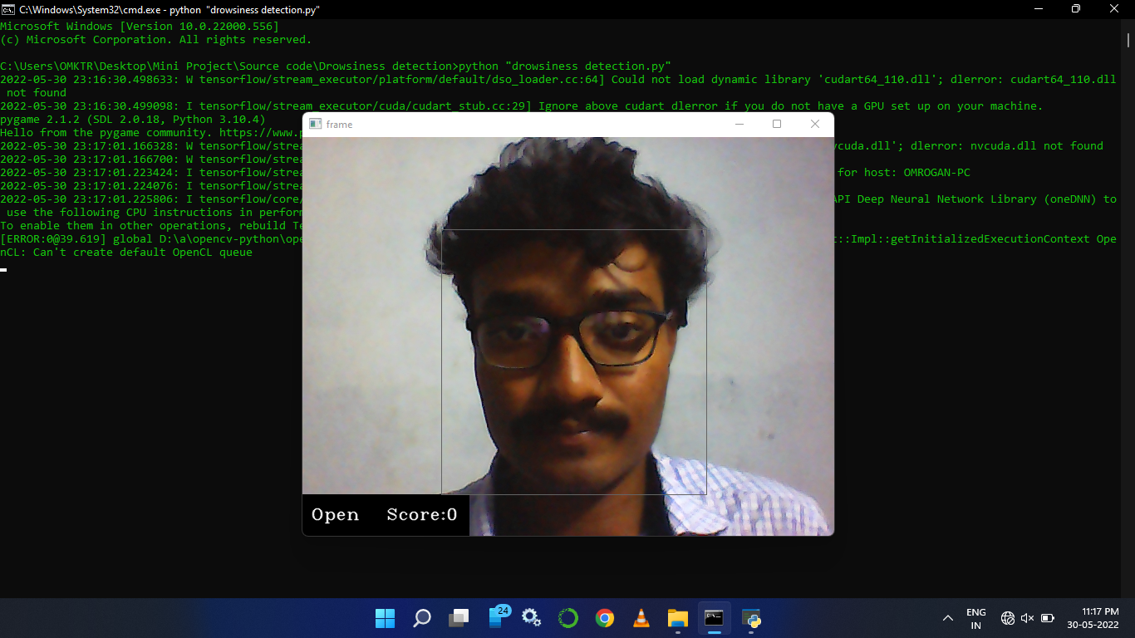
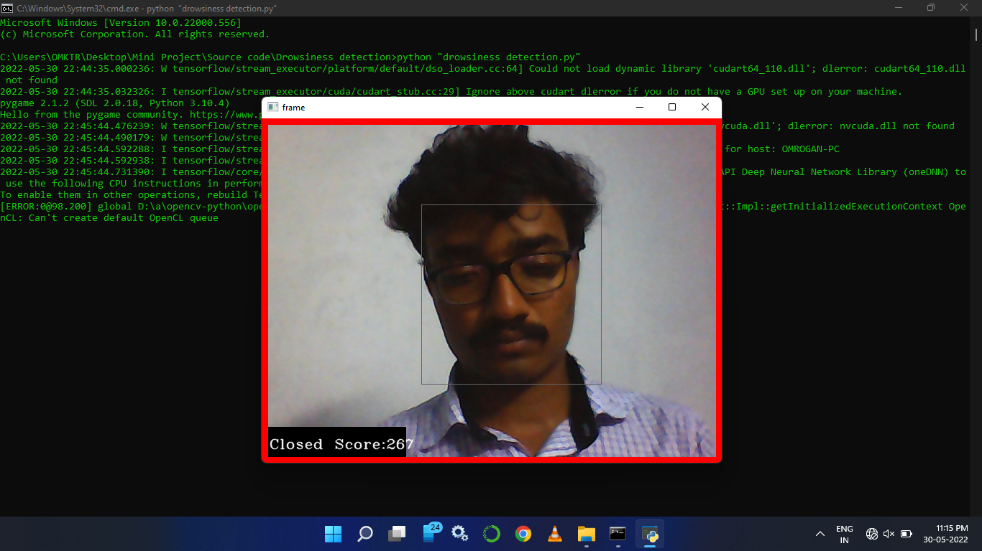
OUTPUT

Slide 22
FUTURE ENHANCEMENT
The model can be improved incrementally by using other parameters like state of the car, etc. If all these parameters are used it can improve the accuracy by a lot.
We plan to further work on the project by adding a sensor to track the heart rate in order to prevent accidents caused due to sudden heart attacks to drivers.
Same model and techniques can be used for various other uses like Netflix and other streaming services can detect when the user is asleep and stop the video accordingly. It can also be used in application that prevents the user from sleeping.
Due the Development of technology now a days, there is a chance of merging the Auto Driving mode to park the vechile safely when the driver fell a sleep.

Slide 23
CONCLUSION
The system will detect the early symptoms of drowsiness before the driver has fully lost all attentiveness and warn the driver that they are no longer capable of operating the vehicle safely.
The driver drowsiness detection is based on an algorithm, which begins recording the driver's steering behavior the moment the trip begins.
It then recognizes changes over the course of long trips, and thus also the driver's level of fatigue.

Slide 24
REFERENCES
K.sathish and A.lalitesh “Driver Drowsiness Detection which is the best till now”2020.
Oana -Isbela,biana Costin “Driver drowsiness detection and warning system for critical infrastructure”2022 .
Md.Motaharal Islam,Ibna Kowsar “Algorithm approach to driver drowsiness detection for ensuring safety in autonomous car” 2020.
Foazia ,Roopalakshmi R “Driver Drowsiness Detection system based on visual features”2020.
DR.Jagendra singh ”Learning based Driver Drowsiness Detection”2021.

Slide 25
THANK YOU

