Slide 1
Omri Elad Yonatan Gartenberg
AutoConnect Computational Design of 3D-Printable Connectors

Slide 2
Objective
Implement part of the “AutoConnect Computational design of 3D Printable Connectors” article
Given a mesh of free form object, compute a “holder mesh”
The holder should answer to user constraints regarding movement direction
Several holders are computed, and representative holders are suggested to the user

Slide 3
Challenges & mitigations
Working with 3D-objects – trimesh package
Understanding the math behind the concept
Choosing the interface
Writing Descriptive Algorithm
Working with limited resources – stick to relatively simple meshes

Slide 4
Implementation
Used Python as the code language.
A repo was built for a user to download it and run a single command: https://github.com/omlad93/auto-connect
The user can add meshes to the repo’s “inputs” folder and run the script. the parameters will be determined through command arguments.
Thresholds are not set for the user to change. (but can be easily modified in the code)

Slide 5
Code Flow
Load the input mesh and perform preliminary calculations.
Calculate the seed starting point (from which the mesh is additively computed).
Add triangles to the holder until conditions are met.
Repeat 2 and 3 according to user’s command.
Output clustered representative holders to “Outputs” folder.

Slide 6
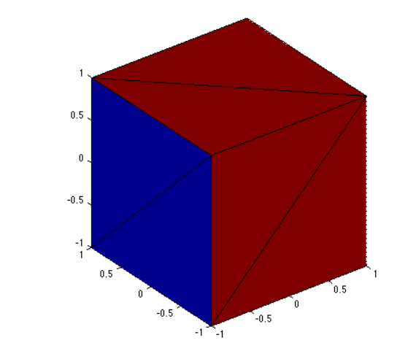
Results – Running Example
Original mesh
$ python .\code\main.py -c 4 5 -in cube -i 20 -r 1 -cv
Notes:
python .\code\main.py -c 4 5 -in cube -i 20 -r 1 -cv

Slide 7
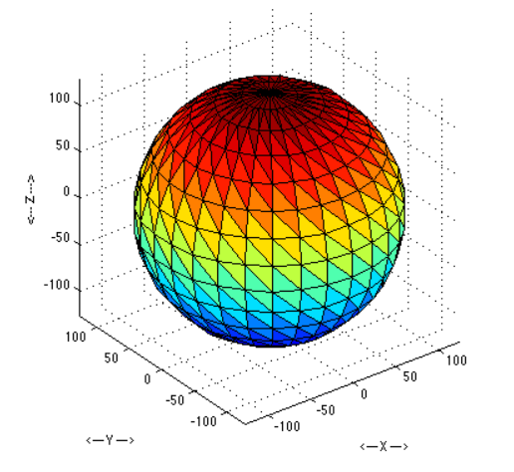
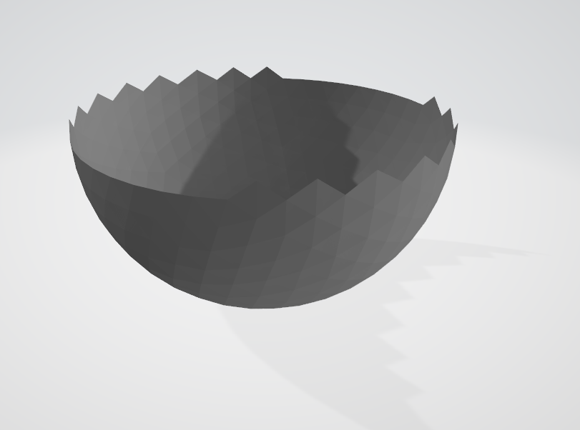
Results
Original mesh
Holder mesh

Slide 8
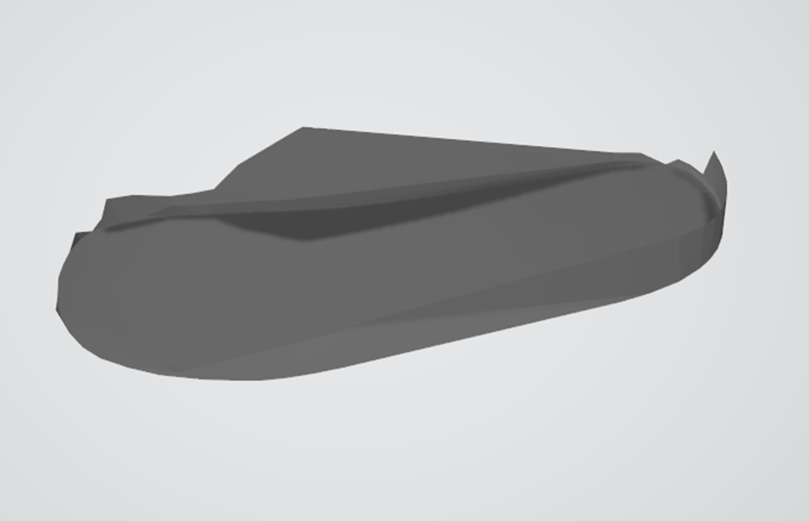
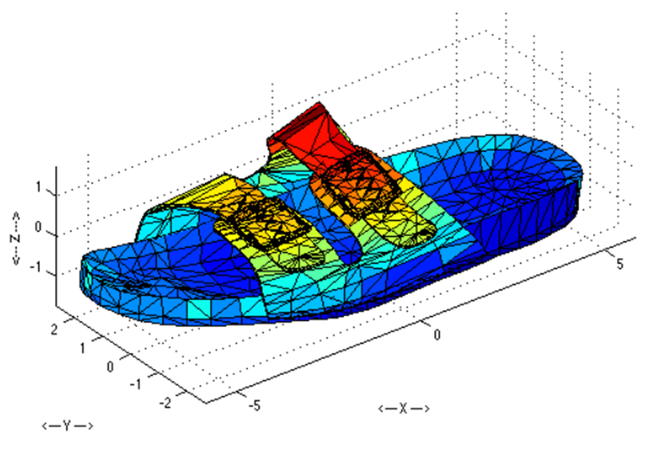
Results
Original mesh
Holder mesh

Slide 9
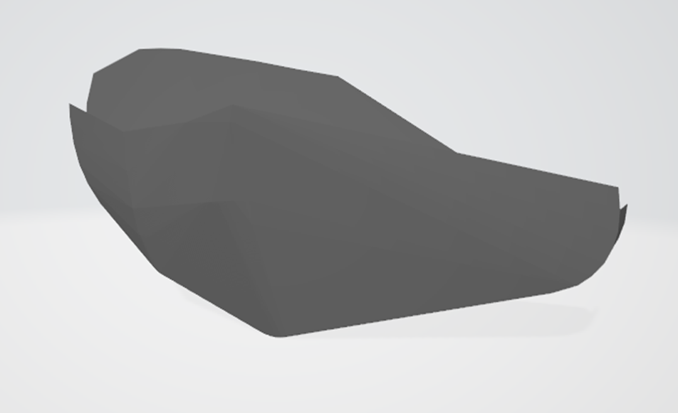
Results
Original mesh
Holder mesh

Slide 10
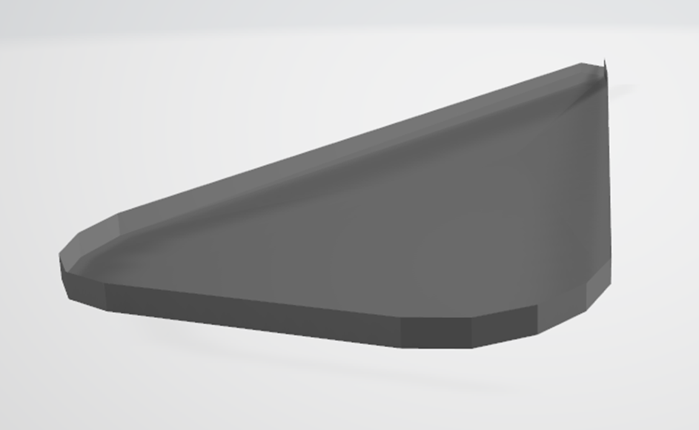
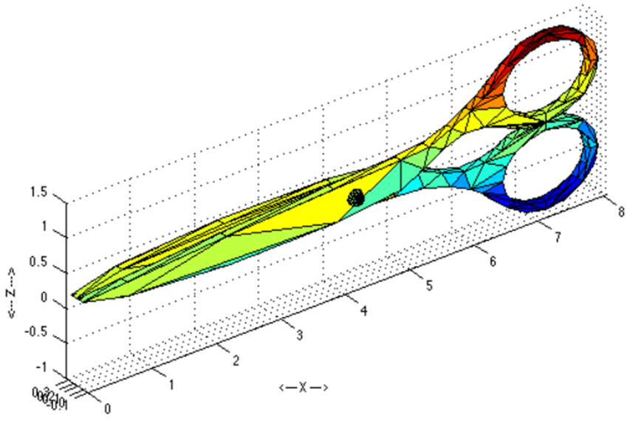
Results
Original mesh
Holder mesh

Slide 11
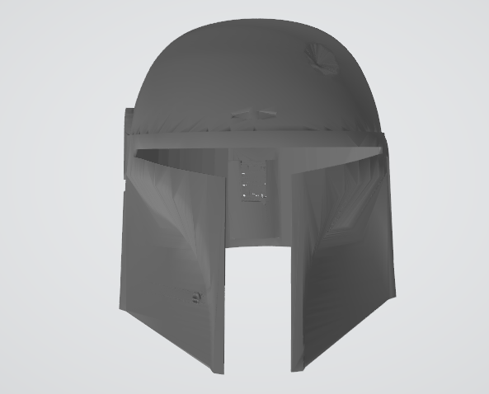
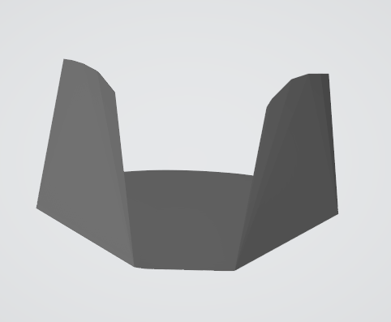
Results
Original mesh
Holder mesh

Slide 12
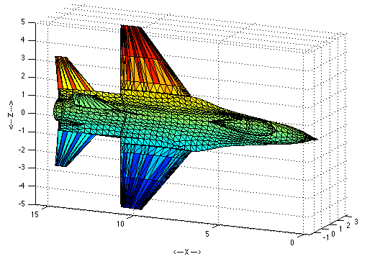
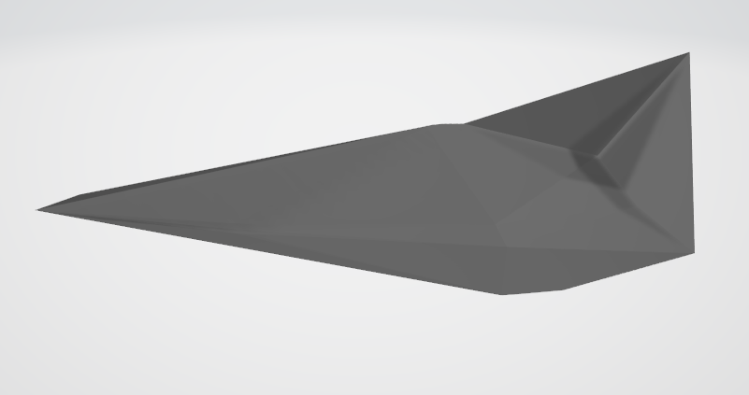
Results
Original mesh
Holder mesh

