Slide 1

SynthEddy
Simulating Turbulent Flow with Synthetic Eddy
Phil Du CAS 741

Slide 2
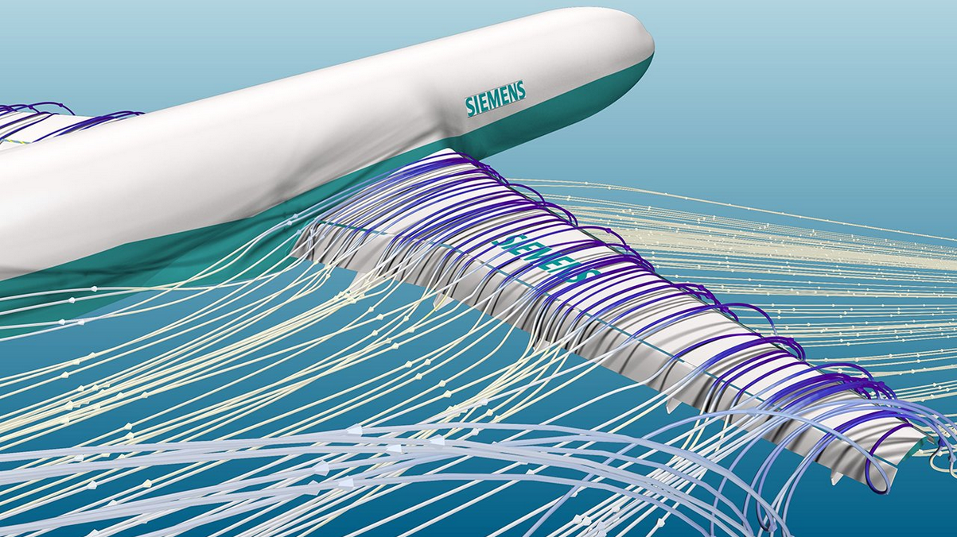
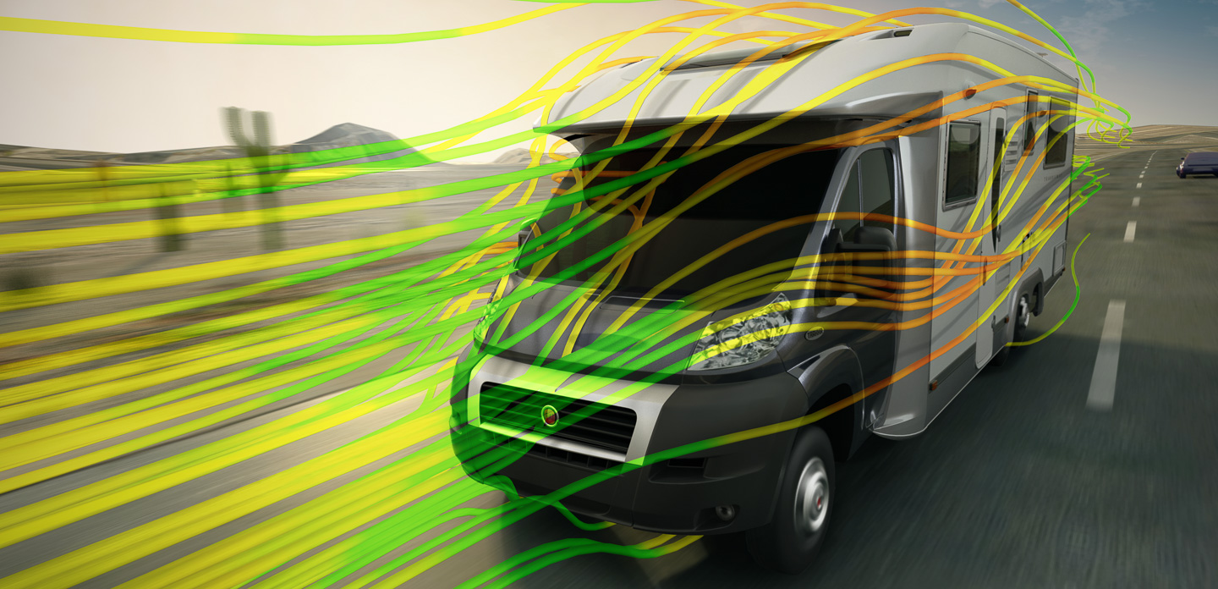
What is CFD
Using computer to simulate fluid (air, water, etc) flow and its interactions with other objects.
Credit: ASCENDTECH GROUP
Credit: SolidWorks
Phil Du CAS 741

Slide 3
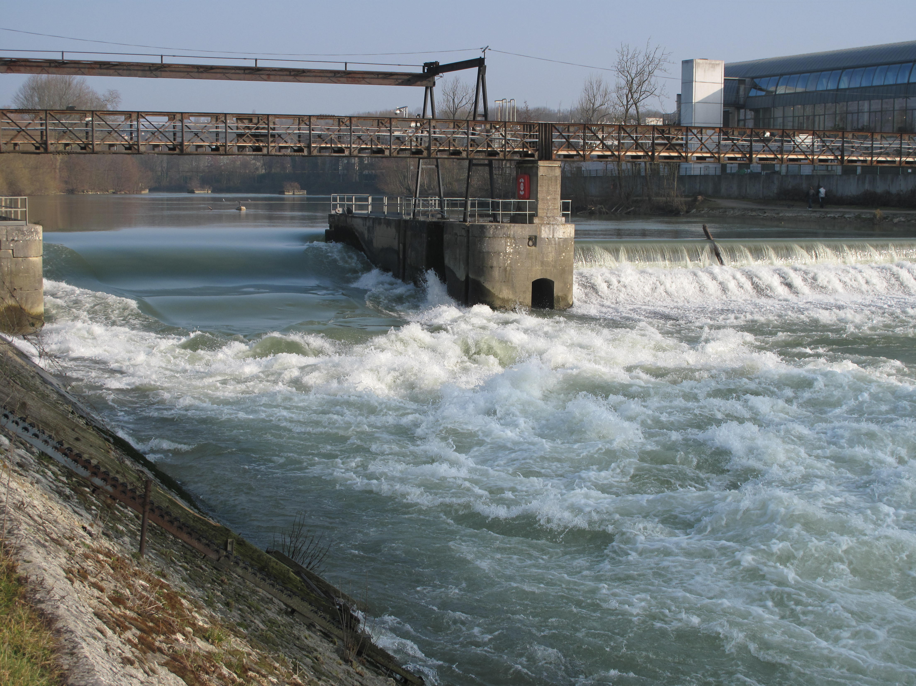
Laminar vs Turbulent Flow
How does CFD simulate turbulent flow?
(black board)
Phil Du CAS 741
Credit: https://commons.wikimedia.org/wiki/User:Tangopaso

Slide 4
Problem Statement
Typically, turbulent flow CFD needs to start from laminar flow and let it develop into turbulent flow.
High computation cost/time.
Proposal to approximate turbulent flow with artificially generated eddies.
Phil Du CAS 741

Slide 5
Goal Statement
Goal:
Generate turbulent flow velocity field with user provided eddy profile(s)
Stretch Goals
Generate realistic turbulent flow velocity field.
Allow common CFD software to obtain initial conditions through this program.
Phil Du CAS 741

Slide 6
Users / Stakeholders
CFD users looking to reduced computation time on turbulent flow
Researchers studying synthetic eddy methods
Phil Du CAS 741

Slide 7
Theoretical Model
Velocity fluctuation: sum of all eddies
u'x=1Nk=1Nqσ(|rk|)|rk|3rk×∝k
where $$r^{k}=\frac{x-x^{k}}{σ^{k}}$$
$$x$$: position vector in the flow field
$$u'$$:fluctuation from average velocity
$$k$$: index of each eddy
$$q_{σ}(|r^{k}|)$$: Shape function
$$σ$$: eddy length-scale
$$∝$$: random eddy intensity, with average of 0
Phil Du CAS 741

Slide 8
Input and Output
Input
Region dimensions $$Lx, Ly, Lz: R^{3}+$$
Average velocity $${v_{a}: R}^{3}$$
Number of eddies $$N: Z$$+
Eddy length-scale $$σ: R+$$
Shape function?
Query: $$x, y, z, t$$
Output
Velocity at any given point or time $$v\left(x, y, z, t\right): R^{3}$$
Phil Du CAS 741

Slide 9
Assumptions
A1: 3D external flow region
A2: 1D flow direction
A3: The synthetic eddy method can indeed mimic turbulent flow for the purpose of being CFD initial conditions
A4: User can provide appropriate eddy profiles
Phil Du CAS 741

Slide 10
Requirements
Functional:
R1: Can generate a velocity field given any valid eddy profile input
R2: Can provide a realistic eddy profile
R3: Generated velocity field must be divergence-free (zero sum of velocity fluctuation, required by the theory)
R4: Must verify that the queried point is within the flow region
Non-functional
Can interface with common CFD software (constrains?)
Phil Du CAS 741

Slide 11
Questions / Comments?
Thank you!
References
Poletto, Ruggero & Craft, T. & Revell, Alistair. (2013). A New Divergence Free Synthetic Eddy Method for the Reproduction of Inlet Flow Conditions for LES. Flow, Turbulence and Combustion. 91. 1-21. 10.1007/s10494-013-9488-2.
Phil Du CAS 741

