Slide 1


SMART INDIA HACKATHON 2026
SYNKRO
Problem Statement ID – 26135
Problem Statement Title- Difficulties in Tracking Employment Outcomes, Skill Gaps, and the Impact of Skilling Initiatives
Theme- Miscellaneous
PS Category- Software
Team ID-
Team Name (Registered on portal): SYNKRO

Slide 2
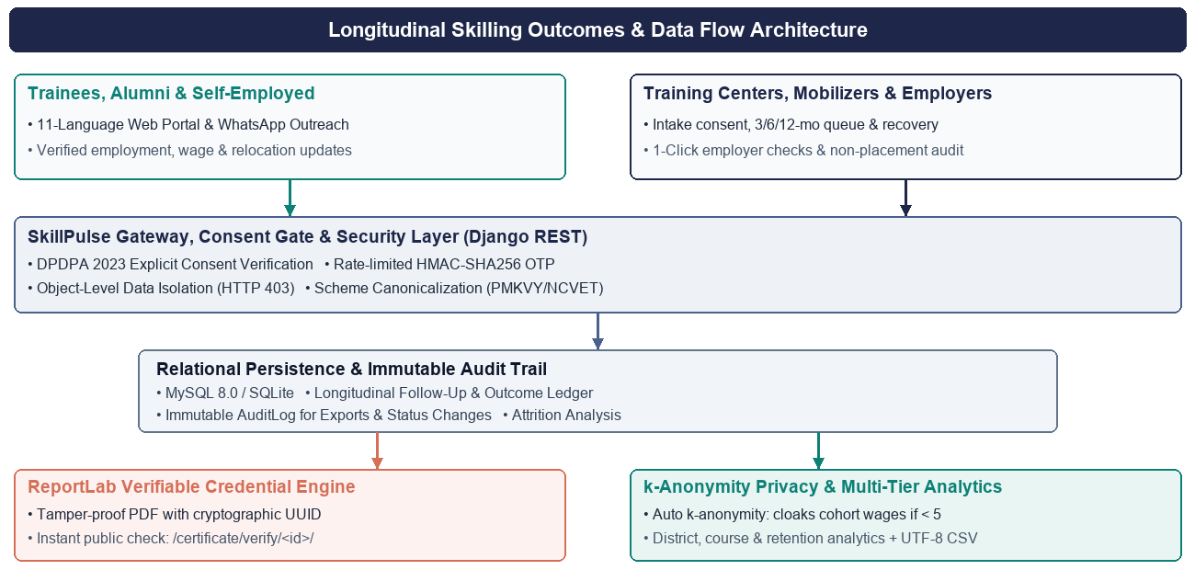
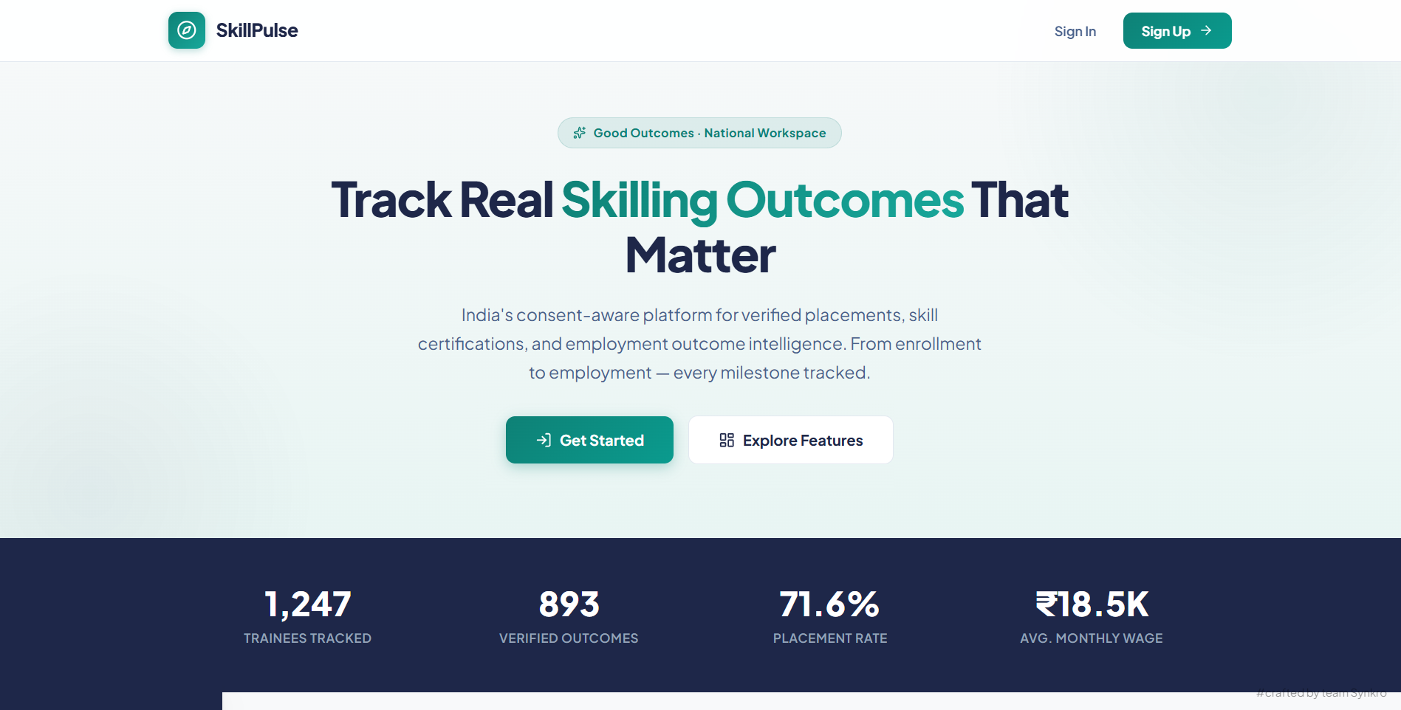
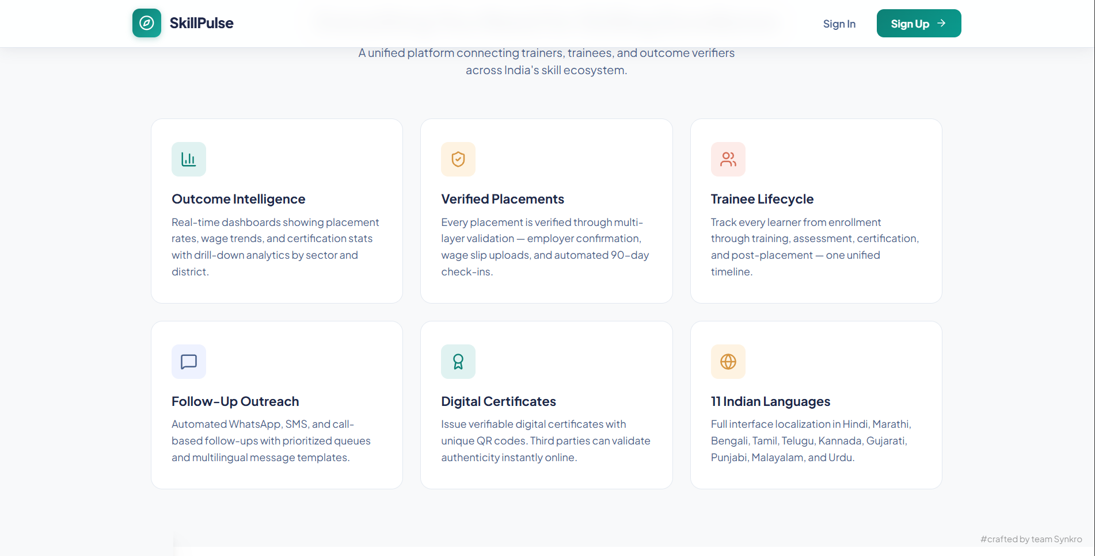
SkillPulse: Field Atlas
❖ Proposed Solution
SYNKRO
• Comprehensive Outcomes Platform: A robust web application ecosystem connecting training providers, vocational trainees, and hiring employers in a unified, consent-based registry.
• Automated Longitudinal Tracking: Multi-milestone post-training outreach queue (3, 6, and 12-month intervals) via WhatsApp, SMS, and calls capturing employment, retention, and wage growth.
• Verifiable Tamper-Proof Credentials: High-fidelity landscape PDF certificates generated via ReportLab with unique cryptographic verification UUIDs, verifiable at public portal.
• k-Anonymity Privacy Safeguards: Automatically cloaks small-cohort wage metrics (< 5 responses) to safeguard learner privacy and strictly enforce Digital Personal Data Protection Act (DPDPA 2023) standards.
• 11-Language Native Localization: Full interface and notification support across 11 Indian languages with dynamic Right-to-Left (RTL) layout switching for Urdu, ensuring rural accessibility.
• Multi-Tenant Trainer Data Isolation: Strict row- and object-level scoping ensuring trainers only query or edit assigned cohorts (HTTP 403 Forbidden on cross-tenant leaks), backed by an immutable AuditLog.
• Skill-Gap & Attrition Diagnostics: Captures reasons for non-placement, dropouts, and job changes to provide actionable diagnostics for course redesign and targeted remedial skilling.
Live Placement & Wage Analytics Dashboard
Tamper-Proof Credential Verification Portal

Slide 3












TECHNICAL APPROACH
❖ Technology Stack
SYNKRO
Frontend : Vanilla JavaScript (ES6+), Semantic HTML5, CSS3 with civic cartography design tokens, 11-language i18n engine, Chart.js, Lucide Icons, Vercel Edge CDN.
Backend : Python 3.12+ (tested on Python 3.14/3.15), Django 5+, Django REST Framework (DRF), 40+ RESTful JSON endpoints, django-cors-headers, PyMySQL driver.
Security & Auth : HMAC-SHA256 Email OTP (secrets module), 5-attempt temporary account lockout, anti-enumeration, k-anonymity privacy algorithm (< 5 responses masked), Pillow image sanitization.
Certificates & Reports : ReportLab 4.0+ landscape PDF generator with cryptographic verification tokens, UTF-8 BOM CSV exports (\ufeff) for Excel regional script rendering, immutable AuditLog.
Database & Cloud : MySQL 8.0 with SQLite local fallback, Docker & Docker Compose containerization, Netlify/Vercel decoupled hosting, GitHub Actions CI.
HTML5
CSS3
JavaScript
Python 3.12+
Django 5
MySQL 8.0
PostgreSQL
Docker
Git / GitHub
Node.js
Postman / REST
Vercel Edge

Slide 4

FEASIBILITY AND VIABILITY
SYNKRO
Feasibility:
1. Technical: Feasible via mature enterprise stack (Python 3.12+, Django 5+, MySQL). 28/28 automated tests passing.
2. Economic: Low infrastructure costs (< Rs 1,500/mo on commodity VPS) justified by massive returns in audit transparency.
3. Operational: 11 Indian languages, low-bandwidth optimization, and WhatsApp outreach ensure seamless adoption.
Viability:
4. Market Opportunities: High demand across PMKVY 4.0, NCVET, DDU-GKY, NULM, and State Skill Development Missions.
5. Sustainability & Future-Proofing: Modular REST APIs adapt seamlessly to DigiLocker and National Skill Qualifications Framework.
Challenges:
6. Trainee Contact Loss: Trainees changing numbers/locations resolved via secondary contacts & center mobilizer queue.
7. Inconsistent Employer Data: Asynchronous 1-click employer validation links & salary slip/offer letter cross-verification.
8. Wage Privacy Hesitation: k-anonymity model conceals micro-cohort wages (< 5 responses) ensuring complete confidentiality.
Use Cases:
9. Milestone Follow-Ups: Automated 3, 6, 12-month check-in queue tracking job retention & wage progression.
10. Instant Credential Checks: Public tamper-evident verification eliminates certificate counterfeiting.
11. Skill-Gap & Dropout Diagnostics: Actionable data identifies causes of non-placement to improve course design.
Business Potential:
1. GovTech SaaS Service: Subscription-based outcomes tracking for State Skill Missions, NSDC, and Sector Skill Councils.
2. Tiered Access: Corporate employer talent matching portal with verified pre-screened candidate profiles.
3. CSR Foundation Partnerships: Automated longitudinal audit reporting and ESG impact verification for enterprise CSR funds.
4. Consulting & Remedial Analytics: Data-driven course redesign and district skilling gap advisory services.
Solutions:
5. Robust Data & Algorithms: Assisted WhatsApp/SMS outreach ensures high response rates despite changed phone numbers.
6. Seamless Integration: Decoupled REST architecture connects effortlessly to existing portal databases and mobile apps.
7. User-Centric Design: 11 native Indian languages and icon-driven UI ensure rural staff adopt the system effectively.
Supporting Facts for Feasibility and Viability
100% Functional Live Prototype deployed at: https://skill-pulse-employeetracker.vercel.app/
28 / 28 Automated Backend Tests Passing (Unit, Scoping, Auth, Privacy & Certificates).
1,247 Trainees & 893 Verified Outcomes actively tracked and benchmarked in live database.

Slide 5
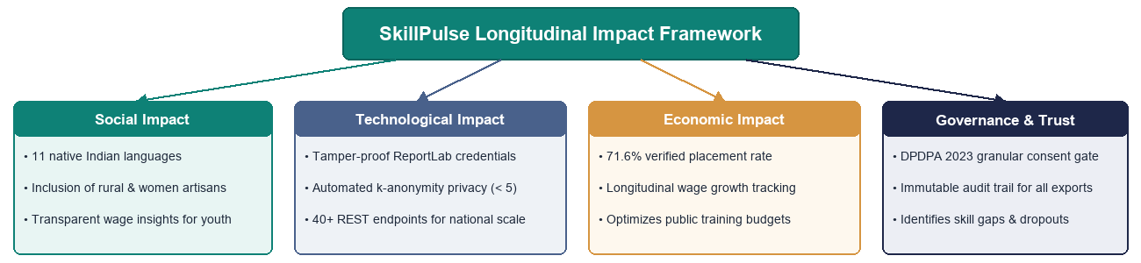
IMPACT AND BENEFITS
❖ Benefits of the solution
SYNKRO
❖ Potential impact on the target audience:
• Trainees & Jobseekers: Empowers youth with permanent tamper-evident digital resumes, salary transparency, and post-placement career tracking in their mother tongue.
• Training Centers & Mobilizers: Automated follow-up scheduling and dynamic overdue alerts save 80% of administrative manual tracking time, preventing loss of trainee contact.
• Hiring Employers & MSMEs: Instant 10-second credential verification without phone calls to institutes; direct access to pre-screened, certified job-ready talent.
• Regulators & Government (MSDE/NSDC): Provides a transparent, data-driven system for comparing provider outcomes, targeting public funds, and designing evidence-based skilling policies.
Social:
• 11 Indian languages ensure dignity & access for rural youth and women.
• Transparent wage insights prevent learner exploitation & set clear goals.
Technological:
• Replaces paper registers with tamper-proof cryptographic credentials.
• Automated k-anonymity privacy protects individual trainee identities.
Economic:
• Achieves 71.6% placement rate and tracks Rs 18,500 avg monthly wage.
• Maximizes public skilling ROI by targeting high-performing courses.
Governance & Compliance:
• 100% compliance with DPDPA 2023 via explicit granular trainee consent.
• Dropout & skill-gap diagnostics guide targeted remedial curriculum.

Slide 6
RESEARCH AND REFERENCES
SYNKRO
❖ References
Research & Best Practices:
➢ https://pmkvyofficial.org/
➢ https://ncvet.gov.in/
➢ https://dgt.gov.in/
➢ https://ddugky.gov.in/
➢ https://www.meity.gov.in/
➢ https://www.sciencedirect.com/
➢ https://owasp.org/www-project-api-security/
SkillPulse Live Platform & Source Code:
➢ Live Web App: https://skill-pulse-employeetracker.vercel.app/
➢ Frontend Repo: https://github.com/priyanshu-pgb/SkillPulse-Frontend
➢ Backend Repo: https://github.com/priyanshu-pgb/SkillPulse-Backend
❖ Comparison with Existing Systems
Feature | SkillPulse (SYNKRO) | Skill India Portal | Generic LMS | Manual Sheets
Real-Time Outcome Tracking | ✔ | ✖ (Delayed) | ✖ | ✖
Longitudinal Follow-Up (3/6/12 Mo) | ✔ (Automated) | ✖ (Incomplete) | ✖ | ✖
Verifiable Cryptographic Certificates | ✔ (ReportLab UUID) | ▲ (Static PDF) | ▲ (Basic) | ✖
k-Anonymity Wage Privacy Guard | ✔ (<5 Masked) | ✖ | ✖ | ✖
11-Language Native Localization | ✔ (11 Langs + RTL) | ▲ (Hindi/English) | ▲ (English) | ✖
DPDPA-Compliant Consent Gate | ✔ (Granular Gate) | ▲ (Checkbox only) | ✖ | ✖
Automated Test Suite Coverage | ✔ (28/28 Passing) | ✖ (Unverified) | ▲ (Varies) | ✖ (0 Tests)

