Slide 1


SmartAttend: AI-Enabled Face Recognition Attendance and Academic Monitoring System
Presentation 2 — Progress Review
1. 202307020119 - Tisha Amit
2. 202307020135 - Nidhi Tak
3. 202307020124 - Priyanshi Vasa
4. 202307020009 - Ahir Om
B.Tech CSE (Semester 7)

Slide 2
Agenda
• Problem Statement
• Existing System / Current Solutions & Limitations
• Proposed Solution & Objectives
• Scope
• System Architecture & ER Diagram
• Technology Stack
• Module Breakdown & Team Responsibilities
• Project Timeline / Work Plan
• Work Completed Since Presentation 1
• Plan & Targets for Next Review
• Demonstration of Actual Progress

Slide 3
Problem Statement
• AI-based face recognition attendance systems typically function as passive logging tools — they record who was present but offer no forward-looking insight, no way to contest a misrecognition, and often reflect updates to students only after a significant delay.
• Doesn’t notify if present or absent right after the class.
• No timely update of the timetable and classroom allocation.
• Faculty have no early signal when a student's attendance pattern puts them at risk of falling below mandatory thresholds (commonly 75%).
• Students have no way to plan around upcoming absences or correct recognition errors until it's too late.

Slide 4
Existing System / Current Solutions & Limitations
• RFID / biometric systems: reduce proxy attendance but require students to queue at a single checkpoint, causing delays for large classrooms.
• Our own college's existing face recognition attendance system: robust biometric recognition that works reliably even without ideal lighting or power conditions, but it functions purely as a logging tool — attendance reflects on the student portal only after a delay of up to 24 hours, with no confidence transparency, no appeal mechanism, and no predictive insight for students or faculty.
Key Gap: Across all existing approaches, none combine real-time sync, transparent confidence reporting, a student-driven appeal process, and predictive planning in a single system — this is the gap SmartAttend addresses.

Slide 5
Proposed Solution
Core Pipeline: A camera at the classroom entrance captures faces in real time; a CNN-based model (FaceNet/ArcFace) identifies each student and returns a similarity/distance score — matches within the configured threshold are accepted, while uncertain matches can be routed for manual verification. A liveness layer blocks photo/video spoofing.
Appeal Workflow: If marked absent, students are notified the same day and can submit a justification/appeal from their portal, reviewed by faculty.
Agentic AI Planner: Students can ask free-form questions like “Can I skip tomorrow's lecture and stay above 75%?” — an LLM agent (Claude/OpenAI API with function calling) pulls real attendance data and reasons through the answer, rather than using a fixed formula.
Updates regularly: The timetable will be up to date and without any glitches.
Faculty Monitoring: The faculty will be able to see the students punch time with all the record of when the student was absent and the overall attendence percentage of individual student.

Slide 6
Objectives
• Automate attendance marking through real-time facial recognition with liveness detection to prevent spoofing.
• Report a confidence score for every recognition, routing low-confidence matches to manual verification.
• Sync attendance to student and faculty portals in real time, rather than after a delay.
• Notify students immediately when marked absent, and allow them to submit an appeal.
• Provide faculty with a live dashboard showing attendance trends and predictive defaulter alerts.
• Give students an agentic AI “What If?” planner that reasons over real attendance data to answer natural-language questions.
• Validate the system's accuracy and reliability through real classroom deployment.

Slide 7
Scope
In Scope: Attendance automation for classroom sessions within the university during the current academic term, using a fixed camera at the entry point.
• Recognition, liveness detection, confidence-based verification, real-time sync, appeal workflow, faculty dashboard, and agentic student planner — all as described in the SRS.
• Pilot testing in a limited number of real classrooms to validate accuracy and usability.
Out of Scope: Multi-campus deployment, integration with the university's official ERP/attendance system, and mobile app versions of the portals are out of scope for this project cycle.

Slide 8
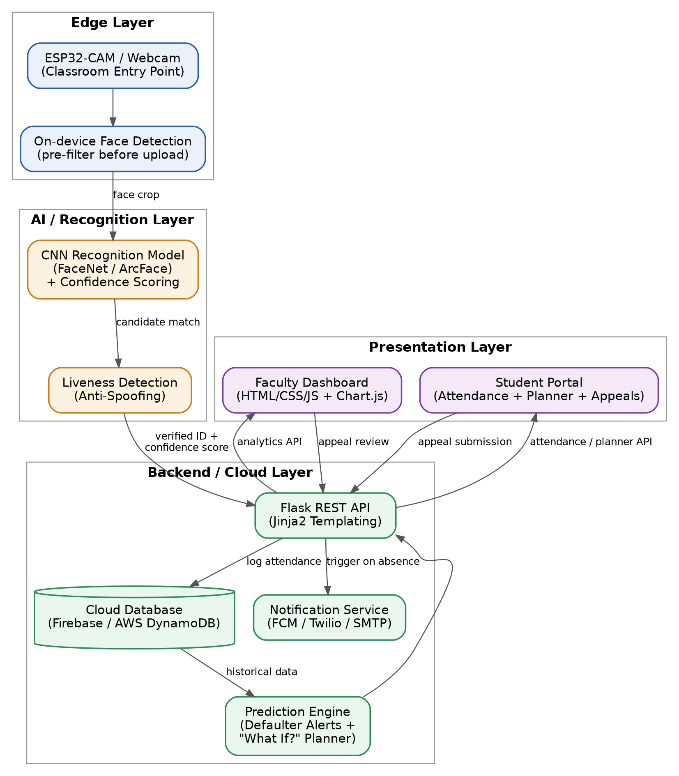
Proposed System Architecture

Slide 9
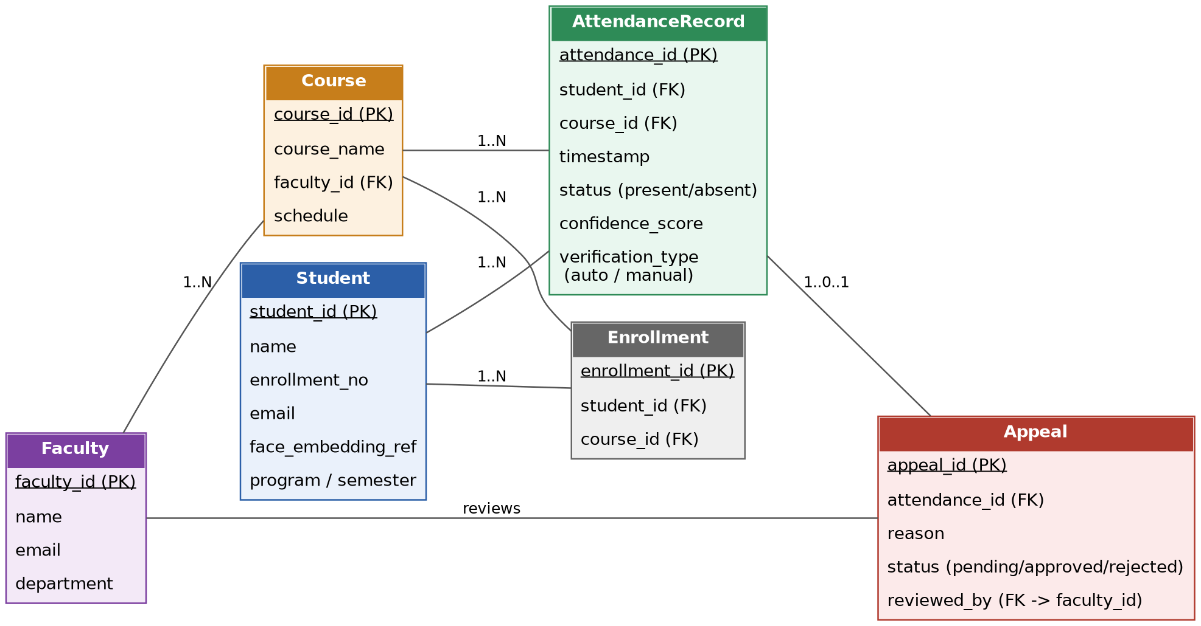
Database / ER Diagram

Slide 10
Technology Stack
Hardware / IoT: ESP32-CAM module (or webcam) at classroom entry point; edge-based face detection before transmitting recognized IDs/embeddings to the cloud.
Computer Vision / ML: OpenCV (Haar Cascade) for face detection; DeepFace (ArcFace model) for recognition via cosine-distance matching; MediaPipe Face Landmarker for blink-based (EAR) liveness detection.
Backend / Database: Python, Flask, Flask-SQLAlchemy, Flask-JWT-Extended; SQLite for local development, with a config hook to switch to a hosted Firebase/AWS database for deployment; Google OAuth (university-domain sign-in) alongside email/password + JWT sessions.
Agentic AI: Tool-calling architecture (get_attendance_history, calculate_projection) implemented and schema-ready for Claude/OpenAI API integration; a rule-based fallback currently powers the planner end-to-end while live LLM wiring is completed.
Frontend: HTML, CSS, vanilla JavaScript, Bootstrap, Chart.js — faculty dashboard and student portal largely built out.
Deployment: Render or Railway planned for backend hosting; environment-variable secrets management.
Other: Git/GitHub, Postman.

Slide 11
Module Breakdown & Team Responsibilities
Module | Scope | Owner
Face Recognition & Liveness (CV/ML) | Dataset, recognition model, embeddings, liveness / spoof detection | Tisha Amit
Core Backend & Database | Flask APIs, DB schema, authentication, attendance logging | Om Ahir Priyanshi Vasa
Frontend (Dashboard & Portal — Core UI) | Faculty dashboard, student portal, attendance views and shared UI | Nidhi Tak
Appeal Workflow & Notifications | Student appeals, faculty review, absence notifications and workflow | Priyanshi Vasa
Ownership finalized: Tisha Amit — Face Recognition & Liveness | Om Ahir — Core Backend & Database | Nidhi Tak — Frontend | Priyanshi Vasa — Appeal Workflow. Each owner handles implementation and module-level testing.

Slide 12
Project Timeline / Work Plan
Period | Focus | Major Deliverables / Milestones
August | Requirements, Architecture & Recognition Setup | SRS, architecture, ER diagram and module ownership finalized; face dataset/enrollment and recognition + liveness prototype completed.
September | Core Backend & Database — Om Ahir & Priyanshi Vasa | Flask APIs, authentication, database schema, attendance models and attendance logging implemented.
September–October | Frontend — Nidhi Tak | Faculty dashboard, student portal, attendance views and common UI developed.
October | Appeal Workflow — Priyanshi Vasa | Appeal submission/review, absence notifications and related workflow implemented.
October–November | Integration & Agentic AI | Recognition → backend → database → frontend integration; agentic planner and attendance-data tools implemented.
November | Testing, Pilot, Deployment & Finalization | End-to-end testing, limited classroom pilot, deployment preparation, documentation, results and final presentation.

Slide 13
Work Completed Since Presentation 1
• Software Requirements Specification (SRS) drafted with functional/non-functional requirements and detailed use cases.
• System architecture designed as a layered edge → recognition → backend/cloud → presentation flow.
• Database structure designed and implemented as SQLAlchemy models (User, Course, Enrollment, AttendanceRecord, Appeal) on SQLite for now, with a config hook to move to a hosted cloud database ahead of the pilot.
• Face dataset collected, enrollment completed, and ArcFace (via DeepFace) embeddings generated and stored for enrolled users.
• Live face recognition and blink-based (EAR) liveness detection implemented and tested successfully.
• Core Backend (Module 2) substantially built: Google OAuth + email/password + JWT authentication, attendance logging, and student/faculty data APIs are implemented and testable.
• Frontend (Module 3) substantially built: faculty dashboard, student portal, and shared design system implemented with live chart visualizations.
• Appeal workflow and defaulter-prediction logic (Module 4) written; agentic planner tool functions implemented and running on a rule-based fallback, pending live LLM integration and wiring into the main app.
• Current status: Face Recognition + Liveness fully working standalone; Core Backend and Frontend largely built; Module 4 wiring and full end-to-end integration are the immediate next step.

Slide 14
Plan & Targets for Next Review
• Register and wire the appeal workflow and planner blueprints into the main Flask app (implemented but not yet connected).
• Replace the rule-based planner fallback with live Claude/OpenAI API tool-calling.
• Replace simulated notification dispatch with real FCM/Twilio/SMTP integration.
• Migrate from local SQLite to a hosted cloud database (Firebase/AWS) ahead of the classroom pilot.
• Integrate recognition → backend → database → frontend into one real end-to-end attendance flow.
• Expand the face dataset and continue tuning recognition/liveness thresholds.
• Perform system-level testing, deployment preparation, and a limited classroom pilot validation.

Slide 15
Demonstration of Actual Progress
• Requirement Analysis / SRS: Prepared with functional/non-functional requirements and use cases.
• System Architecture & ER Diagram: Layered architecture and database schema designed and implemented as SQLAlchemy models.
• Face Recognition: Enrollment + ArcFace (DeepFace) embeddings generated; live recognition demonstrated against enrolled users.
• Liveness Detection: Blink-based (EAR) liveness implemented and demonstrated successfully.
• Core Backend & Frontend: Authentication (Google OAuth + JWT), attendance logging APIs, faculty dashboard, and student portal implemented and functional.
• Appeal Workflow & Agentic Planner: Backend logic and tool functions written, currently running on a rule-based fallback; live LLM integration and full app wiring are the next milestone.
• Current Demonstration Status: Recognition + liveness fully working standalone; backend and frontend independently functional; end-to-end integration across all modules is in progress.

Slide 16
Thank You!
Questions & Answer

