Slide 1

SmartAttend: AI-Enabled Face Recognition Attendance and Academic Monitoring System
Presentation 2 — Progress Review
B.Tech CSE (Semester 7)
202307020119 - Tisha Amit
202307020135 - Nidhi Tak
202307020124 - Priyanshi Vasa
202307020009 - Ahir Om

Slide 2
Agenda
Problem Statement
Existing System / Current Solutions & Limitations
Proposed Solution & Objectives
Scope
System Architecture & ER Diagram
Technology Stack
Module Breakdown & Team Responsibilities
Project Timeline / Work Plan
Work Completed Since Presentation 1
Plan & Targets for Next Review
Demonstration of Actual Progress

Slide 3
Problem Statement
Traditional classroom attendance systems rely on manual roll calls or basic biometric checks, both slow and vulnerable to proxy attendance, and provide no insight beyond a raw daily count.
Even AI-based face recognition attendance systems typically function as passive logging tools — they record who was present but offer no forward-looking insight, no way to contest a misrecognition, and often reflect updates to students only after a significant delay.
Faculty have no early signal when a student's attendance pattern puts them at risk of falling below mandatory thresholds (commonly 75%).
Students have no way to plan around upcoming absences or correct recognition errors until it's too late.

Slide 4
Existing System / Current Solutions & Limitations
Manual roll call: simple but slow, disrupts class time, and is highly vulnerable to proxy attendance.
RFID / biometric fingerprint systems: reduce proxy attendance but require students to queue at a single checkpoint, causing delays for large classrooms.
Our own college's existing face recognition attendance system: uses spoof-resistant recognition, but functions purely as a logging tool — attendance reflects on the student portal only after a delay of up to 24 hours, with no confidence transparency, no appeal mechanism, and no predictive insight for students or faculty.
Key Gap: Across all existing approaches, none combine real-time sync, transparent confidence reporting, a student-driven appeal process, and predictive planning in a single system — this is the gap SmartAttend addresses.

Slide 5
Proposed Solution
Core Pipeline: A camera at the classroom entrance captures faces in real time; a CNN-based model (FaceNet/ArcFace) identifies each student and returns a confidence score — high-confidence matches are marked present automatically, low-confidence matches are flagged for manual verification. A liveness layer blocks photo/video spoofing.
Appeal Workflow: If marked absent, students are notified the same day and can submit a justification/appeal from their portal, reviewed by faculty.
Predictive Layer: A “What If?” Attendance Planner lets students check, e.g., whether missing tomorrow's lecture keeps them above 75%, while faculty get predictive defaulter alerts before shortages occur.

Slide 6
Objectives
Automate attendance marking through real-time facial recognition with liveness detection to prevent spoofing.
Report a confidence score for every recognition, routing low-confidence matches to manual verification.
Sync attendance to student and faculty portals in real time, rather than after a delay.
Notify students immediately when marked absent, and allow them to submit an appeal.
Provide faculty with a live dashboard showing attendance trends and predictive defaulter alerts.
Give students a self-service portal with a forward-looking “What If?” planning tool.
Validate the system's accuracy and reliability through real classroom deployment.

Slide 7
Scope
In Scope: Attendance automation for classroom sessions within the university during the current academic term, using a fixed camera at the entry point.
Recognition, liveness detection, confidence-based verification, real-time sync, appeal workflow, faculty dashboard, and student planner — all as described in the SRS.
Pilot testing in a limited number of real classrooms to validate accuracy and usability.
Out of Scope: Multi-campus deployment, integration with the university's official ERP/attendance system, and mobile app versions of the portals are out of scope for this project cycle.

Slide 8
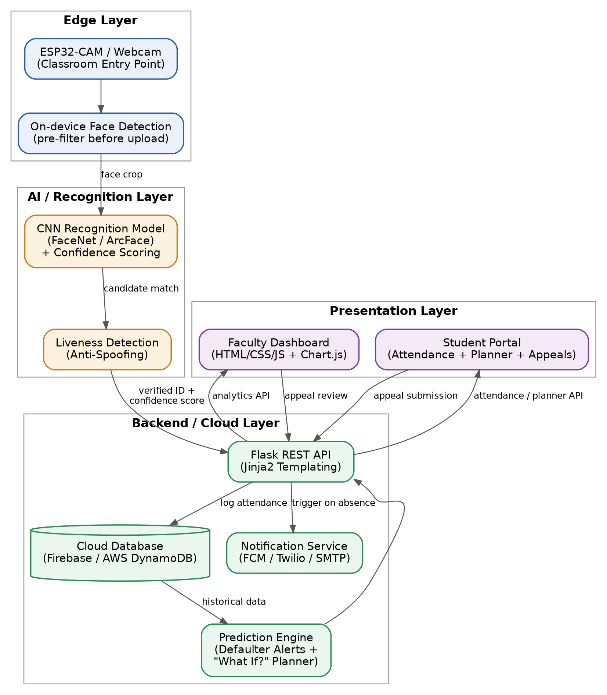
Proposed System Architecture

Slide 9
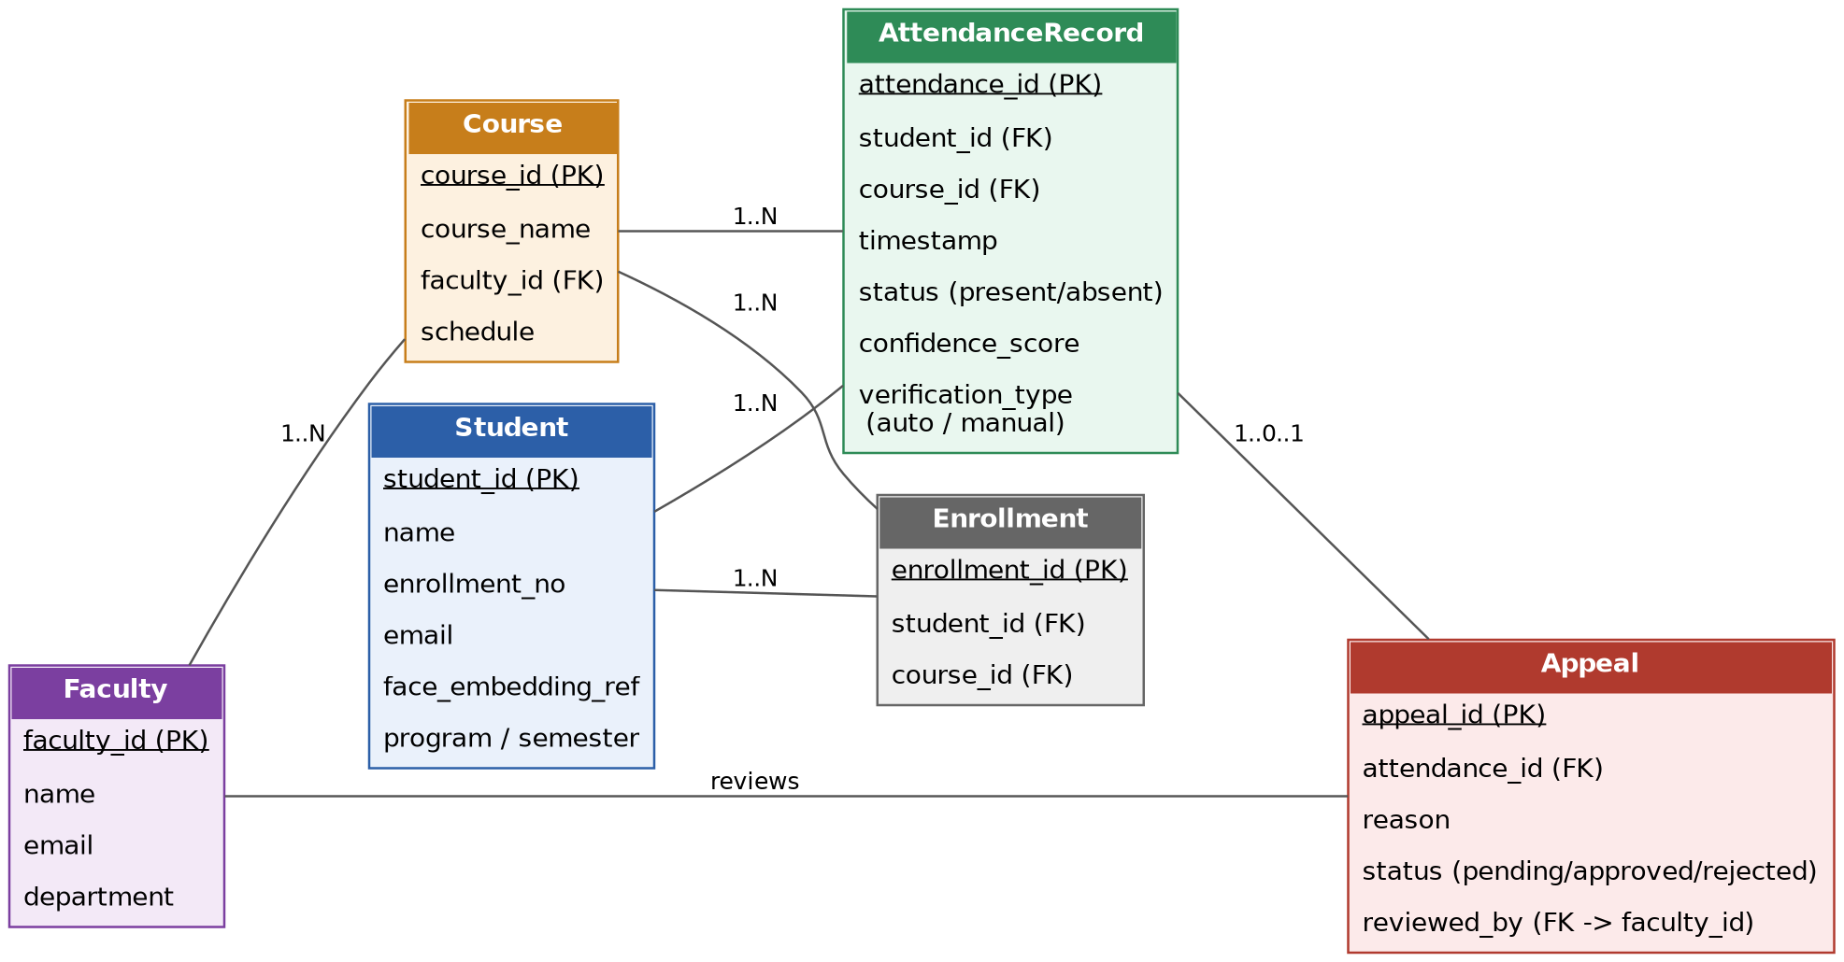
Database / ER Diagram

Slide 10
Technology Stack
Hardware / IoT: ESP32-CAM module (or webcam) at classroom entry point; edge-based face detection before transmitting recognized IDs/embeddings to the cloud.
Computer Vision / ML: OpenCV; CNN-based recognition (FaceNet/ArcFace/dlib); liveness/anti-spoofing detection; confidence scoring & threshold-based routing; lightweight prediction model for planner and defaulter forecasting.
Backend / Cloud: Python, Flask (REST APIs + Jinja2 templating); cloud database (Firebase Firestore or AWS DynamoDB/RDS); cloud storage for face dataset; notification service (FCM or Twilio/SMTP).
Frontend: HTML, CSS, vanilla JavaScript, Bootstrap, Chart.js, AJAX/fetch polling for near real-time dashboard updates.
Other: Git/GitHub, Postman.

Slide 11
Module Breakdown & Team Responsibilities
Module | Scope | Owner
Face Recognition & Liveness (CV/ML) | Dataset collection, recognition model, confidence scoring, spoof detection | TBD
Backend & Cloud | Flask routes, database schema, attendance logging, notifications | TBD
Frontend (Dashboard & Portal) | Faculty dashboard, student portal, planner UI | TBD
Documentation, Testing & Integration | SRS, architecture/ER diagrams, testing, tying modules together, appeal logic | TBD
Note: module scope is proposed based on system components; final ownership to be confirmed by the team before development begins.

Slide 12
Project Timeline / Work Plan
Days | Focus | Deliverable
1–2 | Finalize SRS, architecture & ER diagrams, lock module ownership | Documentation ready
3–5 | Dataset collection + basic face detection/recognition on sample data | Working recognition on sample data
3–5 (parallel) | Flask skeleton: routes, DB schema, login + dashboard/portal templates | Visible UI, even if not fully wired
6–8 | Connect recognition → Flask → DB: capture, detect, log attendance | One real end-to-end working slice
8–9 | Basic testing: run recognition on sample dataset, note accuracy/errors | Testing/validation results
9–10 | Build presentation, rehearse individual contributions | Presentation-ready

Slide 13
Work Completed Since Presentation 1
Software Requirements Specification (SRS) drafted, including functional/non-functional requirements and 3 detailed use cases (attendance marking, appeal submission, attendance planning query).
System architecture designed and documented as a layered block diagram (edge → recognition → backend/cloud → presentation).
Database structure designed as an ER diagram covering Student, Faculty, Course, Enrollment, AttendanceRecord, and Appeal entities.
Technology stack finalized across hardware, CV/ML, backend, and frontend layers.
Dataset sources identified for face image collection; collection itself is planned for the coming days.
Note: This is intentionally an early-stage planning package — our project title was finalized approximately one week ago, and this presentation reflects the design and specification work completed since.

Slide 14
Plan & Targets for Next Review
Collect a working face dataset from team members and volunteers (~10–15 images/person).
Build and test an initial face detection/recognition script on the collected sample data.
Set up the Flask backend skeleton: routes, database schema, and basic login/dashboard templates.
Integrate recognition with the backend to log a real attendance event end-to-end (capture → recognize → log → display).
Run initial testing on the recognition pipeline and document accuracy/error observations.
Finalize module ownership across the team and begin parallel development.

Slide 15
Demonstration of Actual Progress
Requirement Analysis / SRS: Software Requirements Specification — full document with functional requirements, use cases, and data requirements (available for panel review).
System Architecture: Layered block diagram showing the full data flow from camera capture through recognition to the faculty/student portals (shown in this presentation).
Database / ER Diagram: Entity-relationship model covering all core data entities and their relationships (shown in this presentation).
Dataset Identification: Face image data sources identified for the recognition model; collection scheduled to begin immediately following this review.
Algorithm / Workflow Design: Recognition workflow (capture → detect → liveness check → match → confidence routing) fully specified and ready for implementation.

Slide 16
Thank You!
Questions & Answer

