Slide 1

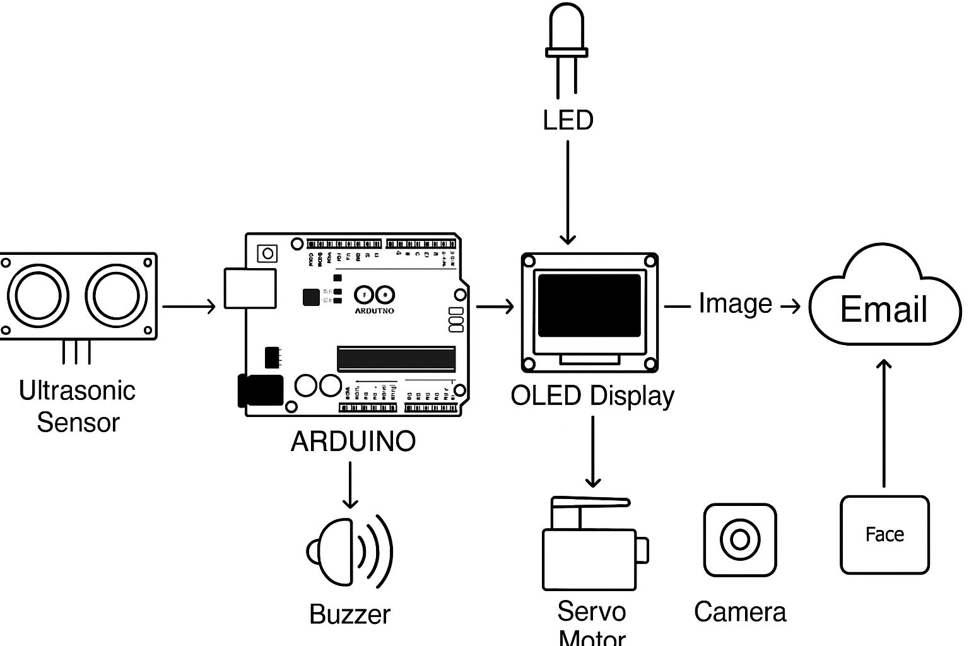
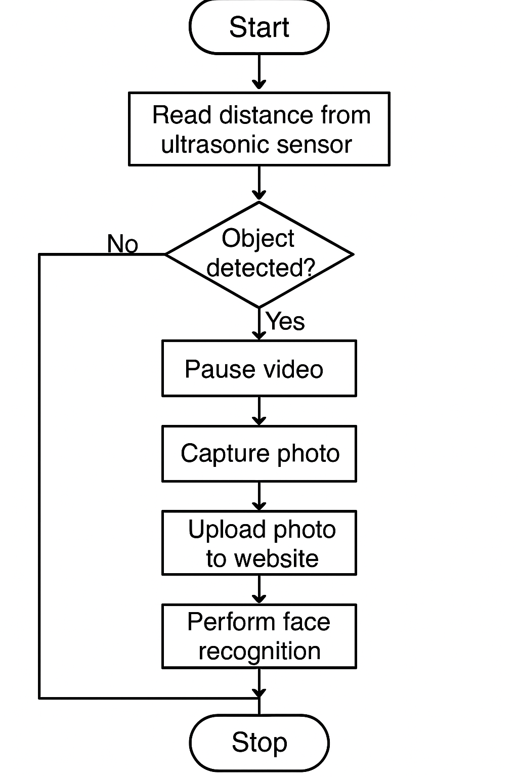
DEPARTMENT OF COMPUTER SCIENCE & ENGINEERING
IoT-Based Security and Surveillance System for Railway Stations
Pratham Shah, Aniket Mukund Pawar, Harshwardhan Patil, Kanishka Mittal, Om Vijay Mangate, Vishwajit Gaikwad
Class : TY AIA:6
Group Id: 15
Faculty Guide: Prof. Neha Gupta
Proposed Architecture/ Diagram:
Problem statement
Railway stations are highly vulnerable to unauthorized access, human accidents on tracks, and unattended baggage, with limited automation in threat detection. Current systems lack real-time action, intelligence, and centralized alerting mechanisms, delaying response and increasing safety risks.
Proposed Solution
We present an IoT-based intelligent surveillance system that detects nearby motion using ultrasonic sensors, triggers a servo-controlled camera to capture intruders, and sends alerts with images to station authorities via email. Captured data is stored on a web platform integrated with face recognition to identify individuals. The system runs autonomously, captures real-time video, and pauses to take photos when activity is detected, ensuring faster decision-making and improved security.
Scope and Feasibility
Scope:
Can be deployed at platforms, entry points, or restricted areas across stations.
Easily extendable to bus terminals, airports, or public events.
Can integrate additional sensors (IR, sound) or AI models for object and behavior recognition.
Feasibility:
Technically Viable
Cost-effective
Modular & Scalable
User-Friendly

