Slide 1

Foot Fracture and Edema Classification using CNNs With MRI for Accelerated Diagnosis
Presenter: Om Dange
Mentor: Dr. Jacob Furst

Slide 2
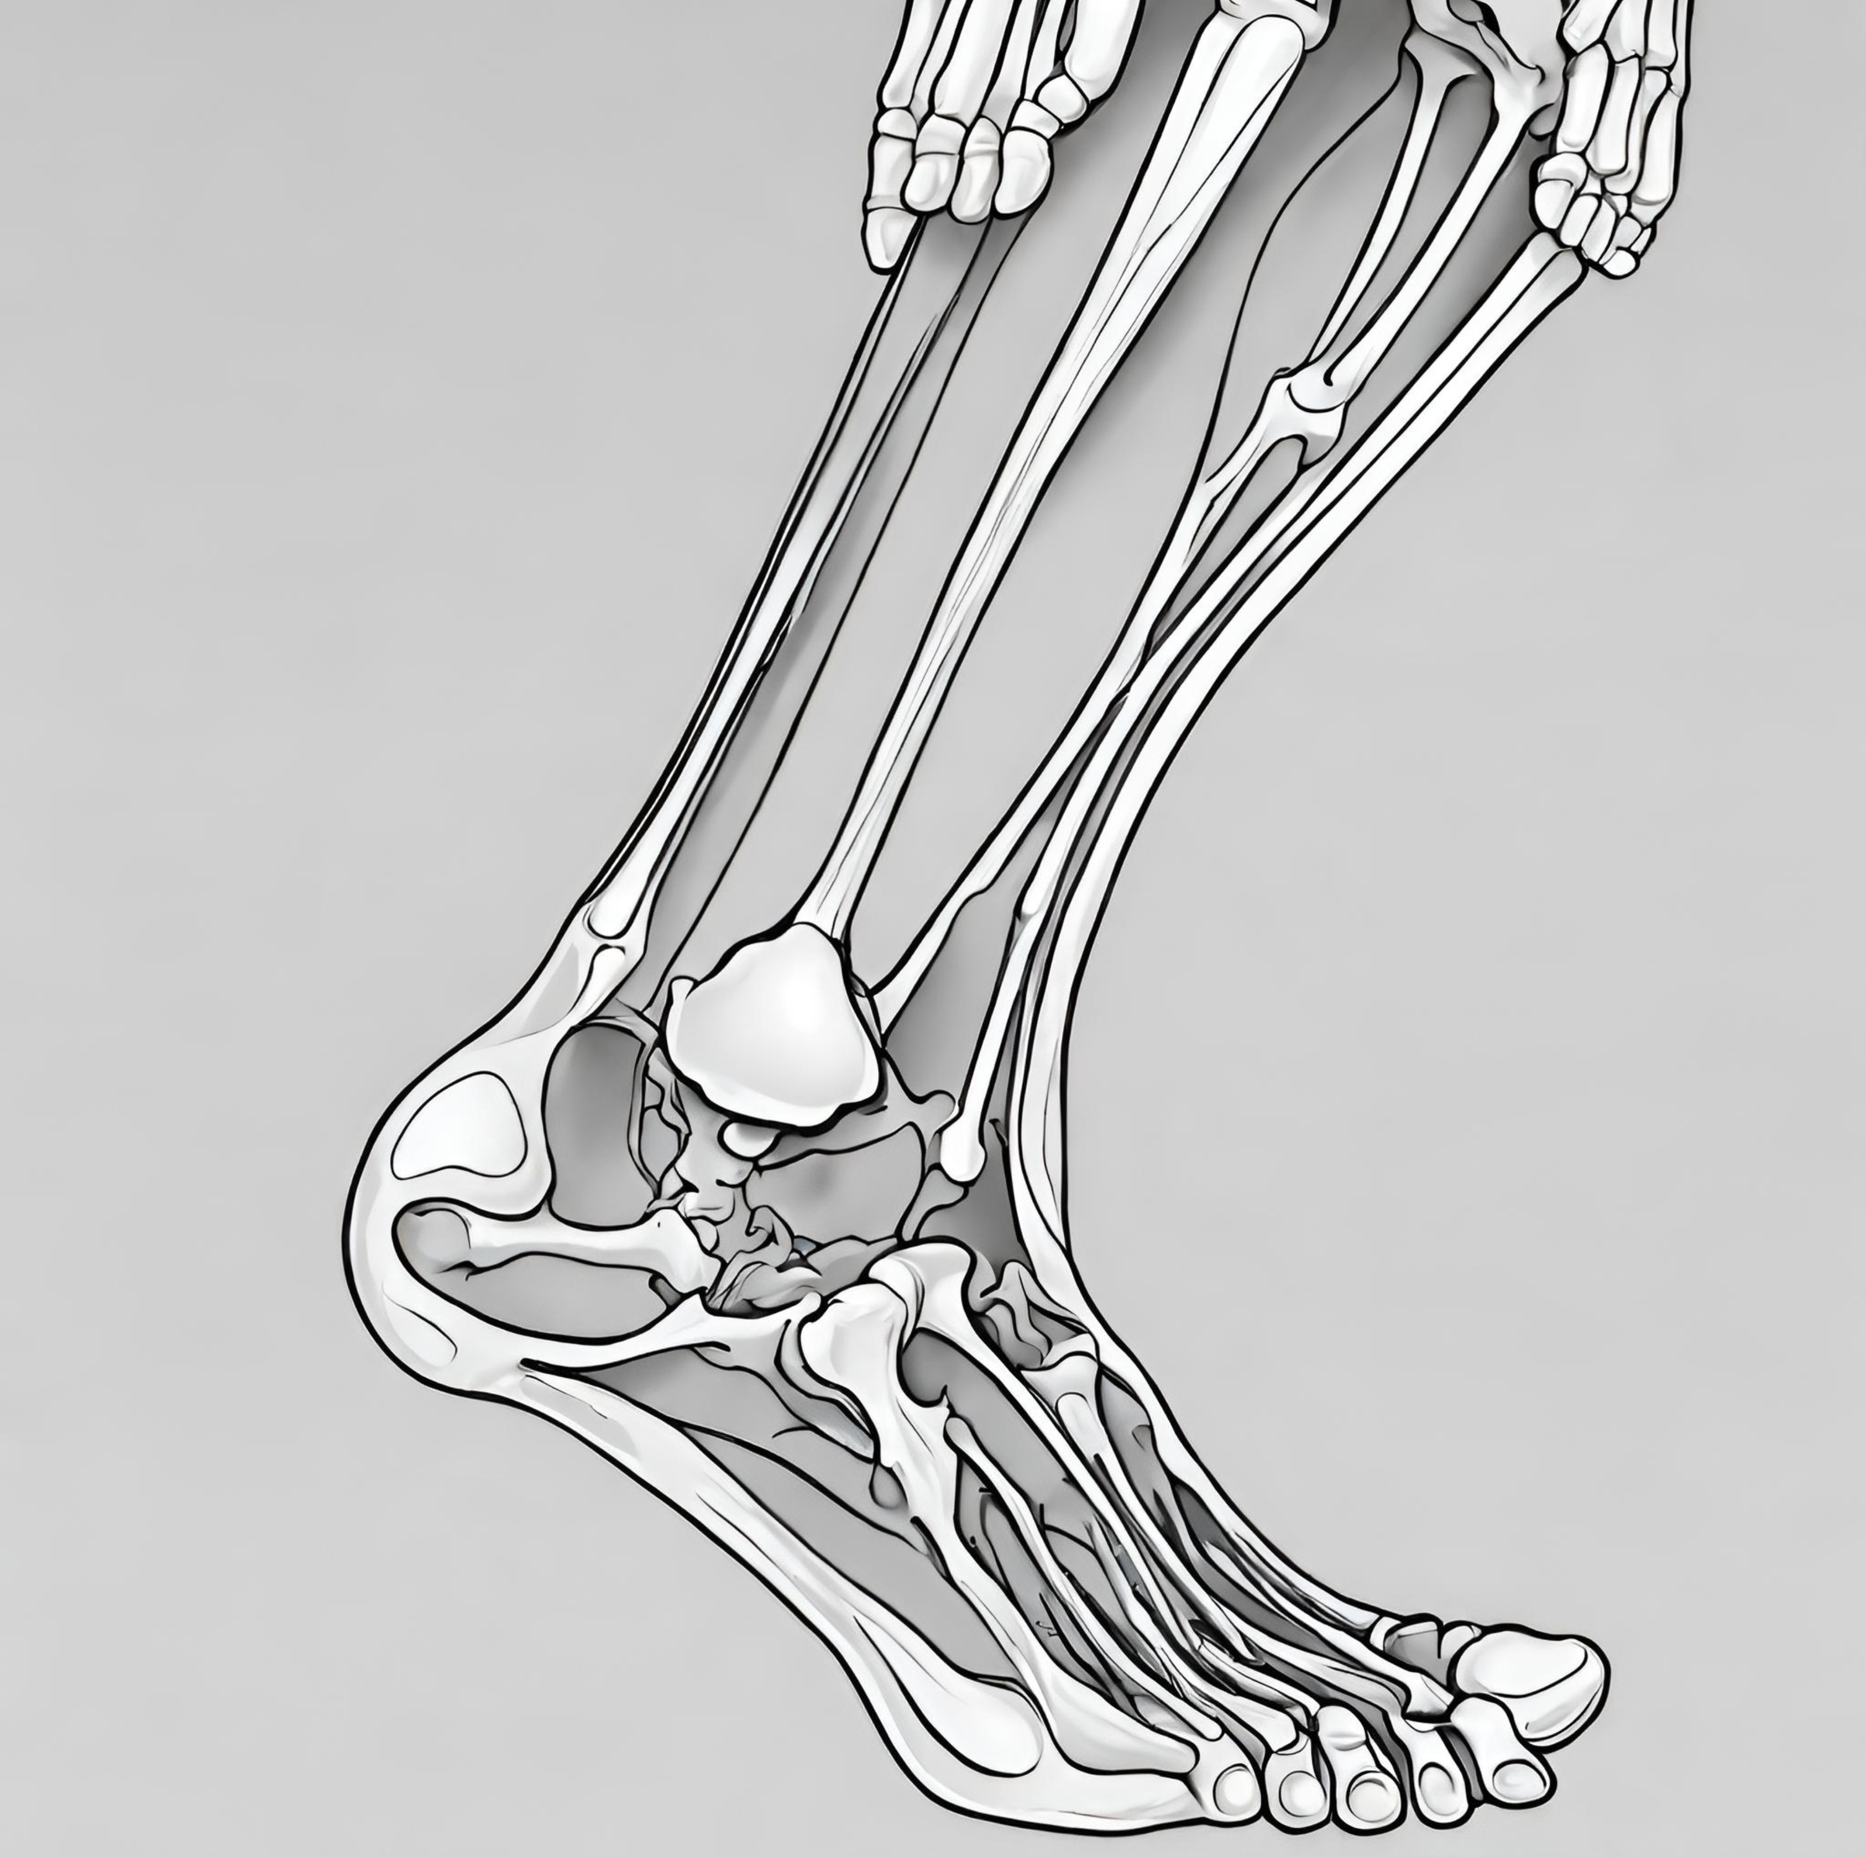
Overview
Develop machine learning (ML) model for precise ankle fracture and edema diagnosis.
Use Magnetic Resonance Imaging (MRI) and physician labeling for training.
Aim to minimize region of interest in physician’s diagnosis to improve accuracy, and enable timely treatment
Current result reached 89% accuracy using Convolutional Neural Network (CNN) model architecture

Slide 3
Specific Contributions
Developed machine learning models for diagnosing fractures and edema in MRI images for
  3-way Classification
  Sequential Classification
Fracture (+ Edema)
Healthy
3-way
Classifier
Edema (no fracture)
1st classifier
Fracture (+ Edema)
Unhealthy
2nd Classifier
Healthy
Edema (no fracture)

Slide 4
Hypothesis
Given the curated set of MRI images, can we achieve clinically relevant accuracy and sensitivity in predicting Fracture and Edema?

Slide 5
Dataset & Preprocessing
All SAGT1’s images:
  Edema: 715 images
  Fracture: 301 images
  Healthy(non black): 439 images (with black slices: 1636)
Excluded non-informative black slices
  Any pixel value that are less or equal to 10 are considered as black pixel.
  And if % of black pixels >= 65 % then those slices were ignored.
Intensity normalization: each input channel is normalized to have zero mean and unit variance

Slide 6
Methodology
Explored RESNET18 for Image Classification
Train-Validation Split in the ratio of 80:20
Two different classification tasks:
  Three-class classification
  Sequential classification

Slide 7
Methodology (contd.)
Transfer Learning Approach (for sequential classification)
  After Healthy and Unhealthy Classification, freezing the initial layers of the pre-trained ResNet-18 (these layers extract low-level features common across many images)
  Fine-tuning the final layers of the network with our specific medical image dataset

Slide 8
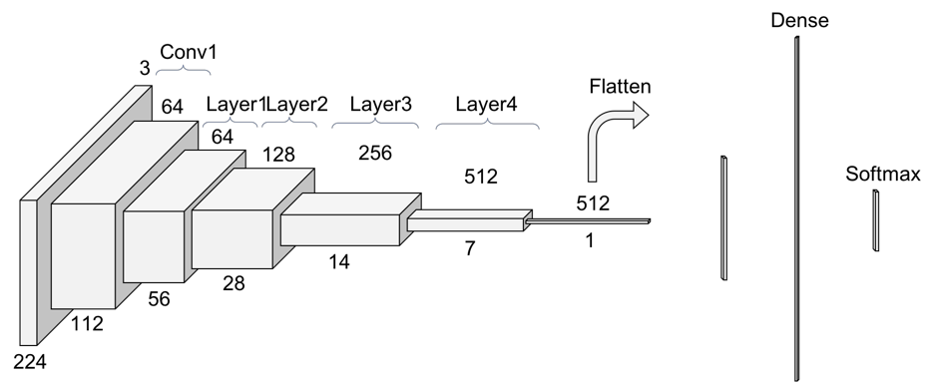
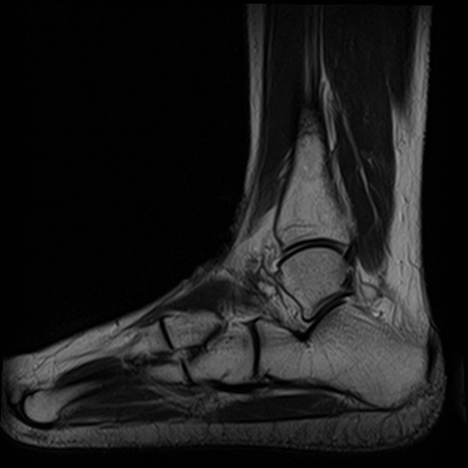
3-way Classification Model Architecture
Fracture
Edema
Healthy

Slide 9
Sequential Classification Model Architecture
Healthy
Unhealthy
Fracture
Edema

Slide 10
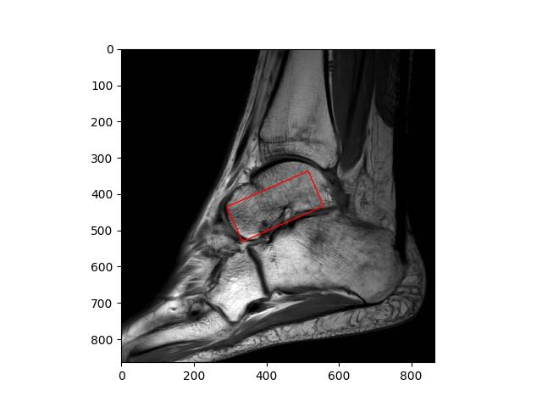
Fracture and Edema?
All fractures have edema around them
  Red box: Edema
  White box: Fracture

Slide 11
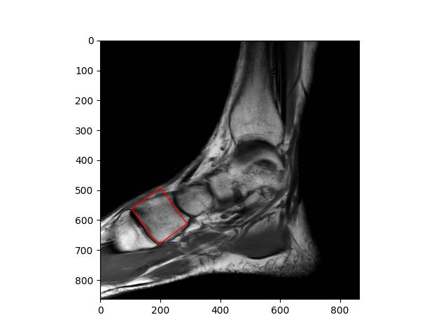
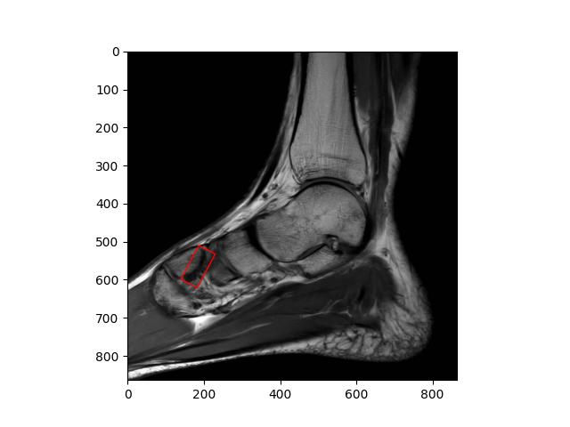
Separating Patients in Train and Test sets
  Consecutive MRI slices of a single patient
  Image in Train set Image in Test set

Slide 12
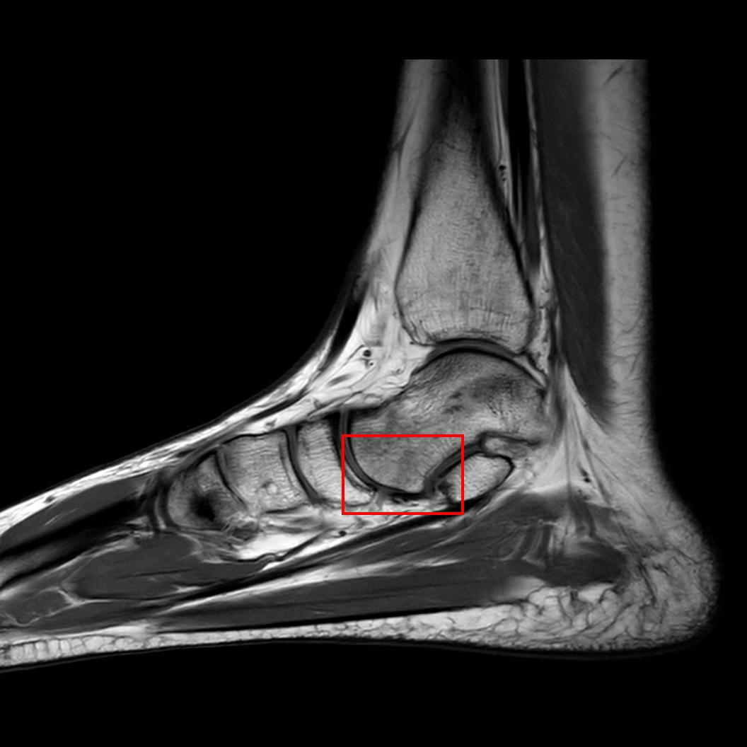
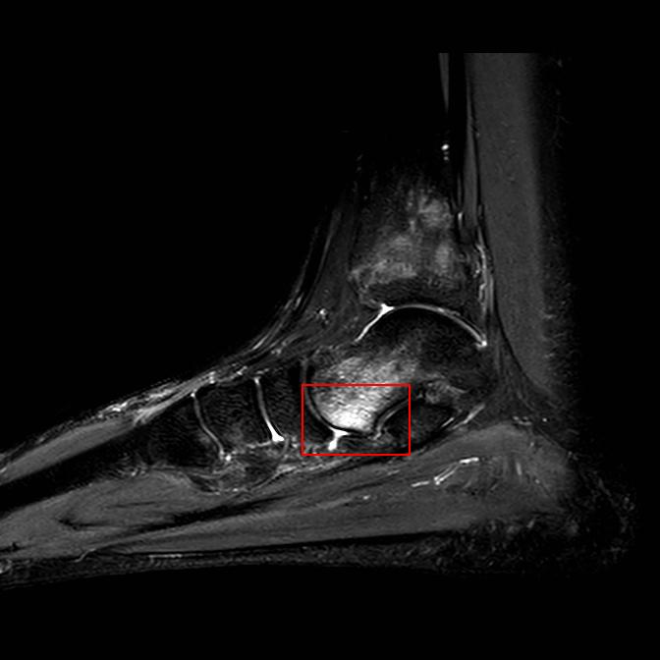
SAGT1 vs SAGIR pulse impulses

Slide 13
Healthy vs Unhealthy Classification
Pretrained ResNet18 used to classify Fracture and Edema using:
  IMGNET_V1 weights
  SAGIR Images
  80: 20 split
  224 x 224 px
  Separate patients
  No augmentation
Labels:
  439 Healthy Images
  745 Unhealthy Images

Slide 14
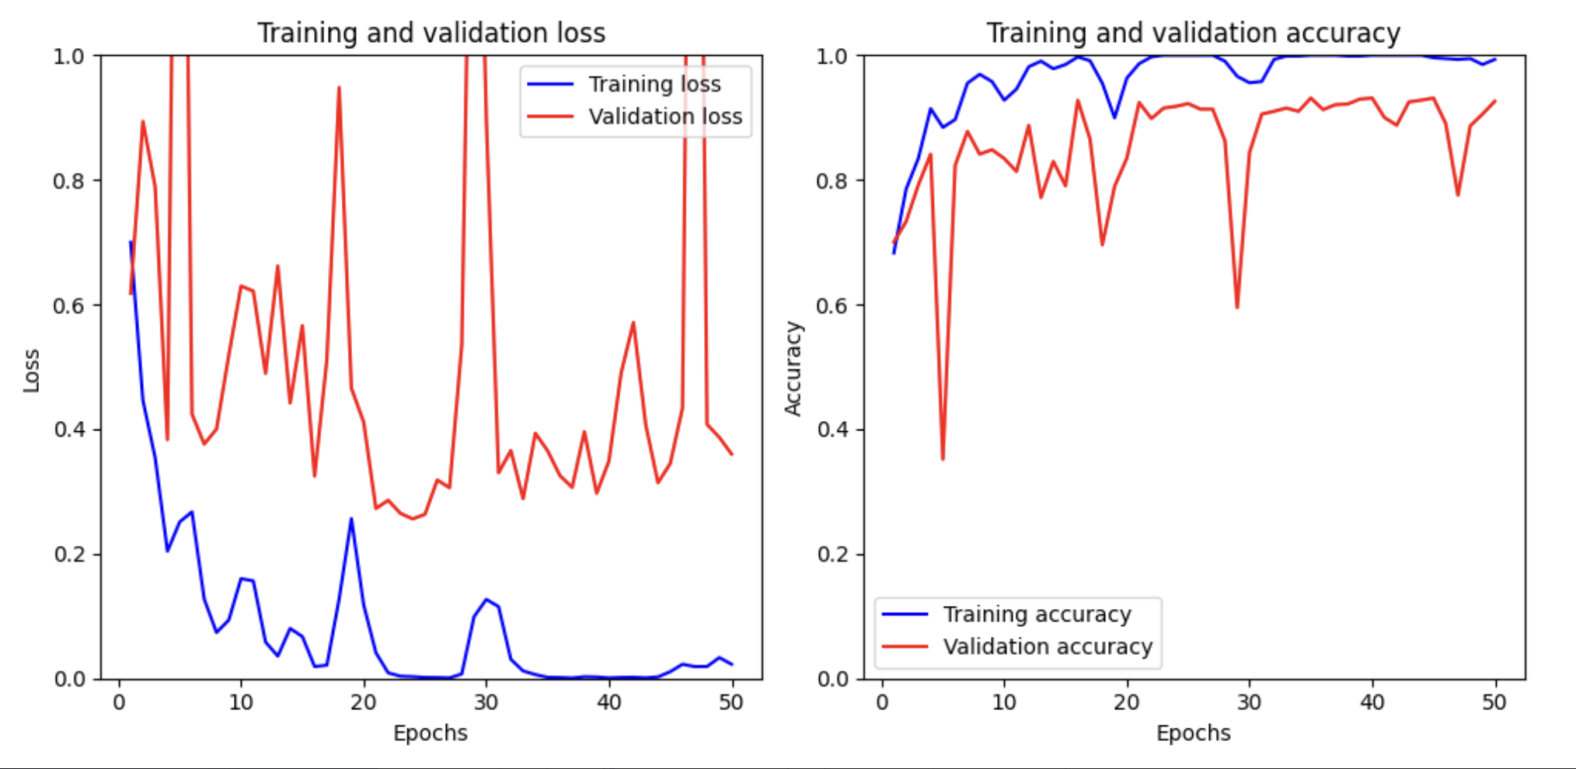
1st-step Classification Results (SAGIR’s)
 |  | Predicted Class
 |  | Healthy | Unhealthy
True Class | Healthy | 56 | 10
 | Unhealthy | 5 | 144
Metric
Sensitivity 0.9180
Specificity 0.9350
Total Accuracy 0.9302

Slide 15
Fracture vs Edema Classification
Pretrained ResNet18 used to classify Fracture and Edema using:
  IMGNET_V1 weights
  SAGIR Images
  80: 20 split
  224 x 224 px
  Separate patients
  No augmentation
Labels:
  185 Fracture Images
  235 Edema Images

Slide 16
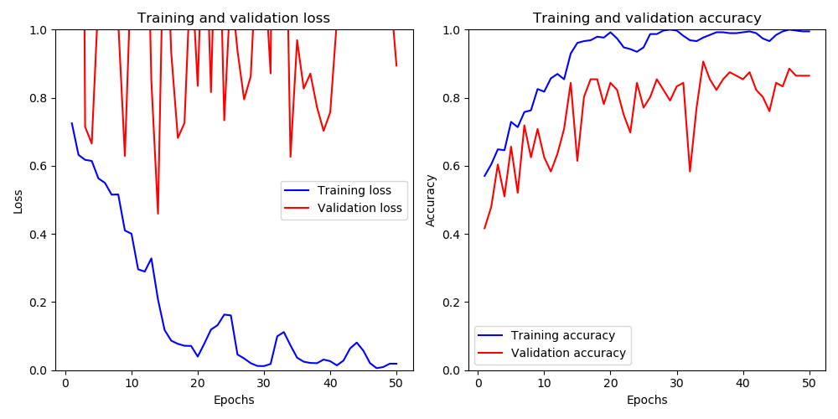
2nd-step Classification Results (SAGIR’s)
Fracture v Edema |  | Predicted Class
 |  | Fracture(+Edema) | Edema(no Fracture)
True Class | Fracture(+Edema) | 34 | 3
 | Edema(no Fracture) | 6 | 41
Metric
Sensitivity 0.85
Specificity 0.9318
Total Accuracy 0.8929

Slide 17
3 – way Classification
Pretrained ResNet18 used to classify Fracture and Edema using:
  IMGNET_V1 weights
  SAGIR Images
  80: 20 split
  224 x 224 px
  Separate patients
  No augmentation
Labels(1455 total images)
  301 Fracture Images
  715 Edema Images
  439 Healthy Images

Slide 18
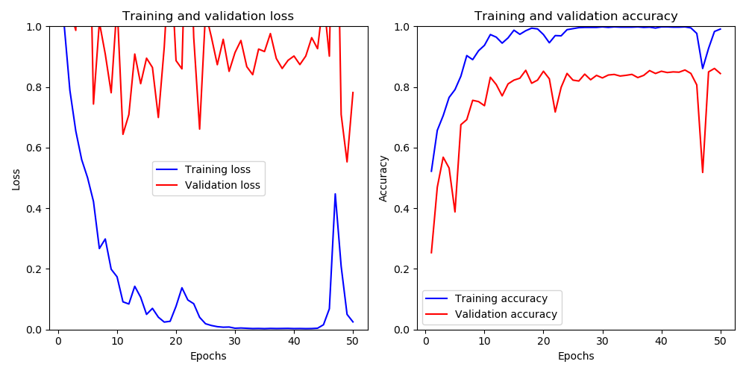
3-way SAGIR Classification Results
 |  | Predicted Class
 |  | Fracture(+Edema) | Edema(No fracture) | Healthy
True Class | Fracture (+Edema) | 88 | 23 | 1
 | Edema(No fracture) | 10 | 104 | 4
 | Healthy | 2 | 5 | 70
Metric Fracture Edema Healthy
Sensitivity 0.5997 0.6599 0.6755
Specificity 0.6837 0.7051 0.7485
Accuracy(overall) 0.8787

Slide 19
3 - way Classification
Pretrained ResNet18 used to classify Fracture and Edema using:
  IMGNET_V1 weights
  80: 20 split
  90º, 180º and 270º Augmentations
  Separate patients
Labels:
  1204 Fracture Images
  2860 Edema Images
  1756 Healthy Images

Slide 20
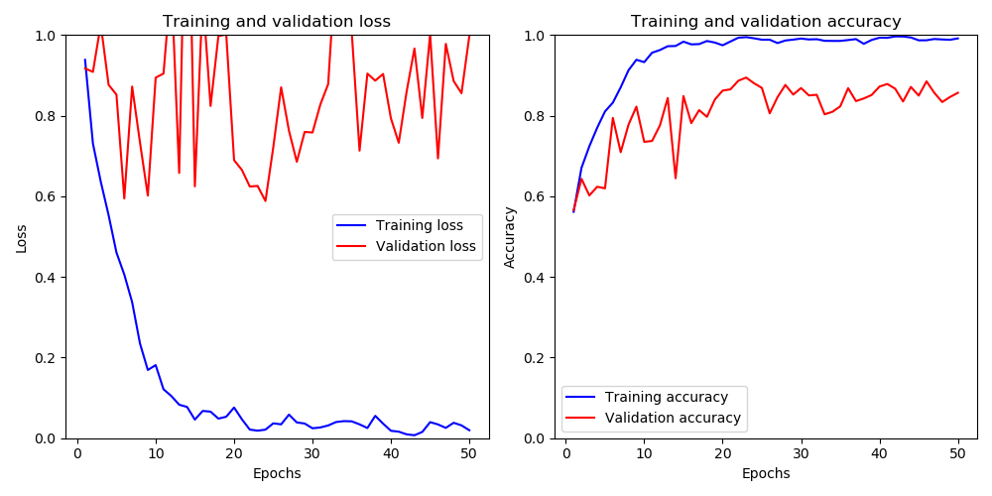
3-way SAGIR Classification Results (Augmented)
 |  | Predicted Class
 |  | Fracture(+Edema) | Edema(No fracture) | Healthy
True Class | Fracture (+Edema) | 390 | 56 | 2
 | Edema(No fracture) | 33 | 425 | 14
 | Healthy | 9 | 21 | 278
Metric Fracture Edema Healthy
Sensitivity 0.8705 0.9004 0.9025
Specificity 0.9436 0.8966 0.9807
Accuracy 0.8900

Slide 21
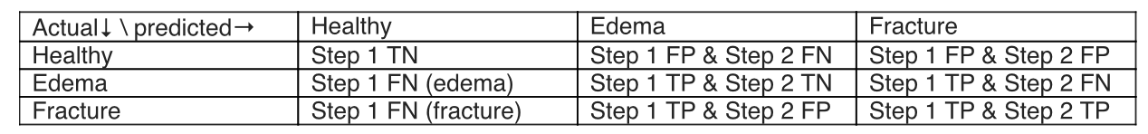
Combining Step 1 and Step 2
3- way |  | Predicted Class
 |  | Fracture(+Edema) | Edema(No fracture) | Healthy
True Class | Fracture (+Edema) | 390 | 56 | 2
 | Edema(No fracture) | 33 | 425 | 14
 | Healthy | 9 | 21 | 278
Sequential |  | Predicted Class
 |  | Fracture (+Edema) | Edema(No fracture) | Healthy
True Class | Fracture (+Edema) | 90 | 59 | 5
 | Edema(No fracture) | 10 | 97 | 6
 | Healthy | 3 | 24 | 144
Total Accuracy(overall) 0.8900
Total Accuracy(overall) 0.7557

