Slide 1
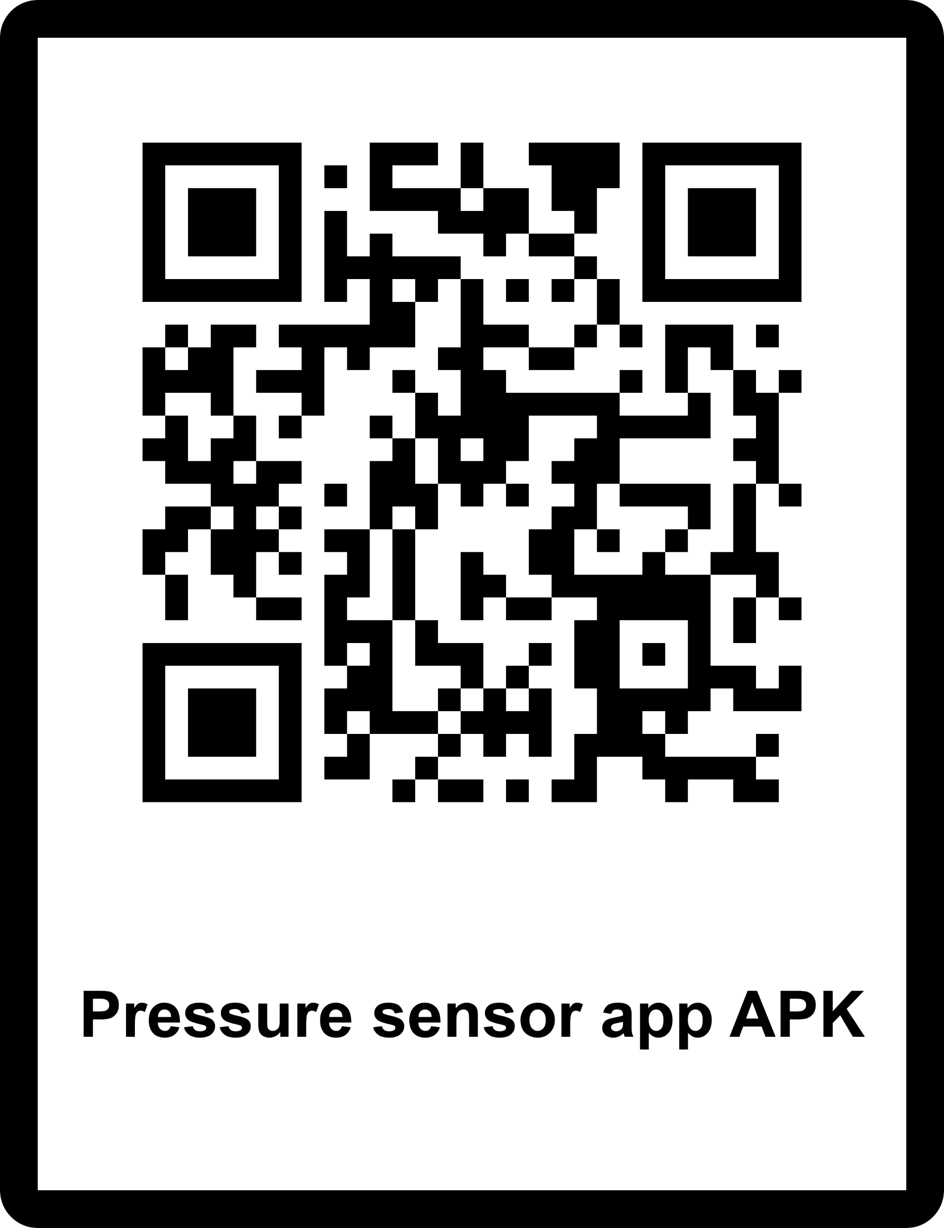
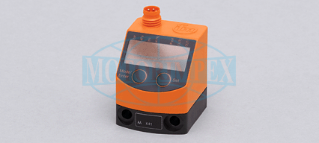
Sensor name: PQ3834-00 Sensor type – Presusre sensor
AR app allow you to:
track the sensor with your camera’s mobile device
Simulate interaction with the sensor, without the need to touch it directly!
The app will give you the information you need about the sensor
Presented to you by: Omer Shamir

