Slide 1
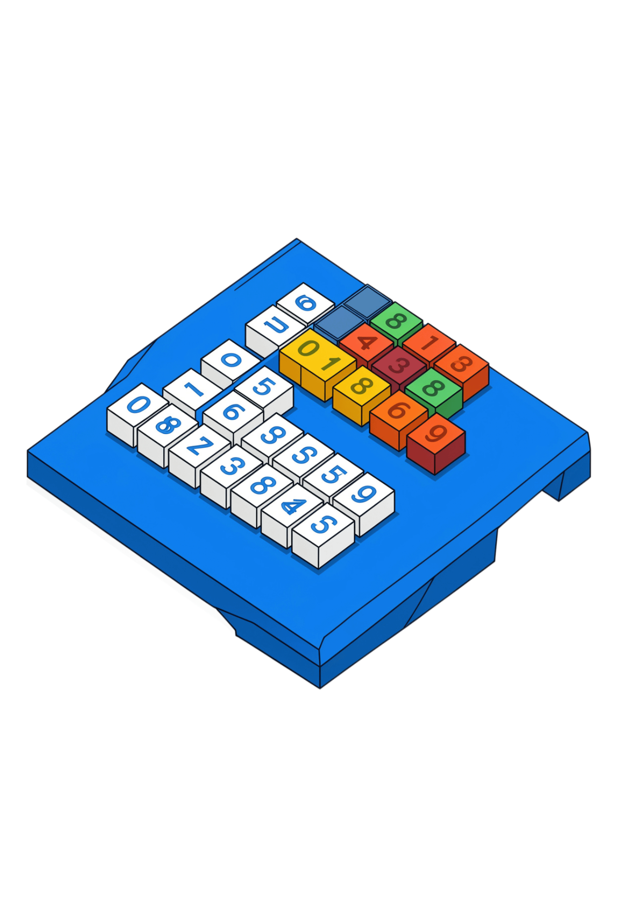
DESIGN AND ANALYSIS OF ALGORITHMS
MERGE
SORT
Understanding the Divide and Conquer Algorithm
Name : Om Mahajan
PRN : 25070521165

Slide 2
WHY MERGE SORT USES DIVIDE AND CONQUER
A large sorting problem becomes a set of small, manageable decisions.
01
02
03
Divide
Conquer
Combine
Split the array into two halves.
Recursively sort each half.
Merge the sorted halves.
The stopping rule
Example
[38, 27, 43, 3, 9, 82, 10] → [3, 9, 10, 27, 38, 43, 82]
A subarray with zero or one element is already sorted.

Slide 3
DIVISION CREATES THE RECURSION TREE
Keep splitting at the midpoint until every leaf contains one element.
LEVEL 0
[38, 27, 43, 3, 9, 82, 10]
LEVEL 1
[38, 27, 43, 3]
[9, 82, 10]
LEVEL 2
[38, 27]
[43, 3]
[9, 82]
[10]
LEVEL 3
[38]
[27]
[43]
[3]
[9]
[82]
[10]

Slide 4
MERGE COMPARES TWO SORTED HALVES
Merge [27, 38] with [3, 43] by selecting the smaller front element.
01
02
03
04
Compare 27 and 3
Compare 27 and 43
Compare 38 and 43
Left half is empty
select 3 → [3]
append 43 → [3, 27, 38, 43]
select 27 → [3, 27]
select 38 → [3, 27, 38]
Two pointers
Linear merge
Track the current element in each half. Advance the pointer that supplied the smaller value.
Once one half is exhausted, append the remainder. One merge takes linear time.

Slide 5
ONE COMPLETE EXECUTION, FROM SPLIT TO SORT
Split until singletons: [38] [27] [43] [3] [9] [82] [10]
[38] + [27] → [27, 38]
[43] + [3] → [3, 43]
[9] + [82] → [9, 82]
[27, 38] + [3, 43] → [3, 27, 38, 43]
[9, 82] + [10] → [9, 10, 82]
[3, 27, 38, 43] + [9, 10, 82] → [3, 9, 10, 27, 38, 43, 82]

Slide 6
THE RECURSIVE ALGORITHM IN PSEUDOCODE
MERGE_SORT(A, left, right):
if left < right:
mid = floor((left + right) / 2)
MERGE_SORT(A, left, mid)
MERGE_SORT(A, mid + 1, right)
MERGE(A, left, mid, right)
Base condition
left < right means more than one element remains.
Order matters
Sort the left half, sort the right half, then merge.

Slide 7
MERGE DETAILS, STABILITY, AND MEMORY
Merge function
Stability
Auxiliary space
Use temporary storage. Compare front elements, copy the smaller value, advance its pointer, append leftovers, then copy back.
Equal keys keep their original relative order. Choose from the left half first when keys are equal.
Temporary array: O(n). Recursion stack: O(log n). Therefore, O(n) dominates.
[(5, A), (3, B), (5, C)] → [(3, B), (5, A), (5, C)]

Slide 8
WHY EVERY CASE IS O(N LOG N)
T(N) = 2T(N/2) + O(N)
01
02
03
Divide
Merge
Total work
About log₂(n) levels until singletons.
Each level processes about n elements.
n × log₂(n) → O(n log n)
Two recursive halves plus linear-time merging.
Best case
O(n log n)
Average case
O(n log n)
Worst case
O(n log n)

Slide 9
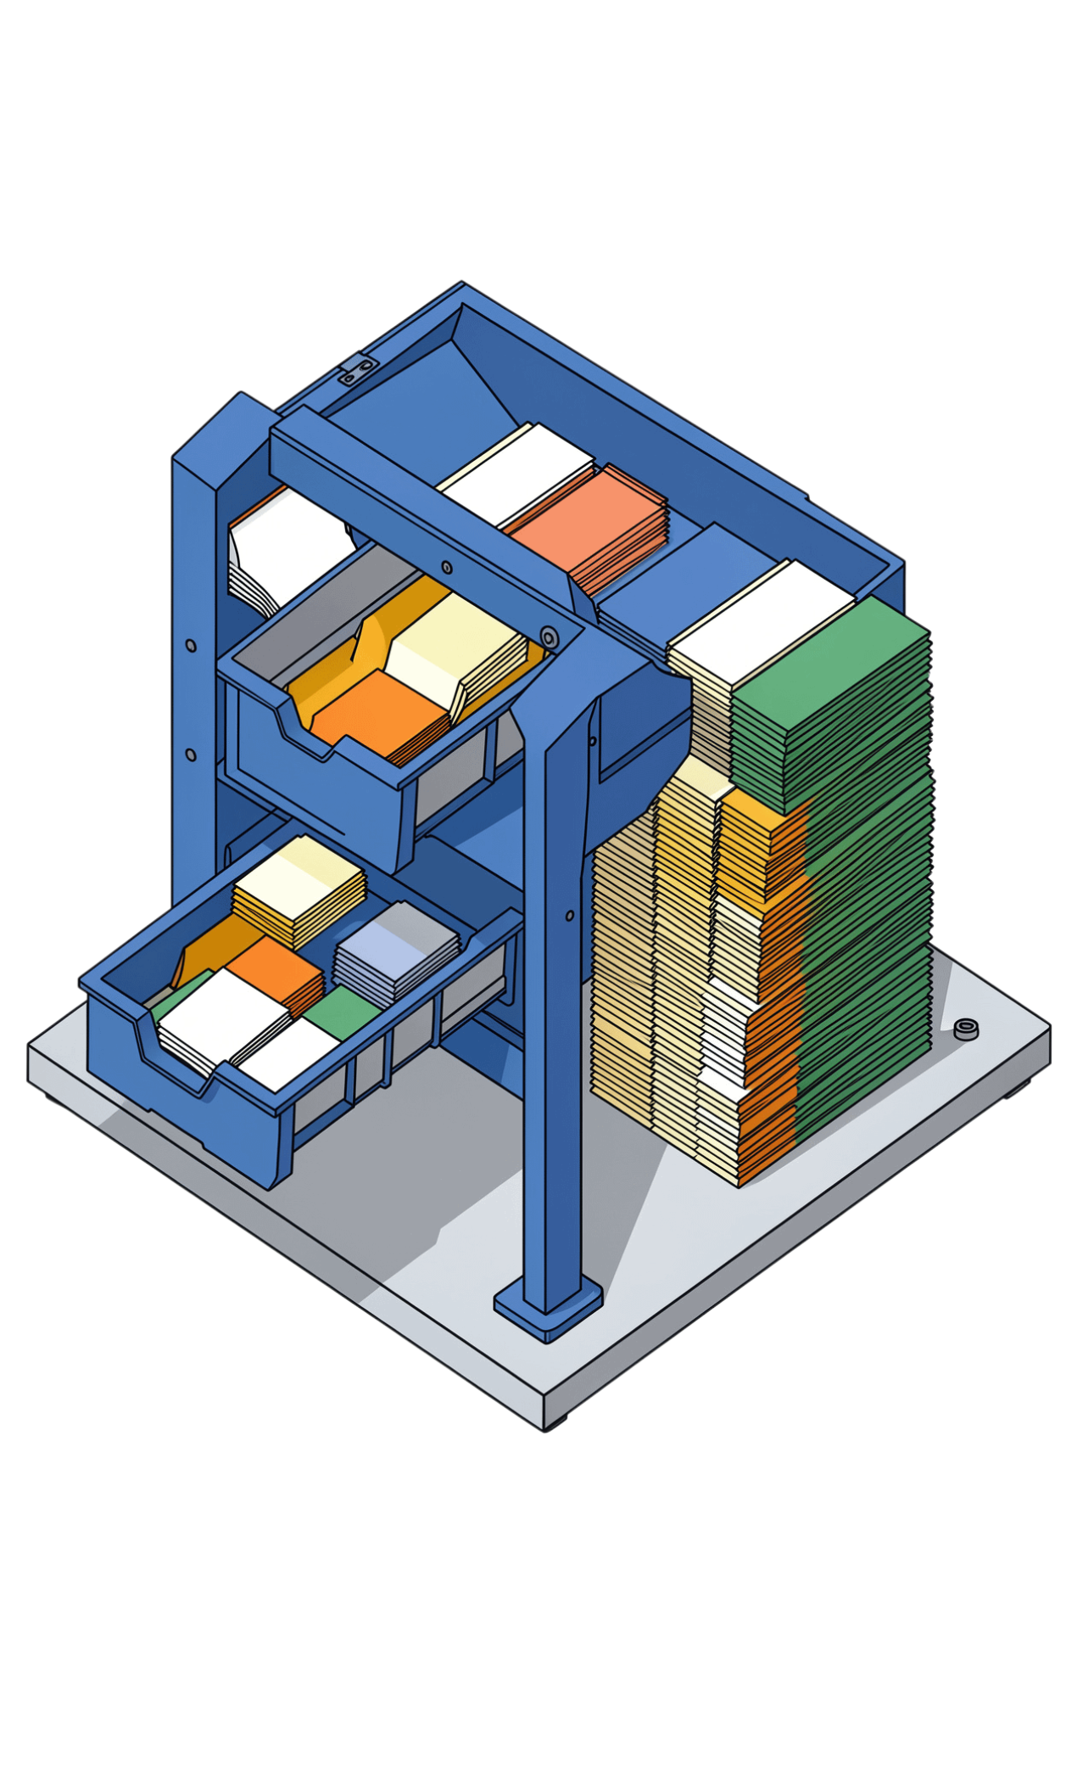
STRENGTHS, TRADE-OFFS, AND APPLICATIONS
Advantages
Guaranteed O(n log n), stable when implemented appropriately, predictable across input orders, strong for large datasets, external sorting, and linked lists.
Limitations
Standard arrays need extra memory. Recursion adds overhead. Insertion sort can win on tiny arrays, and in-place variants are more complex.
Applications
External file sorting, linked-list sorting, stable multi-field records, and predictable data-processing pipelines.

Slide 10
MERGE SORT IN CONTEXT
Algorithm | Best | Average | Worst
Merge Sort | O(n log n) | O(n log n) | O(n log n)
Quick Sort | O(n log n) | O(n log n) | O(n²)
Bubble Sort | O(n)* | O(n²) | O(n²)
*Bubble Sort reaches O(n) best case when its implementation detects that no swaps are needed.
Merge Sort: predictable performance, stability, and O(n) auxiliary space. Choose based on input size, memory, stability needs, and implementation.
Divide → Sort → Merge
[38, 27, 43, 3, 9, 82, 10] → [3, 9, 10, 27, 38, 43, 82]
THANK YOU!

