Slide 1
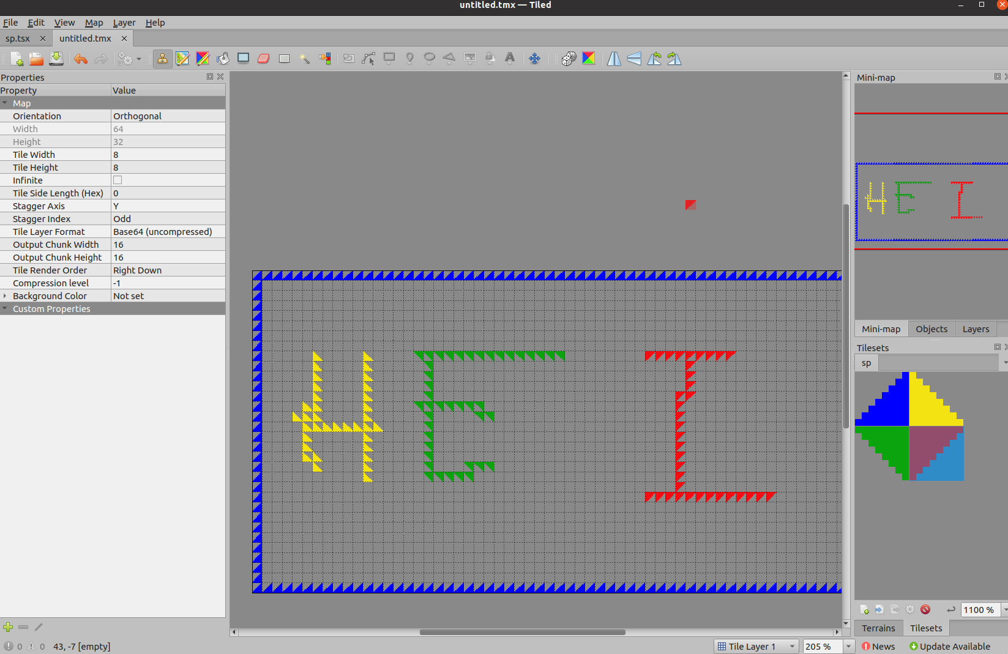
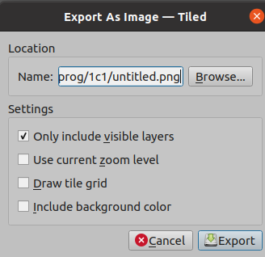
Tile background

Slide 2
Grit command:
/opt/devkitpro/tools/bin/grit untitled.png -gB4 -mLs -ftc

Slide 3
https://www.geeksforgeeks.org/how-to-check-if-a-given-point-lies-inside-a-polygon/
https://wrfranklin.org/Research/Short_Notes/pnpoly.html

Slide 4
GBA-BIOS
https://emulation.gametechwiki.com/index.php/Emulator_files

