Slide 1
LP2 (on CPU2)
LP1 (on CPU1)
LP3 (on CPU3)
Notes:
partitioning

Slide 2
Notes:
perfbar-screenshot

Slide 3
T simulation time
null message
L/R
EIT marker
EIT
T = Rt
Melbourne
timeline
L lookahead
Sydney
timeline
T₁
T = Rt
T₁
τ “MPI latency”
Melbourne LP
t real time
Sydney LP
Notes:
nonblocking-crit

Slide 4
LP_{i}
E_{i,} P_{i}
L_{i,j}, τ_{i,j}
L_{i,k}, τ_{i,k}
LP_{j}
E_{j}, P_{j}
LP_{k}
E_{k}, P_{k}
. . .
. . .
. . .
Notes:
pairwise

Slide 5
S
S
S
Notes:
cqn-model

Slide 6
CPU0
S
CPU1
S
CPU2
S
Notes:
cqn-partitioning

Slide 7
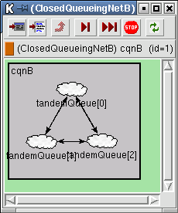
Notes:
cqn-screenshot1

Slide 8
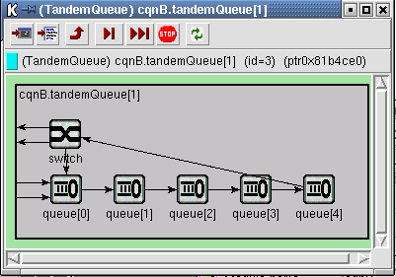
Notes:
cqn-screenshot2

Slide 9
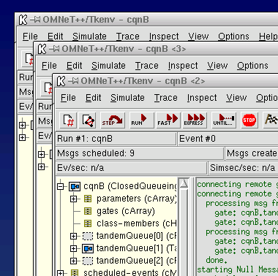
Notes:
parsim-screenshot

Slide 10
CPU0
tandem[0]
tandem[1]
(placeholder)
CPU1
comm. (MPI, pipe, etc.)
tandem[0]
(placeholder)
tandem[1]
Notes:
placeholders

Slide 11
CPU0
simple
module
(placeholder for
compound module)
CPU1
(placeh.)
simple
module
(placeh.)
CPU2
(placeh.)
(placeh.)
simple
module
Notes:
placeholders2

Slide 12
Simulation Model
Simulation Kernel
Parallel simulation
subsystem
Event scheduling,
sending, receiving
Synchronization
Partitioning
Communication
communications library (MPI, sockets, etc.)
Notes:
parsim-arch

Slide 13
system module
simple modules
compound module
Notes:
usmanFig2

Slide 14
parent module
parent module
s1
s2
s1
s2
Submodules connected to each other
Submodules connected to the parent module
Notes:
usmanFig3

Slide 15
A
B
t
A
t
B
message sending
transmission
delay
propagation
delay
message arrival
Notes:
usmanFig4

Slide 16
B
A
C
t
A
t
B
t
C
sending
arrival
Notes:
usmanFig5

Slide 17
Sender
Rec[0]
Rec[1]
Rec[2]
Rec[3]
Rec[4]
Notes:
usmanFig7

Slide 18
110
111
010
011
100
101
000
001
Notes:
usmanFig8

Slide 19
TxGate
100 Mbps
RxGate
Notes:
usmanFig9

Slide 20
HEAD
TAIL
insertion
removal
insert()
pop()
Notes:
usmanFig10

Slide 21
Operations on
A
asking the value
changing the value
cPar A
redirected to
B
cPar B
actually done on
B
ordinary value
Notes:
usmanFig11

Slide 22
range of initial observations
histogram range
Notes:
usmanFig12

Slide 23
underflows
cells
overflows
Notes:
usmanFig13

Slide 24
cell 0,1,...
base point 0,1,...
Notes:
usmanFig14

Slide 25
2
1
2
1
2
3
8
5
8
5
4
4
2
3
0
4
4
Notes:
usmanFig15

Slide 26
ñ
1,0,0
=7
ñ
1,0,1
=6
ñ
0,0
=4
ñ
0,1
=5
2
1
ñ
1,1
=7
2
3
5
8
5
5
2
4
2
2
4
2
7
6
0
4
5
7
Notes:
usmanFig16

Slide 27
network
impl. of
simulation
user
description
simple
kernel
interface
*.ned
modules
library
libraries
NEDC compiling
*.cc
*.lib / *.a
*.lib / *.a
e.g. :
e.g. :
impl. of
sim_std.a
envir.a
structure
cmdenv.a
*_n.cc
C++ compiling
linking
simulation program
configuration file
omnetpp.ini
execution
output files
*.vec, *.sna, etc.
Notes:
usmanFig17

Slide 28
CMDENV
Executing
SIM
ENVIR
or
M
odel
main()
TKENV
or
...
Model
Component
Library
Notes:
usmanFig18

