Slide 1
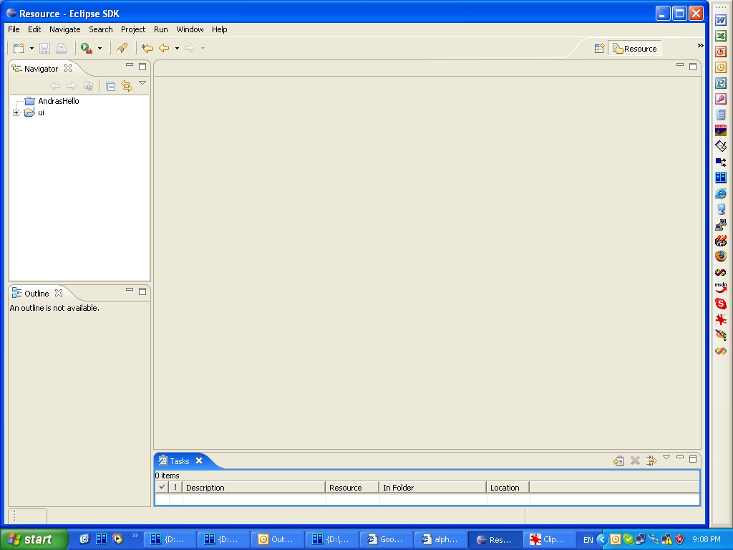
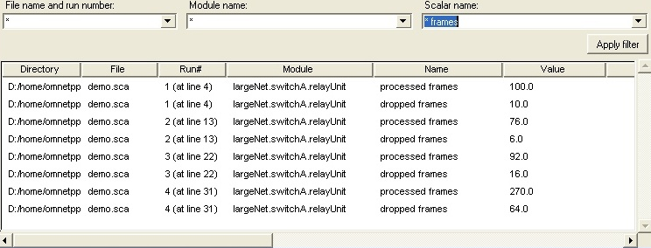
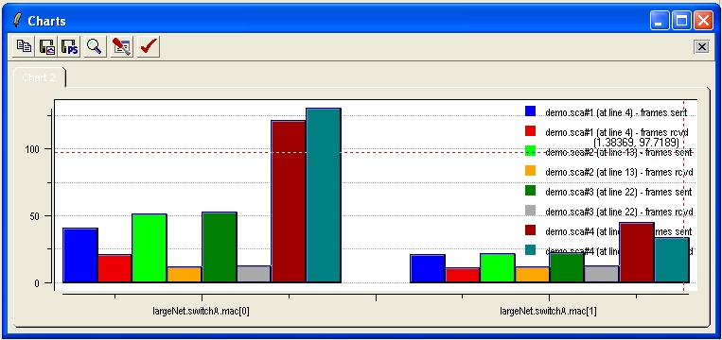
scalars
histograms
vectors
Apply filter
Plot
chart 1
design chart numbers

Slide 2
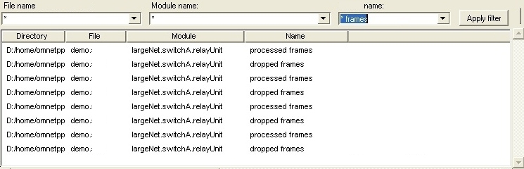
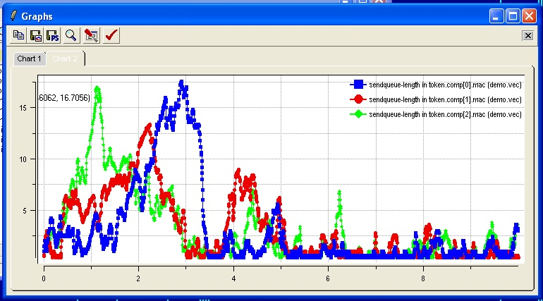
scalars
histograms
vectors
vector
Apply filter
Plot
count | mean | stddev | min | max
vec
..... ......... ...... ...... .....
...... ......... ....... ..... ....
...
..
plot 1
design chart numbers

Slide 3




scalars
histograms
vectors
vector
Apply filter
Plot
mean | stddev | min | max
vec
..... ......... ...... ......
...... ......... ....... ......
...
..
plot 1
(line properties)
(chart properties
to apply)
largenet.switchA.relayUnit
dropped frames
winavg(10)
(line properties)
calculate mean, stddev
store as
derived scalar
largenet.*.relayUnit
processed frames
design chart numbers

Slide 4

scalars
histograms
vectors
Apply filter
Plot
chart 1
demo.sca # run 1
largenet.*.relayUnit
* frames
demo.sca # run *
**.app
generated frames
average across
runs with same
parameters
(chart properties
to apply)
design chart numbers

