Slide 1
figures for OMNeT++ parallel simulation papers
use the WMF2EPS program to convert them into EPS
  select picture & copy to clipboard
  paste into wmf2eps
  click “Convert” button to save to EPS; use slide titles as file names

Slide 2
partitioning
LP2 (on CPU2)
LP1 (on CPU1)
LP3 (on CPU3)

Slide 3
perfbar-screenshot

Slide 4
sydney-melbourne
Sydney
Melbourne

Slide 5
nonblocking-crit
T simulation time
null message
L/R
EIT marker
EIT
T = Rt
Melbourne
timeline
L lookahead
Sydney
timeline
T₁
T = Rt
T₁
τ “MPI latency”
Melbourne LP
t real time
Sydney LP

Slide 6
pairwise
LP_{i}
E_{i,} P_{i}
L_{i,j}, τ_{i,j}
L_{i,k}, τ_{i,k}
LP_{j}
E_{j}, P_{j}
LP_{k}
E_{k}, P_{k}
. . .
. . .
. . .

Slide 7
cqn-model
S
S
S

Slide 8
cqn-partitioning
CPU0
S
CPU1
S
CPU2
S

Slide 9
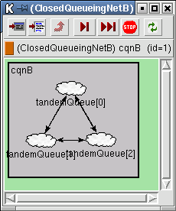
cqn-screenshot1

Slide 10
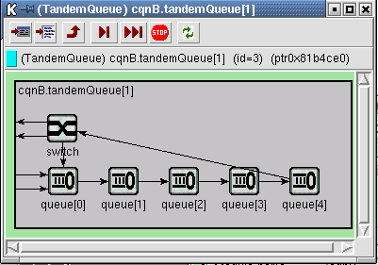
cqn-screenshot2

Slide 11
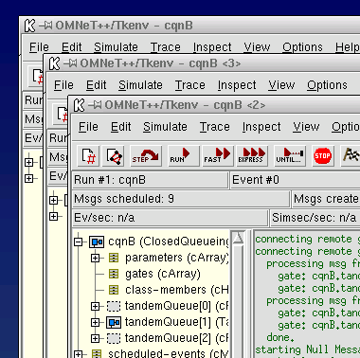
parsim-screenshot

Slide 12
placeholders
CPU0
tandem[0]
tandem[1]
(placeholder)
CPU1
comm. (MPI, pipe, etc.)
tandem[0]
(placeholder)
tandem[1]

Slide 13
placeholders2
CPU0
simple
module
(placeholder for
compound module)
CPU1
(placeh.)
simple
module
(placeh.)
CPU2
(placeh.)
(placeh.)
simple
module

Slide 14
parsim-arch
Simulation Model
Simulation Kernel
Parallel simulation
subsystem
Event scheduling,
sending, receiving
Synchronization
Partitioning
Communication
communications library (MPI, sockets, etc.)

