Slide 1
Wizards for the OMNeT++ IDE
András Varga
OMNeT++ Workshop
March 19, 2010
Malaga, Spain

Slide 2
Motivation
New users often find the IDE and the INET / INETMANET frameworks overwhelming
  Why not help them to make the first steps?
  They want to get a first simple simulation up and running quickly, so that they can start tweaking it
  And: why not show off features? (IPv6, Ad-hoc, Mobility, MPLS,…)
Eclipse is built to be extended
  New tools, new editors, new views,…
  New wizards!

Slide 3
IDE Extensibility
Eclipse extensibility
  features and plug-ins installed in the normal way, Help | Install New software…
OMNeT++ IDE loads plug-ins from projects
  When user opens e.g. the INET project, jars in its plugins/ folder get loaded automatically!
  Users of the project automatically get the UI extension, no extra installation step required!
  But writing Eclipse plug-ins is hard
Wizards contributed to the File|New dialogs
  Easy to write (little/no programming required)
  Can be distributed with the project
  Also automatically activated when project gets opened

Slide 4
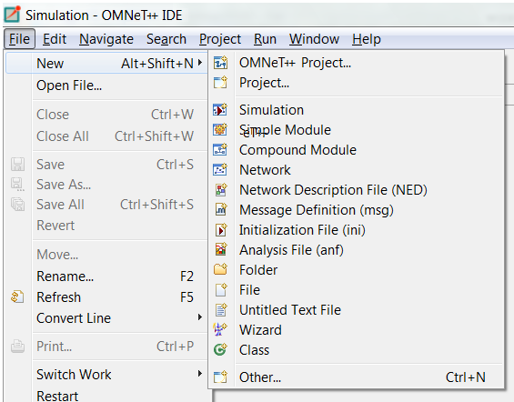
Wizards in the Menu

Slide 5
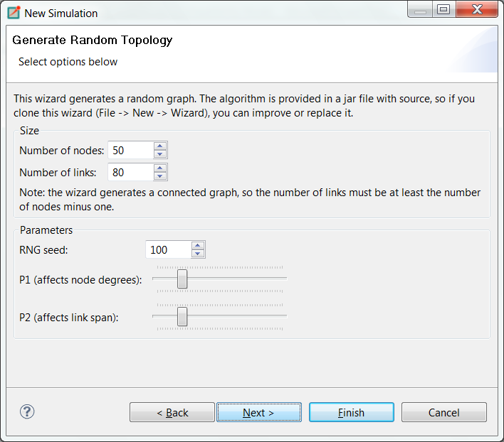
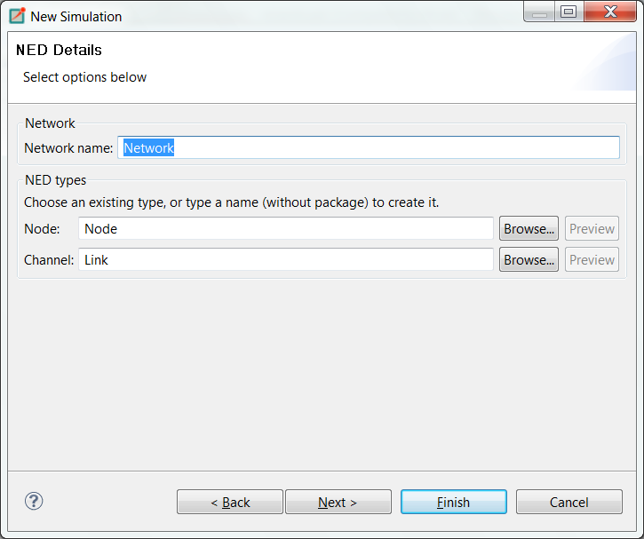
Example: Topology Generation

Slide 6
What is a Wizard?
Technically:
  A templates/<wizardname> folder in the project
  With a bunch of text files in it:
    template.properties: declares wizard name, type, pages, etc.
    .xswt files: XML files that describe the UI of wizard pages
    .ftl files: will be turned into content, after substituting $variables and #if, #list, etc. constructs (ftl=FreeMarker Template Language)

Slide 7
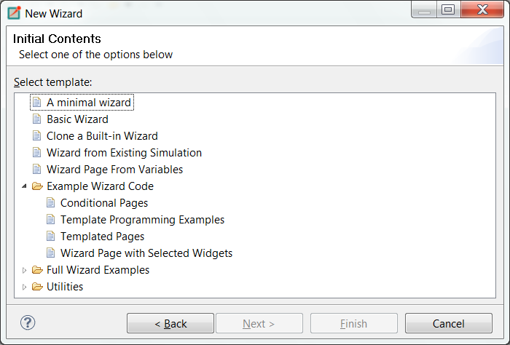

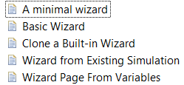
Wizard-Creation Wizards

Slide 8
Creating a Wizard
Let us create a simple “New Simulation” wizard!
It should prompt for:
  network name
  number of hosts
  traffic type
Files:
  In folder inet/templates/newwizard:
    template.properties
    wizardpage.xswt
    network.ned.ftl
    omnetpp.ini.ftl

Slide 9
Example: Properties File
template.properties:
  templateName = New Network Wizard
  templateDescription = Wizard with a single input page
  templateCategory = INET
  supportedWizardTypes = simulation, project
  # custom wizard pages
  page.1.file = wizardpage.xswt
  page.1.title = New Network
  page.1.description = Select options below
  # variables
  networkName = Network
  numNodes = 10
  trafficType = none

Slide 10
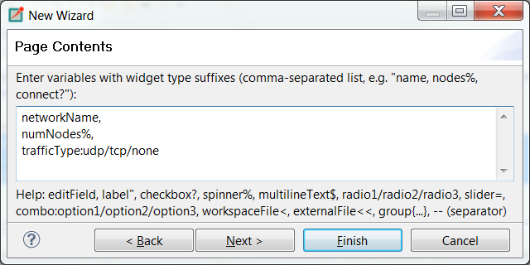
Example: Wizard Page
Let us use the “Wizard page from variables” wizard:

Slide 11
wizardpage.xswt (simplified)
<?xml version="1.0"?>
<xswt>
...
<x:children>
<label x:text="This is a generated wizard page.."/>
<label text="Network name:"/>
<text x:id="networkName"/>
<label text="Num nodes:"/>
<spinner x:id="numNodes" minimum="0" maximum="100"/>
<label text="Traffic:"/>
<combo x:id="trafficType">
<add x:p0="udp"/>
<add x:p0="tcp"/>
<add x:p0="none"/>
</combo>
</x:children>
</xswt>

Slide 12
Example: Templated Content
omnetpp.ini.ftl:
  [General]
  network = ${networkName}
  <#if trafficType==“tcp”>
  …
  <#elseif trafficType==“udp”>
  …
  </#if>
network.ned.ftl
  <@setoutput path=${networkName}+”.ned”/>
  network ${networkName} {
  submodules:
  host[${numNodes}]: Host;
  …
  }

Slide 13
Extensibility
When the FreeMarker template language is not enough:
  Java: you can write the code in Java, copy the JAR file into the templates/ folder, and invoke it from FreeMarker
  External programs: you can run external programs from FreeMarker, and let them do the job and/or capture their output
    Easy way to incorporate C/C++ code
When XSWT or provided widgets are not enough:
  Custom widgets: you can write custom widgets (also compound widgets like table+buttons) in Java
  Custom pages: you can write whole custom pages in Java
    page.1.class = org.example.foo.MyWizardPage

Slide 14
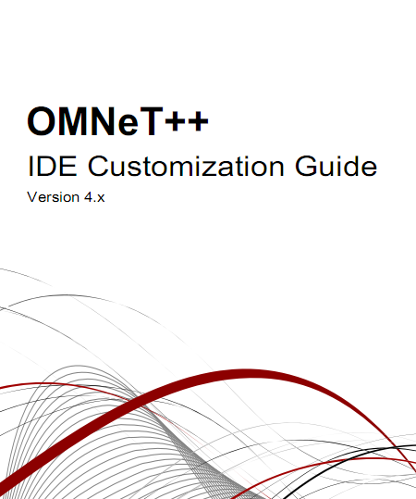
Documentation
“IDE Customization Guide”

Slide 15
Wizards
Questions, comments?
Discussion

