Slide 1
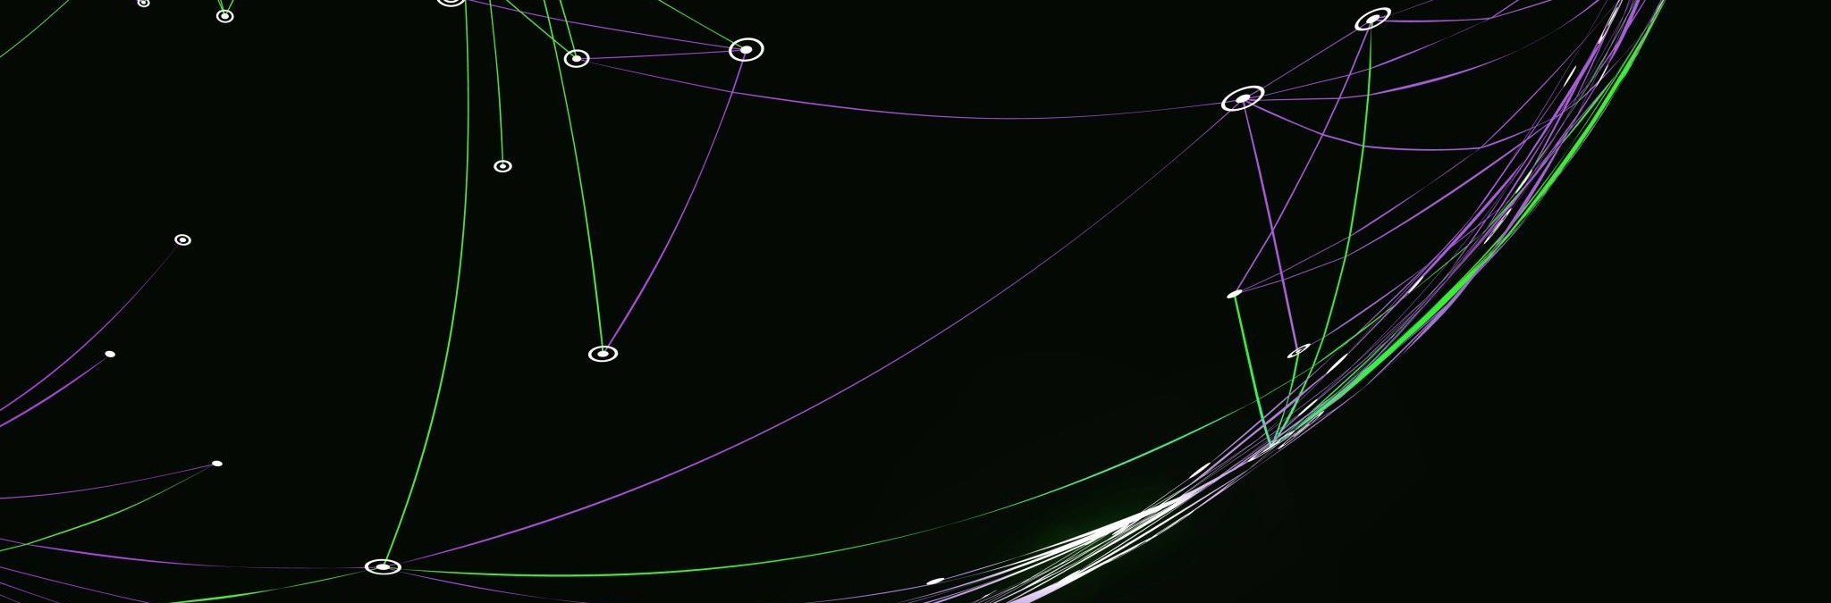
Milestone 7
Owen Lindsey

Slide 2
Functional introduction
This program serves as a store in a game. The user can enter the program via the storeFront, and from there they have multiple ways to manipulate through the store.
The admin is also able to manipulate the inventory from a separate console allowing both the user and the admin into the program at the same time without any issues.
Finally my Junit tests tried to accomplish 100% code coverage however we only made it to around 75% so some bugs are persistent currently but they are not common and do not serve major failures.

Slide 3
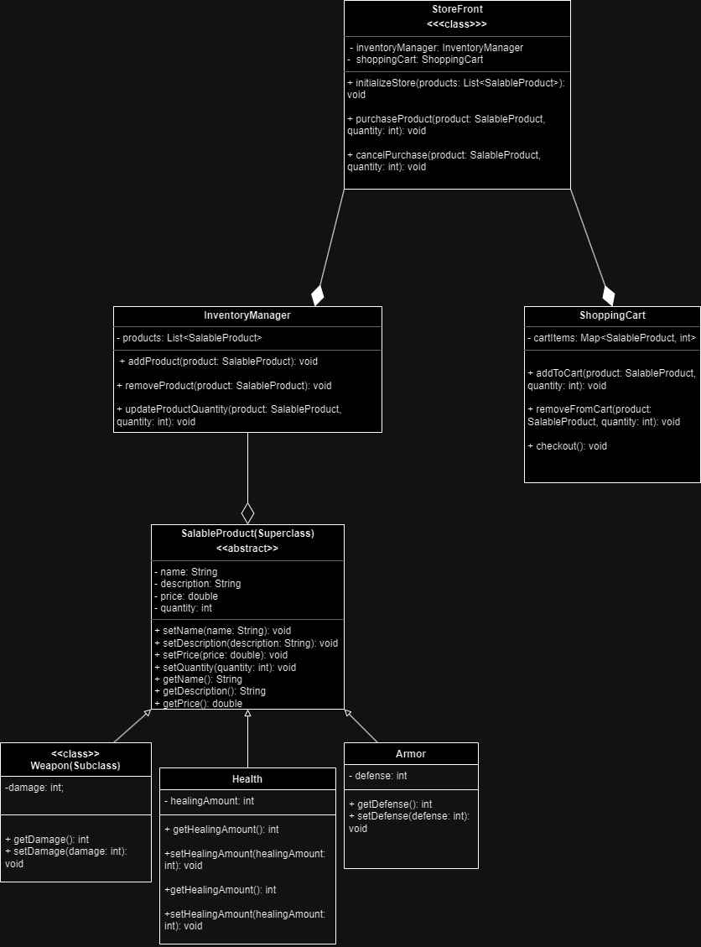
UML of main application

Slide 4
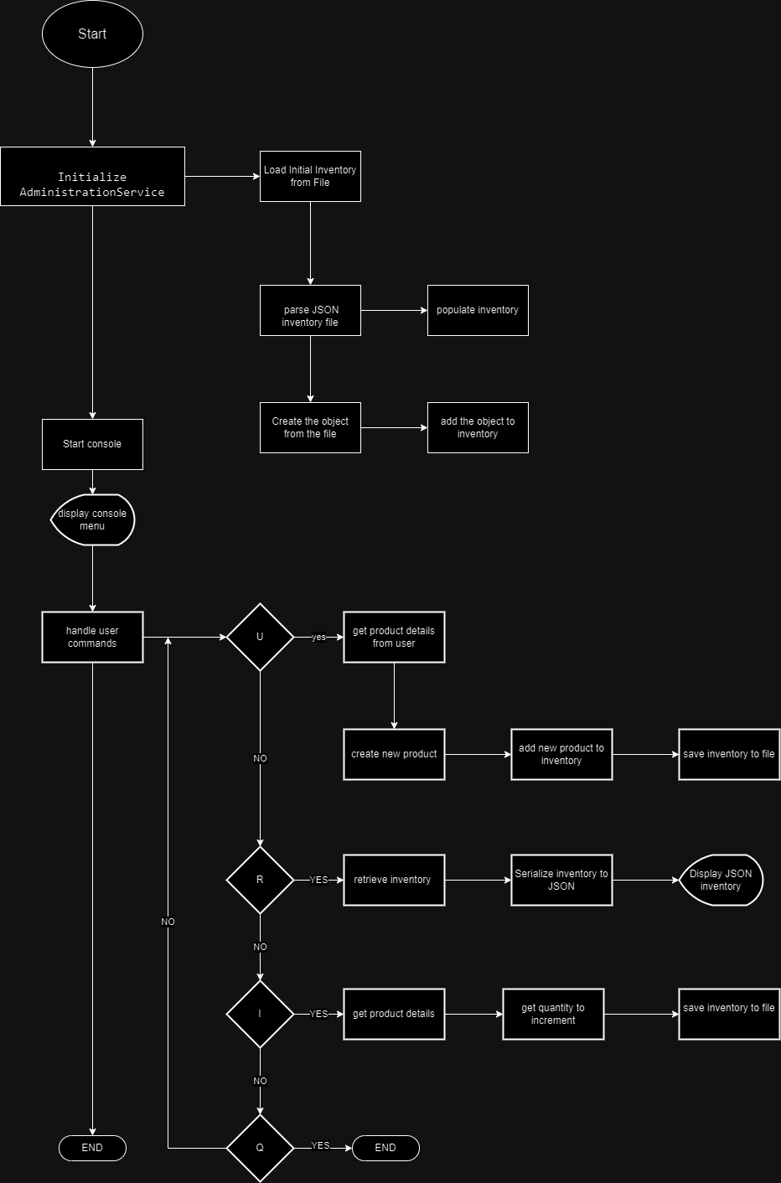
Flow chart of main program

Slide 5
Design choices
My packages in the root of my project file are named to reflect their usage. Products hold all items regarding products etc. Organization was paramount to completing this project.

Slide 6
Goals
My main goal was to make the program easy to understand from a user perspective. All of my menus are descriptive enough to allow the user to understand their process.
The second focus was on proper commenting ensuring that the admin will be able to refactor this program easier in the future.

Slide 7
Challenges
Challenges found during development
Not using a dependency manager
Getting 100% code coverage
FileIO integration changes

Slide 8
Thank you!

