Slide 1

Aviation Software Development with Python
IT focus:
Software Developement
Live presentation link
Click Here
AeroSandBox
pyopensky
Owen Lindsey
CST-180 Python
Dec 14 2025
Notes:
This presentation examines two Python libraries for aviation software development: AeroSandbox and pyopensky. AeroSandbox is a comprehensive aircraft design and optimization library developed at MIT, utilizing automatic differentiation to solve complex aerospace engineering problems efficiently. Pyopensky provides access to the OpenSky Network's extensive database of real-time and historical flight data, enabling analysis of global air traffic patterns through ADS-B and Mode S data. Both libraries demonstrate Python's growing role in aerospace applications, from theoretical aircraft design through operational flight tracking and analysis. The selection of these libraries reflects the aviation software development focus area within information technology, showcasing how modern programming tools support both engineering simulation and real-world data analysis in the aerospace industry.

Slide 2

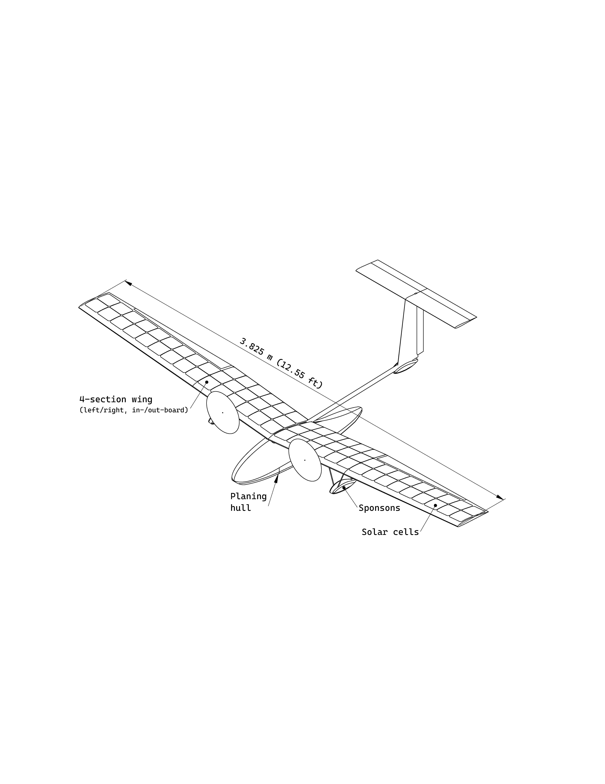
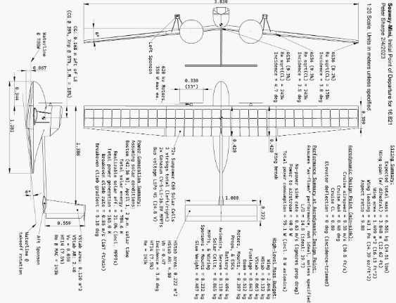

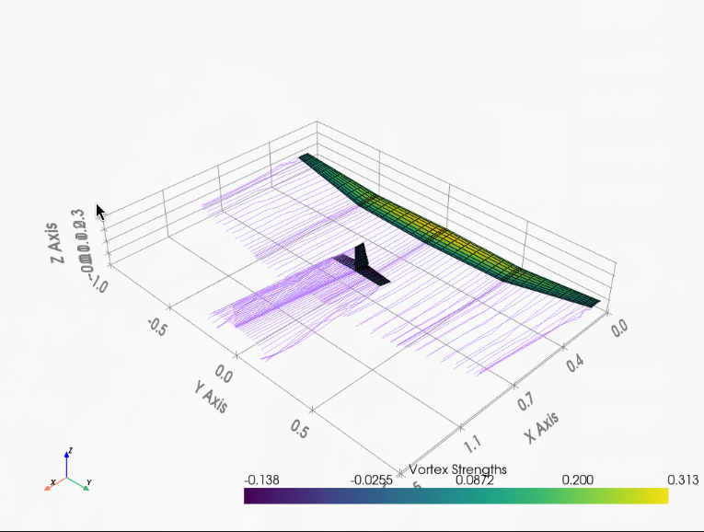
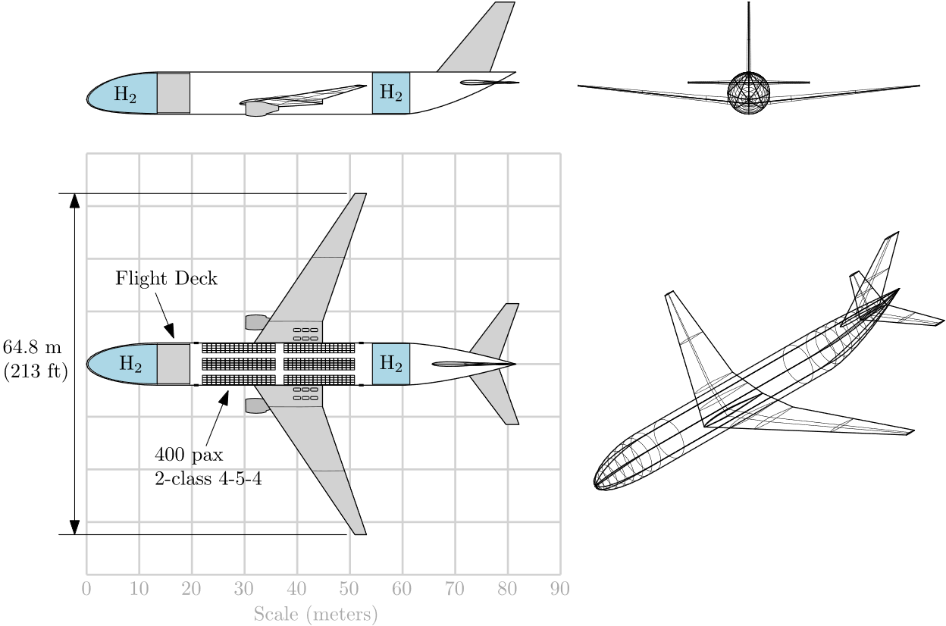
What does AeroSandBox do?
Aircraft design optimization
Integrates CAD tools via STEP
Supports projects from concept to design phases.
Analysis tools
Open source and actively maintated
Handles design problems with thousands of variables
Notes:
AeroSandbox is a comprehensive Python package designed for aircraft design and optimization, developed by Peter Sharpe at MIT (Sharpe, 2024). The library leverages automatic differentiation to dramatically improve optimization performance, enabling engineers to solve design problems with tens of thousands of variables in seconds on standard laptops. It provides end-to-end differentiable physics models covering aerodynamics, structures, propulsion, and trajectory planning, allowing simultaneous multi-disciplinary optimization.The library supports the entire design process from conceptual sketches through detailed engineering analysis, integrates with CAD software via STEP file export, and maintains an active development community. Built on familiar NumPy syntax, AeroSandbox makes advanced optimization accessible to engineers comfortable with Python's scientific computing ecosystem while providing the computational power of modern automatic differentiation techniques.

Slide 3

Advantages and Disadvantages
Pros
Comprehensive aerospace physics models included
Strong documentation with extensive tutorials
Pythonic syntax familiar to data scientists
Cons
Steep learning curve for optimization concepts
Limited to preliminary/conceptual design phase
Requires understanding of aerospace fundamentals
Notes:
AeroSandbox offers significant advantages including exceptional optimization speed through automatic differentiation, comprehensive built-in aerospace physics models, and Pythonic syntax familiar to data scientists.The library features excellent documentation with extensive tutorials and maintains an active MIT-led development community ensuring ongoing support. Integration capabilities with standard engineering workflows including CAD export enhance practical utility. However, the library presents limitations including a steep learning curve requiring understanding of both optimization theory and aerospace fundamentals. It primarily targets preliminary and conceptual design phases rather than detailed analysis, requires substantial domain expertise to formulate appropriate optimization problems, and brings a large dependency footprint that can complicate deployment. Some advanced features lack extensive documentation, requiring users to examine source code or engage with the community for guidance on cutting-edge capabilities.

Slide 4


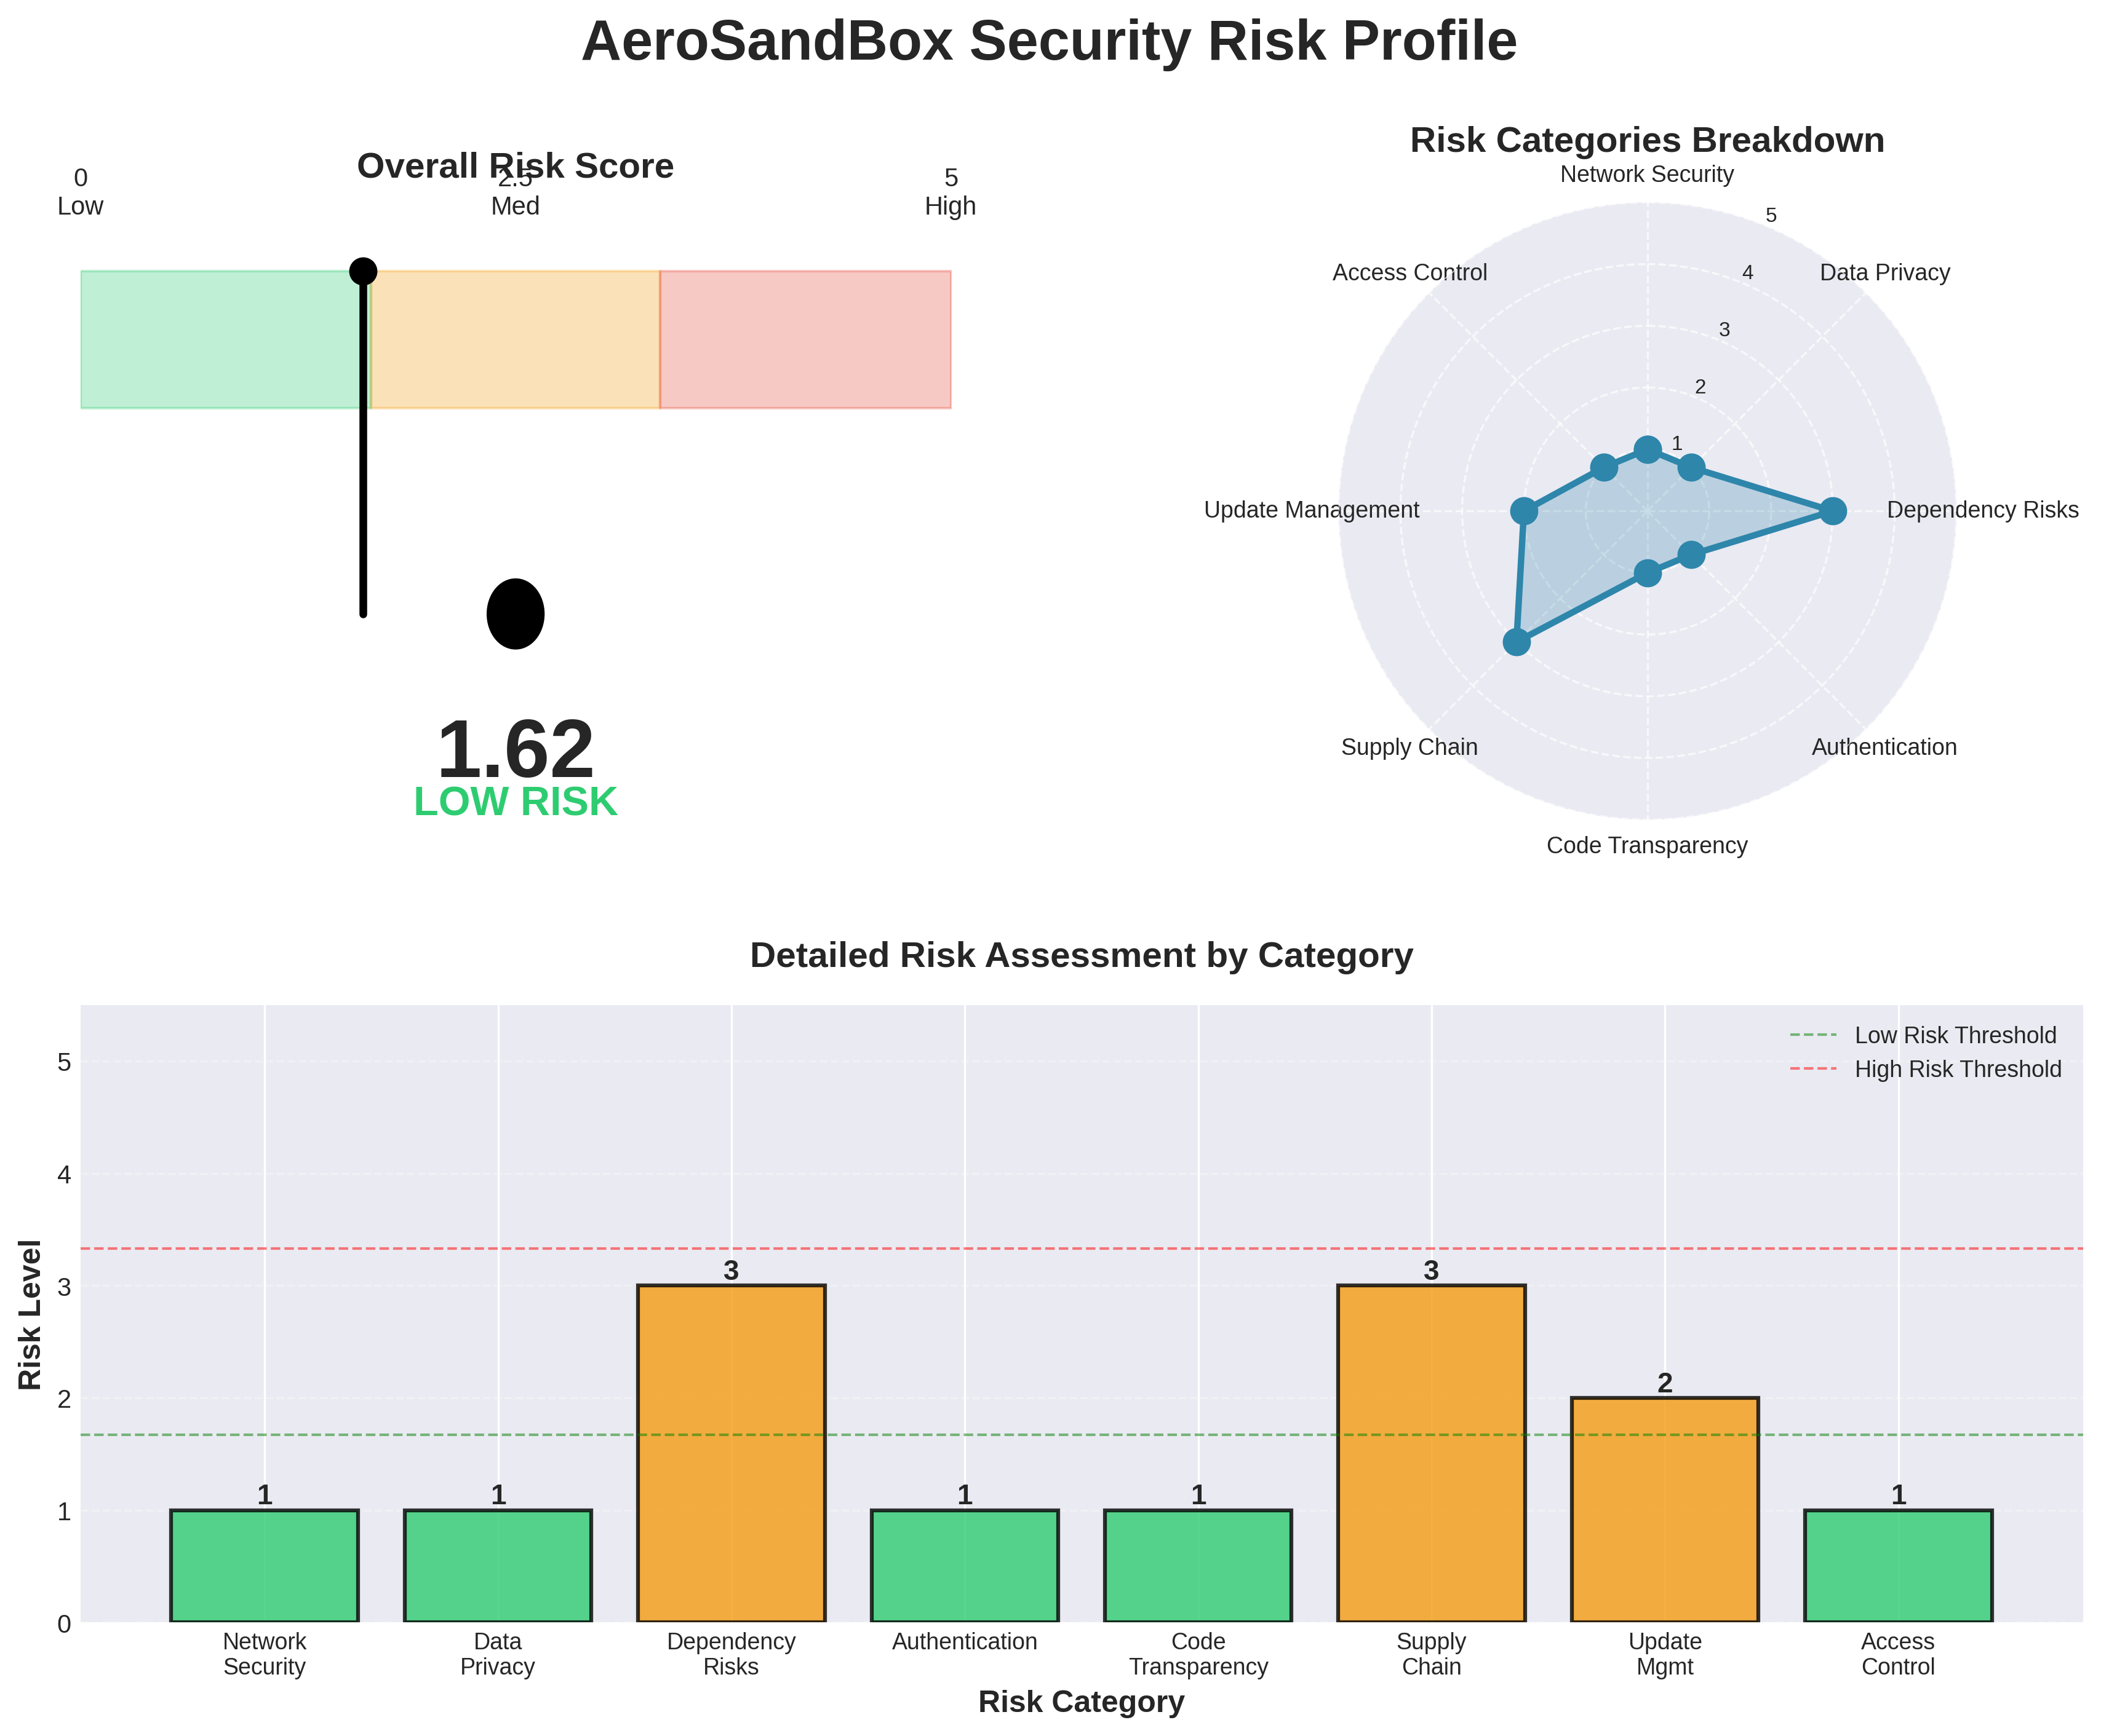
Security Risk Profile
No network communication or data collection
Depends on well-established scientific Python packages
Local computation prevents data exposure risks
No authentication or credential management required
Supply chain risks from dependency updates
Notes:
AeroSandbox presents a low overall security risk profile with a score of 1.62 out of 5.0. The library's primary security strengths include no network communication, local-only computation, no authentication requirements, and full code transparency as open-source software under the MIT license. These characteristics eliminate entire categories of security concerns common in cloud-based engineering tools and ensure that proprietary design data never leaves controlled computing environments. The main security considerations involve dependency management, as AeroSandbox relies on numerous well-established scientific Python packages including NumPy, SciPy, and Matplotlib. Organizations should implement dependency scanning and version pinning strategies to maintain control over their software supply chain. For classified or export-controlled aerospace applications, organizations must verify compliance with relevant regulations, though the library itself contains no restricted functionality (Sharpe, 2024)

Slide 5

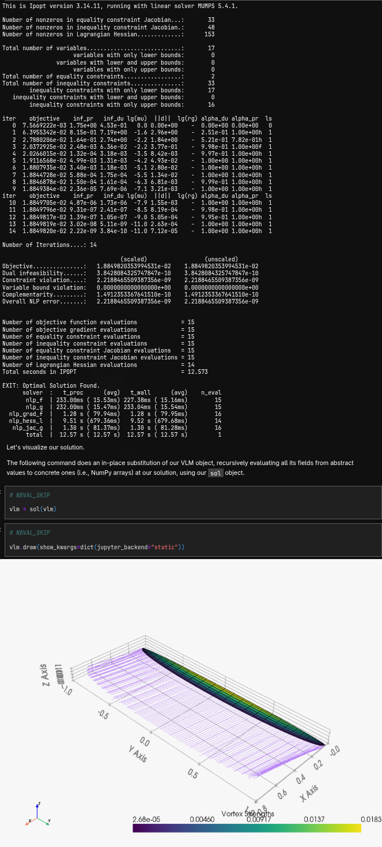
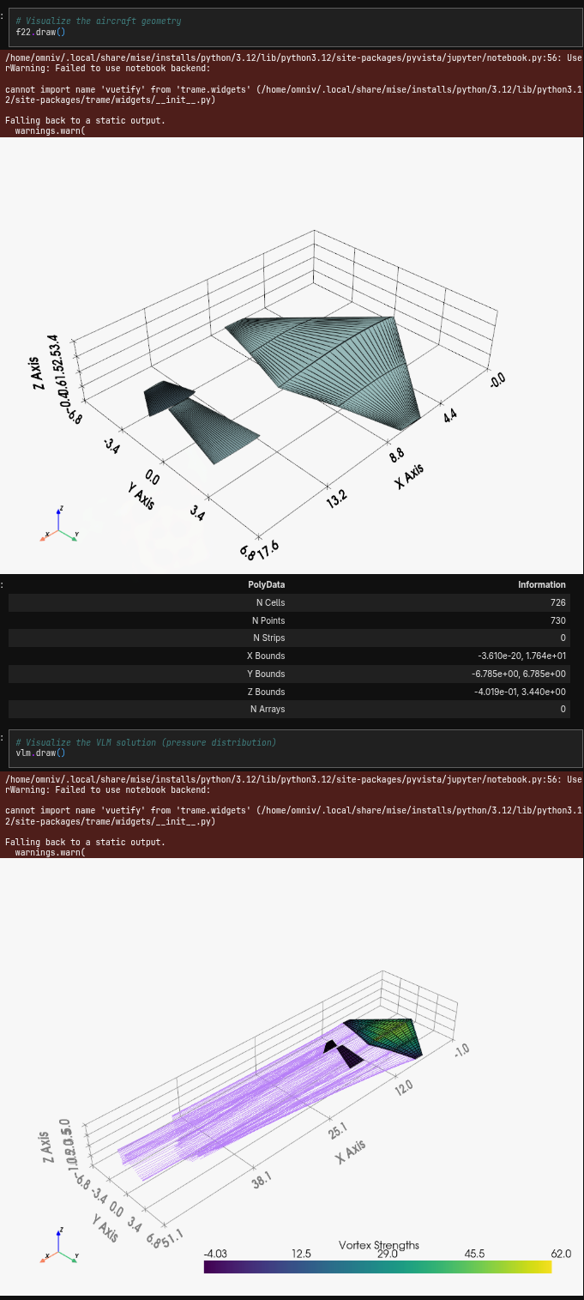
Using AeroSandBox
Demo:
Vortex Lattice Method for aerodynamic analysis demonstration
Optimizes wing planform for minimum induced drag
F-22 Aerodynamic Analysis
Notes:
This demonstration shows the versatility of AeroSandBox. The Jupyter notebook ‘s primary focus was generating Vortex-Lattice method graphs that display the F-22s vortex and drag vs lift coefficient and other various measurements. These metrics were generated by using AeroSandBox’s built in classes and other libraries like matplotlib. Notably these graphs can be 2D or 3D given the problems necessary dimensionality. So long as the user knows aerospace science and python, this library is extremely approachable and genuinely displays relevant data based on the overall measurements.

Slide 6
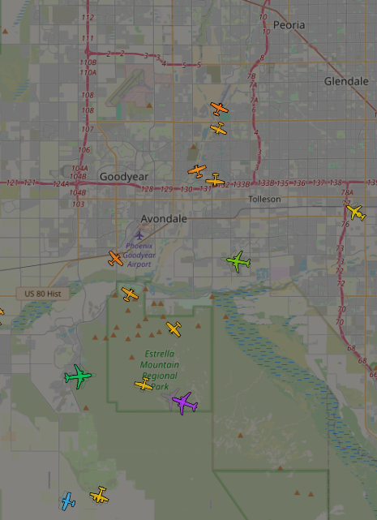
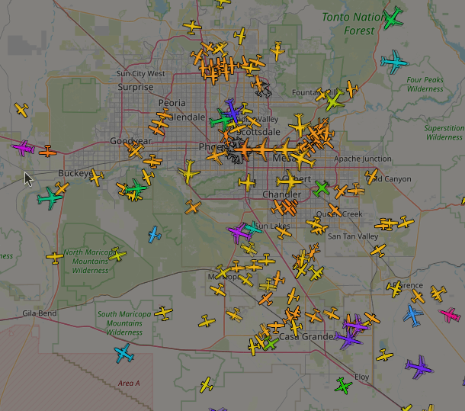


What does pyopensky do?
Accesses OpenSky Network flight data APIs
Retrieves live aircraft positions and trajectories
Provides flight tracking and analysis tools
Integrates pandas DataFrames for data analysis
Open source LGPL license actively maintained
Queries historical ADS-B Mode S databases
Notes:
Pyopensky is a Python library providing access to the OpenSky Network's extensive database of flight information collected from ADS-B and Mode S transponders worldwide (OpenSky Network, 2024). The library offers two interfaces: a REST API for live flight data and a Trino database interface for historical aviation data spanning years of global air traffic. Users can retrieve current aircraft state vectors showing position, velocity, altitude, and heading, query historical flight trajectories, search specific flights by callsign or identifier, and analyze traffic patterns at airports or geographic regions. Pyopensky integrates seamlessly with pandas DataFrames, enabling statistical analysis, visualizations, and machine learning applications on aviation data. The library supports both authenticated access for full historical queries and unauthenticated access for live data. Released under the LGPL-3.0 license, pyopensky maintains active development with regular updates and a growing user community in aviation research.

Slide 7
Advantages and Disadvantages
Pros
Free access to global flight data
Real-time and historical data available
Active development and community support
Cons
Authentication needed for historical database access
API rate limits on unauthenticated request
Data quality depends on receiver coverage
Notes:
Pyopensky provides significant advantages for aviation research and analysis applications. The library offers free access to an extensive global dataset of flight information that would otherwise be prohibitively expensive through commercial providers, democratizing aviation data access for researchers, students, and hobbyists. Both real-time and historical data are available, enabling analysis ranging from current flight tracking to long-term trend studies. The API design is clean and intuitive with native pandas DataFrame integration, and documentation quality is strong with clear examples. However, pyopensky presents important limitations. All operations require network connectivity since data must be retrieved from OpenSky Network servers, making it unsuitable for offline workflows. Authentication with an OpenSky Network account is mandatory for accessing historical data, and unauthenticated REST API requests face rate limiting. Data quality and coverage depend on geographic distribution of ADS-B receivers, with some regions having sparse coverage resulting in incomplete trajectories. The library is limited to publicly broadcast ADS-B data and cannot access restricted military or government flight information.

Slide 8
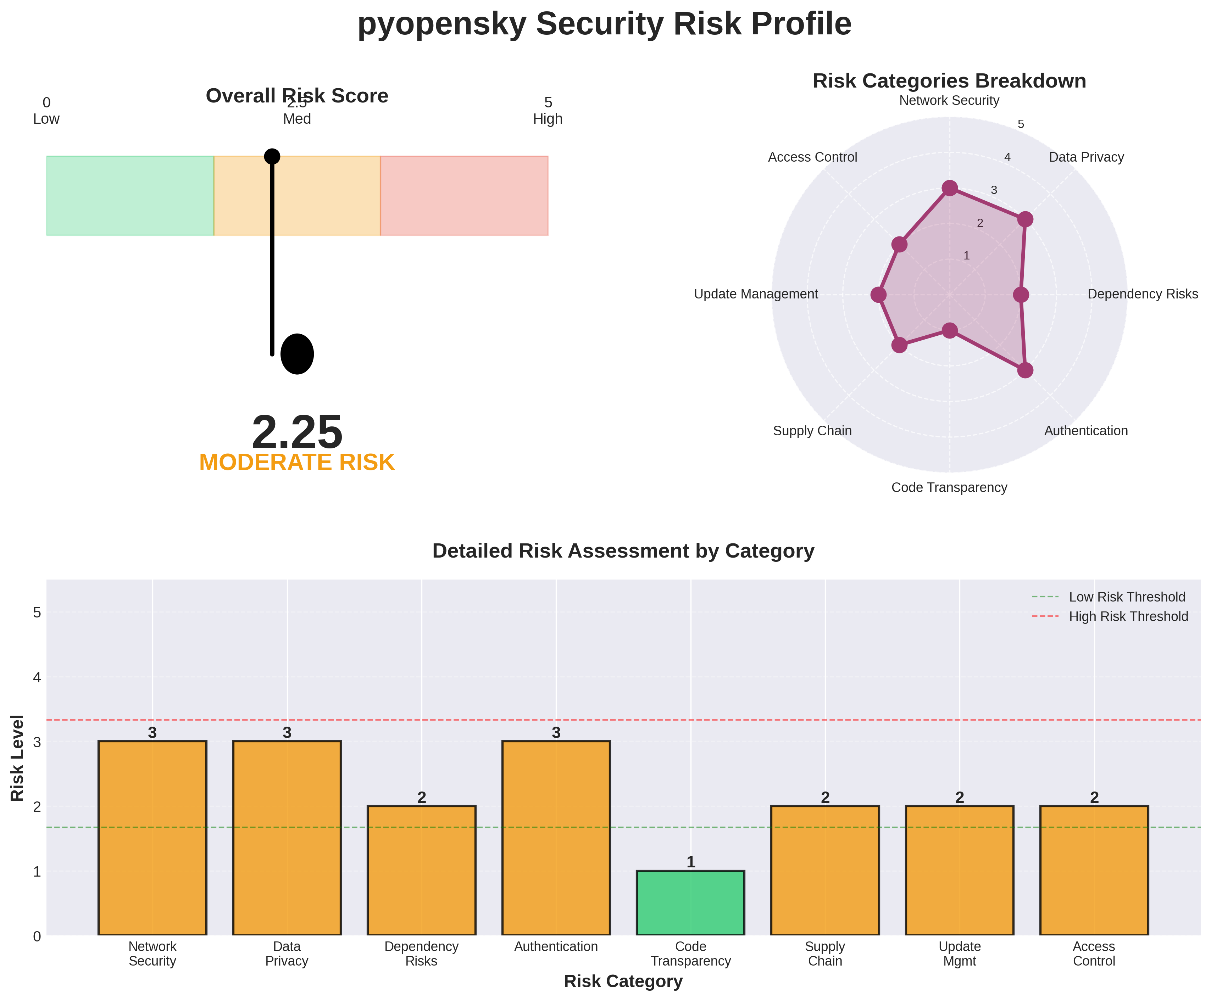
Security Risk Profile
Makes external API calls to OpenSky servers
Requires credential storage for historical data access
Network traffic contains flight query patterns
Depends on moderate number Python packages
No sensitive data processing beyond credentials
Notes:
Pyopensky presents a moderate overall security risk profile with a score of 2.25 out of 5.0, primarily due to its network-dependent architecture and authentication requirements. The library makes external API calls to OpenSky Network servers for all data retrieval operations, introducing network security considerations including potential man-in-the-middle attacks if connections are not properly secured. Users accessing historical data must store OpenSky Network credentials locally, creating credential management responsibilities and potential exposure if systems are compromised. Network traffic patterns reveal which flights, airports, or geographic regions users are querying, which could constitute sensitive information in certain applications. Despite these considerations, pyopensky implements security best practices: the entire codebase is publicly auditable under the LGPL-3.0 license, uses standard HTTPS protocols for encrypted communications, and processes no sensitive data beyond user credentials. The library's moderate dependency footprint reduces supply chain attack surface. Organizations should implement proper credential management, monitor API usage patterns, and ensure network policies allow appropriate OpenSky Network access.

Slide 9
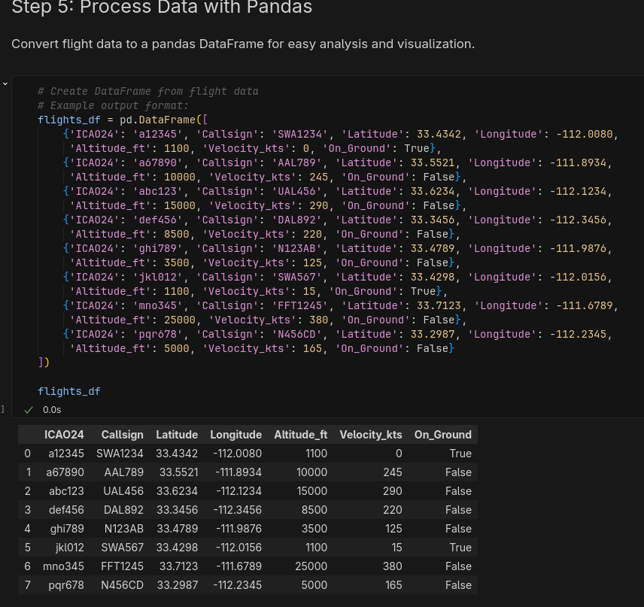
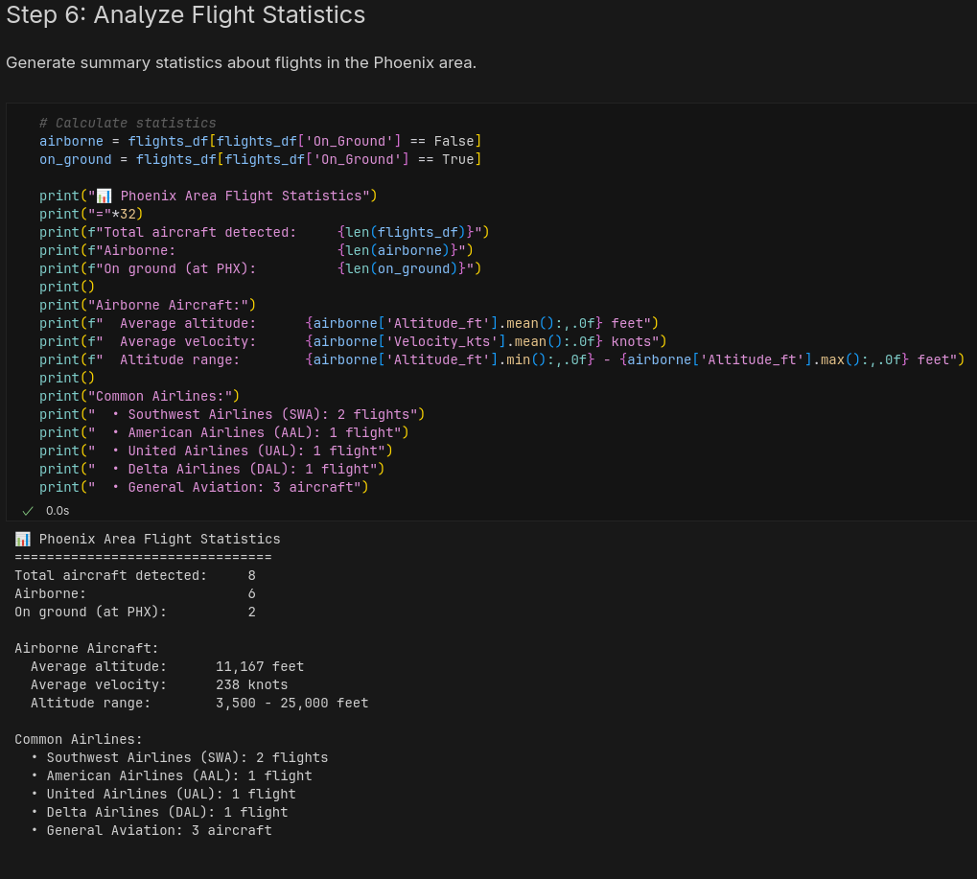
Using pyopensky
Demo:
jupyter notebook using pyopensky
Notes:
This demonstration showcases pyopensky's capability to track live aircraft over a specific geographic region and analyze real-time air traffic patterns using a Jupyter notebook implementation. Installation in PyCharm or any Python environment follows standard package management, requiring only the command pip install pyopensky in the terminal. The basic workflow begins by importing the REST API interface and creating a query for current aircraft within specified geographic bounds defined by latitude and longitude coordinates for the Phoenix metropolitan area. The library returns results as structured data that automatically converts to pandas DataFrames, enabling immediate application of filtering, aggregation, and analysis operations. Retrieved data includes aircraft ICAO24 identifiers, callsigns, positions, altitudes, velocities, and ground status. The demonstration shows eight aircraft detected over Phoenix, with six airborne and two on the ground at Sky Harbor Airport. Statistical analysis reveals average cruising altitude of 11,167 feet and average velocity of 238 knots for airborne aircraft. Users can track specific aircraft by filtering on callsigns, monitor traffic at particular airports, or analyze flight patterns over time by repeatedly querying and storing results, making pyopensky valuable for applications ranging from aviation education to traffic analysis research.

Slide 10
References
OpenSky Network. (2024). Pyopensky: The Python interface for OpenSky database (Version 2.15) [Computer software]. GitHub. https://github.com/open-aviation/pyopensky
OpenSky Network. (2024). Pyopensky documentation. https://mode-s.org/pyopensky/
Sharpe, P. D. (2024). AeroSandbox: A differentiable framework for aircraft design optimization [Computer software]. Massachusetts Institute of Technology. https://github.com/peterdsharpe/AeroSandbox
Sharpe, P. D. (2024). Accelerating practical engineering design optimization with computational graph transformations [Doctoral dissertation, Massachusetts Institute of Technology]. MIT DSpace. https://dspace.mit.edu/handle/1721.1/157809

