Slide 1

CST-391 JavaScript Web Application Development
Notes

Slide 2
Halo Check

Slide 3
Node Package Manger
npm install:
When you run npm install, it installs all modules listed in your package.json file and their dependencies.
It ensures that your project has the correct set of dependencies specified in your configuration.
If a module is already installed, npm install will not update it unless there’s a mismatch (e.g., a missing module or a different version specified in package.json).
npm update:
When you run npm update, it updates all packages in the node_modules directory and their dependencies.
It respects semantic versioning (SemVer) rules, meaning it updates to the latest version specified by the package’s tag configuration (e.g., ^, ~, or exact version).
Additionally, npm update also installs any missing packages.

Slide 4
Semantic Versioning
Details
https://semver.org/
The JavaScript ecosystem has widely adopted Semantic Versioning (SemVer) as the standard versioning scheme for JavaScript packages.
Semver is not universally used, unfortunately.
Summary of Semantic Versioning
Used in Node.JS
package.json
Given a version number MAJOR.MINOR.PATCH, increment the:
MAJOR version when you make incompatible API changes
MINOR version when you add functionality in a backward-compatible manner
PATCH version when you make backward-compatible bug fixes
0.y.z
Major version == 0, the API is under initial development

Slide 5
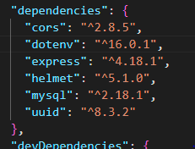
package.json the meaning of ^ and ~
^ - allow updates on the minor version
~ - allow updates on the patch version
Problem
Developers and the Build machine can have different minor versions of the dependencies.
Developers should run npm update whenever pulling a new version from source control.

Slide 6
Importance of updating dependencies
Latest Features
Latest Architecture
Bug Fixes
Security Fixes
The core of your application is in the dependencies
This common core is a hacker target.

Slide 7
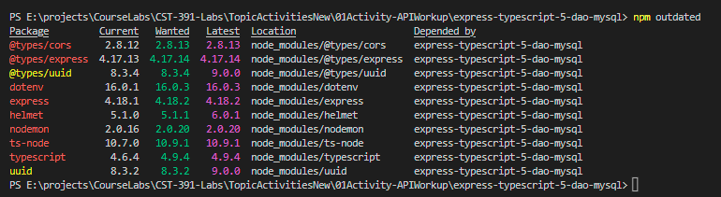
Updating installed dependencies
Build a list of outdated dependencies
npm outdated

Slide 8

Updating installed dependencies
Build a list of outdated dependencies
npm outdated
Followed by a manual update of package.json based on this report
‘wanted’ is the version as specified in package.json, following the rules of semantic versioning.
Install updates to all dependencies
npm update
Will update to the latest allowed level
If we specify '^' all packages update, but not to major releases (shown)
What is the behavior if we specify "~'?
dotenv, for example
With no decorator?
The exact version
You must specify major release versions in package.json, npm has no setting to automatically update to a major version
The previous screen is before 'npm updates'
This shows after 'npm updates':

Slide 9
Automated Updates to package.json using ncu
npm-check-updates
Abbreviation ncu
Which requires a package install;
npm install –g npm-check-updates
You may need to run as an admin
Set-ExecutionPolicy -ExecutionPolicy RemoteSigned
Using ncu
npm outdated
ncu
Study proposed updates to package.json
This is the same information as package.json.
ncu –u
Directly updates package.json with the latest stable releases
npm update
Follows package.json and updates dependencies to the latest level.
Source: https://www.freecodecamp.org/news/how-to-update-npm-dependencies/

Slide 10
Understanding package-lock.json
The package-lock.json file is automatically generated by npm.
It records the exact versions of all installed dependencies (including transitive dependencies) during the initial installation.
It ensures reproducibility by locking down the dependency tree.
npm uses it to recreate the same dependency tree when others install the project.
When running npm update, package-lock.json will be updated to reflect the exact versions now installed

Slide 11
Use of package-lock.json
Install dependencies based solely on the package-lock.json
npm ci
command stands for “clean install”.
It is specifically designed for reproducible builds
It removes the existing node_modules directory.
Installs the exact dependencies specified in package-lock.json
Use Cases for npm ci:
QA and Production Deployments:
Ensures consistent installations.
Developer builds
Rare, but its possible when you want all your developers on the same version and the same version as QA/Production.

Slide 12
Participation lab Package Management
Prepare a Package Management Report
Using the demo-wait cursor lab
git clone https://github.com/ru-sparks/demo-wait.git
Run
npm install
Run
npm outdated
Captioned Screenshot
Using this report describe what would happen on npm install (Hint: use ‘wanted’)
Run
ncu –u
Captioned Screenshot
Describe what has happened to package.json
Instructions for installing ncu are found on Slide 9
Run
npm outdated
Captioned Screenshot
Describe why the report is different
Run
npm update
Captioned Screenshot
Describe what has happened to your install.
Run
npm outdated
Captioned Screenshot
Describe why the report is different

Slide 13

Lab Time

