Slide 1
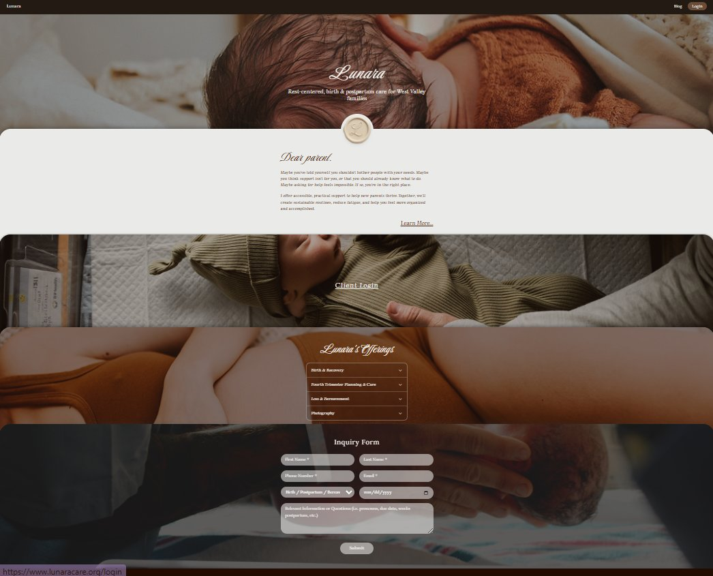
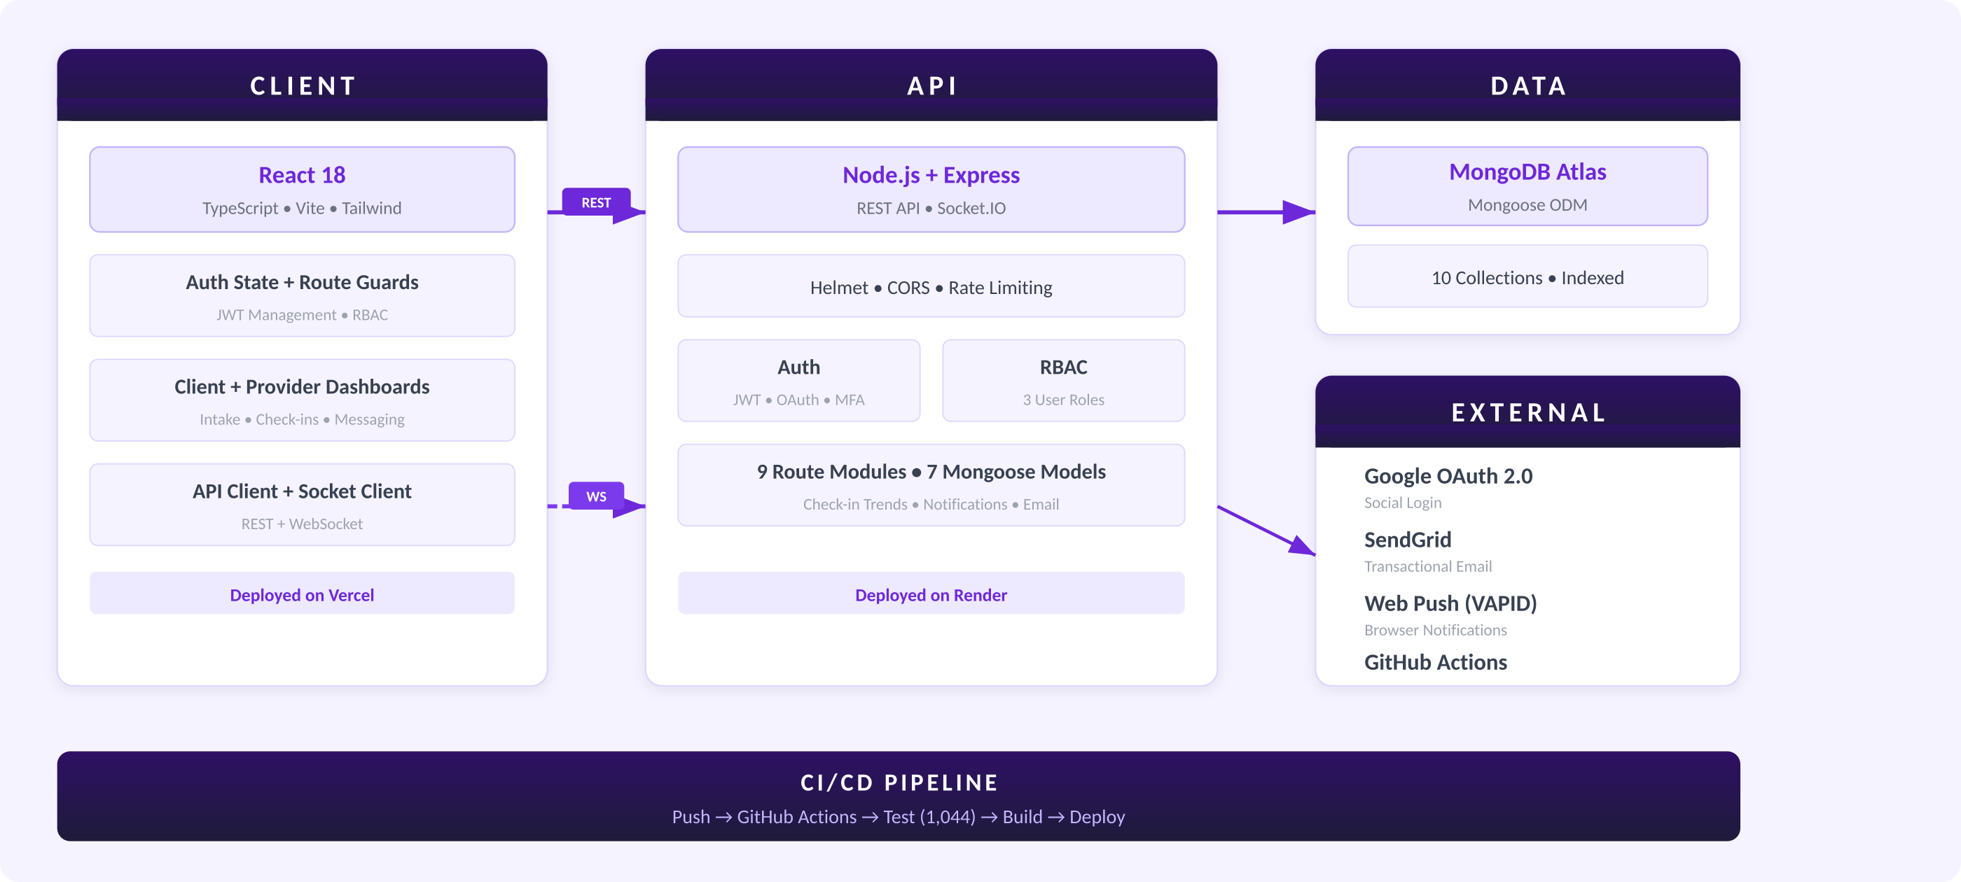
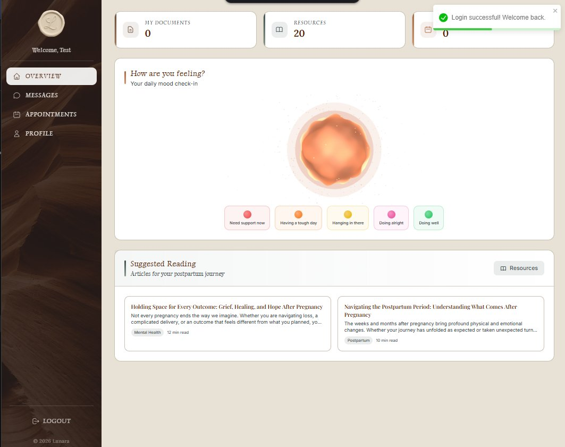
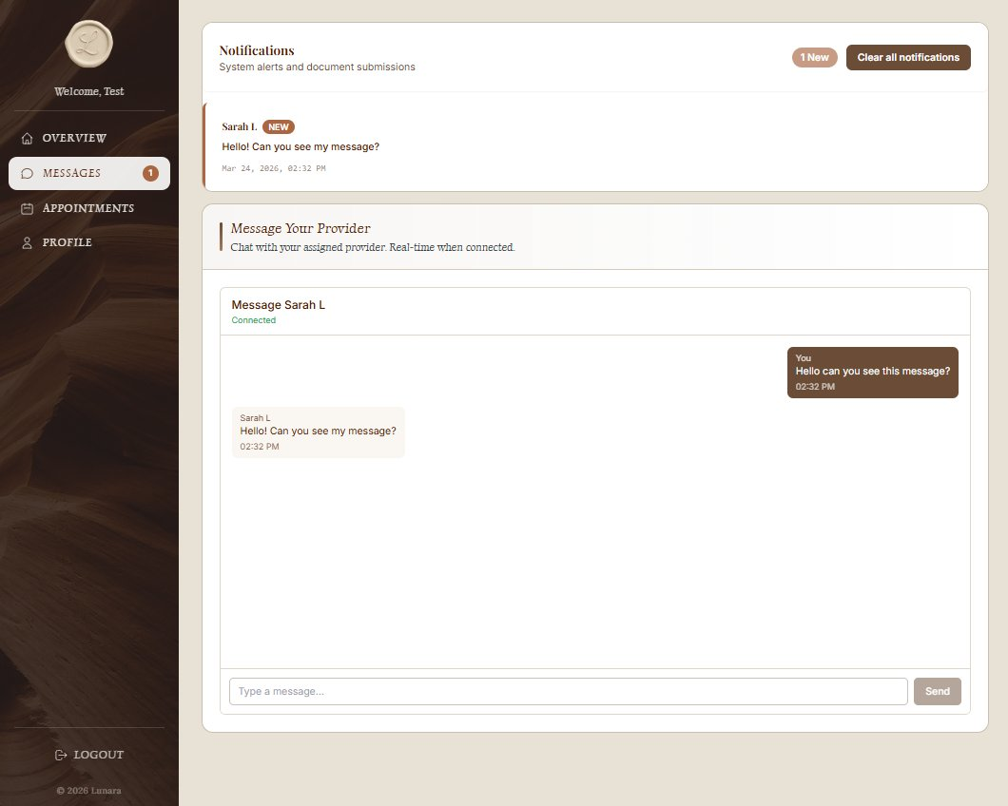
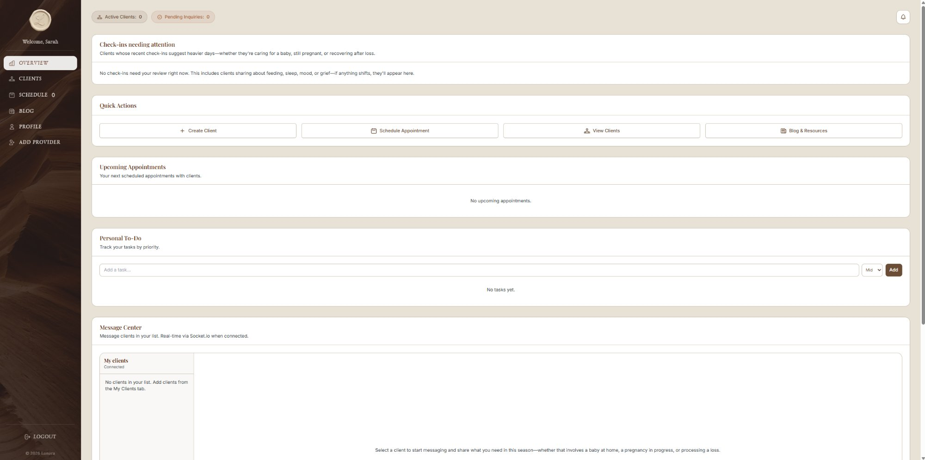


LUNARA
A Postpartum Support Platform
Owen Lindsey | Carter Wright | Andrew Mack
Grand Canyon University • College of Engineering & Technology • CST-452 Senior Capstone
lunaracare.org
PROJECT DESCRIPTION & JUSTIFICATION
FUNCTIONAL REQUIREMENTS & STANDARDS
DATA SUMMARY: TESTING & QUALITY
Project Description
LUNARA is a full-stack web application that connects postpartum mothers with certified doula providers through a unified digital platform. The system delivers structured intake assessments, daily mood and symptom check-ins with clinical alert detection, real-time messaging, appointment scheduling, personalized care plans with milestone tracking, and a curated educational resource library. Role-based access control separates the experience for Clients, Providers, and Administrators.
Project Justification
Approximately 1 in 5 mothers experience a perinatal mood or anxiety disorder, yet fewer than 15% receive adequate treatment (Maternal Mental Health Leadership Alliance, 2023). The postpartum period presents compounding barriers to care: physical recovery, sleep deprivation, and fragmented provider communication. Doula support has been shown to improve maternal outcomes, but the process of finding, vetting, and coordinating with doulas remains largely offline and inaccessible.
LUNARA addresses this gap by centralizing the entire postpartum care workflow into a single platform. Rather than navigating disconnected tools for scheduling, messaging, and health tracking, mothers and providers interact through an integrated system designed specifically for the fourth trimester. The clinical alert system—which flags declining mood trends to providers automatically—directly targets the early detection gap that contributes to untreated postpartum depression.
The platform was developed against 15 functional requirements defined in the CST-451 Requirements Document. Eleven were delivered in full across three iterations; four were formally deferred to post-launch.
1,044
100%
118
ID | Requirement | Status
FR1 | Public website with inquiry form | ✓
FR2 | Authentication & registration (JWT, OAuth, MFA) | ✓
FR3 | Client & provider dashboards | ✓
FR4 | Dynamic five-step intake forms | ✓
FR5 | Real-time messaging (Socket.IO) | ✓
FR6 | Appointment scheduling & reminders | ✓
FR7 | Educational resource library | ✓
FR8 | Daily check-ins with clinical alerts | ✓
FR9 | Provider client management | ✓
FR10 | Care plan system with milestones | ✓
FR11 | Blog platform with draft/publish | ✓
FR12 | Digital journaling | Deferred
FR13 | Daily insights | Deferred
FR14 | Sleep & feeding trackers | Deferred
FR15 | AI-powered note summarization | Deferred
Automated
Tests
Pass
Rate
Test
Suites
90.58%
63.35%
Backend Statement
Coverage
Frontend Statement
Coverage
Test Category | Suites | Tests
Backend Unit | 5 | 96
Backend Integration | 7 | 57
Backend Services | 8 | 57
Frontend Components | 98 | 715
E2E (Playwright) | — | 32
Manual Test Cases | — | 20
Zero open defects at submission. Full suite executes in 25.6 seconds. CI/CD pipeline enforces all quality gates on every push.
Standards: OWASP Top 10 security compliance, WCAG 2.1 AA accessibility, RESTful API design, Agile sprint-based delivery.
DESIGN PROCESS
PROJECT SCOPE & COMPLETION
Development followed an iterative sprint-based process across three coding milestones. Each iteration cycle moved through a consistent pattern: define a scoped story objective, implement the backend route and service layer, build the frontend consumption layer and UI, integrate and validate in the running environment, and refine based on testability and usability constraints.
Planning and task tracking were managed through GitHub Project Boards. All code changes went through a pull request workflow with peer review before merging. A GitHub Actions CI/CD pipeline ran the full automated test suite on every push, enforcing quality gates before deployment. The backend deployed to Render and the frontend to Vercel, with MongoDB Atlas as the managed database layer.
The requirements document defined 15 functional requirements. Across three development iterations, the team delivered 11 of 15 in full, reaching 73% overall project completion. The four deferred features (journaling, insights, trackers, AI summarization) were formally descoped after discussion with the instructor when core requirements consumed more integration effort than initially estimated. The modular architecture positions all deferred items for post-launch implementation without architectural changes.
FUTURE WORK
SYSTEM ARCHITECTURE
Near-term priorities include beta user recruitment to validate clinical workflows with real doula–client pairs and payment processing integration. Longer-term goals include a Progressive Web App for mobile access, AI-powered session note summarization, and the sleep and feeding tracker modules.
Landing Page — Public-Facing Website (FR1)
Client Dashboard — Check-In & Resource Access (FR3, FR8)
Real-Time Messaging — Client–Provider Chat (FR5)
VISIT THE SITE
Provider Dashboard — Client Management (FR9)
github.com/omniV1/AQC
Scan to explore the live platform
Source Code Repository
lunaracare.org
Owen Lindsey Full-Stack Developer
Carter Wright Full-Stack Developer
Andrew Mack Full-Stack Developer
Advisor: Professor Amr Elchouemi
CST-452: Senior Capstone Project II

