Slide 1
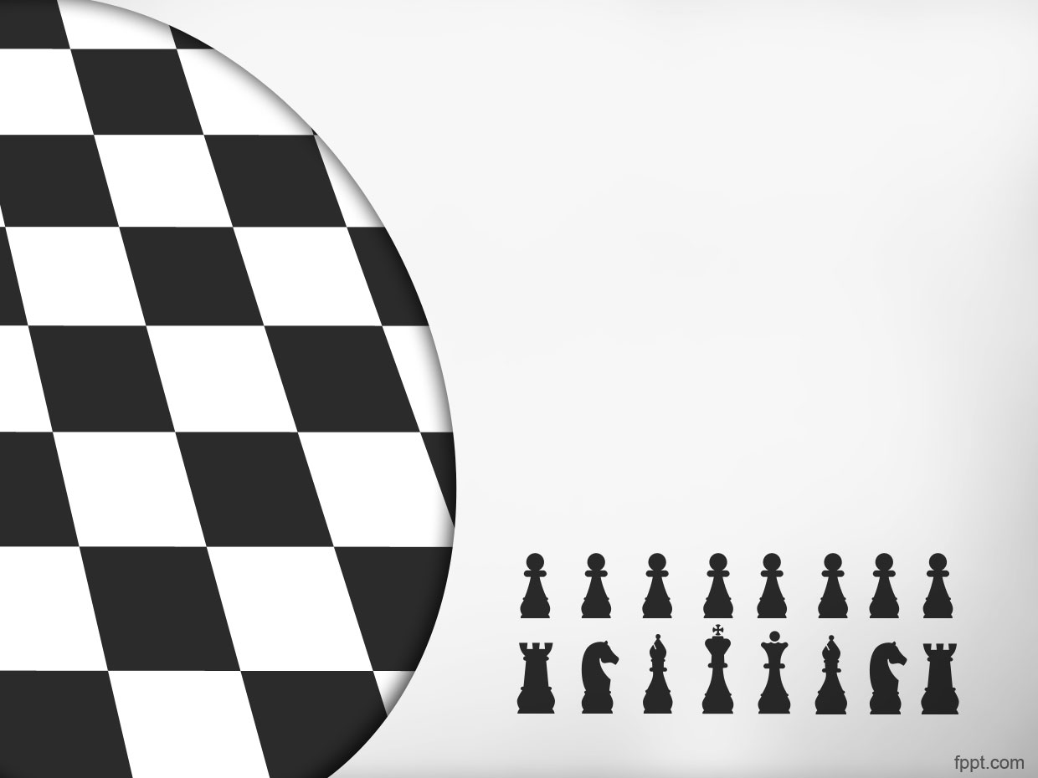
Intelligent Chess Player

Slide 2

Pray for Palestine

Slide 3
Ziad Hany Wadea 20210380
Ahmed Harmas Mostafa 20210125
Mohammad Mahmoud Hanafi 20210827
Omnia Ibrahim Sayed 20210180
Zineb Yasser Mohammed 20210389
Huda Ismail Ibrahim 20211030
Mariam Mahmoud Mustafa 20210927

Slide 4
Journey through Chess history #
Chess, a timeless and strategic game, has captivated minds for centuries. Originating in India, it has evolved into a global pursuit, challenging players to engage in a battle of wits on the 64 squares of the checkered board.

Slide 5
Journey through Chess history ##
It has evolved through diverse cultures and civilizations. Its roots can be traced to the ancient game of Tauranga, a precursor that symbolized the four divisions of the military – infantry, cavalry, elephants, and chariots.

Slide 6
General Rules: #
The ultimate goal of chess is to checkmate your opponent's king, placing it in a position where it cannot escape capture.

Slide 7
General Rules: ##
Each piece has specific moves. Pawns advance, bishops diagonal, knights jump, rooks traverse horizontally or vertically, queens combine these movements, and kings cautiously move one square at a time.
Chess can be a leisurely pastime or a race against the clock. Time controls, from classical to rapid, add an element of urgency and decision-making pressure.

Slide 8
Introducing our chess player: #
In a world where technology meets strategy, We've developed something cool
—The Intelligent Chess Player.
This AI-powered chess whiz goes beyond our expectations.
“We designed it in the context of our AI course”

Slide 9
Introducing our chess player: ##
There is lots of different platforms and games that provide online and intelligent chess game
We made a chess game using different algorithms:
. depth-first search
. alpha-beta pruning
. min-max

Slide 10
Leave you with our Intelligent Chess Player
Here is the chess player let’s dive in~
I was implemented using two heuristics
-Intelligent Decision making Heuristic
-Positioning Heuristic

Slide 11
“Intelligent Decision making”
Driven by a keen understanding of piece values. Each chess piece is assigned a score, creating a dynamic framework for strategic maneuvers.
Prioritizing high-value pieces gives the ability to capture formidable opponents, strategically enhancing its position.
Avoid exchanging a high-value piece for one that has less score without good positioning and weird moves if there were no good captures ahead and no need to defend itself.

Slide 12
“Positioning Heuristic”
we've introduced a sophisticated positioning heuristic.
Here, each piece is assigned a position array, optimizing its location for strategic advantage. For instance, knights favor the center, reflected in their lower scores towards the borders, preventing unnecessary cornering.

Slide 13
Chess Player:
I’ve walked you through the general strategies and decision-making processes I employ, guided by heuristics.
I navigate the chessboard. Through a method known as depth-first exploration, I meticulously analyze potential moves, unraveling the consequences of several moves ahead. It's akin to peering down a labyrinth of possibilities, seeking the most advantageous route toward triumph.

Slide 14
“Impact of Depth-first”
Now let’s go through the Depth-first search:
Depth-first exploration allows me to analyze potential moves in exquisite detail, envisioning the consequences several moves ahead. This depth of analysis is the bedrock of my strategic approach, enabling me to traverse the complex branches of the game tree and uncover hidden tactics.

Slide 15
“cons of Depth-first”
Depth-first exploration comes with its considerations. While it excels in meticulous analysis, it may occasionally overlook promising moves in unexplored branches.
The risk lies in potentially missing out on unexpected opportunities, as the exploration is committed to thoroughly investigating a particular path before backtracking.

Slide 16
“pros of Depth-first”
Yet depth-first exploration remains an indispensable tool. Its advantages in thorough analysis often outweigh the drawbacks, shaping my decision-making and contributing to the overall finesse of my gameplay.
As we journey through the complexities of chess, keep in mind that every move is a calculated step, and depth-first exploration is my guide through the intricate dance of strategy and tactics.

Slide 17
Chess Player:
So, you know how we were doing this depth-first search thing – exploring one path until we hit a dead-end or found a solution? Good times. But then I thought, "What if we could be even smarter?"
In chess, it's not just about the current move. We need to peek into the future, see how different moves play out. Enter Minimax – our strategy to think not just one move ahead, but many moves ahead.

Slide 18
“mini-max”
Minimax is like our chess buddy who helps us make smart moves. It's all about picking moves that minimize the worst-case scenario while maximizing our potential gains.
our opponent isn't just making random moves. With Minimax, I can think ahead, considering different move sequences and figuring out what happens next.

Slide 19
“mini-max”
Chess is crazy complex, right? Minimax simplifies things by narrowing down the options. It's like saying, "Hey, focus on these moves; they're the real game-changers.“
Minimax grades each board position, telling us how good or bad it is. It looks at things like where our pieces are, how much of the board we control, and what threats we're throwing at the opponent.

Slide 20
Chess Player:
“Maximizing the Good, Minimizing the Bad”, my team goal so..
Each move gets a score, and we pick the one with the best outlook. It's not just about the next move; it's about the entire sequence of moves.
Minimax is fantastic, but it can be a bit of a chatterbox, exploring every nook and cranny. Alpha-Beta Pruning steps in to speed things up. It's like telling Minimax, "Hey, focus on what matters, skip the rest."

Slide 21
Chess Player:
The Alpha-Beta algorithm. Imagine it as my refined and strategic tool, a calculated approach to decision-making that complements and elevates my depth-first exploration.
Together, where heuristics lay the foundation, depth-first exploration refines the details, and the Alpha-Beta algorithm orchestrates the symphony of strategic brilliance.

Slide 22
“Impact of alpha-beta”
Allow me to introduce a key player in my strategic ensemble: Alpha-Beta pruning. This ingenious algorithm transforms the way I traverse the possibilities on the chessboard.
Imagine a method that stops evaluating a move the moment it uncovers a possibility worse than a previously examined one—a game-changer in efficiency and precision.

Slide 23
NO. moves
Before After
- 9966 - 643
- 724 - 39
- 35572 - 6034

Slide 24
“Impact of alpha-beta”
Here's the brilliance: it significantly reduces the number of moves I need to evaluate. By intelligently pruning away unpromising branches, it streamlines the decision-making process. Think of it as a sculptor chiseling away the unnecessary, leaving behind a masterpiece of strategic brilliance.

Slide 25
“Cons of alpha-beta”
In certain situations, where move rankings are close, the impact of Alpha-Beta pruning might be less pronounced, revealing a nuanced challenge.
Implementing this requires a careful coding, as any misstep can affect the quality of its pruning performance.
The effectiveness of Alpha-Beta pruning play in harmony with move order; a subtle cadence that influences the quality of its pruning, demanding strategic acumen.

Slide 26
“Pros of alpha-beta”
Alpha-Beta pruning is my efficiency virtuoso, reducing the number of moves I scrutinize, and allowing me to focus on the most promising ones.
By intelligently pruning away less fruitful branches, I refine my strategic precision.
at resource conservation, optimizing computational prowess, and enabling me to delve deeper into the chess tapestry.

Slide 27
“Conclusion of alpha-beta”
Using this algorithm, allows me to peer into the future moves, adeptly assess positions, and strategically choose the path that promises success.
In essence, I navigate the chessboard with a blend of foresight, evaluation, and strategic decision-making.

Slide 28
me after using all of those:
So, from Depth-First Search to Minimax, and now from Minimax to Alpha-Beta Pruning, we're leveling up our chess AI. It's not just about making moves; it's about making the right moves at lightning speed.

Slide 29
Chess Player:
Here my role as The Chess player done, the presentation will continue all the required topics to be discussed

Slide 30
Similar apps in market
Stockfish: An open-source chess engine that is widely regarded for its strength and analysis capabilities. Many chess platforms use Stockfish as their engine.
Komodo: Another powerful chess engine known for its deep analysis and strategic play. It's available for various platforms and is used in both standalone applications and online chess platforms

Slide 31
Similar apps in market
Chess.com: A popular online chess platform that offers a computer opponent for players of all levels. It also includes features like lessons, puzzles, and an interactive community.
Lichess: A free, open-source online chess platform that includes a computer opponent powered by Stockfish. It's known for its clean interface and strong community.

Slide 32
Main functionalities #1
Importing Modules:
import pygame: Imports the Pygame library for building the game.
import engine: Imports a custom module (engine) that seems to handle the game logic.
import Ai: Imports a module for artificial intelligence, presumably for the chess opponent.

Slide 33
#2
Configurations:
WIDTH, HEIGHT: Defines the dimensions of the
game window.
SQUARES_NUMBER: Specifies the number of
squares in each axis.
SQUARE_SIZE: Calculates the size of each
square based on the board dimensions.
IMAGES: An empty dictionary to store
images of chess pieces.

Slide 34
#3
Loading Piece Images:
  get_images(): Loads images of chess
  pieces into the IMAGES dictionary using
  Pygame's transform.scale method.
Drawing Board:
  draw_board(background): Draws the
  chessboard with alternating colors for
  each square.

Slide 35
#4
Drawing Pieces:
  draw_pieces(screen, board_state): Draws
  chess pieces on the board based on
  the current game state.
Drawing Current State:
  draw_current_state(): Calls functions to
  draw the board and pieces based on the
  current game state.

Slide 36
#5
Initialization:
Initializes Pygame and sets up the
game window.
Creates a GameState object from the
engine module.
Retrieves valid moves for the initial state.

Slide 37
Game Loop: #6
Runs the main game loop.
Handles events such as mouse clicks and key presses.
Manages human and AI turns, allowing players to make moves.
Checks for game-over conditions (checkmate or stalemate).
Allows undoing moves with the backspace key.
Updates the display with the current game state.

Slide 38
#7
AI Moves:
  Calls the AI module to find and execute the best move for the AI player.
Display Update:
  Updates the display to reflect the current state of the game.

Slide 39
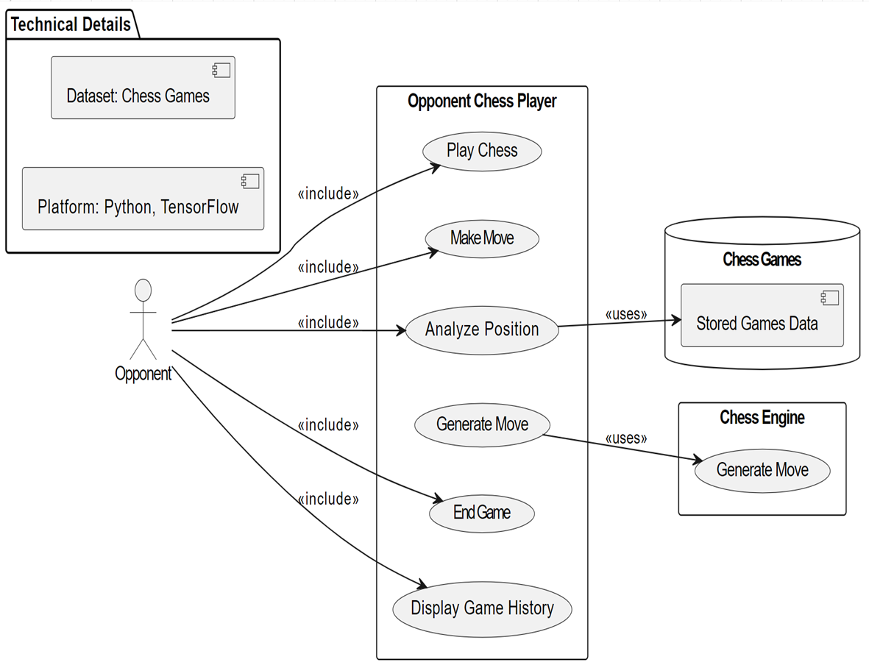
Usecase for the game

Slide 40
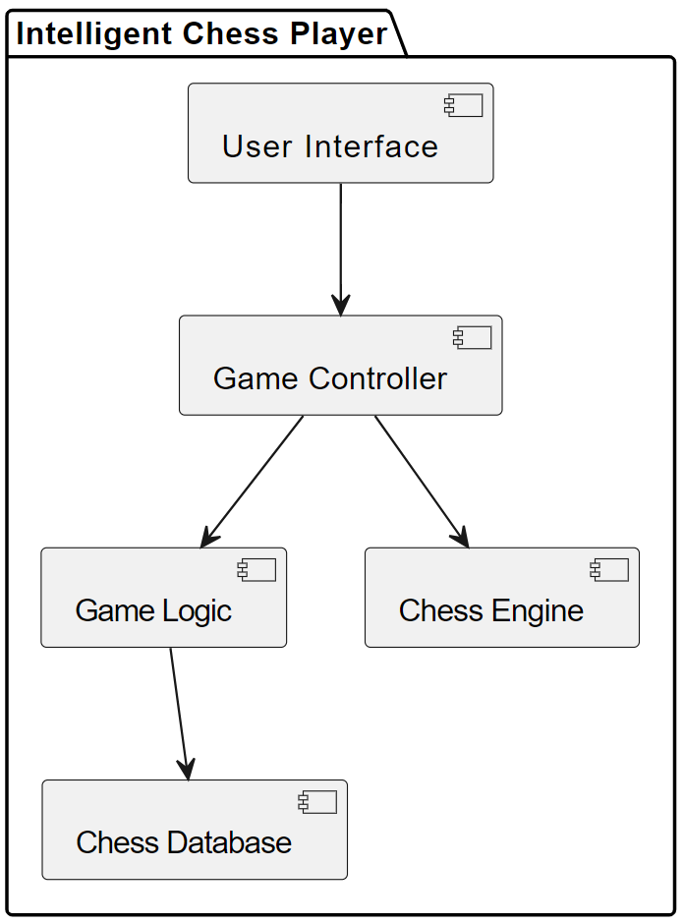
Block diagram

Slide 41
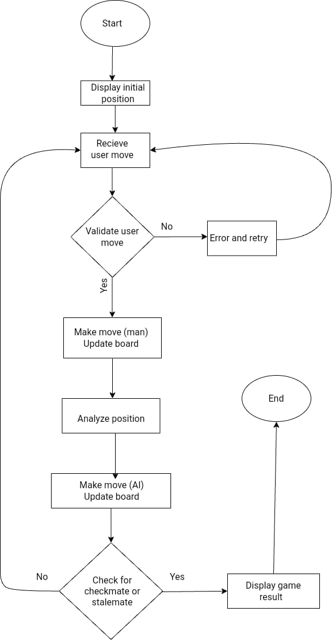
Flowchart

Slide 42
The goal is to convey that the intelligent chess player system, whether controlled by a human or AI, has the capability to analyze the current chess position.

Slide 43
Search papers in this context #
https://www.researchgate.net/publication/49400711_Intelligence_and_chess
https://www.sciencedirect.com/science/article/abs/pii/S0160289606001139
https://www.geocities.ws/chess_camp/study_1.pdf

Slide 44
Search papers in this context ##
https://arxiv.org/pdf/1712.01815v1.pdf
https://www.chesspower.co.nz/chess-research.html

Slide 45
Platform and Dataset
Dataset link: https://www.kaggle.com/datasets/ziadhanywadea/chess-game/data
Development Platform: Visual studio

Slide 46
Pray for Palestine

Slide 47
Thanks

