Slide 1
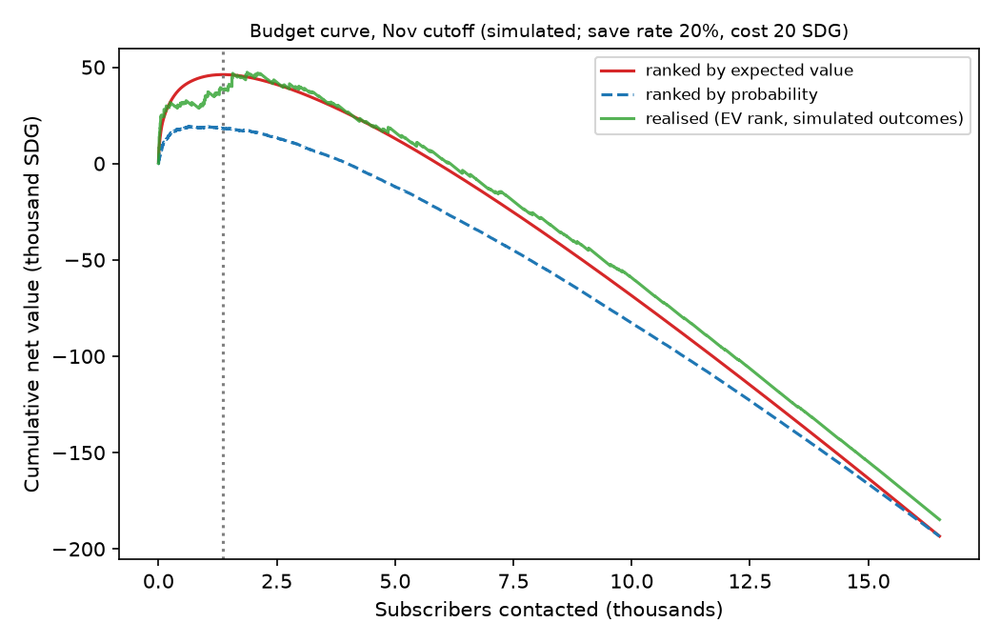
Churn early-warning and retention budget
Should we spend this month's budget on N subscribers, and which ones?
Predict next-month churn, explain it in English and Arabic, and turn scores into a contact decision.
The rule engine explains churn after it happens; this model predicts it before. They are complementary.
Answer: contact about 8.3% of the base, ranked by expected value, and stop where the next contact no longer pays.
20,000 simulated subscribers, hidden churn process, validated out of time and against a known answer key.
Simulated data: demonstrates the method, not real-world performance.

Slide 2
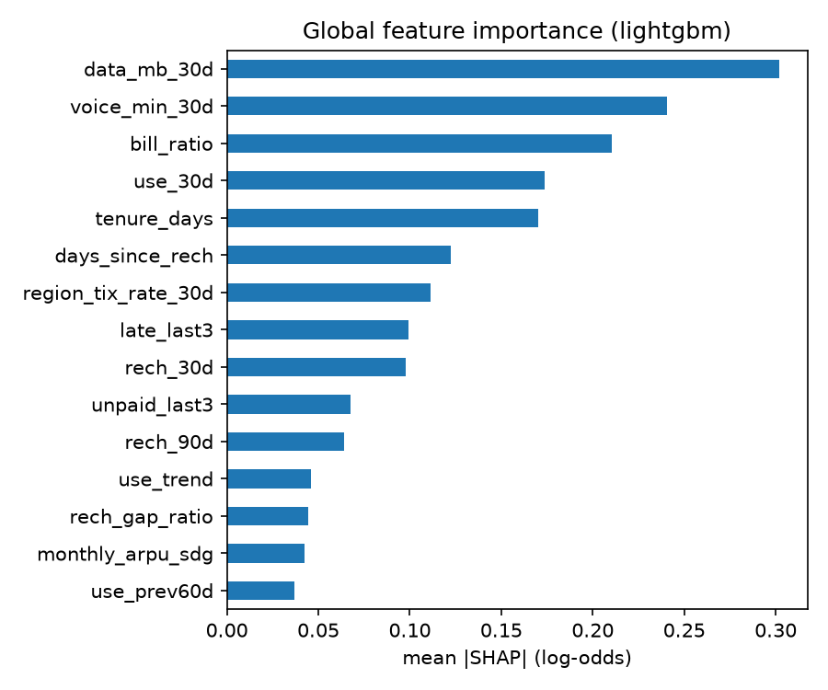
Method: no leakage, out-of-time, checked against truth
Data: hidden dissatisfaction drives usage, recharge, tickets and bills; churn is a random draw from a hazard.
22 as-of features per subscriber per month-end; label = churn in the next month.
Train Mar-Jul, validate Aug, test Sep-Nov (Kassala outage inside the test window).
Logistic vs LightGBM, Platt calibration on pooled out-of-fold scores, 200 customer-level bootstrap resamples.
Excluded: persona, label-anchored fields, gender, age, msisdn; hashed IDs only.
Simulated data: demonstrates the method, not real-world performance.

Slide 3
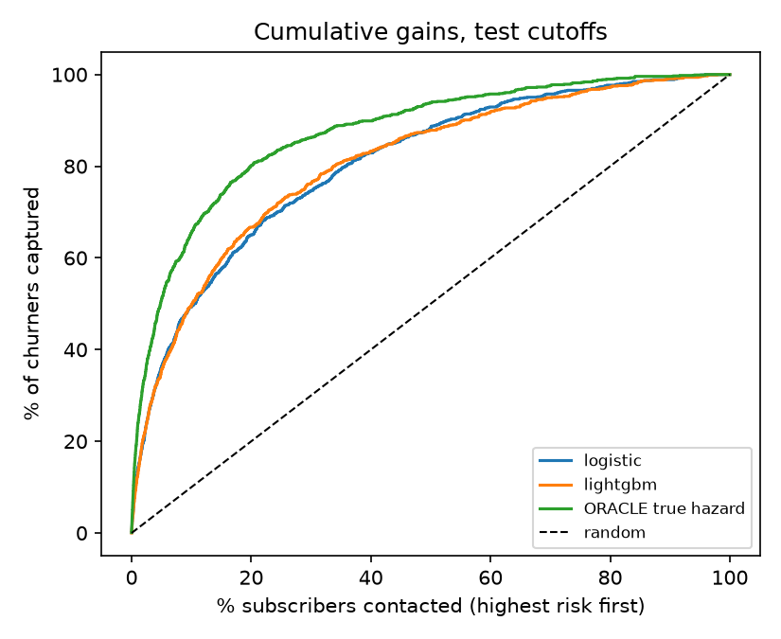
Results: about 5x lift, and we say how far from the ceiling
Model | PR-AUC | ROC-AUC | Top-10% lift
no-skill | 0.019 | 0.500 | 1.00
rule heuristic | 0.054 | 0.629 | 3.38
logistic | 0.134 | 0.812 | 4.93
lightgbm | 0.129 | 0.813 | 4.97
ORACLE true hazard | 0.276 | 0.880 | 6.55
Boosting ties logistic: the planted signal is near-linear (CIs overlap).
Recovers about half of the oracle PR-AUC; Spearman with true hazard 0.70.
SHAP leans on the planted drivers, with the right signs. It shows what the model uses, not causes.
Region is uneven (Kassala over-flagged); age bands are even.
Simulated data: demonstrates the method, not real-world performance.

Slide 4
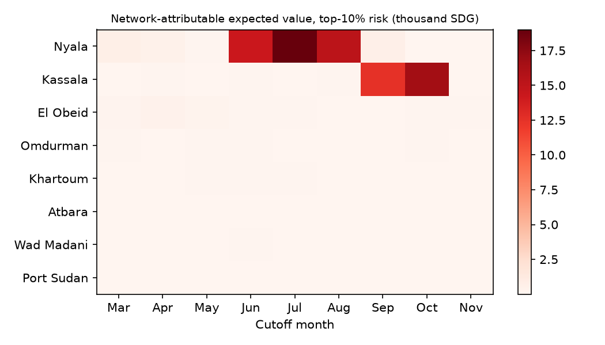
Decision: rank by expected value, not probability
Nov backtest, 1,363 contacts: net 38,382 SDG (value ranking) vs 16,458 SDG (probability ranking).
Only 34% of the two lists overlap: some high-risk subscribers are low value.
Expected net (46,147 SDG) overstates realised in a quiet month: plan on the realised figure.
Assumptions (labelled): save rate 20%, cost 20 SDG per contact, 6-month value horizon.
Network hand-off ranks Nyala and Kassala first at every planted-outage cutoff (Kassala is out of sample).
Simulated data: demonstrates the method, not real-world performance.

Slide 5
Deployment, pilot and risks
Monthly Airflow DAG: features, validation, registered model, scores with reasons, PSI drift check, retrain gate.
Monitor already alerts on regional ticket rate once the outages end.
Pilot: 50/50 randomised top-decile prepaid holdout; baseline churn 9.8%.
Sample per arm for a 15 / 20 / 25 / 30% relative reduction: 5,983 / 3,282 / 2,046 / 1,383.
Risks
Simulated data; real performance unknown.
Expected value still overstates realised (about 17% in the Nov backtest).
Regional outages distort scores.
Only ticket signals for the network, no cell KPIs.
Next: pilot, real operator data, native review of Arabic text.
Simulated data: demonstrates the method, not real-world performance.

