Slide 1
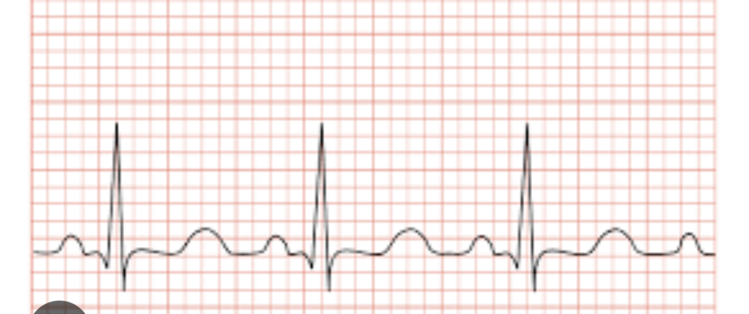
Optimal Multi-Stage Arrhythmia Classification Approach

Slide 2

Members:
Samah khaled
Omnia Mohamed
Batool yousry

Slide 3
dataset

Slide 4

dataset
-we collected and disseminated this novel database that contains 12-lead ECGs of 45,152 patients with a 500 Hz sampling retether part of
this database (10,646 patient) was shared .
-12-lead resting ECG test that was taken over a period of 10 seconds
-The institutional review board of Shaoxing People’s Hospital and Ningbo First Hospital approved this study, granted the waiver application to obtain informed consent, and allowed the data to be shared publicly after de-identification.
Types of diseases that can cause arrhythmia.
atrial fibrillation
general supraventricular tachycardia
sinus bradycardia
sinus irregularity rhythm

Slide 5
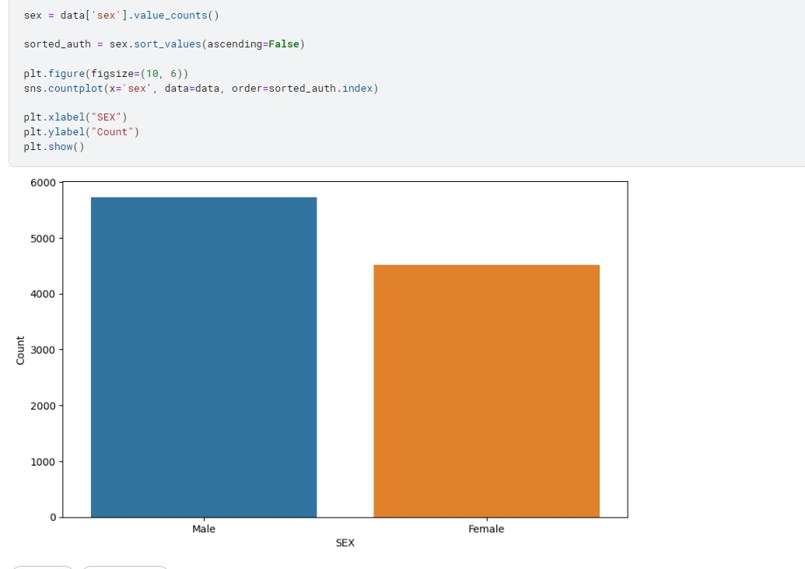
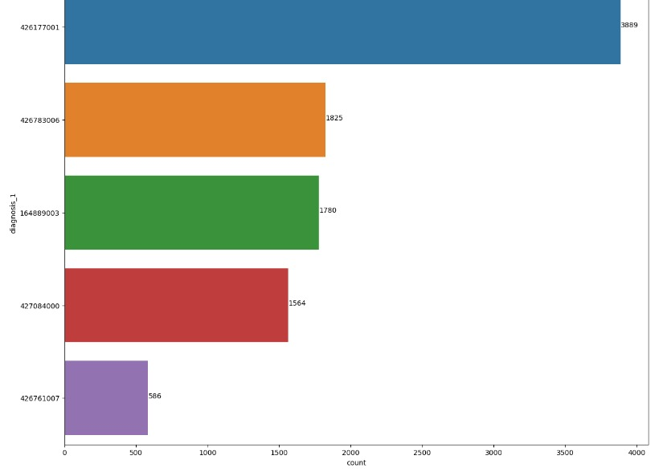
Classification of data

Slide 6
The main disease that was chosen from this dataset
sinus bradycardia:
-is a condition characterized by an abnormally slow heart rate originating from the sinus node, which is the natural pacemaker of the heart.
-In adults, sinus bradycardia is typically defined as a resting heart rate of fewer than 60 beats per minute.
-Frequency [3,889 (36.53) n(%) ]
-Male [2,481 (58.48%)]
Age[58.34 ± 13.95] ± SD
-Reduce number of samples from 45.125 to 2568

Slide 7
preprocessing

Slide 8
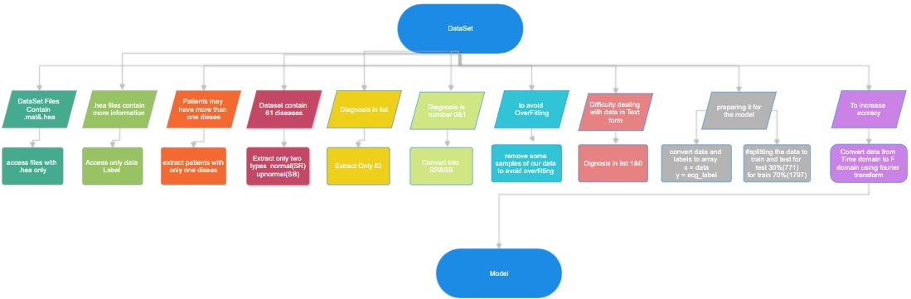

Slide 9
Overview

Slide 10
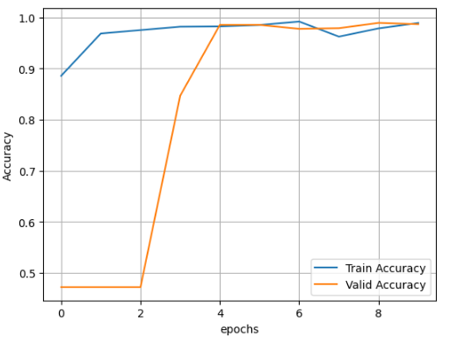
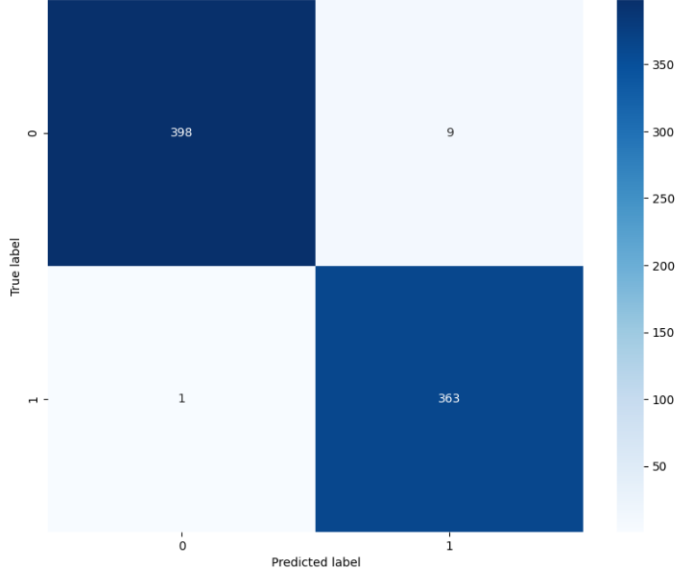
Cnn model in time domaim
Train valid accuracy
Confusion matrix

Slide 11
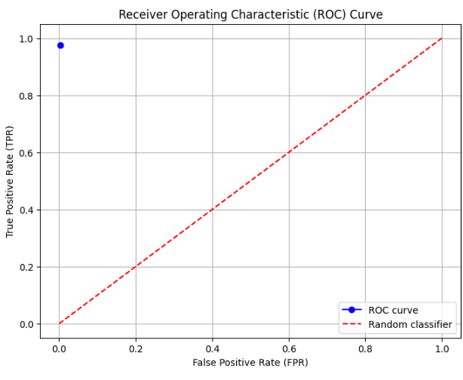
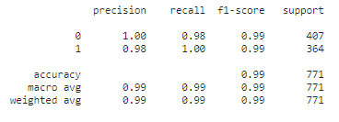
ROC
classification_report

Slide 12
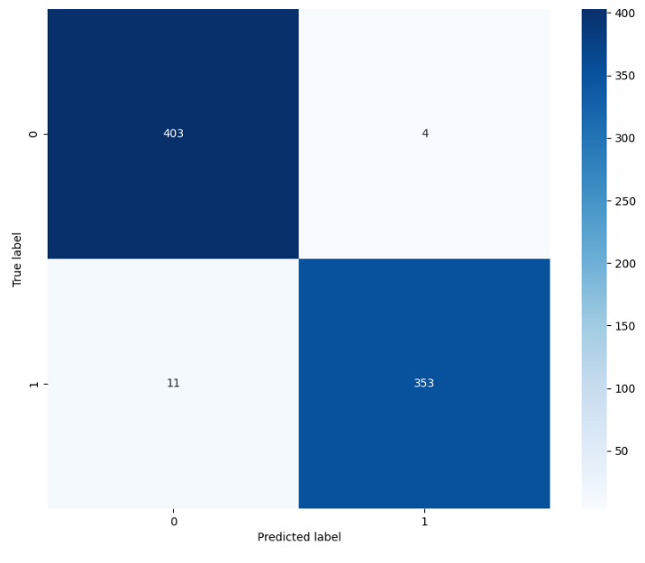
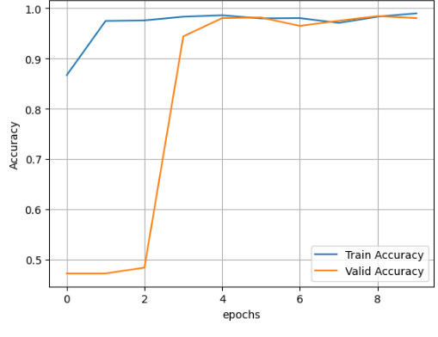
CNN model frequency domain
Train valid accuracy
Confusion matrix

Slide 13
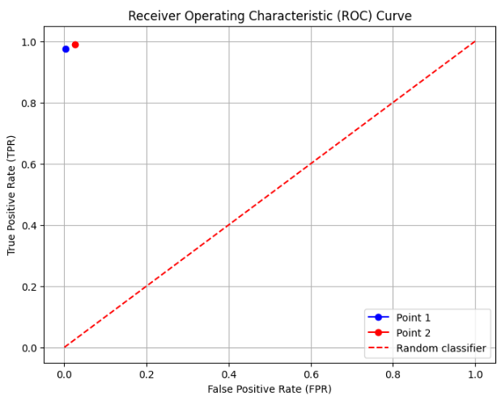
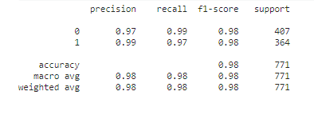
ROC
classification_report

Slide 14

Lstm model time domain
Confusion matrix

Slide 15
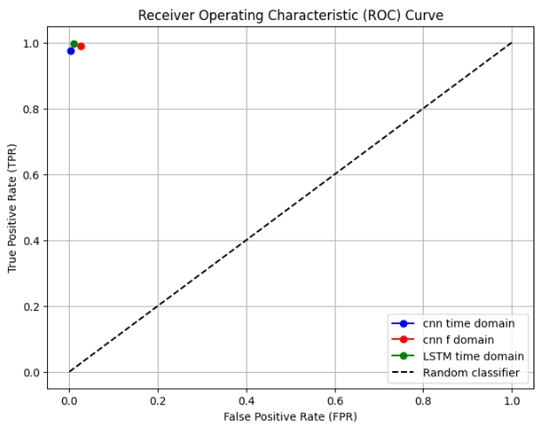
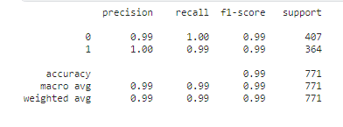
ROC
classification_report

Slide 16
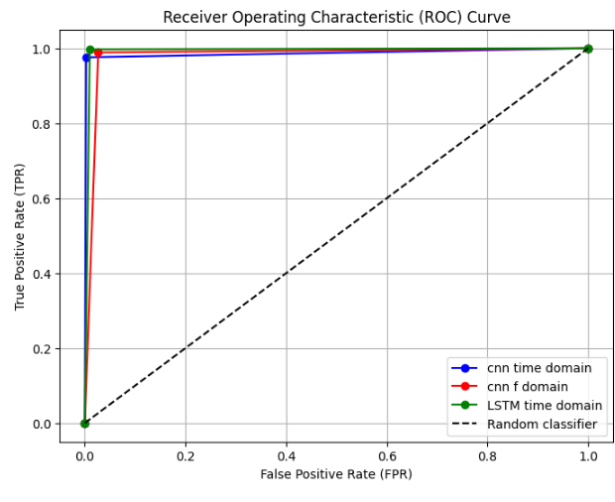
Roc curve

Slide 17
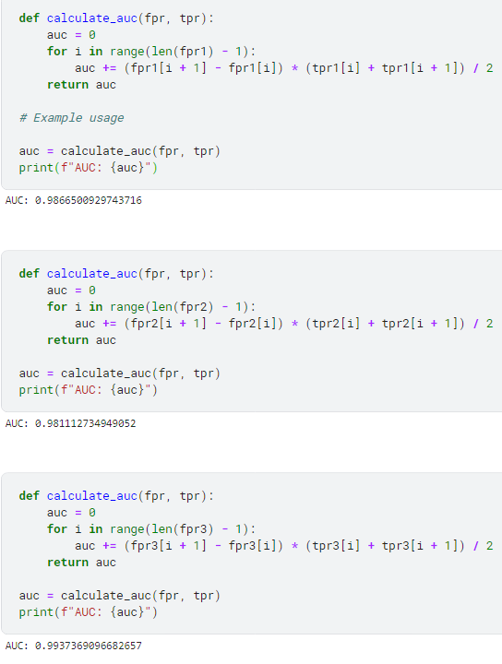
Auc values using trapezoid method
Cnn time domain
Cnn frequency domain
LSTM time domain

Slide 18

Conclusion:
According to the previous results we get that:
The whole 3 models we mentioned is good , because the accuracy and the AUC for the three model are almost the same
But due to this result the LSTM model is the winner.

Slide 19
Problems:
Getting an EEG dataset which is similar to the dataset of other group: change it to ECG.
The number of samples were small : we change it with our dataset.
When we try to get the signals from .mat files we get it as dictionary format: we get it using WFDB p_signal.
The accuracy of LSTM was law :we use the technique of adding cnn layers before it.
The y predicted label in LSTM is only 0 [0,0,0,0,0] for all the samples: remove argmax and print the y predicted label as probability.

Slide 20
thank you

