Slide 1

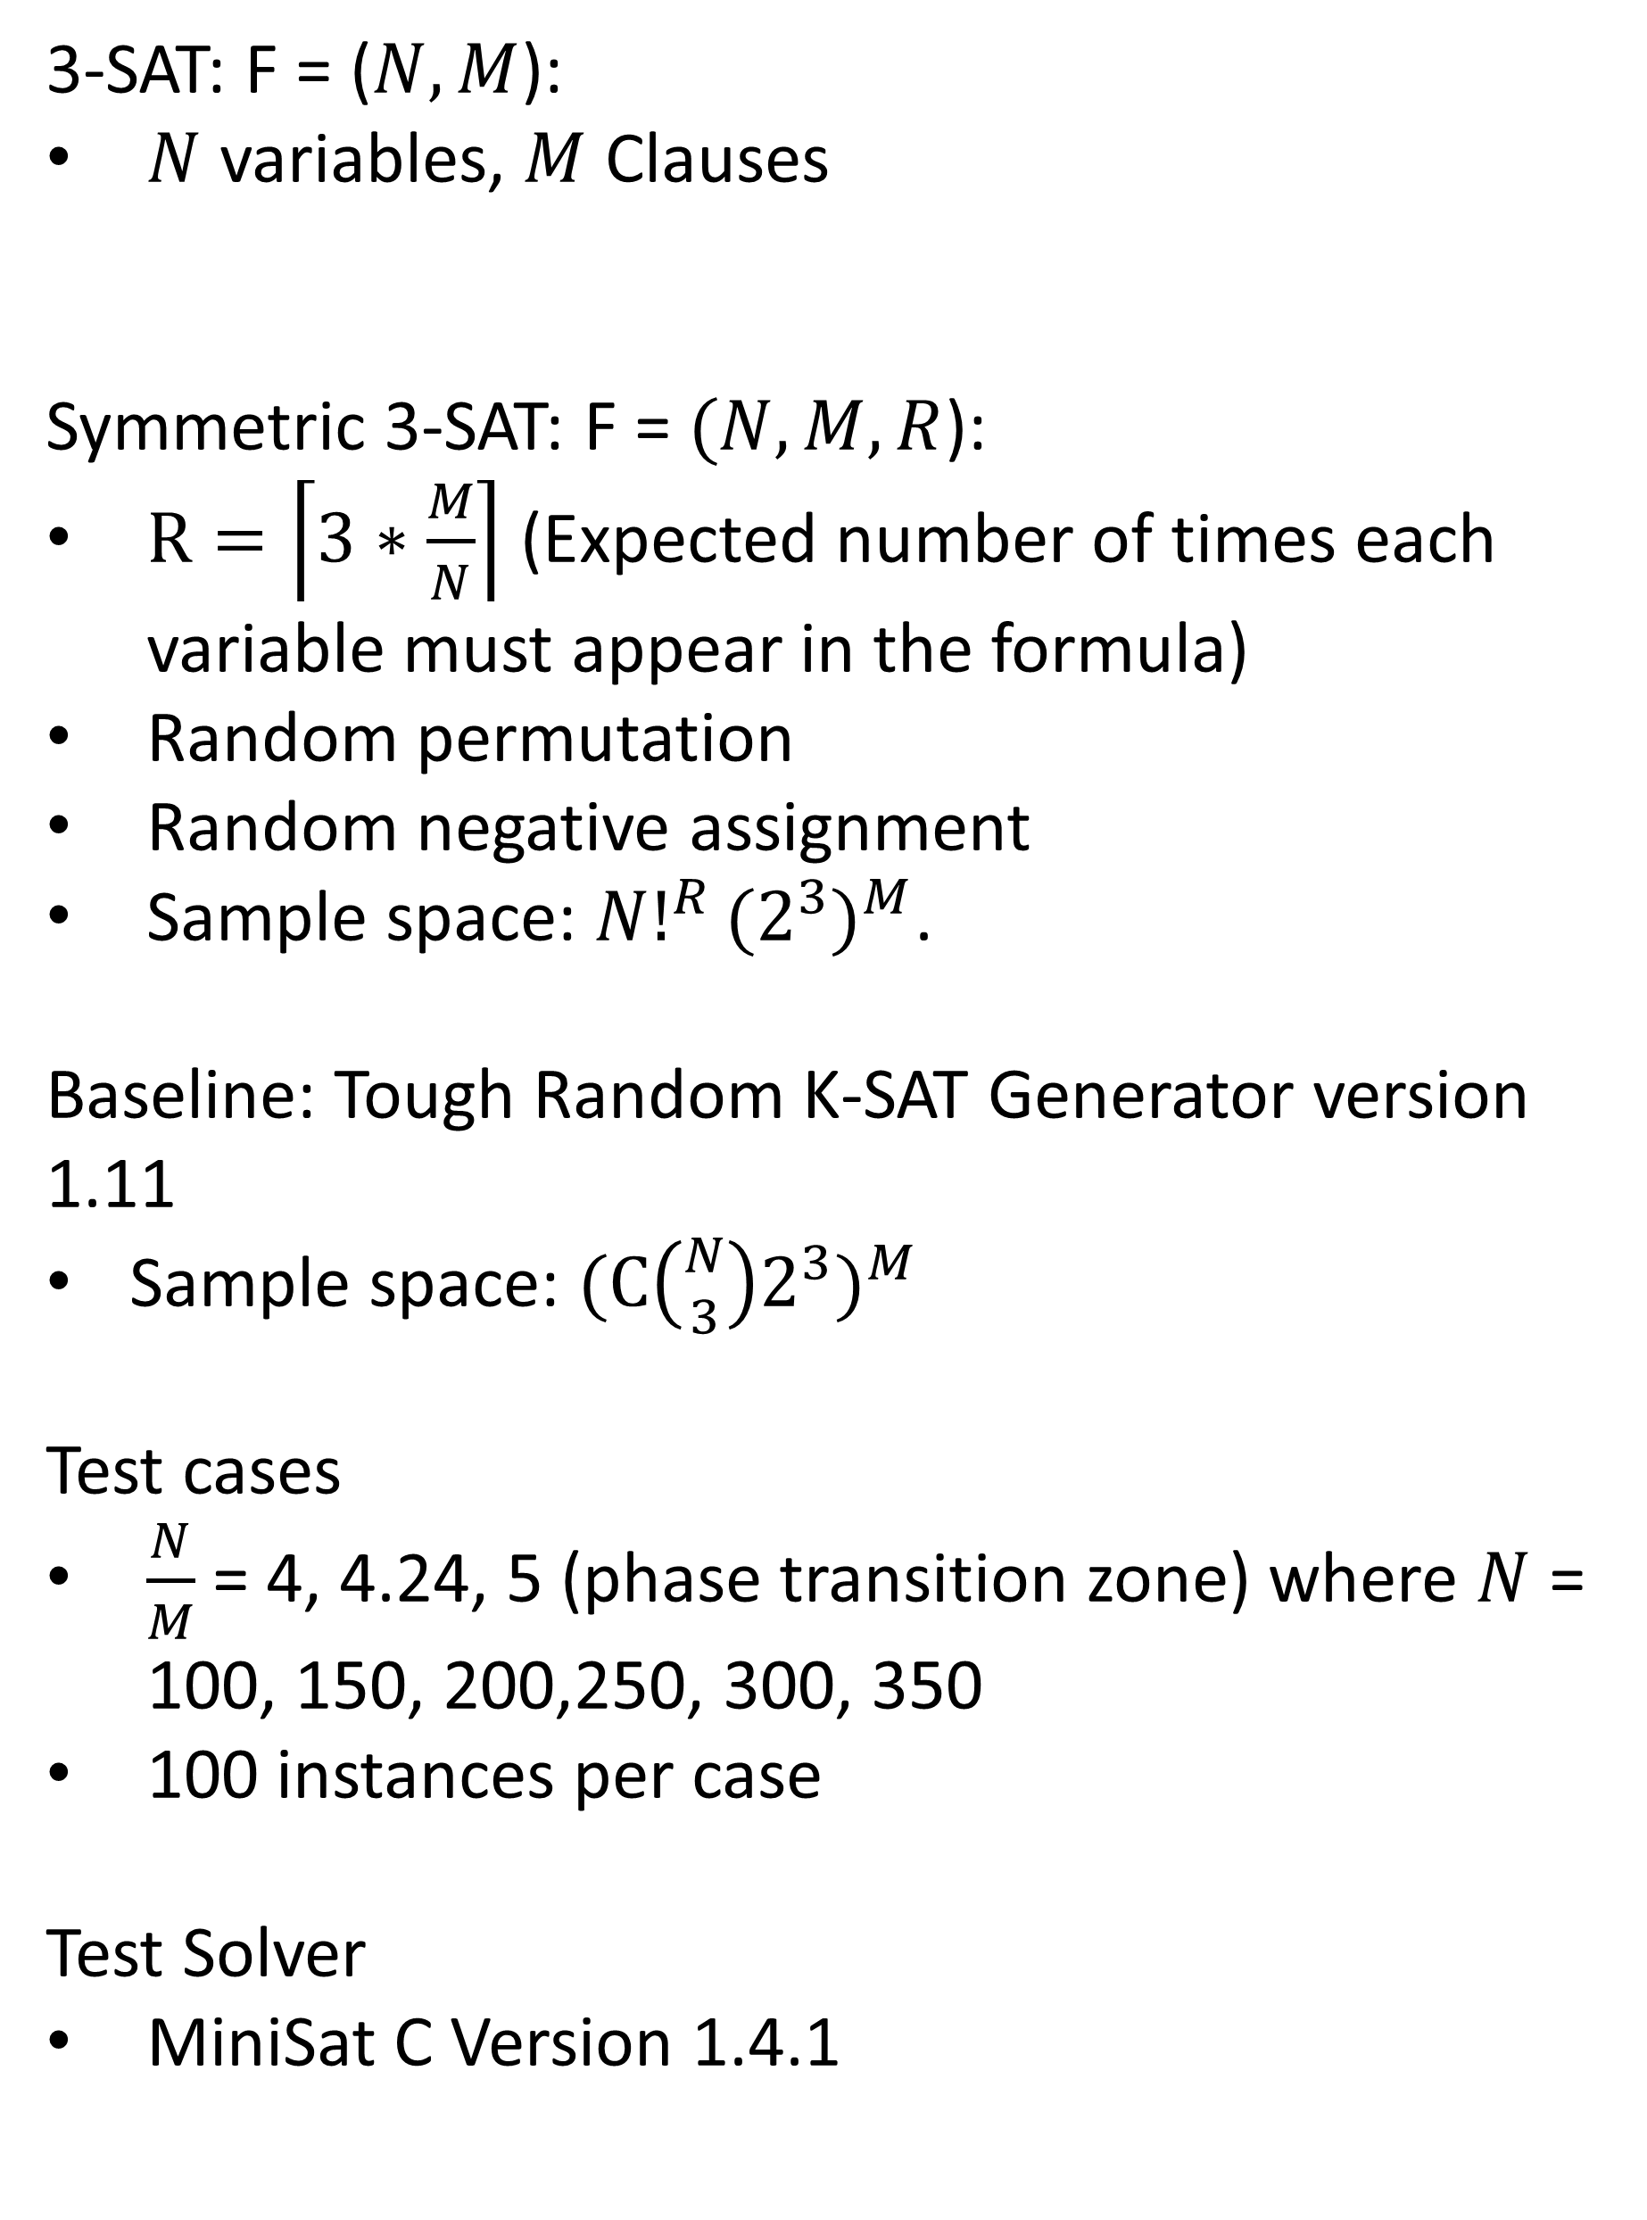
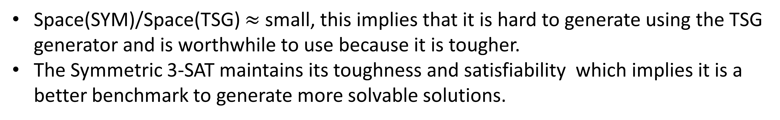
Symmetric 3-SAT Generation & Difficulty
Robert Amador, Chen-Fu Chiang, Chang-Yu Hsieh
Introduction
Results Legend: TSG SYM
Boolean satisfiability: An NP-complete problem utilized in many different computer science fields, such as artificial intelligence, program verification, protein folding, etc.
SAT formulas are represented in
Conjunctive Normal Form:
{A, B, C} (A V B V ~C) …
3-SAT, 3 referring to the number of literals per clause, problems are used because any NP-complete problem can be represented as a 3-SAT problem in polynomial time. (Cooke-Levin theorem)
As seen from the results it took more CPU time to solve the symmetric problems as we reached towards and beyond the normal phase transition zone. The number of propagations conflicts and decisions also experience the same increase overtime. Propagation is used to break down larger clauses into a smaller number of literals. Conflicts occur when one variable is assigned both a positive and negative literal and Decisions are simply assignments of a literal to a variable.
+ Literal
AND
V
Binary Variables
OR
- Literal
Clause
Experimental Methods
Result Summary
3-SAT: F = ($N,M$):
$N$ variables, $M$ Clauses
Symmetric 3-SAT: F = $(N,M,R$):
$R=\left\lceil 3∗\frac{M}{N}\right\rceil$ (Expected number of times each variable must appear in the formula)
Random permutation
Random negative assignment
Sample space: ${N!}^{R}{(2^{3})}^{M}$.
Baseline: Tough Random K-SAT Generator version 1.11
Sample space: ${(C\left({N \atop 3}\right)2^{3})}^{M}$
Test cases
$\frac{N}{M}$ = 4, 4.24, 5 (phase transition zone) where $N$ = 100, 150, 200,250, 300, 350
100 instances per case
Test Solver
MiniSat C Version 1.4.1
It is harder for a CDCL based solver to solve symmetric 3-SAT problems.
It is harder for the solver to make a satisfiability assignment, as all problems in the 1:5 case were unsatisfiable.
The Symmetric generator can create more useful cases when at the phase transition zone than the TSG.
Conclusions
Space(SYM)/Space(TSG) $≈$ small, this implies that it is hard to generate using the TSG generator and is worthwhile to use because it is tougher.
The Symmetric 3-SAT maintains its toughness and satisfiability which implies it is a better benchmark to generate more solvable solutions.
Future Work
Acknowledgments
Analysis of Landscape problem
Our efficient Most Constrained Variable partition solver
New phase transition number for symmetric 3-SAT
Tough SAT Generator: toughsat.appspot.com
MiniSat: minisat.se
Cloud9: c9.io

