Slide 1





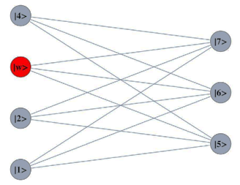






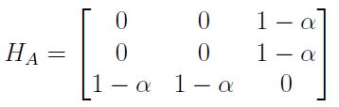

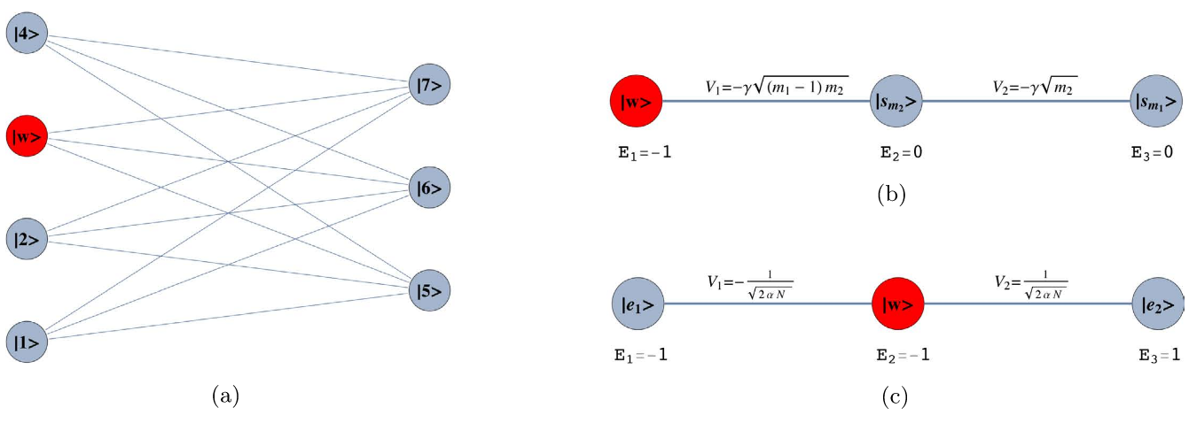
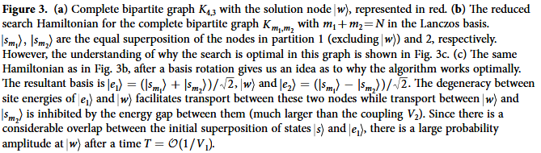
Optimality of Perturbed Quantum Walk via Dimension Reduction
Viktoria Koscinski, Chen-Fu Chiang, Chang-Yu Hsieh
Introduction/Objectives:
Results/Discussion:
Quantum Walk (QW) models provide a natural framework for solving spatial search problems. They are central to quantum algorithms and are designed for computationally difficult problems. Quantum computers are more susceptible to errors than classical computers because the quantum nature of the superposition of states and the continuous process of quantum evolution makes the system more delicate and reactive to environmental noise. Error must be controlled or compensated for in order to preserve the efficiency of a computational system. This work aims at preserving the optimality and simplifying the analysis of a Continuous Time Quantum Walk (CTQW) search subject to systematic error.
Search Hamiltonian, H_{S}, is obtained: , where -ɣ is the coupling factor between connected nodes and is the marked node. Additionally, to use perturbation theory, H_{S} = H⁽⁰⁾ + H⁽¹⁾ .
H_{S} +
N = m₁ + m₂
ρ = m₁ / N
Compute the eigenbasis ( , , ) of H⁽⁰⁾. Write H_{S} in the eigenbasis of H⁽⁰⁾:
H_{S} = (1 - ɑ)
Gamma factor is chosen for search optimality:
and degenerate: faster transport.
Optimality preservation conditions require high overlap between and . The matrix element responsible for search speed is .
Dimensionality reduction applied to Continuous Time Quantum Walk (CTQW) problems is a powerful method that is able to make the analysis of various studies relating to Quantum Walks (QWs) much simpler. Using dimensionality reduction preserves the dynamics of an original graph of an arbitrary size, allowing a spatial search algorithm to be mapped to a transport problem on a reduced graph.
Because the objective of using the CTQW in the analysis of a spatial search problem is to find a marked basis state, the value of ɣ must be chosen in such a way which optimizes transport between the initial state and the basis state. The reduction analysis scheme is as follows: (1) converting the original graph into its adjacency matrix, (2) using the Lanczos Algorithm to construct the reduced matrix, (3) constructing the quantum walker Hamiltonian based on the reduced basis, (4) expressing the quantum walker Hamiltonian in the dominant basis, and (5) finally choosing the optimal ɣ value based upon the optimality conditions.
In this work, systematic error was introduced to the original Complete Bipartite Graph (CBG) in the form of (1 – ɑ), to represent unwanted noise affecting the system. The relation for the new ɣ tuning factor with error ɑ is as follows: .
Problem Statement:
The search space is a Complete Bipartite Graph with a marked solution state:
Solution state: ω
Starting state: s
m₁ elements
m₂ elements
Future Work/Inference:
Technique/Process:
Because of the intuitiveness of the procedural process of computation to find this gamma factor, the search problem using analysis of the CTQW can be applied to important uniform multipartite graphs other than the CBG, such as the Complete Graph (CG) and the Star Graph (SG). A more difficult problem arises when the uniformity (symmetry) of the graph is broken. While the analysis of the optimal spatial search on the CG with broken links (symmetry) proves to be relatively simple computationally, extending the concept to a CBG with broken symmetry requires extra factors which transform the problem into a much more computationally difficult one, where the Lanczos Algorithm will require numerous steps before it terminates. These extra steps result in a much larger reduced matrix and complicate the analysis. Our further research will impose additional constraints to help the algorithm converge more efficiently.
While current constraints allow the analysis of CTQWs to be applied to specific types of graphs, generally uniform multipartite graphs, these specific cases are important examples of how the computation process relating to CTQWs provides an important framework for the possible applications in spatial searches and quantum transport and state transfer problems.
Adjacency matrix, H_{A}: systematic error is introduced to H_{A}.
Reduced matrix, H_{R}, is obtained: The Lanczos Algorithm is used to reduce H_{A} (N x N) and obtain H_{R} (3 x 3). The algorithm is as follows: Given a Hermitian adjacency matrix H_{A}:
Choose an arbitrary vector with a norm of 1 as v₁.
Initial iteration (j = 1):
Let ω₁‘ = H_{A}v₁
Let a₁ = ω₁‘*v₁
Let ω₁ = ω₁‘ - a₁v₁
For following iterations j such that j = 2, …, m
Let β_{j} = |ω_{j-1}|
If β_{j} ≠ 0, let v_{j} = ω_{j-1}/β_{j}. If β_{j} = 0, stop iterating
Let ω_{j}‘= H_{A}v_{j}
Let a_{j} = ω_{j}‘*v_{j}
Let ω_{j} = ω_{j}‘ - a_{j} v_{j} - β_{j}v_{j-1}
} solution state
} m₁ – 1 elements
} m₂ elements
High overlap
Fast transport
Acknowledgments:
Thank you to the 2017 SUNY Polytechnic Institute Summer Internship Program for providing this opportunity, my professors, and all others who have been supportive.
β₂
β₃
a₁, a₂, a₃
[1]
[1] Source: Scientific Reports 5, Article number:
13304 (2015), doi:10.1038/srep13304

