Slide 1

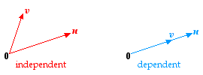
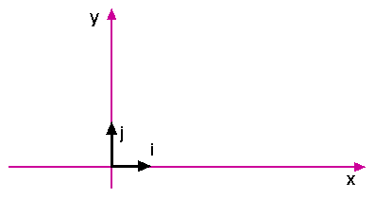

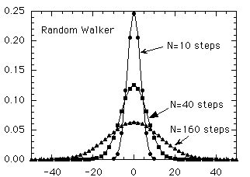
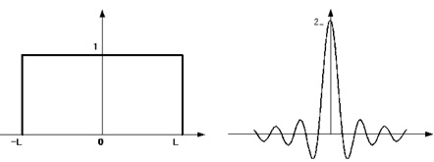
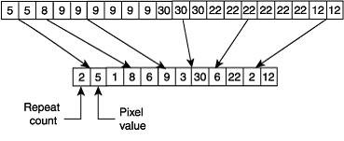
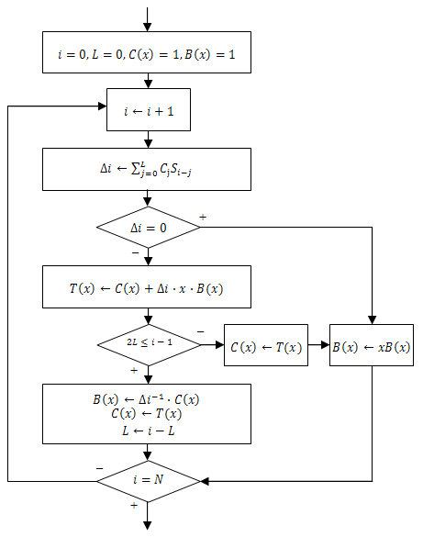
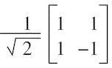
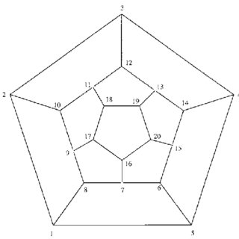
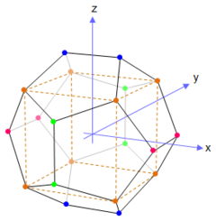
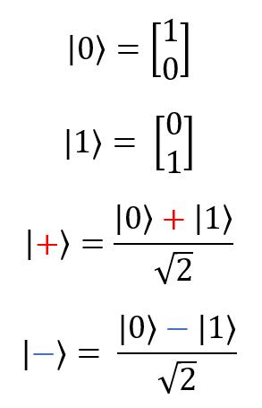
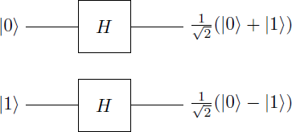
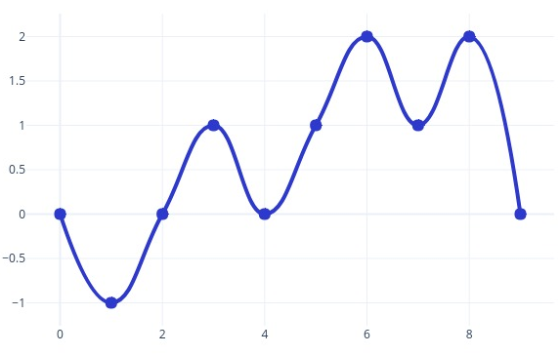
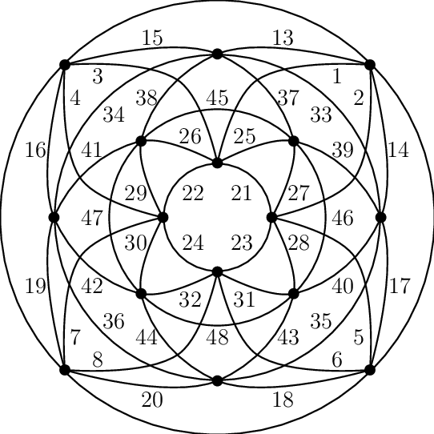
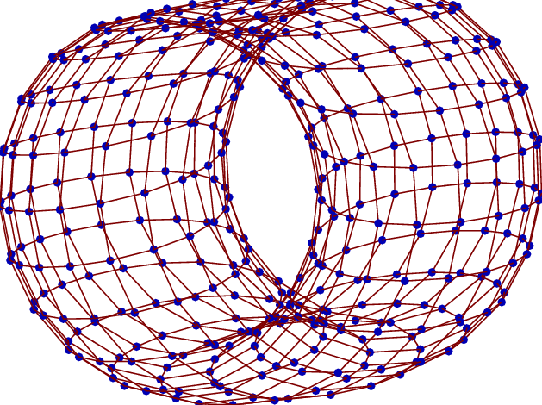
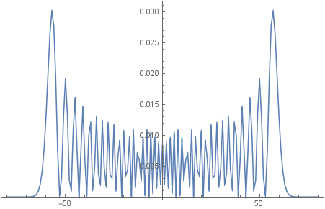


Simulation of Coin Based Discrete Quantum Random Walk Pseudo-Random Number Generator
Javier Liu, Dr. Chen-Fu Chiang
Goal Statement
NIST SP 800-22: Statistical Test Suite for PRNG
Results
To utilize the asymptotic, chaotic probability amplitudes of Discrete Coin Based Quantum Random Walks (DQRW) to produce binary sequences that pass the NIST SP 800-22 Randomness Statistical Test Suite
NIST SP 800-22 is a statistical test suite used to run on a random number generator (RNG) in order to see whether the data generated is truly “random.” based on a P-value.
P-value method for hypothesis testing
Null Hypothesis, H₀: Binary bitstream is a random sequence
Level of significance ∝ = 0.01
If sequence was accepted as random, there’s an expected 1 sequence in 100 sequences to be rejected as non-random.
If P-value ≥ 0.01, it indicates the sequence is random with 99% confidence
If P-value ≤ 0.01, it indicates the sequence is non-random with 99% confidence
Implement DQRW
Set DQRW Parameters
Binary Sequence from Amplitudes
NIST SP 800-22 Tests
Frequency Tests
Monobits Test: Examines the proportion of 0s and 1s in the bitstream. If P-value is inadequate, either there were too many 1s or too many 0s.
Block Test: Examines the proportion of 0s and 1s in a m-bit block. Performs Monobits Test upon the block.
Runs Test: Examines the number of “runs” in the bitstream and compares it to that of a truly random sequence. If P-value is inadequate, it implies the oscillation between 1s and 0s was either too fast or too slow.
If Sequence Fails Tests
1 0 0 1 0 1 0 0 0 0 1 0 1 0 0 0 0 0
Number of “runs”: 1 2 3 4 5 6 7 8 9 10
1 1 1 0 1 0 1 0 1 0
1 1 0 1 0 1 0 0 0 1
0 0 0 1 1 0 1 0 1 1
0 1 1 1 0 0 0 1 1 1
10-bit block with 6/10 ratio
Figure 8) Example of Runs Test
Introduction to Classical Random Walks
Find ratios for remaining 10-bit blocks
Binary Matrix Rank Test: Examines the ranks of disjoint submatrices of the bitstream compares it to that of a truly random sequence to check for linear dependency within the sequence.
The Coin Based Classical Random Walk has the following algorithm:
On a number line, start at position x = 0
Flip a coin and track the result
Move right from position x if coin is heads, otherwise move left.
Repeat step 2, with new position x
Figure 7) Example of Frequency Tests
1 0 0 1
1 0
0 1
NIST SP800-22 Randomness Tests for the DQRWs-based PRNG.
Test Name P-value Result
Frequency 0.350485 SUCCESS
BlockFrequency 0.122325 SUCCESS
CumulativeSums (forward) 0.739918 SUCCESS
CumulativeSums (reverse) 0.534146 SUCCESS
Runs 0.739918 SUCCESS
LongestRun 0.350485 SUCCESS
Rank 0.066882 SUCCESS
FFT 0.911413 SUCCESS
NonOverlappingTemplate 0.424142 SUCCESS
OverlappingTemplate 0.534146 SUCCESS
Universal 0.600000 SUCCESS
Serial (Test 1) 0.834308 SUCCESS
Serial (Test 2) 0.637119 SUCCESS
LinearComplexity 0.911413 SUCCESS
Random Excursions --------------- ---------------
Random Excursions Variant --------------- ---------------
Approximate Entropy 0.000000 FUTURE RESEARCH
T
Longest Run of Ones Test: Examines the length of the longest consecutive ones in the bitstream and compares it to that of a truly random sequence.
Figure 10) Example of Linearly Independent 2x2 Matrix
Time
H
1 0 0 1 0 1 1 1 1 1 1 1 0 0 0
Template Matching Tests
Non-overlapping Template Matching Test: Examines the occurrences of a specified m-bit string in a m-bit window in the sequence. If pattern is found, set the window to the bit after the pattern. Otherwise, set it to the next bit in the sequence.
Overlapping Template Matching Test: Performs Non-overlapping Template Matching Test except when a pattern is found, set the window to the next bit in the sequence.
H
Figure 9) Example of Longest Run of Ones Test
Discrete Fourier Transform (Spectral) Test: Examines the number of peak heights in the Discrete Fourier Transform of the sequence and compares it to that of the Discrete Fourier Transform of a truly random sequence to check for periodic patterns.
...
...
0
1
2
Figure 1) Example of Classical Walk
Figure 2) Example of Classical Walk
3
1
2
4
5
Both template matching tests finds pattern
Only Overlapping Template Matching Test finds pattern
Probability
Binomial (Gaussian Distribution) about the initial position, in this case 0
Template: 1011
0 0 1 0 1 1 0 1 1 0
Figure 11) Discrete Fourier Transform of a Box-Car Waveform Peak Heights
Bit Numbers: 1 2 3 4 5 6 7 8 9 10
Position
Maurer’s “Universal Statistical” Test: Examines the number of bits between recurring patterns to check if the sequence can be significantly compressed without loss of data. If P-value is inadequate, it implies the sequence is significantly compressible.
Figure 12) Example of Template Matching Tests
Figure 3) Distribution of Classical Random Walk
Linear Complexity Test: Examines the length of the linear feedback shift register (LFSR) of the sequence to see whether the sequence is complex enough to that of a truly random sequence. Inadequate P-values implies the sequence has a short LFSR.
Introduction to Quantum Random Walks
The Discrete Coin Based Quantum Random Walk is the quantum implementation of the Classical Walk, but uses qubits and superposition.
Quantum system with two subspaces: |x⟩ and |c⟩, where x is the initial position (in this case 0) and c is the coin state, -1 or 1.
Two unitary operators
Ĉ, coin operator which acts upon the coin subspace
Ŝ |x, 0⟩ = |x - 1, 0⟩ and Ŝ |x, 1⟩ = |x + 1, 1⟩, shift operator which looks at the coin subspace and acts upon the position subspace accordingly.
If Ĉ holds a 0, shift left. If Ĉ holds a 1, shift right.
Repeat step 2 until the walk is finished.
Measure the resulting position.
Figure 13) Example of Compression Algorithm: Run Length Encoding
Figure 19) Table of Results
Serial Test: Examines the frequency of all possible (m),(m-1), and (m-2)-bit, patterns in the sequence and compares it to that of a truly random sequence. If P-value is inadequate, the sequence’s patterns are not uniform.
Future Endeavors
1 0 0 1 0 1 0 1 0 1 1 1 0 0 0
(m) = 3 m₀₀₀= 1,m₀₀₁= 1,m₀₁₀= 3,m₀₁₁= 1,m₁₀₀= 2,m₁₀₁= 3,m₁₁₀= 1,m₁₁₁= 1
(m-1) = 2 m-1₀₀= 2 ,m-1₀₁= 4 ,m-1₁₀= 5 ,m-1₁₁= 2
(m-2) = 1 m-2₀= 8, m-2₁= 7
Approximate Entropy Test
Random Excursions Test
Random Excursions Variant Test
Discrete Quantum Random Walk along higher dimensional structures
Let Ĉ = Hadamard Gate =
Uniform superposition
Figure 14) Berlekamp-Massey Algorithm Used to Find Sequence LFSR
Figure 15) Example of Serial Test
Random Excursions and Variant Tests: Examines the number of “cycles” with a certain amount of occurences of a particular state and comparing it to that of a truly random sequence. If P-value is inadequate, the sequence’s distribution of a particular state across all “cycles.” The normal Random Excursions Test examines integer states [-4,-1] ⋃ [1,4], while the variant Random Excursions Test examines states [-18,-1] ⋃ [1,18].
Approximate Entropy Test: Examines the frequency of all possible (m) and (m+1)-bit patterns in the sequence and compares it to that of a truly random sequence. Similar to the Serial Test in its purpose.
1 0 1 1 0 0 0 1 0 0 1 1 0 0 1
(m+1) = 3 m₀₀₀= 1,m₀₀₁= 3,m₀₁₀= 1,m₀₁₁= 2,m₁₀₀= 3,m₁₀₁= 1,m₁₁₀= 2,m₁₁₁= 0
(m) = 2 m-1₀₀= 4 ,m-1₀₁= 4 ,m-1₁₀= 4 ,m-1₁₁= 2
0, 1, 1, 0, 1, 1, 0, 1
Time
T
H
T
H
T
H
T
H
T
H
Figure 16) Example of Approximate Entropy Test
Cumulative Sum (Cusum) Test: Examines the maximum excursion from 0 of the binary sequence and compares it to that of a truly random sequence by converting bits 0, 1 into digits -1, 1 (respectively), and finding the partial sums and cumulative sums. If P-value is inadequate, the sequence has too many 1s or 0s towards the end of the sequence, or the 1s and 0s are mixed too evenly.
-1, 1, 1, -1, 1, 1, -1, 1
Figure 20) Walkable Dodecahedron Structure
-2
-1
0
1
2
Partial Sums:
S₁ = -1 S₅ = 1
S₂ = 0 S₆ = 2
S₃ = 1 S₇ = 1
S₄ = 0 S₈ = 2
Figure 4) Example of Quantum Walk
Figure 5) Example of Quantum Walk
Cycle 1 Cycle 2 Cycle 3
(0,-1,0) (0,1,0) (0,1,2,1,2,0)
0 1 0 0 1 1 1 0
0, -1, 0, 1, 0, 1, 2, 1, 2, 0
S₁ = X₁
S₂ = X₁ + X₂
…
...
S_{k} = X₁ + X₂ + … + X_{k}
…
…
S_{n} = X₁ + X₂ + … + X_{k} + … + X_{n}
S₁ = (-1)
S₂ = (-1) + 1 = 0
S₃ = (-1) + 1 + (-1) = -1
S₄ = (-1) + 1 + (-1) + (-1) = -2
S₅ = (-1) + 1 + (-1) + (-1) + 1 = -1
S₆ = (-1) + 1 + (-1) + (-1) + 1 + 1 = 0
S₇ = (-1) + 1 + (-1) + (-1) + 1 + 1 + 1 = 1
S₈ = (-1) + 1 + (-1) + (-1) + 1 + 1 + 1 + (-1) = 0
Find v_{k}(x) for integer states x ∈ [-4,-1] ⋃ [1,4]
v_{k}(x): Total number of cycles in which state x is visited exactly k times throughout all cycles
v₀(-4) = 3 since the state -4 was visited exactly 0 times in all three cycles
v₀(-2) = 3 since the state -2 was visited exactly 0 times in all three cycles
...
v₂(2) = 1 since the state 2 was visited exactly 2 times in only one cycle
v₀(4) = 3 since the state 4 was visited exactly 0 times in all three cycles
High probabilities at outer positions
Maximum excursion of 2
Prepend and append 0s
Figure 6) Probability Distribution of Classical Random Walk
Figure 17) Example of Cusum Test
Figure 18) Example of Random Excursions and Random Excursions Variant Tests
Figure 21) Walkable Toroidal Structure

