Slide 1
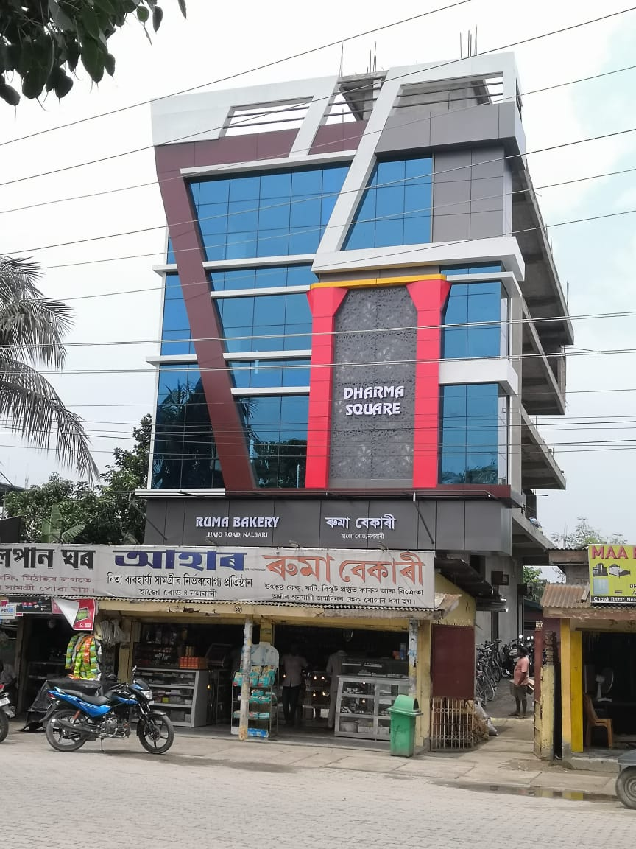
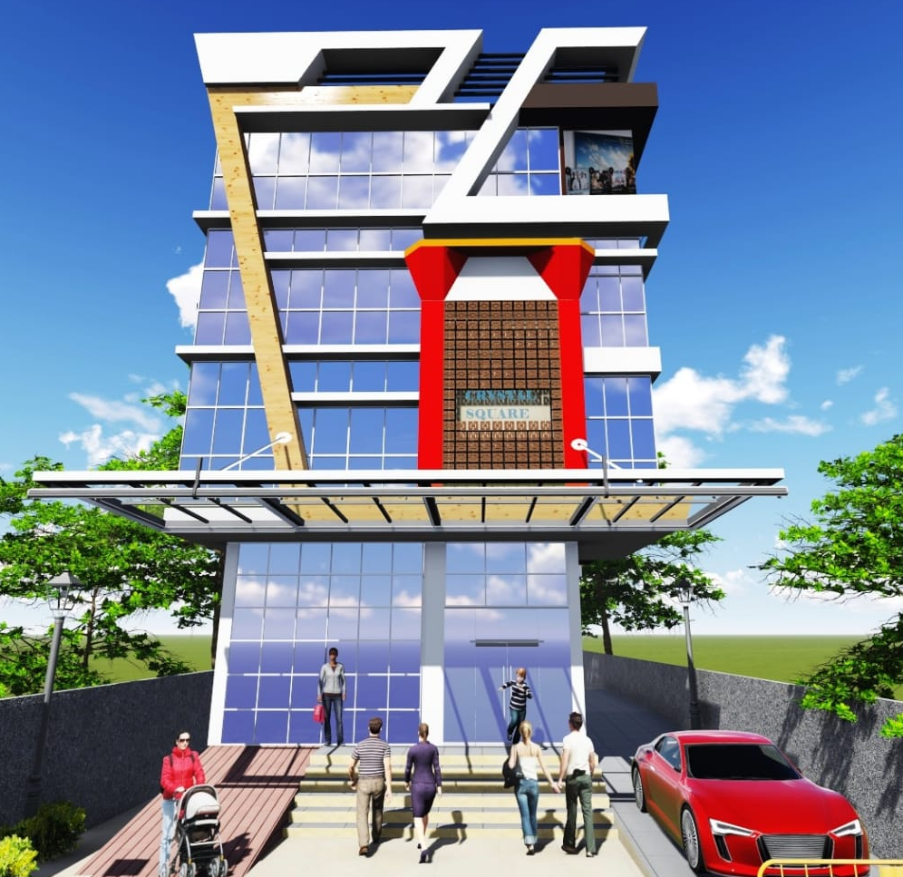

IT’S THE PLACE WHERE EXECUTION AND DESIGN

