Slide 1

Jakarta REST 3.1 Services – Easier than you might think
Ken Fogel

Slide 2

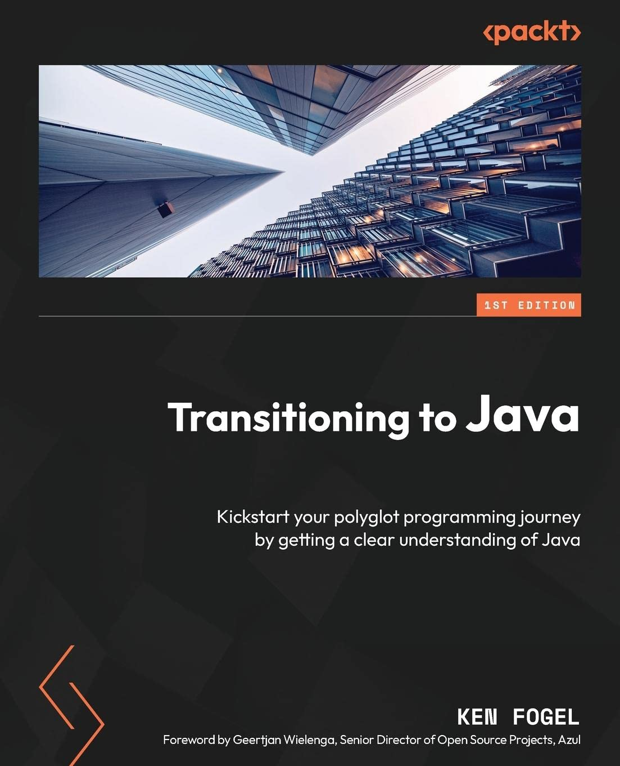
Who am I?
Retired CS instructor at Dawson College
Research Scholar in Residence at Dawson College
Java Champion
JChampions Conference organizer
Member of the JCP EC
Author of Transitioning to Java
Workshop developer for the Eclipse Foundation
@omniprof

Slide 3
Before we begin the presentation, I’d like to talk about how to learn on the job.

Slide 4
The best way to learn is to teach.

Slide 5
The best way to teach is to:
Prepare and give a presentation to your team
Prepare and give a presentation at a local user’s group
Submit presentations to conferences
Write a blog
Write a book
Create a video

Slide 6
The Tool Box
Java SE 17
Jakarta versions are tied to a Java LTS version.
Jakarta 10 supports Java 17
Build tool
Maven
Use the most recent version
IDE
Not required but convenient
I will use NetBeans
Application Server
Any Jakarta 10 compliant server can work
I will use GlassFish 7
Basic Service Testing Tool
cURL for CLI testing of services
Browser
Any browser on any platform will do

Slide 7
Jakarta EE 10 – Jakarta REST 3.1
REST Client
REST Server
Request: GET, POST, PUT, DELETE
Java SE
Console
Swing
JavaFX
Jakarta EE
Servlet
Faces (JSF)
JSP
Embedded Server
Jersey
RESTEasy
App Server
GlassFish
Payara
& others
Response
A REST client in any language
Request
Response

Slide 8
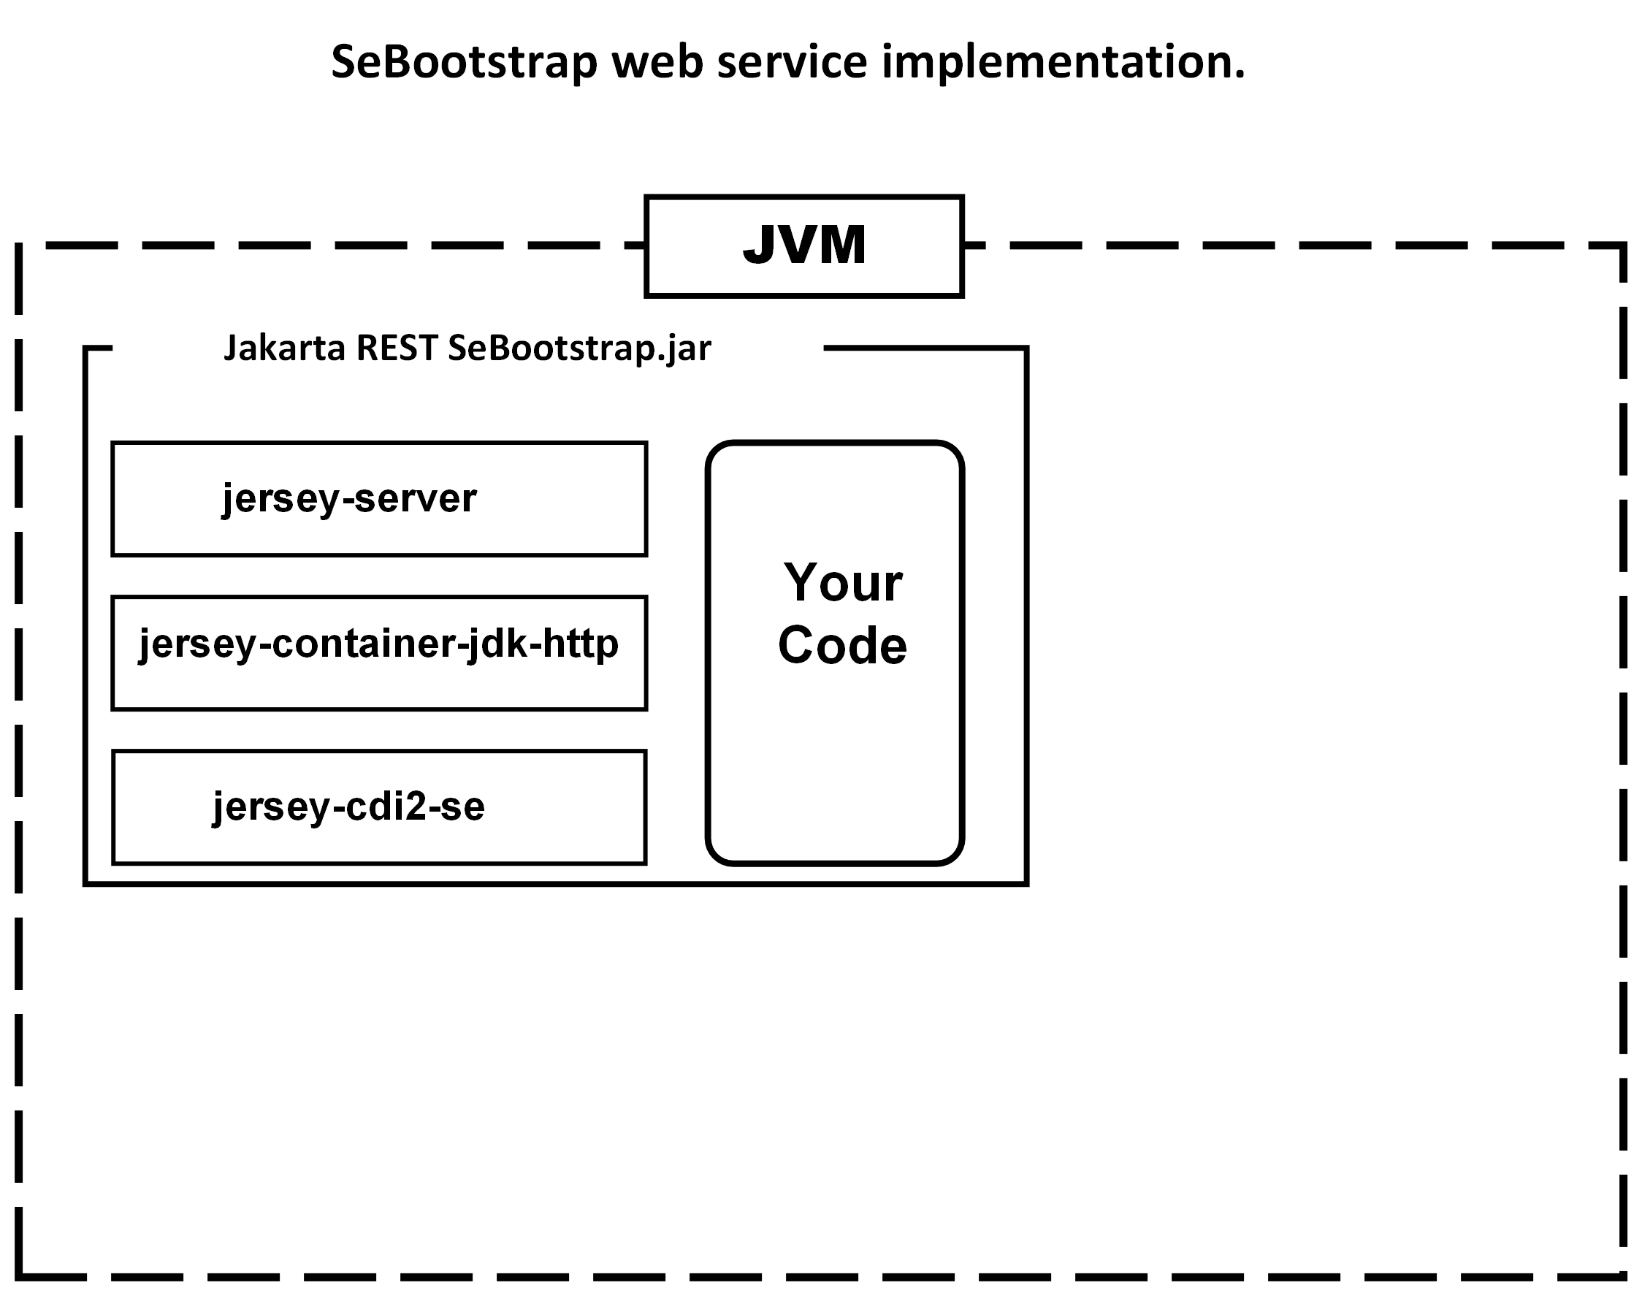
Source Code: 01_restsebootstrap

Slide 9
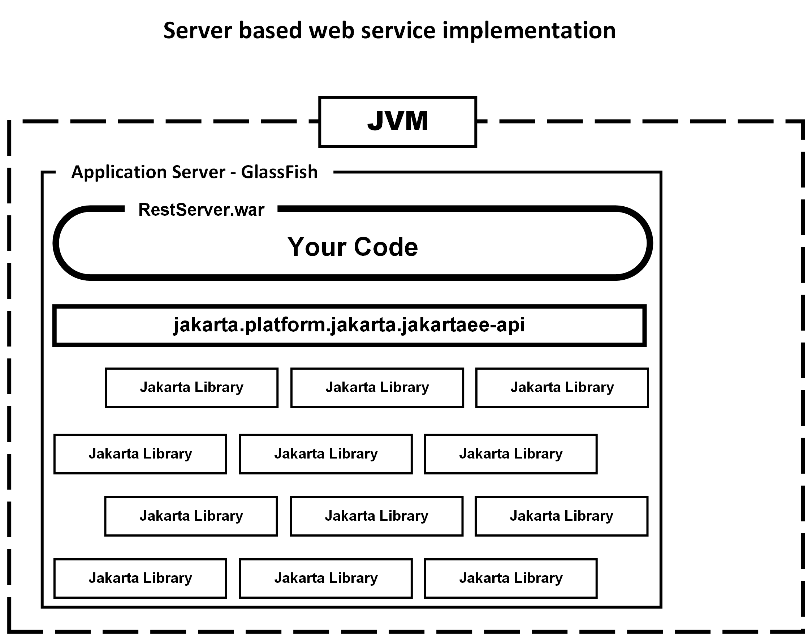
Source Code: 02_restserver

Slide 10
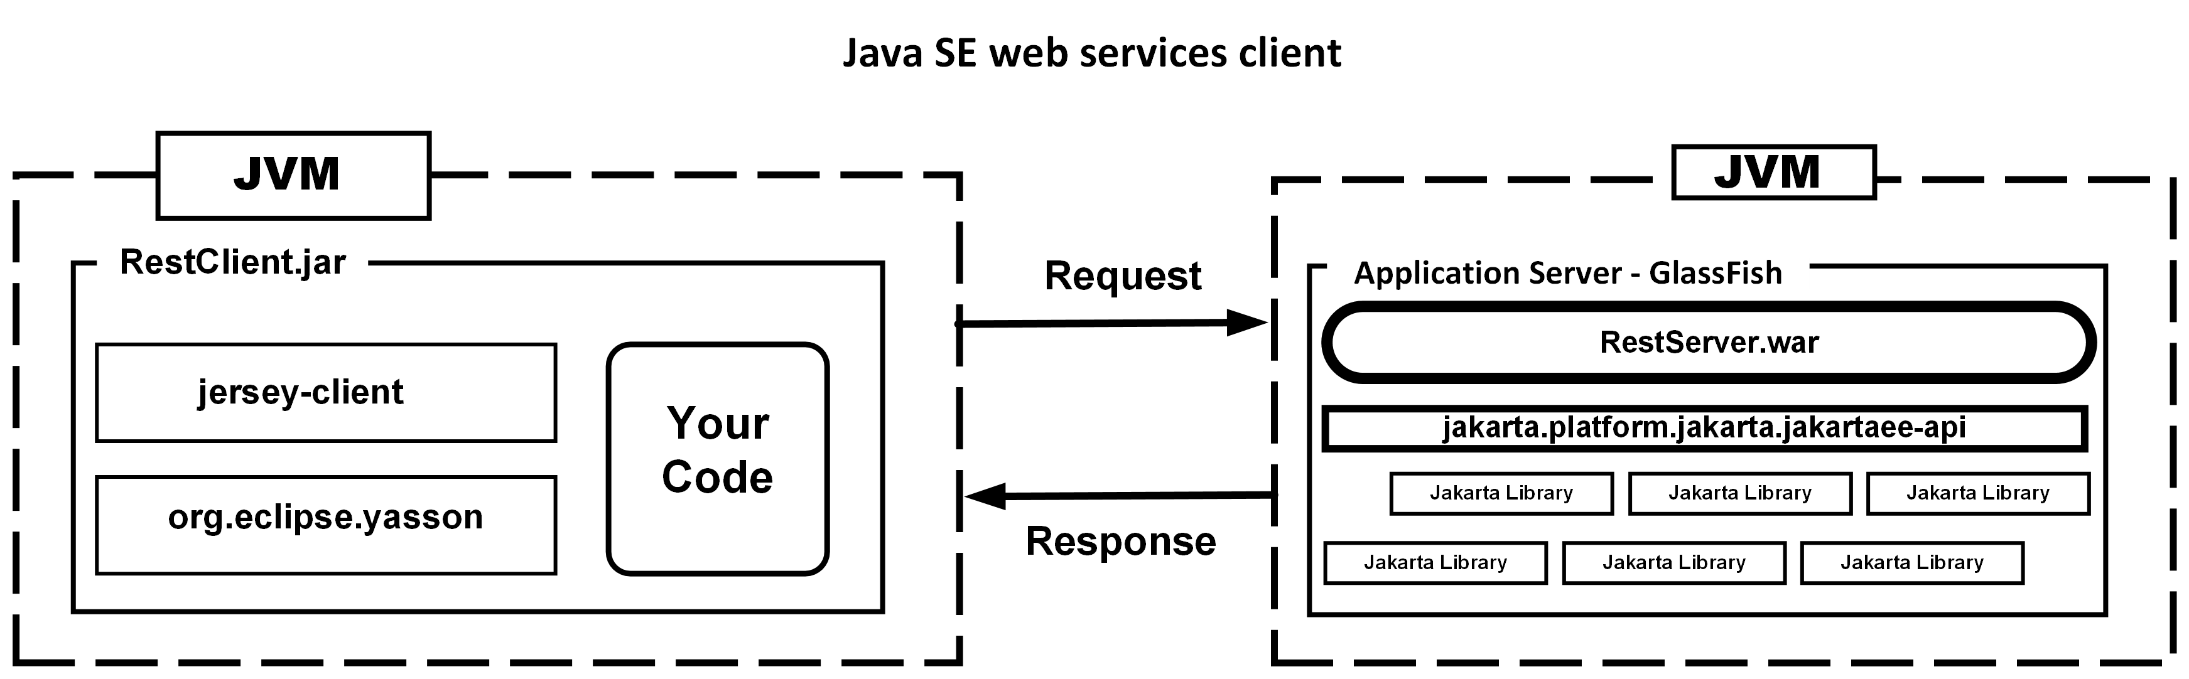
Source Code: 03_restserver, 03_restclient

Slide 11
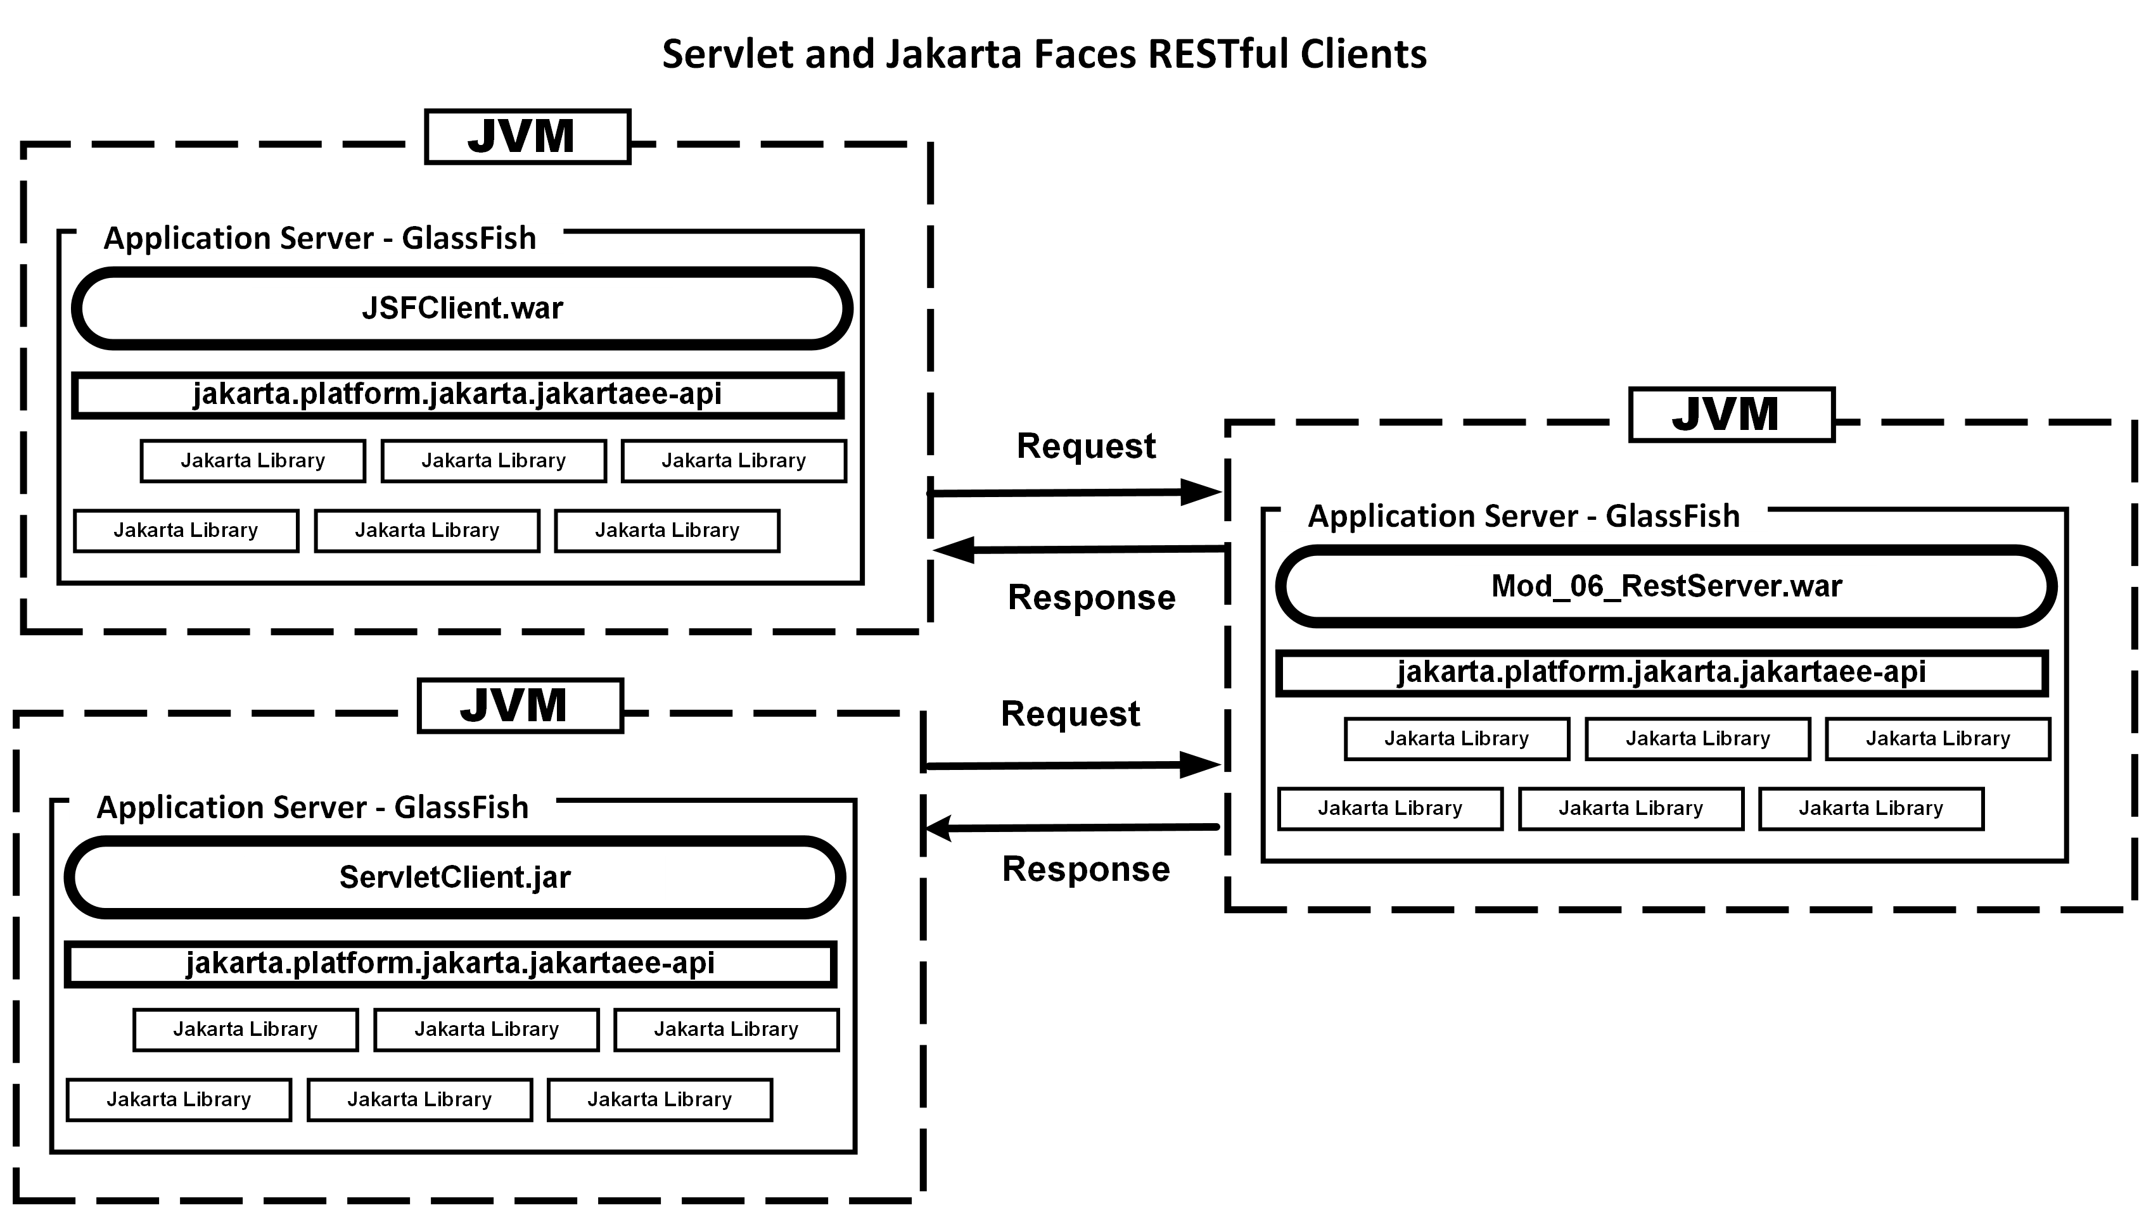
Source Code: 04_restserver, 04_jsfclient, 04_servletclient

Slide 12
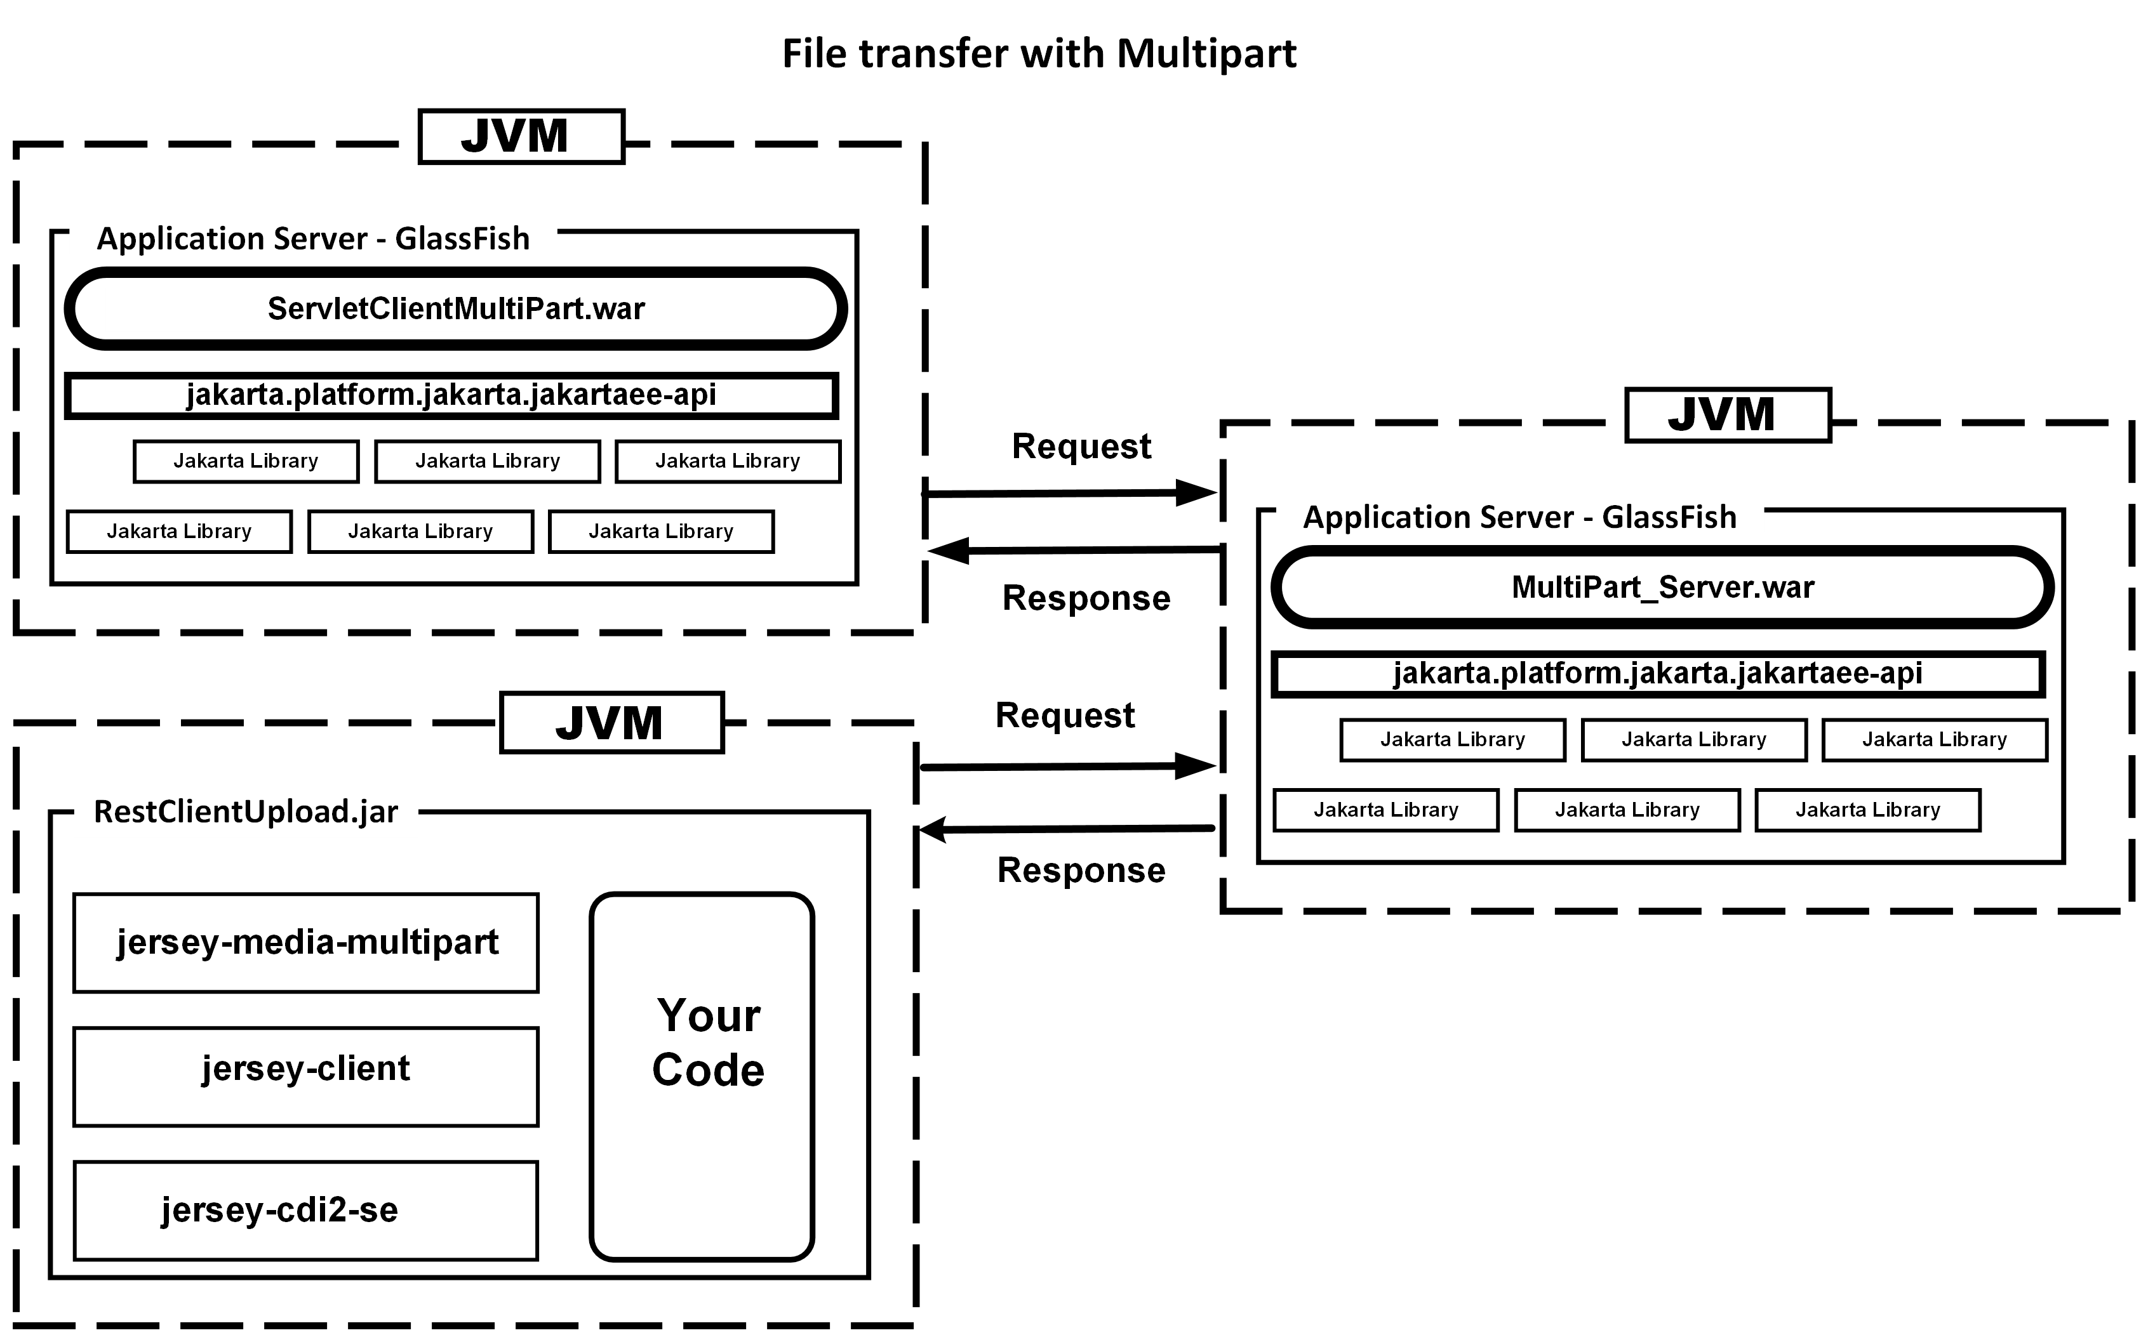
Source Code: 05_multipart_server, 05_restclientupload, 05_servletclientmultipart

Slide 13
You can find the source code at:
https://github.com/omniprof/JakartaRESTPresentation.git
I can be found on most social media platforms as omniprof or KenFogel however X/Twitter is where I post the most.
You can also reach me by email at omniprof@gmail.com
Happy coding!

