Slide 1

This will take you to the Collections Performance V6 GitHub repo
Slides are in this repo in docs folder
This will appear again at the end of the presentation.

Slide 2

I Just Discovered the Java Microbenchmark Harness* and You Should To
Ken Fogel
* JMH has been around since 2013.

Slide 3

Gratuitous Plug
I wrote a book!
A book for those with experience with other languages who now need Java skills.
A quick refresher if you have been away from Java for a while.
Buy all your Python, C#, & other non-Java friends a copy.

Slide 4
When I taught
Java Collections
. . .

Slide 5
Sequential Collections Performance
 | ArrayList | ArrayDeque | LinkedList
get | O(1) | n/a | O(n)
set | O(1) | n/a | O(n)
add | O(1)/O(n) | n/a | O(1)
addFirst | n/a | O(1) | O(1)
addLast | n/a | O(1) | O(1)
contains | O(n) | O(n) | O(n)
remove | O(n) | O(n) | O(n)

Slide 6
Map Collections Performance
 | HashMap | TreeMap
get | O(1) | O(log n)
put | O(1) | O(log n)
contains | O(1) | O(log n)
remove | O(1) | O(log n)

Slide 7
Size Matters
 | constant | logarithmic | linear |  | quadratic | cubic
n | O(1) | O(log N) | O(N) | O(N log N) | O(N²) | O(N³)
1 | 1 | 1 | 1 | 1 | 1 | 1
2 | 1 | 1 | 2 | 2 | 4 | 8
4 | 1 | 2 | 4 | 8 | 16 | 64
8 | 1 | 3 | 8 | 24 | 64 | 512
16 | 1 | 4 | 16 | 64 | 256 | 4,096
1,024 | 1 | 10 | 1,024 | 10,240 | 1,048,576 | 1,073,741,824
1,048,576 | 1 | 20 | 1,048,576 | 20,971,520 | **** | ********

Slide 8

How to measure performance inaccurately.
Rule #1: Do not use a compass.

Slide 9
The basic algorithm
Record the time at the start
Record the time at the end
Subtract start from end
Voila, you have measured time

Slide 10
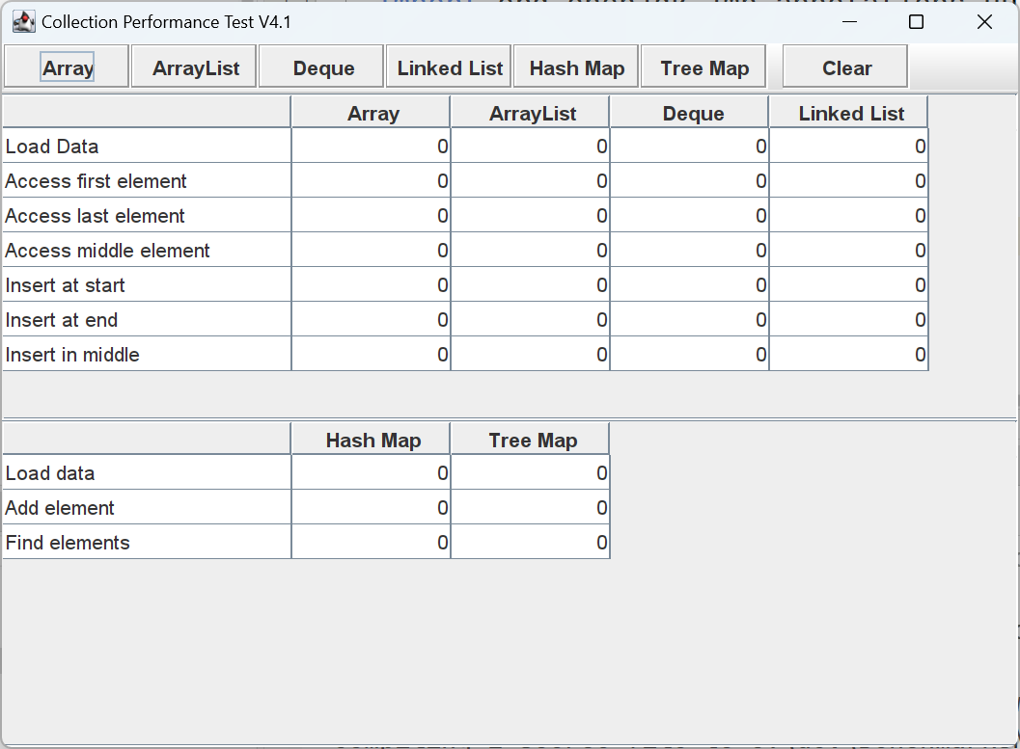
Let us look at my first version

Slide 11
What have I ignored. What have I done wrong?* * actually, quite a long list

Slide 12

No warmup
The JVM initializes internal structures over time
This is why repeatedly asking for a benchmark changes the results

Slide 13

Dead code
No return value/No arguments
Only local variables
Fields untouched
Results are always the same
Compiler considers this code to be dead

Slide 14
Constant folding
Expressions whose calculation returns a constant value
These can be calculated during the compilation phase
The result can take the place of the call to the calculation

Slide 15

Loops
Loop unrolling replicates the loop body multiple times
Reduces the Loop control structure overhead

Slide 16
Brief Code Review of Collections Performance 4.1

Slide 17
The solution:
Java Microbenchmark Harness

Slide 18

Image generated by Dall-E 3

Slide 19
Java Microbenchmark Harness (JMH)
JMH is a Java harness for building, running, and analyzing nano/micro/milli/macro benchmarks written in Java and other languages targeting the JVM.*
*from https://github.com/openjdk/jmh

Slide 20
In preparation:
Clone the JMH repo from
https://github.com/openjdk/jmh
Bookmark in your browser the Java Docs at
https://javadoc.io/doc/org.openjdk.jmh/jmh-core/latest/index.html

Slide 21
Create a project from the Maven JMH archetype
* In the Windows Console replace \ with ^. DO NOT USE PowerShell.

Slide 22
A JMH Project
Update the pom.xml file with the version of Java you will use.
Optionally, update the version numbers of the plugins

Slide 23
How the Harness will work
No need for a main method
Create one or more classes with methods annotated with @Benchmark

Slide 24
How the Harness will work
When run, the harness identifies all the benchmark methods
The method’s code is used to generate the actual tests

Slide 25
Configure the method for the JMH
@Benchmark
@Fork(value = 2)
@Measurement(iterations = 5, time = 10)
@Warmup(iterations = 5, time = 10)

Slide 26
Configure the class for the JMH
@BenchmarkMode(Mode.AverageTime)
@OutputTimeUnit(TimeUnit.NANOSECONDS)

Slide 27
Let’s benchmark something simple: String Concatenation vs StringBuilder

Slide 28
Reduce JVM Optimizations
Create and use a State class/object
Use a Blackhole object
Let’s look at how we deal with optimization.

Slide 29

Collections Performance V 6.0
Let us look at the rewrite of the 4.1 tests for the JMH.

Slide 30
Collections Performance 6.0
This project features two versions of testing.
First is a re-write of the original test code that displays its result in a table.
Second uses the JMH.
Operations being tested are the same as 4.1.
The big change is that every tested operation is a unique method.

Slide 31
The QR Code will take you to the Collections Performance V6 GitHub repo
Slides are in this repo.
The next slides show references and repos of other code used today

Slide 32
Bibliography
https://www.geeksforgeeks.org/analysis-algorithms-big-o-analysis/
https://www.baeldung.com/java-microbenchmark-harness
https://javadevcentral.com/measuring-execution-time-the-wrong-way
https://javadevcentral.com/naive-benchmarking-framework-in-java
https://javadevcentral.com/jmh-benchmark-with-examples
https://blog.nyrkio.com/2024/06/27/an-introduction-to-benchmarks/
https://jenkov.com/tutorials/java-performance/jmh.html
https://java-performance.info/jmh/
https://www.javaadvent.com/2019/12/measuring-time-from-java-to-kernel-and-back.html

Slide 33
GitHub repos
https://github.com/omniprof/collectionsperformance_v6
https://github.com/omniprof/CollectionsPerformanceV4.1
https://github.com/omniprof/StringConcatenation_JMH
https://github.com/omniprof/JMH_State_Demo
https://github.com/omniprof/JMH_TestBed
The JMH Repo
https://github.com/openjdk/jmh
The JMH JavaDocs
https://javadoc.io/doc/org.openjdk.jmh/jmh-core/latest/index.html

