Slide 1

Introduction to Reinforcement Learning
AR0202
Computational Intelligence for Integrated Design

Slide 2
Contents
Introduction
Markov Decision Processes
Planning: Value Iteration
Learning: Q-Learning

Slide 3
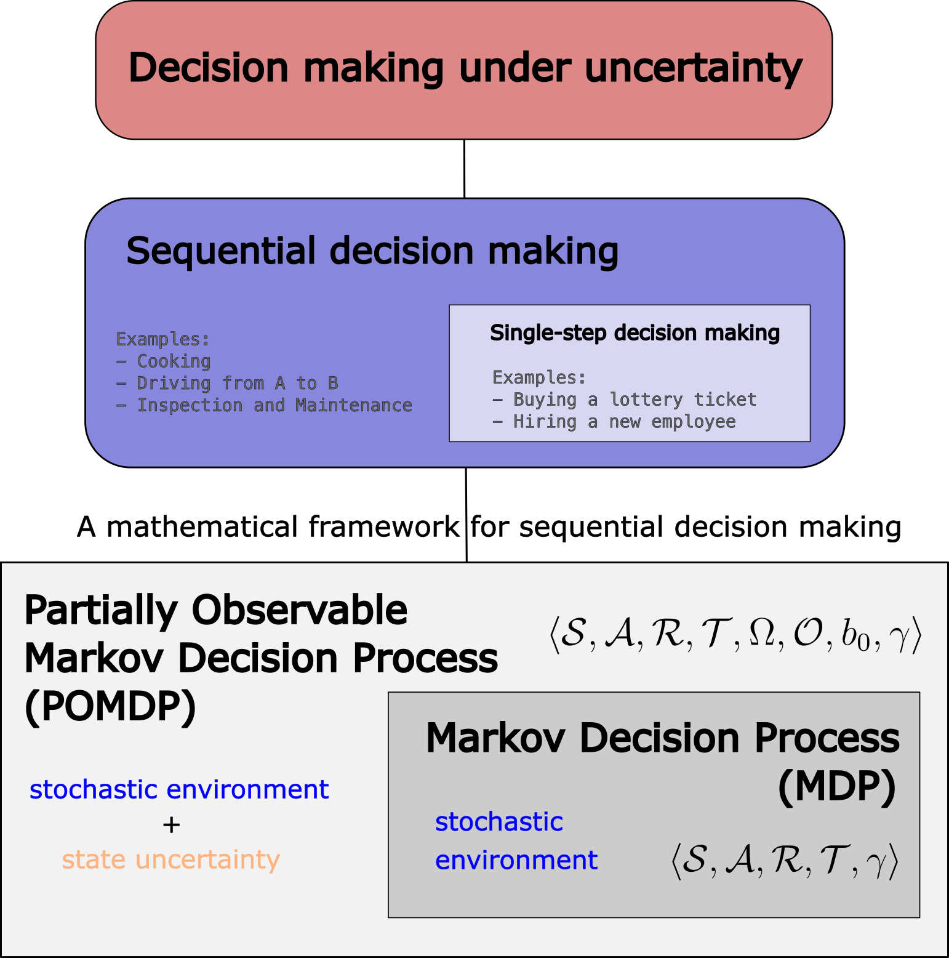
Overview

Slide 4
Overview

Slide 5
Overview

Slide 6
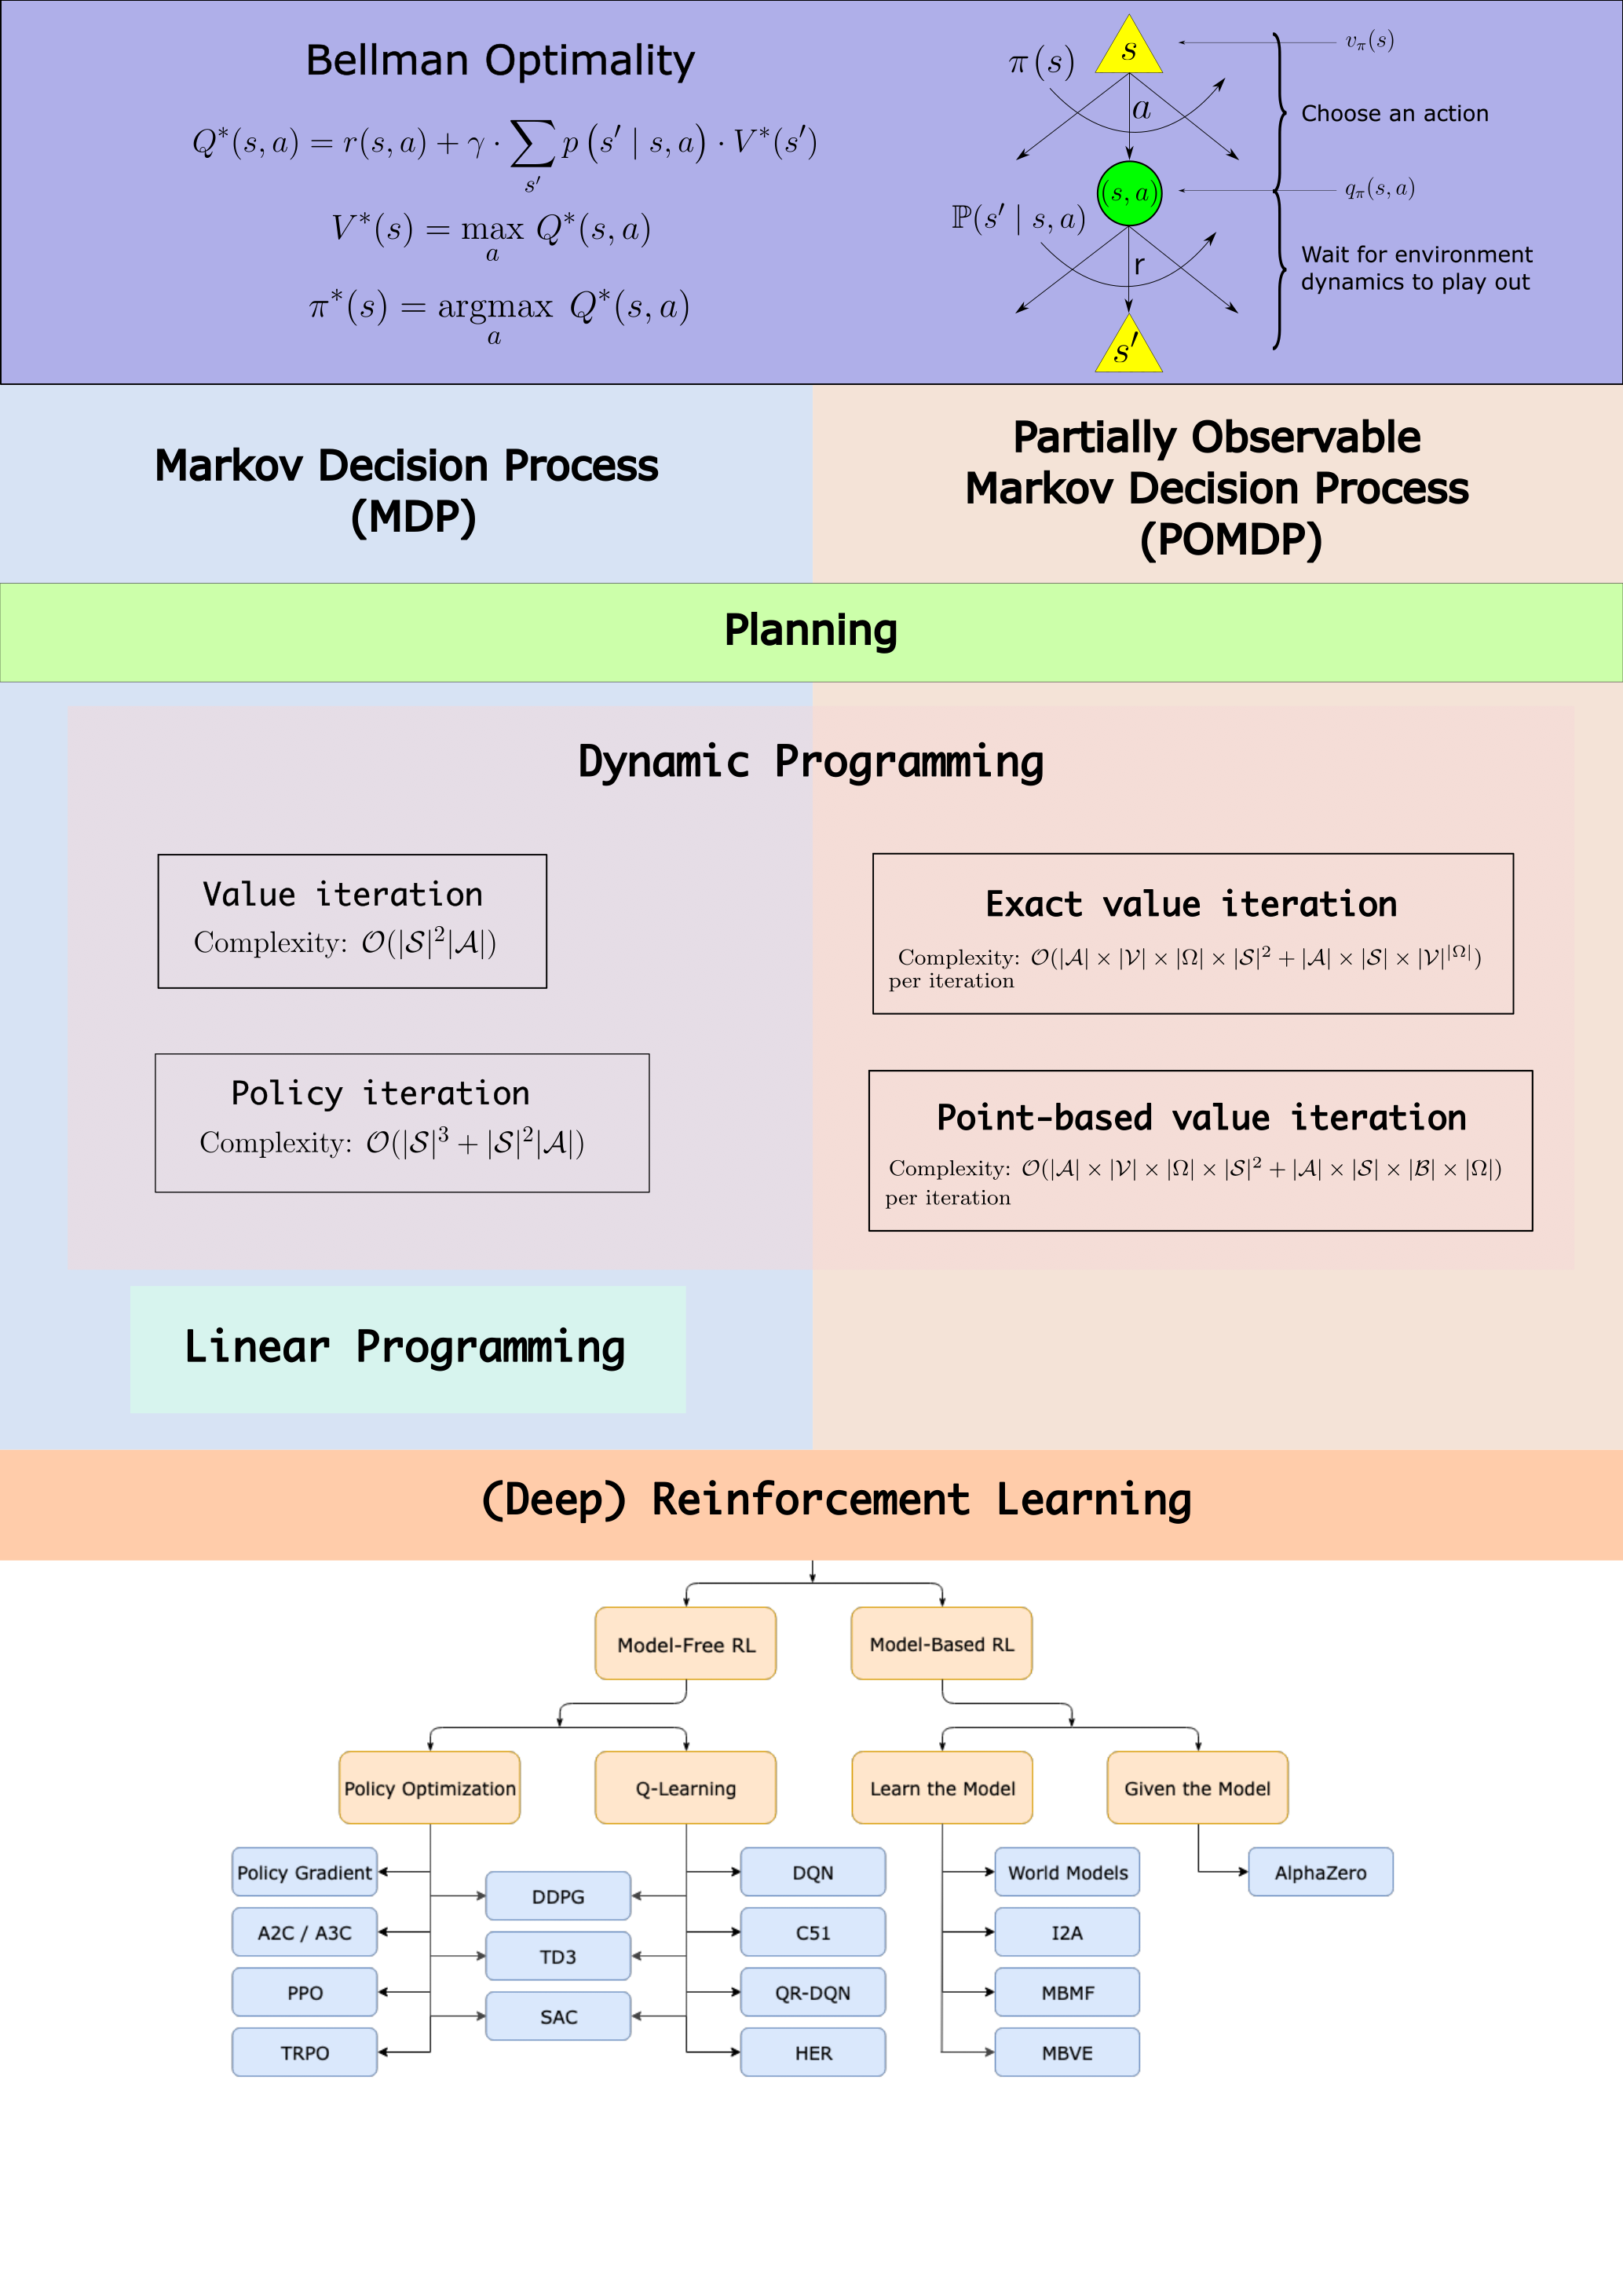
How do we solve them?

Slide 7
How do we solve them?

Slide 8
How do we solve them?

Slide 9
A Gentle Introduction to Markov Decision Processes (MDPs)

Slide 10
Please setup your Jupyter Notebooks ☺

Slide 11
Motivation
Consider the following problems,
Autonomous driving
How can you navigate from A to B in traffic in minimum time?
Stragetic Games
How can you win at a game of Chess/Go?
Inspection and Maintenance
How can we plan inspection and maintenance of deteriorating structures like aeroplanes/buildings?
Notes:
Source: LinkedIn Sep-21

Slide 12
Motivation
What do they have in common?
Decision Making Under Uncertainty
Intuitively, this refers to acting in an uncertain/stochastic environment (and potentially with limited observability) in order to achieve the desired goal.
Notes:
Source: LinkedIn Sep-21

Slide 13
How many decisions?
Within this realm, we have
Single-step decision making, which involves making a single decision
Examples: Buying a lottery ticket or hiring a new employee
Sequential decision making, which involves making a sequence of decisions to achieve the desired goal.
Examples: *try to think of examples other than the ones we saw earlier*

Slide 14
Types of uncertainty
In the context of decision making under uncertainty, we distinguish between
Transition uncertainty
Uncertainties arising from the stochastic environment in which we must make decisions
- Mathematical framework: Markov Decision Processes (MDPs)
State uncertainty
Uncertainty about our state arising from partial/noisy observations of the environment.
[Transition + State uncertainty]
Mathematical framework: Partially Observable Markov Decision Processes (POMDPs)

