Slide 1
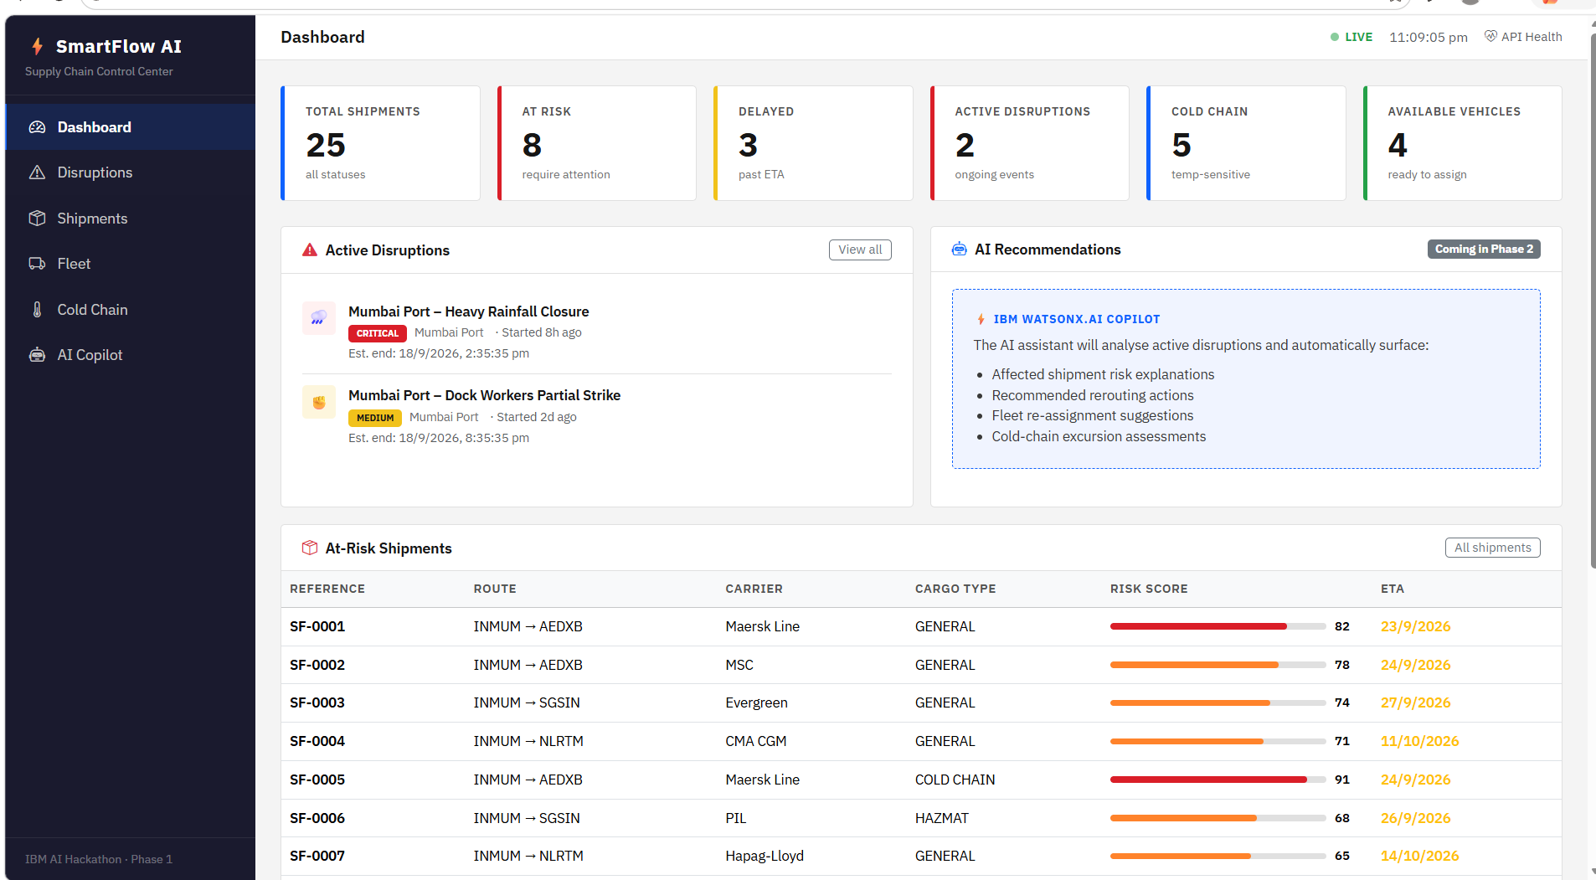
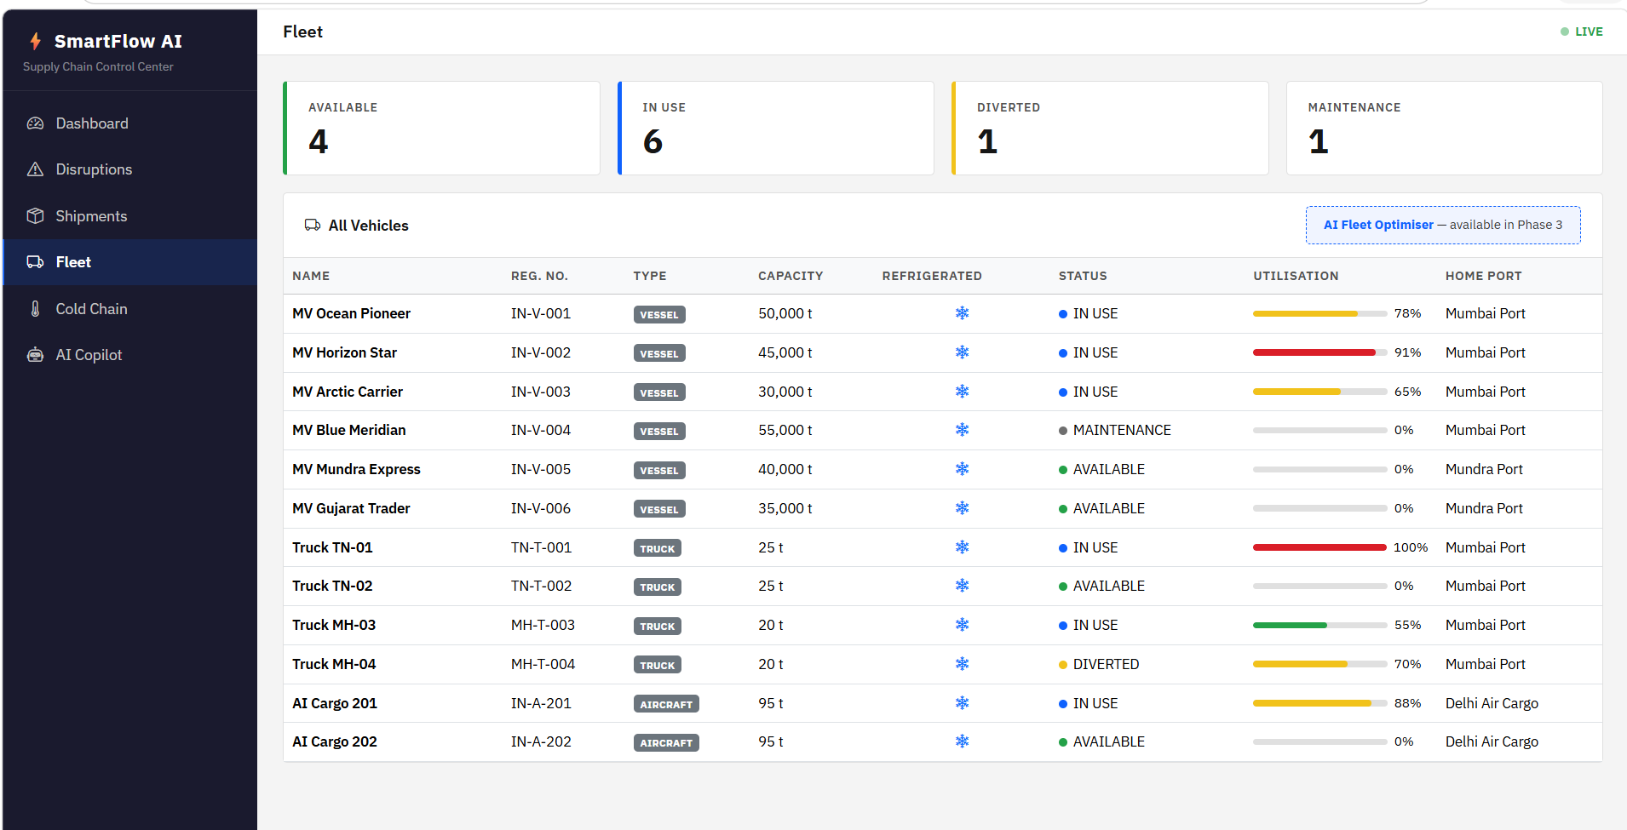
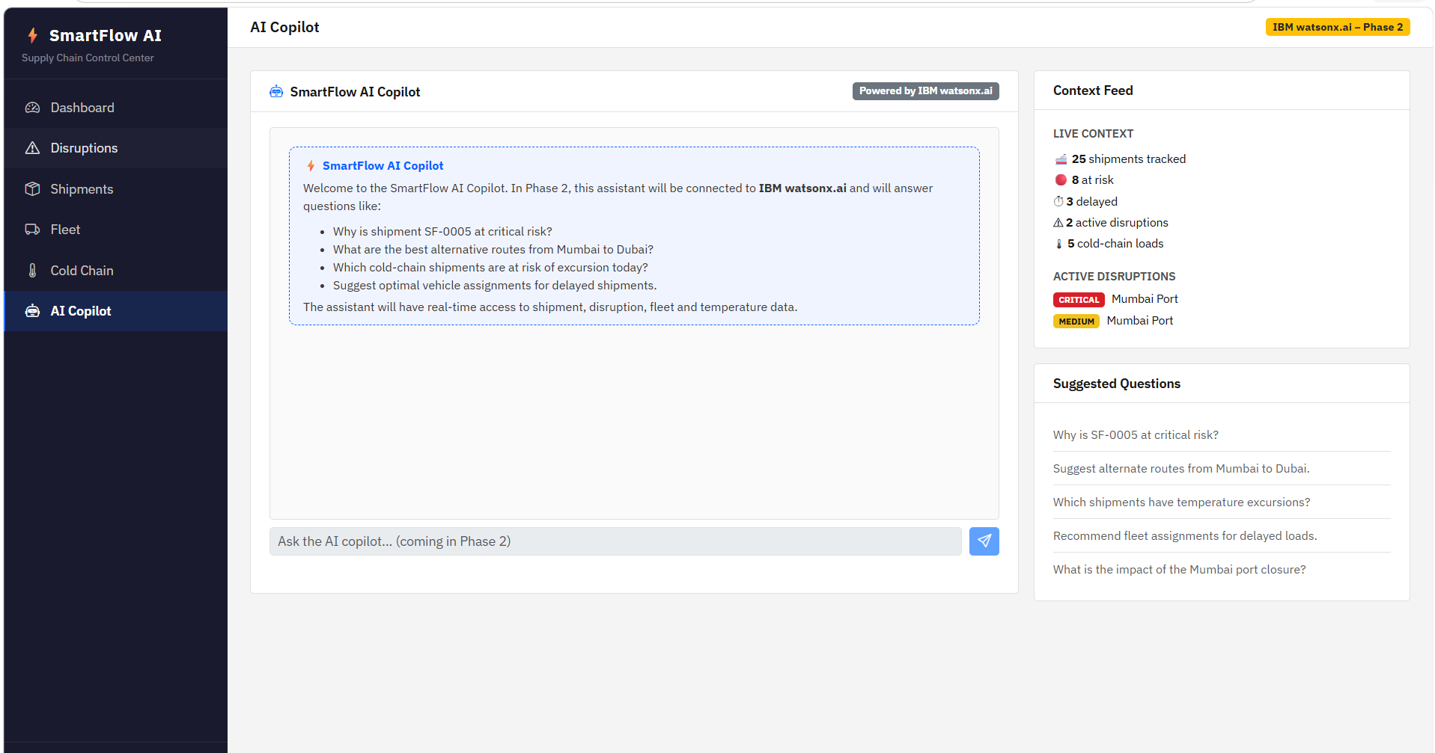
⚡
SMARTFLOW AI
Supply Chain Control Center
Supply Chain Disruption Assistant
& Fleet Utilisation Optimizer
AI-powered visibility, risk detection and operational recommendations
for resilient and efficient logistics.
HACKATHON SOLUTION
Team: Om • Ayush • Krunal • Dhruv
Team Leader: Om Nayak

Slide 2
Problem Statement
02
Why supply chains need proactive disruption intelligence
Real-world logistics is highly dynamic. A single disruption can create delays, cost overruns and cargo risk across the network.
⚠
Disruptions happen suddenly
◉
Limited real-time visibility
Weather, port closures, strikes and operational incidents can change the planned route.
Teams need one place to see shipments, fleet status, disruption impact and cold-chain health.
↻
Manual decision-making
❄
Cold-chain risk
Rerouting and vehicle assignment can be slow when every minute matters.
Temperature-sensitive cargo needs continuous monitoring and immediate excursion alerts.
Our goal: move from reactive firefighting → proactive, AI-assisted control.
SMARTFLOW AI • Supply Chain Disruption Assistant & Fleet Utilisation Optimizer

Slide 3
Proposed Solution
03
One control center for disruption, shipment, fleet and cold-chain decisions
LIVE DATA
RISK ENGINE
AI ASSISTANT
ACTION
Shipments • Fleet
Disruptions • Sensors
Identify affected
loads & priorities
Explain risk • Recommend
action • Compare options
Reroute • Reassign
• Escalate
Core capabilities
✓ Live disruption detection
✓ AI alternative route recommendations
✓ Fleet utilisation optimisation
✓ Cold-chain temperature monitoring
✓ AI Copilot for operational questions
✓ Dashboard with risk and ETA visibility
SMARTFLOW AI • Supply Chain Disruption Assistant & Fleet Utilisation Optimizer

Slide 4
System Architecture & Workflow
04
DATA SOURCES
Shipment records | Fleet status | Port/disruption events | Temperature sensors
How SmartFlow AI turns operational data into actionable decisions
BACKEND
Spring Boot APIs | Business rules | Risk scoring | Data persistence
AI / INTELLIGENCE
Python + ML/LLM API | IBM watsonx.ai integration (Phase 2)
DECISION SERVICES
Disruption impact | Alternate route | Fleet assignment | Cold-chain alerts
WEB CONTROL CENTER
Dashboard | Disruptions | Shipments | Fleet | Cold Chain | AI Copilot
Output: faster response • lower disruption impact • better vehicle utilisation • safer cold-chain cargo
SMARTFLOW AI • Supply Chain Disruption Assistant & Fleet Utilisation Optimizer

Slide 5
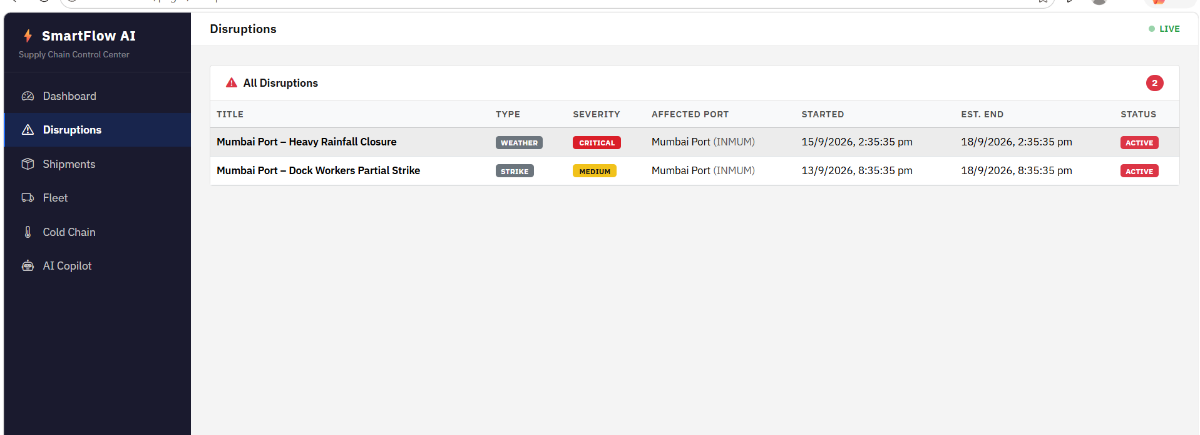
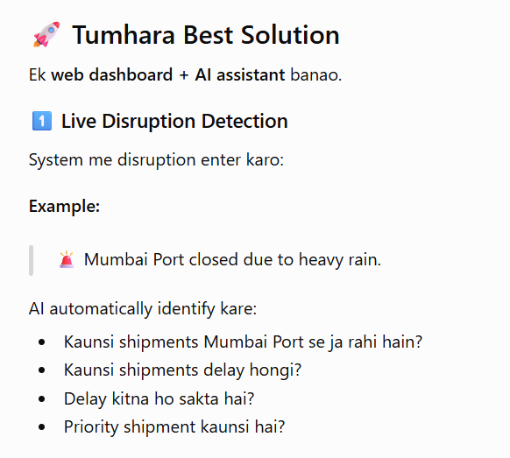
1. Live Disruption Detection
05
Automatically identify which shipments are affected and how urgent the impact is
What the system detects
Example
Affected shipments • delay exposure • priority/risk level • disruption status
Mumbai Port heavy rainfall is marked CRITICAL and surfaced as an active disruption.
SMARTFLOW AI • Supply Chain Disruption Assistant & Fleet Utilisation Optimizer

Slide 6
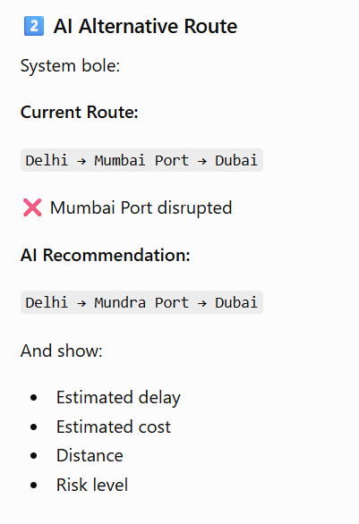
2. AI Alternative Route Recommendation
06
When a route is disrupted, compare safer alternatives instead of waiting for manual planning
Route comparison example
CURRENT ROUTE
Delhi → Mumbai Port → Dubai
✕ Mumbai Port disrupted
AI RECOMMENDATION
Delhi → Mundra Port → Dubai
Estimated delay
Estimated cost
8 hours
Compare
Distance
Risk level
Compare
LOW
SMARTFLOW AI • Supply Chain Disruption Assistant & Fleet Utilisation Optimizer

Slide 7
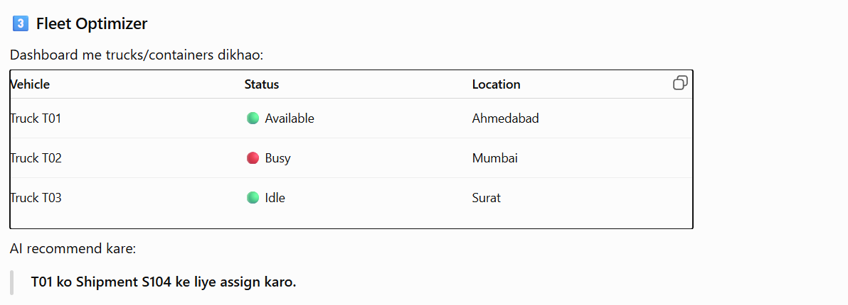
3. Fleet Utilisation Optimizer
07
Recommend the best available vehicle for delayed or disrupted loads
Fleet visibility
Optimisation goal
Available • In Use • Diverted • Maintenance
Higher utilisation with fewer idle/overloaded assets
SMARTFLOW AI • Supply Chain Disruption Assistant & Fleet Utilisation Optimizer

Slide 8
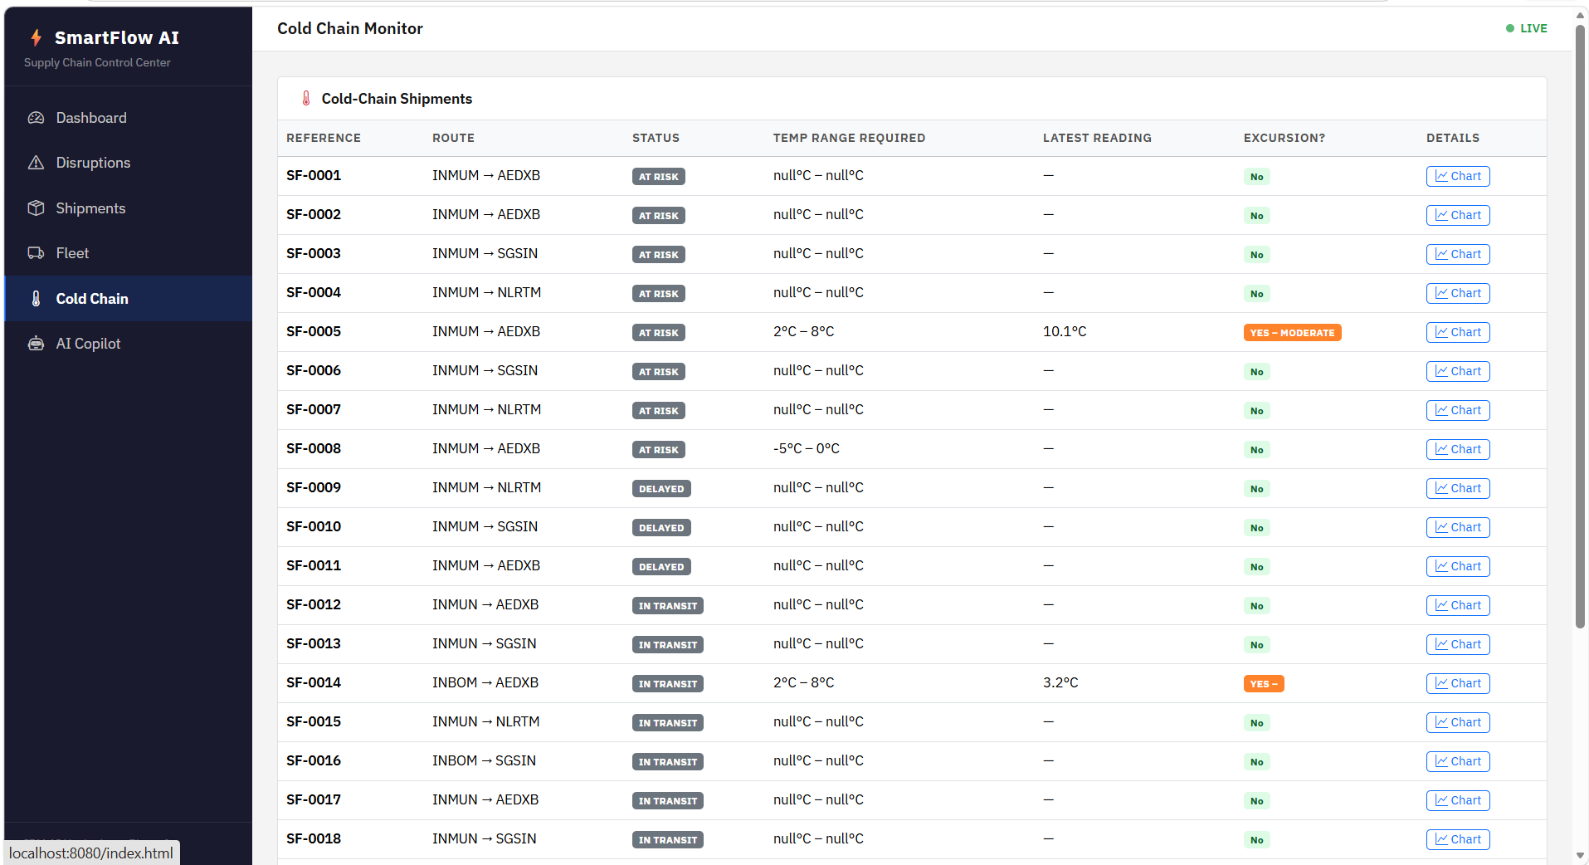
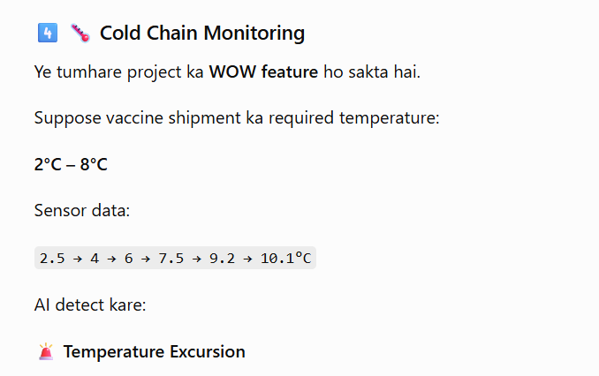
4. Cold-Chain Monitoring
08
Protect temperature-sensitive cargo with automatic excursion detection
Example: SF-0005
AI action
Required: 2°C–8°C | Reading: 10.1°C
Flag excursion severity and prioritise intervention
SMARTFLOW AI • Supply Chain Disruption Assistant & Fleet Utilisation Optimizer

Slide 9
5. SmartFlow AI Control Center
09
A single operational dashboard gives decision-makers an instant network health view
Live KPIs
25
Total shipments
8
At risk
3
Delayed
2
Active disruptions
5
Cold chain
4
Available vehicles
Decision focus
See risk → understand cause → choose action.
SMARTFLOW AI • Supply Chain Disruption Assistant & Fleet Utilisation Optimizer

Slide 10
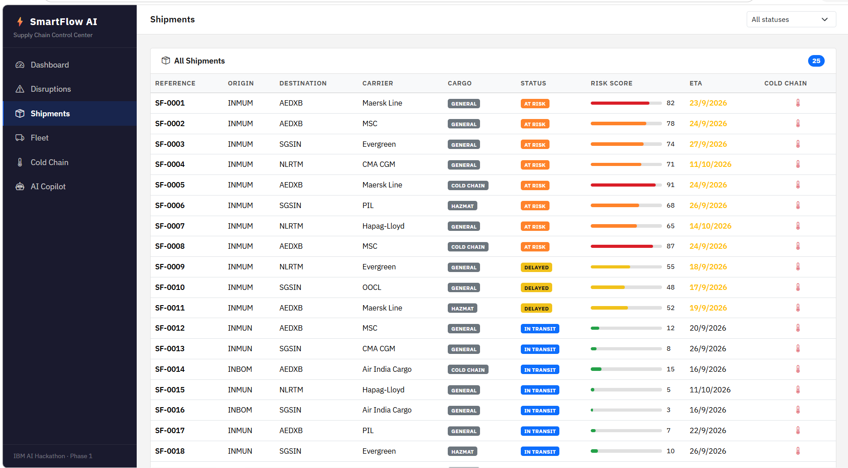
6. Shipment Risk Intelligence
10
Prioritise the loads that need attention first
Risk scoring
A simple score makes critical loads easy to prioritise.
Status tracking
At Risk • Delayed • In Transit are visible in one table.
Cold-chain flag
Temperature-sensitive shipments are visually highlighted.
SMARTFLOW AI • Supply Chain Disruption Assistant & Fleet Utilisation Optimizer

Slide 11
7. Disruption Management
11
Centralised incident tracking with severity, location, timing and status
Current example
CRITICAL
Mumbai Port – Heavy Rainfall Closure
MEDIUM
Dock Workers Partial Strike
SMARTFLOW AI • Supply Chain Disruption Assistant & Fleet Utilisation Optimizer

Slide 12
8. Fleet Management
12
Know what is available, where it is, and how heavily it is being utilised
Operational insight
4 available • 6 in use • 1 diverted • 1 under maintenance
SMARTFLOW AI • Supply Chain Disruption Assistant & Fleet Utilisation Optimizer

Slide 13
9. AI Copilot
13
Natural-language access to shipment, disruption, fleet and temperature intelligence
Ask questions like:
• Why is SF-0005 at critical risk?
• Suggest alternate routes from Mumbai to Dubai.
• Which shipments have temperature excursions?
• Recommend fleet assignments for delayed loads.
• What is the impact of the Mumbai port closure?
Phase 2
IBM watsonx.ai
SMARTFLOW AI • Supply Chain Disruption Assistant & Fleet Utilisation Optimizer

Slide 14
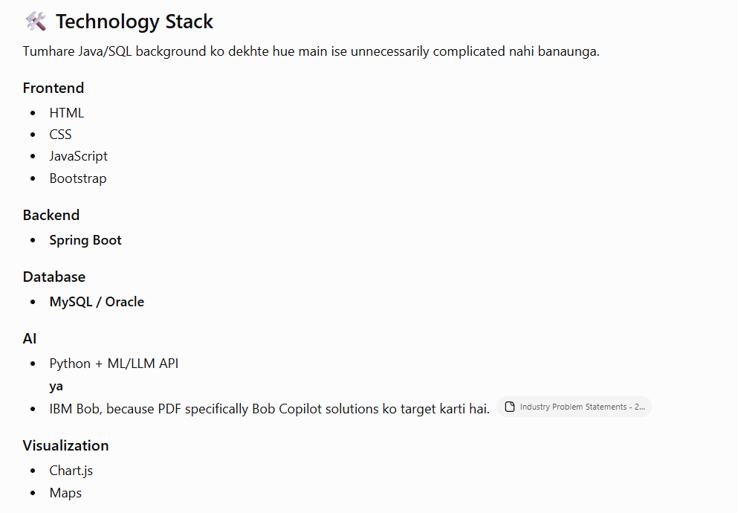
Technology Stack
14
Simple, practical architecture aligned with the implemented dashboard
Frontend
HTML • CSS • JavaScript • Bootstrap
Backend
Spring Boot • REST APIs • Business logic
Database
MySQL / Oracle
AI
Python + ML/LLM API • IBM watsonx.ai (Phase 2)
Visualisation
Chart.js • Maps
Design principle: keep the stack focused on reliability, speed and demo-ready integration.
SMARTFLOW AI • Supply Chain Disruption Assistant & Fleet Utilisation Optimizer

Slide 15
Expected Impact
15
Business value of proactive supply-chain intelligence
01
Faster response
02
Lower delay impact
03
Better fleet utilisation
Detect disruptions early and surface affected shipments immediately.
Compare alternate routes before a disruption becomes a major bottleneck.
Use available capacity intelligently instead of leaving assets idle.
04
Reduced cargo risk
05
One source of truth
06
Smarter decisions
Protect cold-chain shipments through temperature excursion alerts.
Bring shipment, fleet, disruption and sensor data into one control center.
Give operators explanations and recommendations, not just raw data.
Result: a control-tower experience that helps teams act before disruptions cascade.
SMARTFLOW AI • Supply Chain Disruption Assistant & Fleet Utilisation Optimizer

Slide 16
Roadmap & Team
16
From a strong operational dashboard to an AI-driven control tower
Next phases
Phase 1
Dashboard foundation
Live operational visibility
Phase 2
IBM watsonx.ai Copilot
AI explanations & recommendations
Phase 3
AI Fleet Optimiser
Smarter assignments & route choices
Team
OM NAYAK
AYUSH
KRUNAL
DHRUV
Team Leader
Team Member
Team Member
Team Member
THANK YOU
SMARTFLOW AI • Team Om • Ayush • Krunal • Dhruv

