Slide 1
Building a Mini SIEM/SOAR in Azure
Project Initiation
Setup Azure Environment
Logging and Monitoring
SIEM Configuration
SOAR (Secure Cloud Configuration)
Documentation
Define project scope and objectives
Create an Azure subscription
and resources
GeoIP Data Ingestion,
Log Analytics and Microsoft
Sentinel (SIEM) Setup
Configure Microsoft
Sentinel
Regulatory Compliance
Create documentation
Research and
Requirement
Gathering
Setup Azure Virtual Machines
Enable Microsoft Defender
for Cloud, Log connection
for VMs and Network
Security Group
Azure Private Link & Firewall
for Resources (NIST SC-7)
Project Review & Presentation
Construct World Maps
Configure networking
security groups, and
firewall rules in Azure
Set up alerts and
notifications
Run Secure Environment for
24 Hours and Capture Analytics
Identify Azure
services and tools
for SIEM/SOAR
implementation
KQL modification and modification.
Create incident response playbooks
– IR Playbook
Install MS SQL Server and
SQL Server Management
Studio
Understanding and Triggering Sentinel Alert
Access Control (login and Priority)
Implement automated responses
for cloud security incidents
Precursor to Security Operations (Failed auth, log observation)
Run insecure
environment for
24hours and capture
Analytics.
Set up Log Analytic Workspace
Install Azure Active
Directory (Entra ID)
Set up firewall rules for
forwarding logs
Incidence Handling

Slide 2
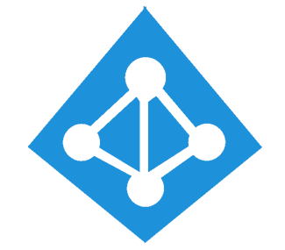
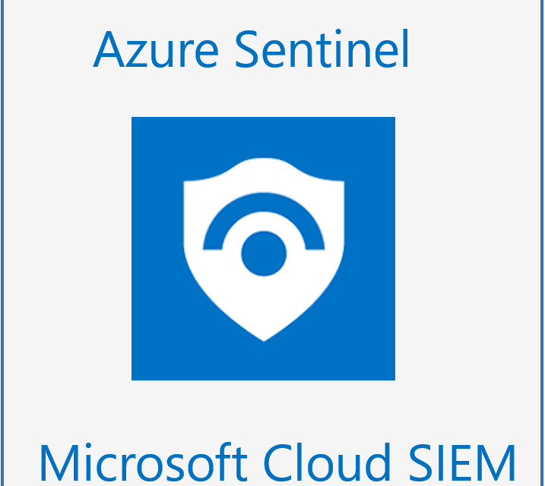



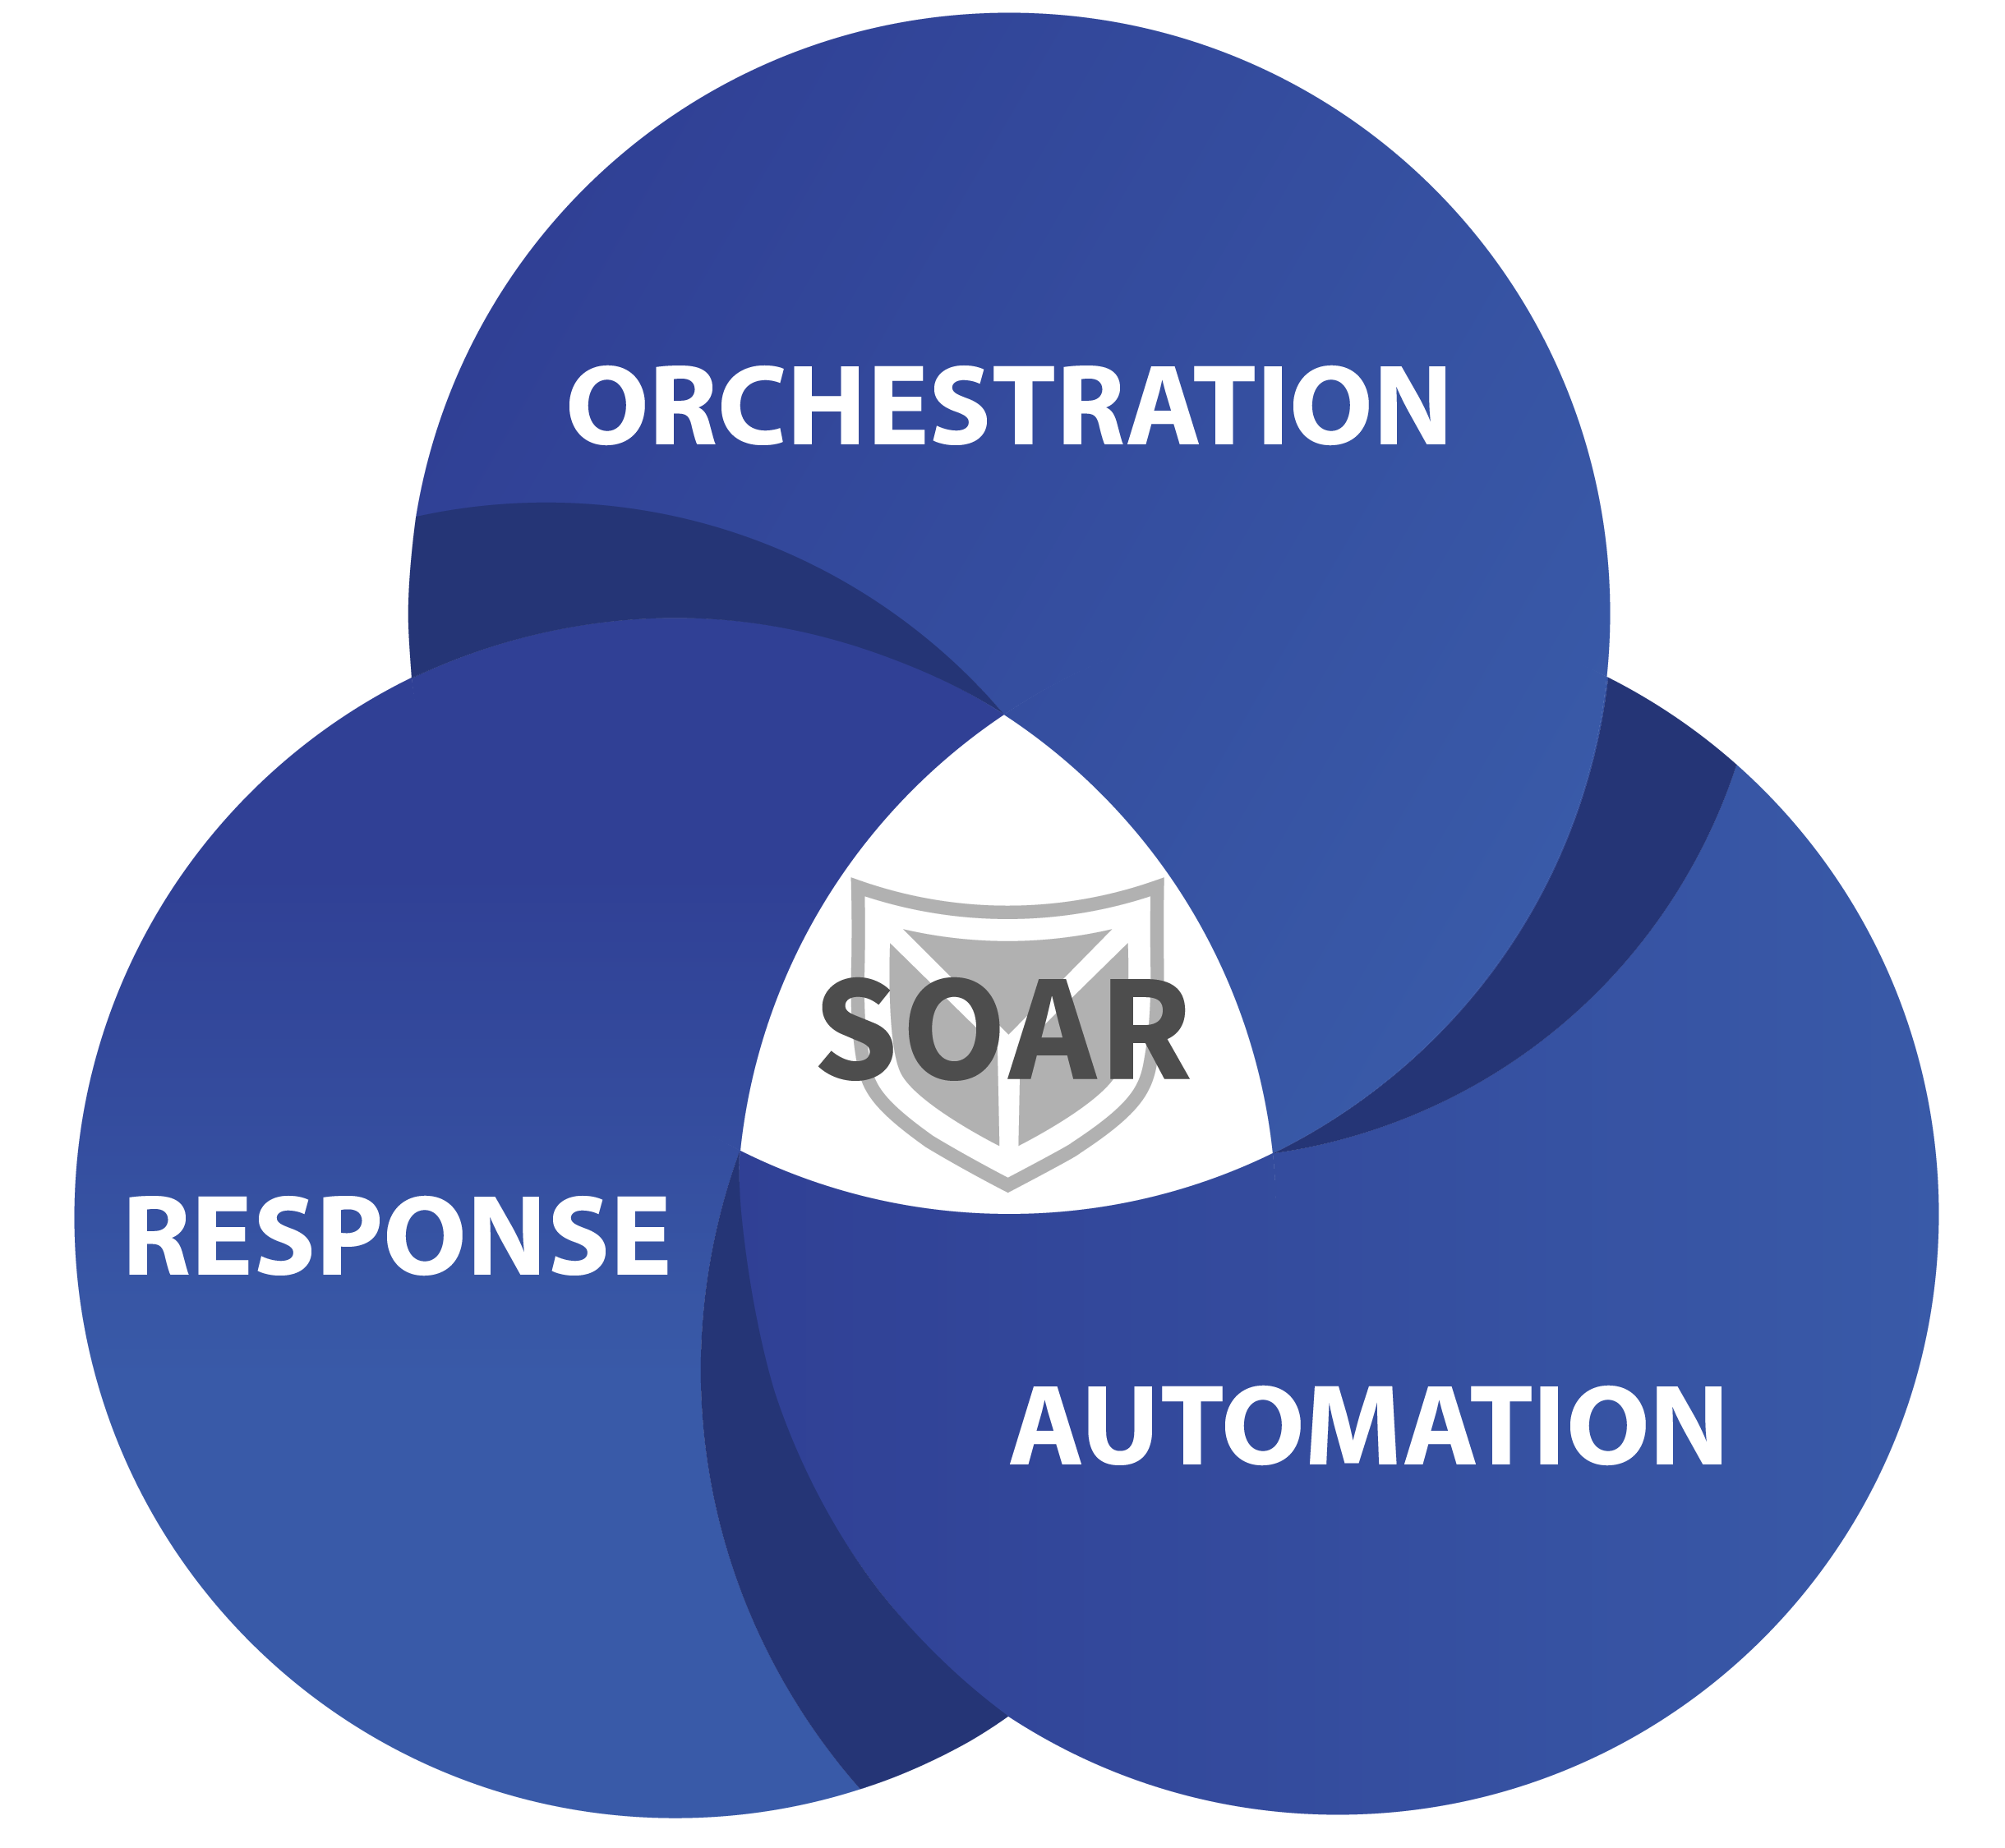
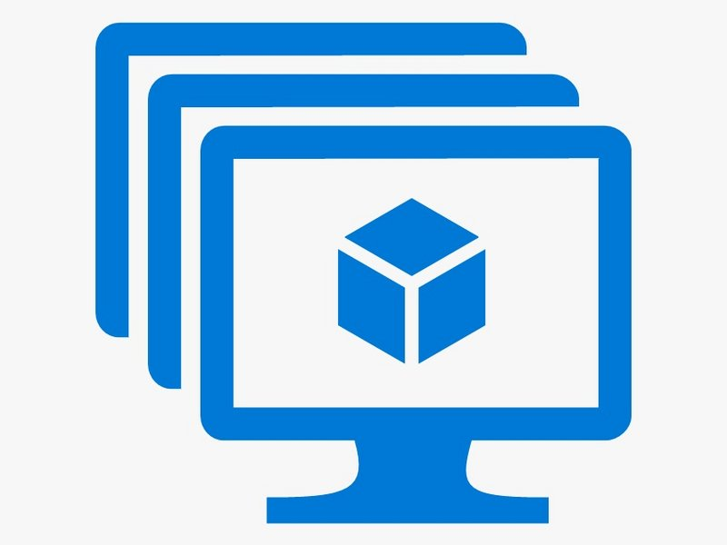



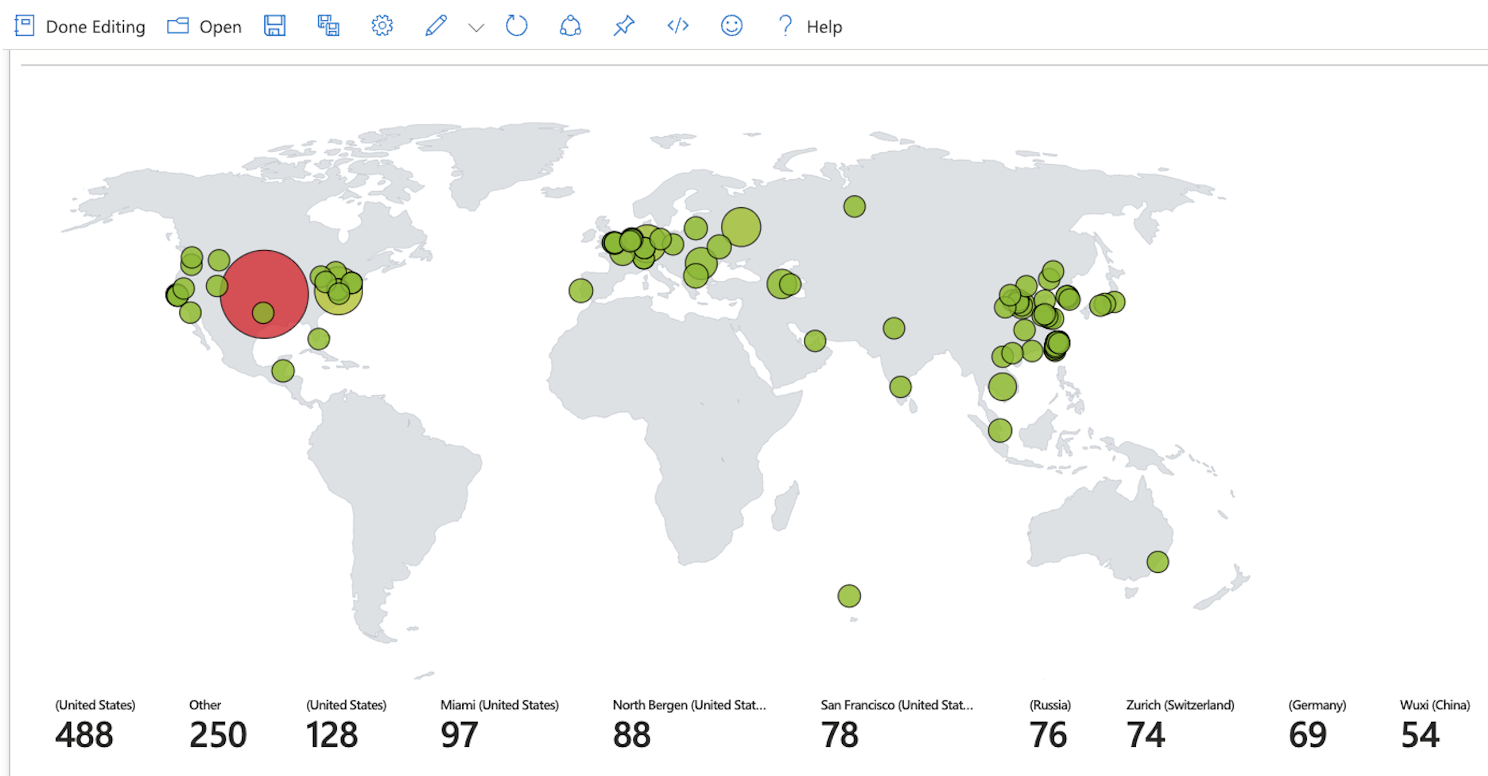
Log Analytics
Workspace
Entra ID
Map. Incidence and Alert.
VMs:
- Linux
- Windows
Blob
Storage
Key Vault
Activity Log

Slide 3

MS SQL
Server 2019
Windows-vm
Linux-vm

Slide 4
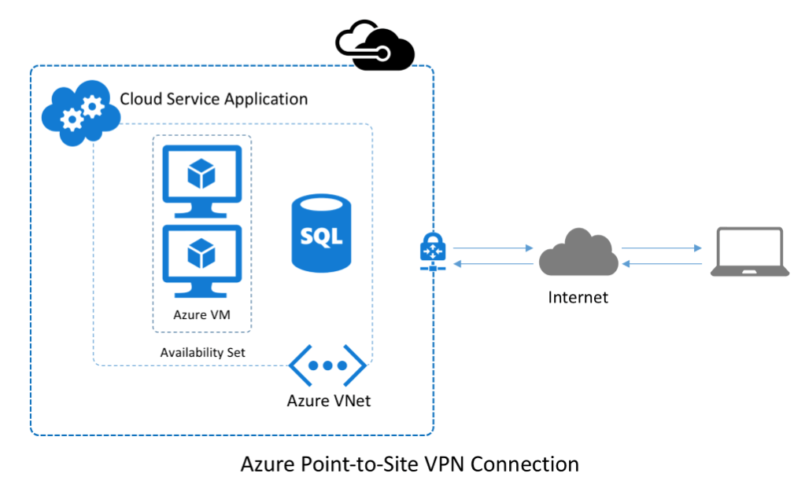
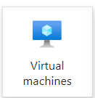
Tenant (Organization)
Subscription
Resource Group 1
Azure VNet
Linux-vm
Windows-vm

Slide 5
Tenant (Organization)
Fail Auth /
Successful Auth
Subscription
Resource Group 1
Azure VNet
Linux-vm
Windows-vm
Attack-vm

Slide 6




Azure Active Directory
AAD/Tenant Logs
Data Plane Logs
(Resource Level)
Resource Log
Log Analytics
Workspace
Activity Log
Management Plane Logs
(Subscription Level)
Notes:
Talk about how if they’re not sure if their communication skills are up to par then they can schedule a time to talk with me on the course page and I’ll give them the feedback on if you would do fine.

Slide 7




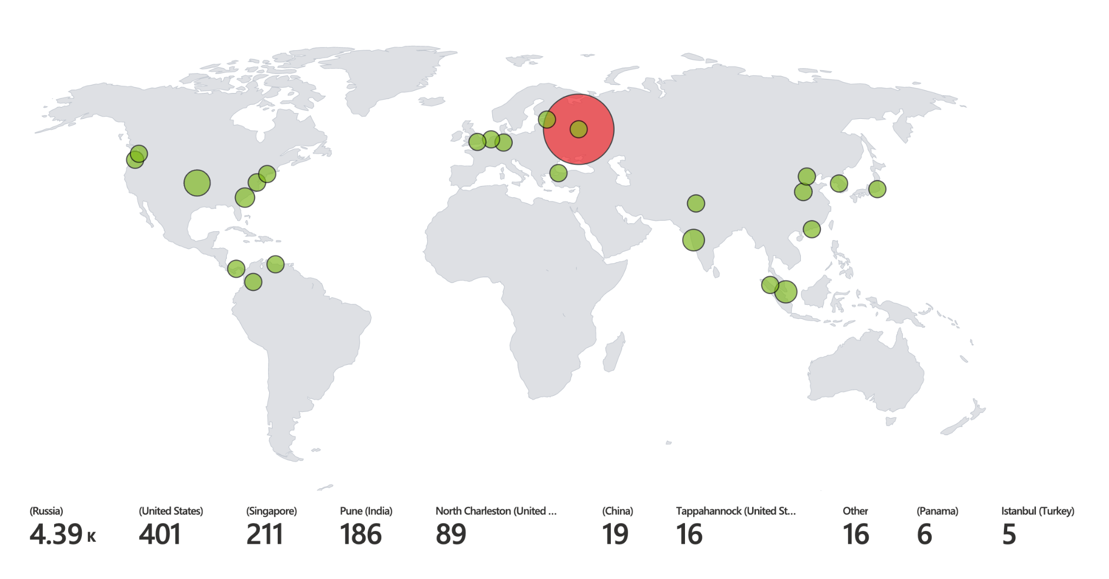

Final Project: Cloud SOC
Log Analytics
Workspace
Azure Sentinel (SIEM)
Azure AD
SQL Database
Maps, Incidents, & Alerts
Virtual Machines
Blob Storage
Key Vault
Activity Log
Notes:
Talk about how if they’re not sure if their communication skills are up to par then they can schedule a time to talk with me on the course page and I’ll give them the feedback on if you would do fine.

Slide 8
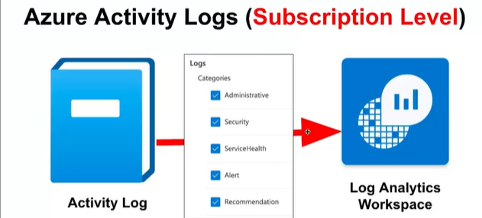
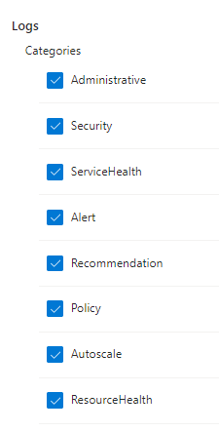

Slide 9
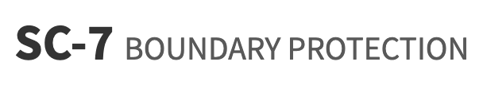
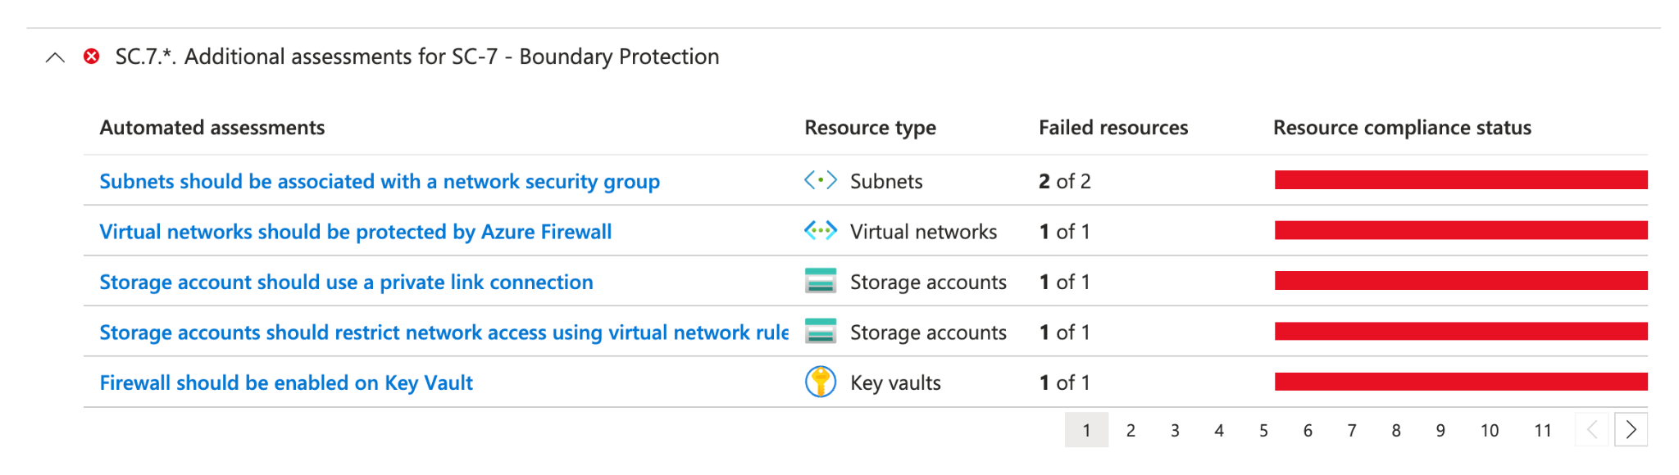
Implementing NIST 800-53: SC-7

Slide 10

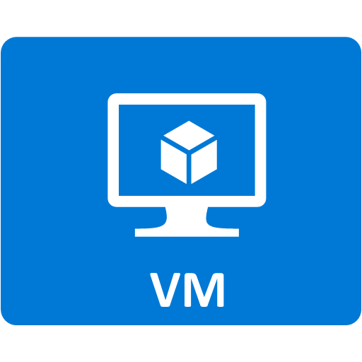

Public
Internet
(Wide Open NSGs)

Slide 11
Storage
Key Vault

Slide 12
Virtual Network
Subnet
Private Endpoint
Public Internet
Private Endpoint

Slide 13
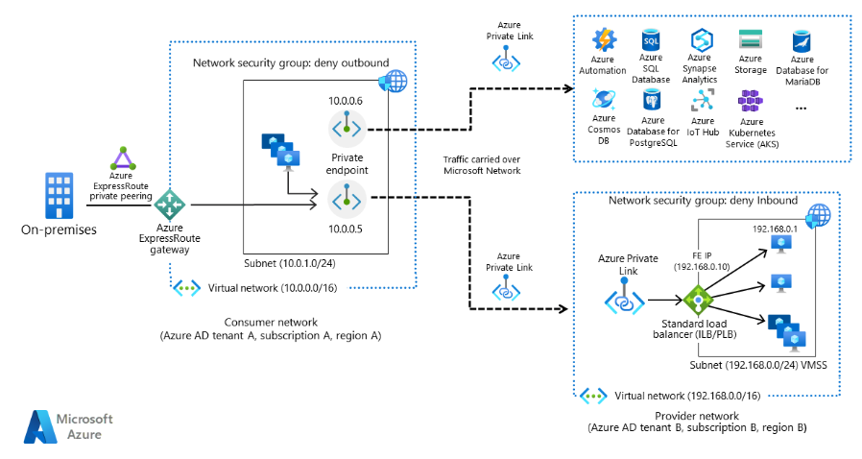
Private Link Overview: https://learn.microsoft.com/en-us/azure/private-link/private-link-overview

Slide 14



Virtual Machines
Log Analytics
Workspace
Key Vault
Entar ID
FIREWALL
Activity Log
MSSQL
Blob Storage
Azure Sentinel (SIEM)
FIREWALL
Attack & Incident Map
Notes:
Talk about how if they’re not sure if their communication skills are up to par then they can schedule a time to talk with me on the course page and I’ll give them the feedback on if you would do fine.

