Slide 1
ATLIQ Hardware Project (SQL)
Providing solutions to ATLIQ Hardware key stakeholders business problems for strategic decision making
OMOBOLAJI A. A.

Slide 2
Provide the list of markets in which customer “atliq exclusive” operates its business in the apac region
Customer | Market
Atliq Exclusive | India
 | Indonesia
 | Japan
 | Philiphines
 | South Korea
 | Australia
 | Newzealand
 | Bangladesh
Notes:
## 1. List of markets in which customer "Atliq Exclusive" operates its business in the APAC region (stored procedures available in SQL file)
SELECT
customer, market
FROM
dim_customer
WHERE
customer = 'Atliq Exclusive'
AND region = 'APAC'
GROUP BY market;

Slide 3
What is the percentage of unique product increase in 2021 vs 2020?
2020 Unique Products | 2021 Unique Products | % Change
51 | 68 | 33.33
Notes:
## 2. The percentage of unique product increase in 2021 vs. 2020.
WITH CTE AS (
SELECT
COUNT(DISTINCT CASE
WHEN fiscal_year = 2020 THEN p.product
END) AS unique_products_2020,
COUNT(DISTINCT CASE
WHEN fiscal_year = 2021 THEN p.product
END) AS unique_products_2021
FROM
dim_product p
JOIN
fact_sales_monthly s ON p.product_code = s.product_code)
SELECT
*,
ROUND(((unique_products_2021/unique_products_2020) - 1) * 100,2) AS percentage_change
FROM
CTE;

Slide 4
Provide a report with all the unique product counts for each segment and sort them in descending order of product counts
Segment | Product Count
Accessories | 20
Peripherals | 20
Notebook | 17
Storage | 9
Desktop | 4
Networking | 3
Notes:
## 3. Unique product counts for each segment.
SELECT
segment,
COUNT(DISTINCT product) AS product_count
FROM
dim_product
GROUP BY
segment
ORDER BY
product_count DESC;

Slide 5
Which segment had the most increase in unique products in 2021 vs 2020?
Segment | Product Count 2020 | Product Count 2021 | Difference
Accessories | 13 | 19 | 6
Peripherals | 15 | 20 | 5
Desktop | 1 | 3 | 2
Notebook | 14 | 16 | 2
Networking | 2 | 3 | 1
Storage | 6 | 7 | 1
Notes:
## 4. Segment with the most increase in unique products in 2021 vs 2020
WITH CTE1 AS (
SELECT
p.segment,
COUNT(DISTINCT CASE
WHEN fiscal_year = 2020 THEN p.product
END) AS product_count_2020,
COUNT(DISTINCT CASE
WHEN fiscal_year = 2021 THEN p.product
END) AS product_count_2021
FROM
dim_product p
JOIN
fact_sales_monthly s ON p.product_code = s.product_code
GROUP BY
p.segment)
SELECT
*,
product_count_2021 - product_count_2020 AS difference
FROM
CTE1
ORDER BY
difference DESC;

Slide 6
products with the highest and lowest manufacturing costs.
Product Code | Product | Manufacturing Cost
A6120110206 | AQ HOME Allin1 Gen 2 | 240.5364
A2118150101 | AQ Master wired x1 Ms | 0.892
Notes:
## 5. Products with highest and lowest manufacturing costs
WITH manufacturing_cost AS (
SELECT
p.product_code,
p.product,
manufacturing_cost
FROM
dim_product p
JOIN fact_manufacturing_cost m
ON m.product_code = p.product_code),
min_max_costs AS(
SELECT
MIN(manufacturing_cost) AS min_cost,
MAX(manufacturing_cost) AS max_cost
FROM
fact_manufacturing_cost
)
SELECT
mc.product_code,
mc.product,
mc.manufacturing_cost
FROM
manufacturing_cost mc
JOIN min_max_costs mm
ON mc.manufacturing_cost = mm.min_cost
OR mc.manufacturing_cost = mm.max_cost
ORDER BY mc.manufacturing_cost DESC;

Slide 7
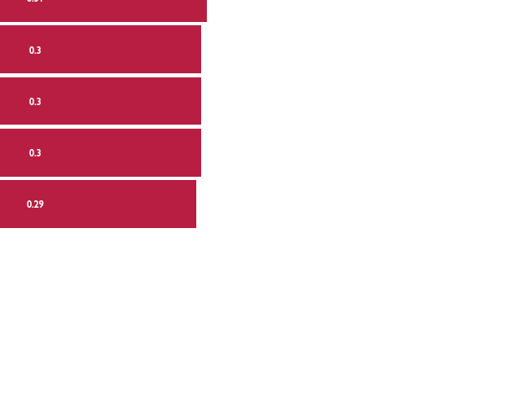
Who are the top 5 customers with the highest Average pre-invoice discount percentage for fiscal year 2021 in India market?
Customer Code | Customer | Average discount percentage
90002009 | Flipkart | 0.31
90002006 | Viveks | 0.3
90002002 | Croma | 0.3
90002003 | Ezone | 0.3
90002016 | Amazon | 0.29
Notes:
## 6. Top 5 Customers who received an average high pre-invoice-discount-pct for the fiscal year 2021 in India (stored procedures available in SQL file)
SELECT
c.customer_code,
c.customer,
ROUND(AVG(pre_invoice_discount_pct), 2) AS average_discount_percentage
FROM
dim_customer c
JOIN
fact_pre_invoice_deductions pre ON c.customer_code = pre.customer_code
WHERE
fiscal_year = 2021 AND market = 'India'
GROUP BY c.customer , c.customer_code
ORDER BY average_discount_percentage DESC
LIMIT 5;

Slide 8
Monthly gross sales amount of customer “atliq exclusive”.
Notes:
## 7. Gross monthly sales for Atliq Exclusive (stored procedures available in SQL file)
WITH Atliq_exclusive_data AS(
SELECT
c.customer_code,
c.customer,
date,
gross_price,
sold_quantity,
s.fiscal_year,
gross_price * sold_quantity AS gross_sales_amount
FROM
fact_sales_monthly s
JOIN fact_gross_price gp ON s.product_code = gp.product_code
AND s.fiscal_year = gp.fiscal_year
JOIN dim_customer c ON c.customer_code = s.customer_code
WHERE customer = "Atliq Exclusive")
SELECT
MONTHNAME(date) AS month,
YEAR(date) AS year,
ROUND(SUM(gross_sales_amount),2) AS gross_sales_amount
FROM
Atliq_exclusive_data
GROUP BY month, year;

Slide 9
Quarterly Breakdown of Total Sold Quantity in 2020
Quarter | Total Sold Quantity
4 | 17447125
3 | 7137551
1 | 3704398
2 | 3395899
Notes:
## 8. Maximum total sold quantity by quarter in 2020 (stored procedures available in SQL file)
SELECT
QUARTER(date) AS Quarter,
SUM(sold_quantity) AS total_sold_quantity
FROM
fact_sales_monthly
WHERE
YEAR(date) = 2020
GROUP BY Quarter
ORDER BY total_sold_quantity DESC;

Slide 10
Channels percentage contribution to gross sales in fiscal year 2021
Channel | Gross Sales (mln) | % Contribution
Retailer | 1219.08 | 73.23
Direct | 257.53 | 15.47
Distributor | 188.03 | 11.3
Notes:
## 9. Channels percentage contribution to gross sales in FS 2021 (stored procedures available in SQL file)
WITH All_data AS(
SELECT
c.customer_code,
c.channel,
gross_price,
sold_quantity,
s.fiscal_year,
gross_price * sold_quantity AS gross_sales_amount
FROM
fact_sales_monthly s
JOIN fact_gross_price gp ON s.product_code = gp.product_code
AND s.fiscal_year = gp.fiscal_year
JOIN dim_customer c ON c.customer_code = s.customer_code
WHERE s.fiscal_year = 2021),
channel_sales AS (
SELECT
channel,
ROUND(SUM(gross_sales_amount)/1000000,2) AS gross_sales_mln
FROM
All_data
GROUP BY channel)
SELECT
channel,
gross_sales_mln,
ROUND(gross_sales_mln/SUM(gross_sales_mln) OVER () * 100, 2) AS percentage_contribution
FROM
channel_sales
ORDER BY percentage_contribution DESC;

Slide 11
Top 3 products per division with the highest total sold quantity in fiscal year 2021
Produce code | Division | Product | Total sold qty | Ranking
A6720160103 | N & S | AQ Pen Drive 2 IN 1 | 701373 | 1
A6818160202 | N & S | AQ Pen Drive DRC | 688003 | 2
A6819160203 | N & S | AQ Pen Drive DRC | 676245 | 3
A2319150302 | P & A | AQ Gamers Ms | 428498 | 1
A2520150501 | P & A | AQ Maxima Ms | 419865 | 2
A2520150504 | P & A | AQ Maxima Ms | 419471 | 3
A4218110202 | PC | AQ Digit | 17434 | 1
A4319110306 | PC | AQ Velocity | 17280 | 2
A4218110208 | PC | AQ Digit | 17275 | 3
Notes:
## 10. Top 3 products in each product division based on total_sold_quantity in FS 2021 (stored procedures available in SQL file)
WITH FS_2021_data AS (
SELECT
p.product_code,
division,
product,
SUM(sold_quantity) AS total_sold_quantity
FROM
dim_product p
JOIN fact_sales_monthly s ON p.product_code = s.product_code
WHERE fiscal_year = 2021
GROUP BY division, p.product_code, product
),
ranked_data AS (
SELECT
*,
DENSE_RANK() OVER(PARTITION BY division ORDER BY total_sold_quantity DESC) AS ranking
FROM
FS_2021_data
)
SELECT
*
FROM
ranked_data
WHERE ranking <=3;

Slide 12
The end
REUSEABLE QUERIES ARE STORED AS “STORED PROCEDURES” FOR EASY RETRIEVAL OF DATA NEEDED TO ANSWER FURTHER QUESTIONS.
THANK YOU FOR LISTENING

