Slide 1
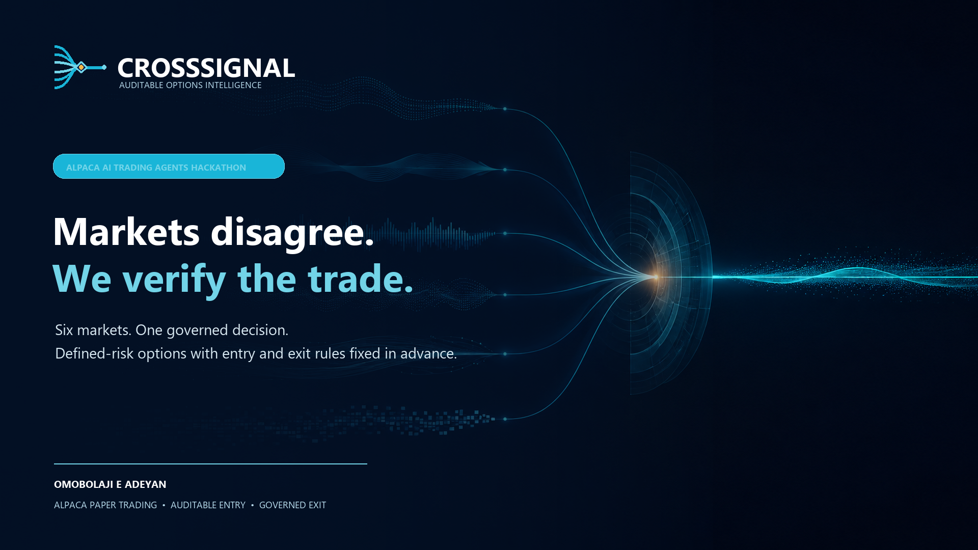
Notes:
Markets often disagree before they reprice. CrossSignal identifies that disagreement, challenges the conclusion, applies deterministic controls, and records whether the prediction was ultimately correct.

Slide 2

02
THE PROBLEM
Trading agents generate signals. Few can defend a decision.
01
02
03
Fragmented
Unaccountable
Unmanaged
Single-market analysis misses information moving between rates, credit and equities.
LLM conclusions are difficult to reproduce, challenge or audit after the outcome.
Many agents govern entry but provide no explicit profit, loss, time or expiry exit policy.
CROSSSIGNAL · OMOBOLAJI E ADEYAN · ALPACA PAPER TRADING
2
Notes:
Markets transmit information at different speeds. CrossSignal addresses fragmented evidence, weak AI accountability, and the common gap between governed entry and disciplined exit.

Slide 3
03
THE SOLUTION
A scientific proof chain for every trade
The SIGNAL protocol turns a thesis into a governed, falsifiable decision.
1
2
3
4
5
6
Source
→
Compare
→
Challenge
→
Stress
→
Seal
→
Score
Provenance
Disagreement
Falsification
Greeks
SHA-256
Outcome
ABSTAIN is a successful outcome when evidence or execution quality is insufficient.
CROSSSIGNAL · OMOBOLAJI E ADEYAN · ALPACA PAPER TRADING
3
Notes:
Every decision passes a proof chain. Crucially, abstention is treated as a correct policy outcome when evidence fails a gate.

Slide 4
04
TECHNOLOGY
Alpaca is the market and execution backbone
LIVE EVIDENCE
CROSSSIGNAL
PAPER LIFECYCLE
• Stocks and options
• Quotes, volume and Greeks
• Account and positions
• Alpaca News context
• Claude macro synthesis
• Deterministic construction
• Risk and stability gates
• Sealed Decision Contract
• All-leg preflight
• Take-profit and stop-loss
• Time and expiry exits
• Fresh quotes, broker reconciliation, atomic close
→
→
CROSSSIGNAL · OMOBOLAJI E ADEYAN · ALPACA PAPER TRADING
4
Notes:
The official Alpaca MCP server powers market evidence and the paper lifecycle. Claude reasons, but deterministic code controls entry and exit. Every spread persists thresholds fixed at entry. Before an exit, CrossSignal reconciles broker legs, rejects stale quote timestamps, atomically claims the transition, and reverses both legs under a deterministic client order ID.

Slide 5
05
DEFENSIBILITY
One scorecard. A decision that defends itself.
Signal strength never gets to hide weak execution evidence.
82
90
87
Pending
Signal quality
Decision stability
Execution quality
Outcome evidence
PUBLIC JUDGE REPLAY
LIVE DEDICATED ACCOUNT
Sanitized case, credential-free
ABSTAIN · 13 of 15 checks · quotes not executable
CS-20260903-5C194F65 · PA3PDTUDIXDU · 0 orders · 0 positions · no P&L claim
CROSSSIGNAL · OMOBOLAJI E ADEYAN · ALPACA PAPER TRADING
5
Notes:
This is the key proof slide from the September 3 unattended Evidence Watch. Confidence cleared at 56 percent and all six base gates passed. The all-leg option preflight then found zero displayed volume on the weakest leg and a 93.33 percent relative bid-ask spread, against limits of ten contracts and 25 percent. Only 13 of 15 checks passed, so the agent abstained. The run occurred after the regular options session; it did not queue a non-executable order. The dedicated account therefore has no trade P&L to claim.

Slide 6
06
TRUST AND SAFETY
Safe by architecture—not by prompt
Public UI
Read-only replay
Cloud watch
Observe only
LLM
No direct tool access
Evidence
Secret-free receipts
Exit state
No duplicate closes
Recovery
Explicit approval
NIST AI RMF and SSDF aligned · voluntary and tailorable · not NIST-certified
CROSSSIGNAL · OMOBOLAJI E ADEYAN · ALPACA PAPER TRADING
6
Notes:
CrossSignal follows NIST-aligned risk-management reasoning without claiming certification. Public infrastructure and scheduled GitHub automation have no broker mutation capability. The cloud watcher always runs execute false and exports only a secret-free artifact.

Slide 7
07
BUSINESS VALUE
The accountability layer for AI-assisted trading
WHO NEEDS IT
HOW IT GROWS
VALUE
• Active options traders
• Small investment teams
• Broker and platform providers
• Risk and compliance teams
01
Professional SaaS
Faster review. Stronger trust.
02
Team governance
03
Broker partnerships
04
Enterprise policy APIs
CROSSSIGNAL · OMOBOLAJI E ADEYAN · ALPACA PAPER TRADING
7
Notes:
The wedge is decision accountability for serious individual and small-team options users, with a path toward broker and enterprise governance integrations.

Slide 8
THE PROOF IS PUBLIC
Inspect the intelligence. Challenge the decision.
LIVE JUDGE DEMO
crosssignal-ai-agent .streamlit.app
59
4
13/15
SOURCE CODE
automated tests
sealed exit rules
latest full checks
github.com/omobolajiadeyan/ alpaca-cross-market-agent
CrossSignal proves when a trade deserves entry— and manages exactly how it exits.
Omobolaji E Adeyan · Paper trading only · Not investment advice
Notes:
Close on verified evidence: fifty-nine tests pass, including profit, loss, time, expiry, broker-reconciliation, quote-freshness, uncertain-submission locking, market-clock, atomic-close, audit, and idempotency tests. Ten connected cycles are sealed against the dedicated account; the latest rejected non-executable after-hours quotes. The account remains at 100,000 dollars with no orders or positions, so there is no P&L claim and the lifecycle replay is illustrative rather than broker fill evidence.

