Slide 1

Data Visualization
Data Visualization: Presentation 1
Ali Haydar Özdağ
Oghenemano Utomudo Omogha

Slide 2
Data Visualization
Data set description:
Domain: GDP per capita all countries
Number of Attributes: Typically around 10-15 attributes including location, size (square footage), number of bedrooms/bathrooms, price, age of property, etc.
Data Size : 73 mb
Source : https://data.un.org/ or https://datatopics.worldbank.org/world-development-indicators/

Slide 3
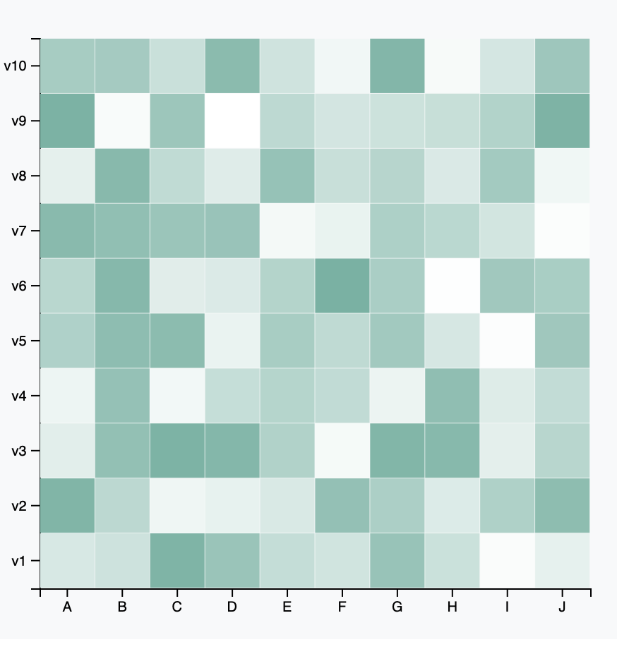
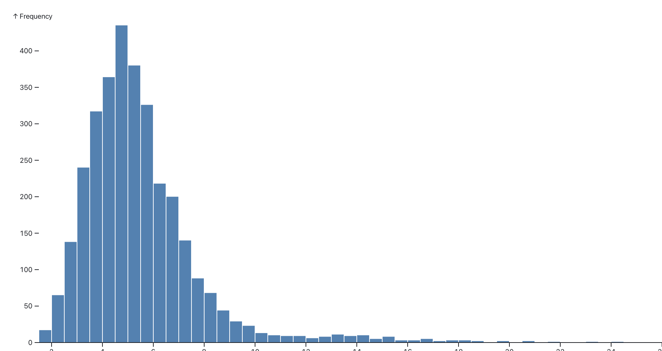
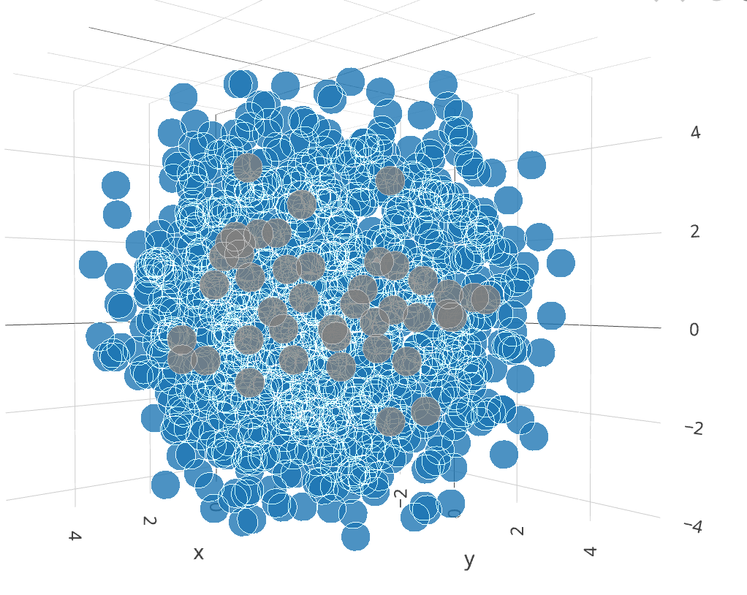
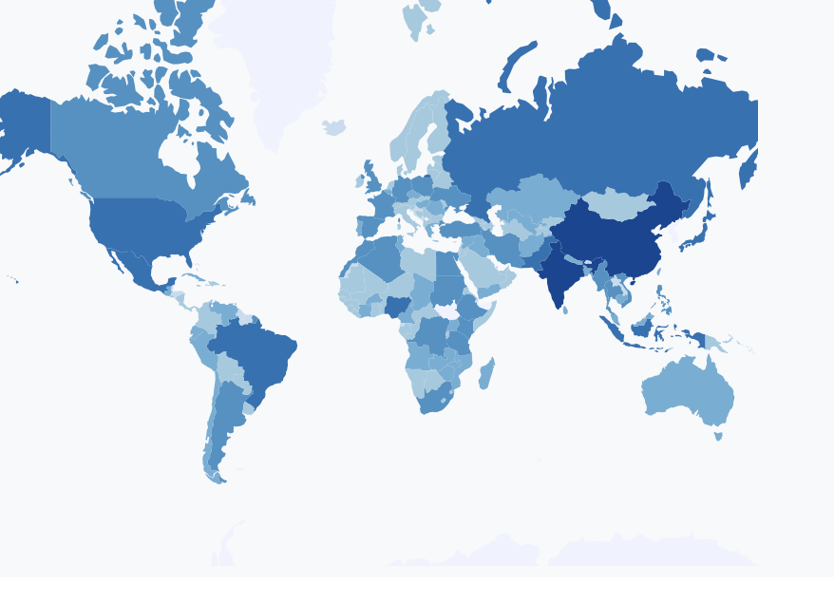
Data Visualization
Dashboard Visualization Techniques:
3d scatter plot
Heat map
Histogram plot
Choropleth Maps for Geographic Insights

Slide 4
Data Visualization
Dashboard Visualization Techniques:
TODO add meaningful techniques and images
Heatmaps for Correlation Analysis: Visualize pairwise correlations between numerical attributes (e.g., price, size, age) to identify key factors impacting housing prices.
Histograms and Box Plots: Display distributions of key attributes like property prices, sizes, and ages.
3D Scatter Plots for Complex Relationships: Visualize interactions between three key attributes (e.g., price, size, location) in a 3D space for deeper insights.
Choropleth Maps for Geographic Insights: Show regional variations in housing prices using color-coded maps based on location data.
Interactions
Filtering Interactions: Allow users to filter properties based on attributes (e.g., price range, number of bedrooms) to refine the dataset.
Map Interactivity: Clicking on a location marker updates other charts to show details of selected property.
Brushing and Linking: Highlighting a segment in one chart (e.g., price range) dynamically updates other charts to show properties falling within that range.
Tooltips: Display additional details (like exact price, size, or location) when hovering over data points in the charts.

Slide 5
Data Visualization
Reasoning Behind Visualizations and Interactions:
Visualizations' Purpose and Complexity: Explain how advanced visualizations enable deeper exploration of complex data structures and relationships.
Importance of Interactivity for Exploring Multidimensional Data: Discuss how interactive features empower users to uncover hidden insights and patterns.
Implementation & Insights:
Special Arrangements of Charts for Multivariate Views: Design layouts to accommodate multiple sophisticated visualizations for comprehensive data analysis.
Implementation Details (Advanced Libraries & Tools): Utilize powerful visualization libraries like D3.js for rendering complex charts and interactive dashboards.
Statistical Analysis Techniques for Insightful Visualizations: Apply advanced statistical methods (e.g., clustering, dimensionality reduction) to preprocess data and derive meaningful visual representations.
Advanced Transitions/Animations for Enhanced User Experience: Incorporate dynamic transitions and animations to enhance usability and engagement

