Slide 1

MzansiRide SafeAI
PRAESIGNIS × AWS HACKATHON 2026
A safety-first, AI-powered ride-sharing platform for South Africa
Get there safely. Someone’s always checking in.
Notes:
SLIDE 1: COVER
Magala · 0:00 · about 20 seconds
“Good day. I’m Magala, and this is Nhlanhla. We’re presenting MzansiRide SafeAI: a safety intelligence platform for ride operators, built for passengers in South Africa. I’ll take you through the problem and our solution. Nhlanhla will cover the architecture and the frontend. I’ll come back for the AI, and then Nhlanhla will explain our AWS implementation and run the live demo before I close.”
Cue: don’t linger on this slide.

Slide 2

Picture this
You’re in the back of a ride at night. The car stops somewhere you don’t recognise. Is it a detour? A phone call? Something worse?
Now imagine finding your phone, opening an app and pressing the right button, while your heart is racing.
A panic button asks you to act in the hardest moment of your journey. We asked: what if the system noticed first?
Notes:
SLIDE 2: PICTURE THIS
Magala · 0:20 · about 30 seconds
“Imagine you’re in the back of a ride at night. The car stops somewhere you don’t recognise. Is it a detour? A phone call? Something worse?” [Pause.]
“Now imagine finding your phone, opening an app and pressing the right button, while your heart is racing.” [Pause.] “A panic button asks you to act in the hardest moment of your journey. We asked a different question: what if the system noticed first? This is MzansiRide SafeAI.”
Cue: speak slowly and let the last line land before you move on.

Slide 3














What we’ll cover
The problem
Our solution
Architecture and security
The frontend
Magala · slide 4
Magala · slides 5–12
Nhlanhla · slides 13–14
Nhlanhla · slides 15–18
AI integration
AWS implementation
Working prototype
Outstanding work and close
Magala · slides 19–20
Nhlanhla · slide 21
Nhlanhla · slides 22–23
Nhlanhla, then Magala · 24–26
Notes:
SLIDE 3: WHAT WE’LL COVER
Magala · 0:50 · about 15 seconds
“Here’s our route: the problem, our solution, the architecture and security, the frontend, the AI integration, our AWS implementation, the working prototype, and what’s still outstanding. Nhlanhla and I will share it, and we’ll tell you when we swap.”

Slide 4



Safety shouldn’t depend on a button
Women, students and daily commuters often travel with unfamiliar drivers. They worry about unexpected stops, route changes, and whether anyone they trust knows where they are.
Reactive
Blunt
Invisible to the operator
A panic button only works if you are able to press it, in the very moment you are most stressed.
Every unusual event looks the same. A phone call and a real problem trigger the same response.
The company often learns about an incident when a complaint arrives, not when it begins.
Cost matters too. Students and commuters need cheaper travel. Shared rides can help, but only if people feel safe sharing.
Notes:
SLIDE 4: SAFETY SHOULDN’T DEPEND ON A BUTTON
Magala · 1:05 · about 60 seconds
“Let’s start with why this matters. For millions of South Africans, especially women travelling alone, getting into a car with an unfamiliar driver is a calculation made on every trip. Students and daily commuters worry about unexpected stops, route changes, and whether anyone they trust knows where they are. Today’s answer is the panic button, and it has three weaknesses. It is reactive: it only works if you’re able to press it. It is blunt: every unusual event looks the same. And it is invisible to the operator, who often learns about an incident when a complaint arrives, not when it begins. Cost matters too. Students and commuters need cheaper travel, and shared rides can help, but only if people feel safe sharing. So we asked one question: how can AI and cloud technology detect a problem early, support the passenger, and give the operator visibility, without ever assuming the worst about anyone?”
Cue: add a statistic only if you can name its source aloud.

Slide 5
Proactive, not reactive
A typical panic button
MzansiRide SafeAI
You must notice, find the button and press it
Works only if you can reach your phone
Treats every unusual event the same way
The operator finds out later
The system watches the trip data for you
Checks in on WhatsApp: one tap to answer
Rules detect events, AI explains them calmly
The operator sees it live and can act fast
Notes:
SLIDE 5: PROACTIVE, NOT REACTIVE
Magala · 2:05 · about 30 seconds
“We didn’t set out to build a better panic button. The difference is who acts first. On the left, a typical panic button needs you to notice, find it and press it. On the right, our system watches the trip data for you, checks in on WhatsApp with a single tap, uses rules to detect and AI to explain, and gives the operator a live view. Proactive, not reactive.”

Slide 6






Who it’s for
Women and vulnerable passengers
Students
Daily commuters
Extra safety support on every trip.
Affordable transport, and the confidence to share rides.
Regular trips, with a weekly or monthly budget.
Budget-conscious riders
Drivers
Transport operators
Shared rides, up to 60% cheaper (illustrative).
Their details and trip status, visible to passengers.
Clear, live visibility of trips and alerts.
Notes:
SLIDE 6: WHO IT’S FOR
Magala · 2:35 · about 30 seconds
“We built this for six groups: women and vulnerable passengers who want extra safety support; students who need affordable transport; daily commuters; budget-conscious passengers interested in shared rides; drivers, whose details and trip status passengers can see; and transport operators, who gain clearer visibility of trips and alerts. In this prototype, every passenger and driver profile is simulated, not real people’s information.”

Slide 7
How it works
1
2
3
4
5
Request & activate
Trip is watched
We check in
We escalate
Operator sees it
Book a ride, see the driver and vehicle, and switch on Safe Journey Mode.
Rules look for two things: a long unexpected stop, or a big route deviation.
“Are you safe?” arrives on WhatsApp and in the app. Reply 1 for yes, 2 for help.
If you reply “help”, or don’t reply, the system escalates automatically.
A live dashboard shows the alert with an AI summary. Everything is recorded.
We never assume the driver is acting maliciously. A stop can have an innocent explanation, so the passenger is always asked first.
Notes:
SLIDE 7: HOW IT WORKS
Magala · 3:05 · about 45 seconds
“Here’s how it works. One: the passenger requests a ride, sees the driver and vehicle, and switches on Safe Journey Mode. Two: rules watch the trip for a long unexpected stop or a big route deviation. Three: when a rule fires, we check in on WhatsApp and in the app: ‘Are you safe? Reply 1 for yes, 2 for help.’ Four: if she replies help, or doesn’t reply, the system escalates. Five: the operator sees it on a live dashboard with an AI summary, and everything is recorded. We never assume the driver is acting maliciously. A stop can have an innocent explanation, so the passenger is always asked first. In the prototype, the stops and deviations are simulated.”

Slide 8


A check-in, not an alarm
Works outside our app
MzansiRide SafeAI
You don’t need to open anything. The message simply arrives.
⚠️ Sarah, your trip has stopped off-route. Are you safe?
Reply 1 = Safe 2 = Help
Already on every phone
Familiar and trusted, with no extra app to install.
One tap, not a search
1
In a stressful moment you answer “1” or “2”. No hunting for a button.
Reply 1: the alert closes. Reply 2, or no reply: escalation begins. Silence is recorded as a fact, never as a conclusion.
Example message
Notes:
SLIDE 8: A CHECK-IN, NOT AN ALARM
Magala · 3:50 · about 40 seconds
“We chose WhatsApp for three reasons. It works outside our app, so nothing needs to be opened. It’s already on every phone, with no extra app to install. And it asks for one tap, not a search for a button in a crisis. Reply 1 and the alert closes. Reply 2, or no reply, and escalation begins. Silence is recorded as a fact, never as a conclusion.”
Cue: the message on screen is an example. Don’t say WhatsApp needs no mobile data.

Slide 9
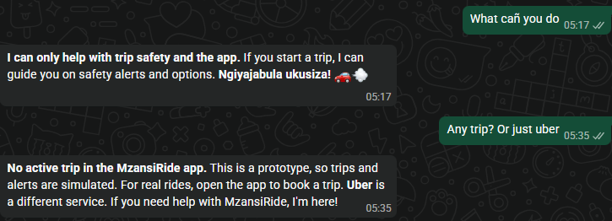
WhatsApp: a safety line, not just an alert
Say it on WhatsApp
CHECK <plate>
Look up a driver by plate or name (simulated)
TRIP <code>
Link this chat to your trip
STATUS
See your linked trip
A real chat with our prototype number
SOS
Alert your trusted contact now
Stays on topic. The AI, running on Amazon Bedrock, helps with trip safety and the app only. It says it’s a prototype, points to 10111 or 112 in danger, and even greets in isiZulu.
1 / 2
Answer a check-in: OK, or need help
Just type
Describe your situation and the AI guides you
Notes:
SLIDE 9: WHATSAPP: A SAFETY LINE, NOT JUST AN ALERT
Magala · 4:30 · about 40 seconds
“WhatsApp isn’t only where alerts arrive. It’s a two-way channel on a real number. A passenger can type CHECK to look up a driver, which is simulated, TRIP to link the chat to her trip, STATUS to see it, SOS to alert her trusted contact, or 1 or 2 to answer a check-in. Or she can simply describe her situation and our AI assistant guides her. We’ll show that assistant in the AI section.”

Slide 10
If you don’t answer
WORKING IN PROTOTYPE
1
2
3
4
5
Check-in sent
Wait window
Trusted contact told
Operator alerted
A person acts
A WhatsApp message and an in-app prompt: “Are you safe? Reply 1 or 2.”
The operator sets it (1–5 min). A reminder goes out halfway.
No reply, or a “2”? Her trusted contact is messaged.
The trip turns red, with the AI’s one-line next step.
The operator calls the driver. Everything is logged.
Reply 1 at any point and the alert closes. Silence is recorded as a fact, never as a conclusion.
We never auto-call emergency services or assume wrongdoing. People make those decisions.
Notes:
SLIDE 10: IF YOU DON’T ANSWER
Magala · 5:10 · about 45 seconds
“A fair question: what happens if you don’t answer? Here is the workflow. The check-in goes out on WhatsApp and in the app. A wait window follows, and the operator sets how long. If there’s no reply, or she sends a 2, her trusted contact is messaged. The operator’s screen turns red with the AI’s one-line next step. Then a person acts: the operator calls the driver, and everything is logged. Reply 1 at any point and the alert closes. We never auto-call emergency services, and we never assume wrongdoing. People make those decisions.”
Cue: this is built. The operator sets the wait window on the Fleet page (1 to 5 minutes) and a reminder goes out halfway. Before the demo, set it to 5 minutes so there is time to reply.

Slide 11


Know your driver before you get in
SIMULATED IN DEMO
Driver unlocks the app
Passenger sees the result
Passenger decides
Face ID or fingerprint, on the driver’s own phone, at the start of every ride.
“Verified at the start of this ride” or “Not verified”, on the driver card (simulated in the demo).
She can go ahead, ask for another ride, or share her trip first.
Honest limits
Privacy by design
A phone biometric proves the person who unlocked it is the one enrolled on that phone.
A one-time ID check at sign-up links that person to a licensed driver.
No biometric phone? The card says “Not verified” and the passenger decides.
Face data stays on the driver’s phone. Our system receives only a pass or a fail. Biometrics are special personal information under POPIA, so a formal assessment comes first.
Notes:
SLIDE 11: KNOW YOUR DRIVER BEFORE YOU GET IN
Magala · 5:55 · about 40 seconds
“We want passengers to know who is driving before they get in. At the start of every ride, the driver unlocks the app with Face ID or a fingerprint on their own phone. The passenger sees ‘Verified at the start of this ride’ or ‘Not verified’, and decides. We’re honest about the limits. A phone biometric proves who unlocked the phone, not that they hold a licence, so a one-time ID check at sign-up is still needed. Drivers without a biometric phone show as ‘Not verified’. Face data stays on the driver’s phone, and we only receive a pass or a fail.
Cue: say clearly that the Face ID result is SIMULATED in the prototype: the driver card shows “Driver verified with Face ID at the start of this ride” (or “not verified”) when the trip starts. Real biometrics come later.

Slide 12
Safer and cheaper
60%
cheaper per rider when three people share
R67.50 down to R27.00
Illustrative fares
Shown before you book, next to the safety check-ins. Sharing only works when people feel safe sharing, so safety is what unlocks the saving.
Fares from simple pricing rules (base R15 + R8.50/km + R1.20/min) on a simulated 5.1 km trip.
Notes:
SLIDE 12: SAFER AND CHEAPER
Magala · 6:35 · about 40 seconds
“Now the part that makes a difference to the pocket. The same trip costs R67.50 alone. Share it with one other person and it’s R40.50 each. Share it with two others and it’s R27.00 each, which is 60 percent cheaper per rider. We show that saving before you book, right next to the safety check-ins, because sharing only works when people feel safe sharing. These fares are illustrative, from simple pricing rules, on a simulated trip.”
Handover: “That’s our solution. Nhlanhla will now show you how we built it.”
Cue: don’t claim that no competitor offers shared rides. Some do.

Slide 13
How we built it on AWS
A serverless design: it scales automatically and cost grows with use, not ahead of it.
React app
requests
API Gateway
Lambda
Bedrock
Served through Amazon CloudFront: passenger journey and fleet dashboard
Front door: receives requests, and the webhook for WhatsApp messages and replies
The brain: rule engine, check-ins, escalation, calls the AI
AI triage, explanations and assistant
DynamoDB
Trips, alerts, safety log
messages and replies (webhook)
WhatsApp
Real number: a two-way channel
CloudWatch
Logs and tracing
check-ins and AI replies out
Prototype data is simulated.
Notes:
SLIDE 13: HOW WE BUILT IT ON AWS
Nhlanhla · 7:15 · about 75 seconds
“Thanks. Let me walk one alert through our architecture. We chose a serverless design on AWS, so it scales automatically and cost grows with use. The React app is served through Amazon CloudFront, and it sends requests to Amazon API Gateway, our front door. API Gateway is also the webhook for WhatsApp: every message and reply from the passenger arrives here. It triggers AWS Lambda, the brain. Lambda runs the rule engine, sends the check-ins, handles escalation, and calls Amazon Bedrock, which returns the triage line, the explanation or the assistant’s answer. Amazon DynamoDB stores trips, alerts and the safety log, and Amazon CloudWatch records logs so we can trace every alert. The red dashed line is the outbound side: check-ins and AI replies travel from Lambda back out to the passenger on WhatsApp. In one line: WhatsApp is how we reach the passenger, and API Gateway is how that conversation reaches our system.”
Cue: point to each box as you name it. If a service isn’t wired up yet, call it planned.

Slide 14
Built to be responsible
Simulated data
No blame
Approved guidance
Sample passengers, drivers and trips. No real location data is collected.
An unusual event is a prompt to check in, never proof of wrongdoing.
The AI works only from approved safety information.
Not emergency services
Secure by design
POPIA-minded
We say clearly that the app does not replace them: 10111 or 112.
Minimal data stored, access controlled at the backend, no credentials in the frontend.
Designed with South African privacy law in mind. Production needs a formal assessment.
Notes:
SLIDE 14: BUILT TO BE RESPONSIBLE
Nhlanhla · 8:30 · about 30 seconds
“Security and privacy are designed in. We use simulated data only, so no real location data is collected. An unusual event is a prompt to check in, never proof of wrongdoing. The AI works only from approved safety information, and it is clearly not an emergency service: in danger, call 10111 or 112. We store minimal data, control access at the backend, and keep credentials out of the frontend. We’ve designed with POPIA in mind, and a production version would need a formal assessment.”

Slide 15
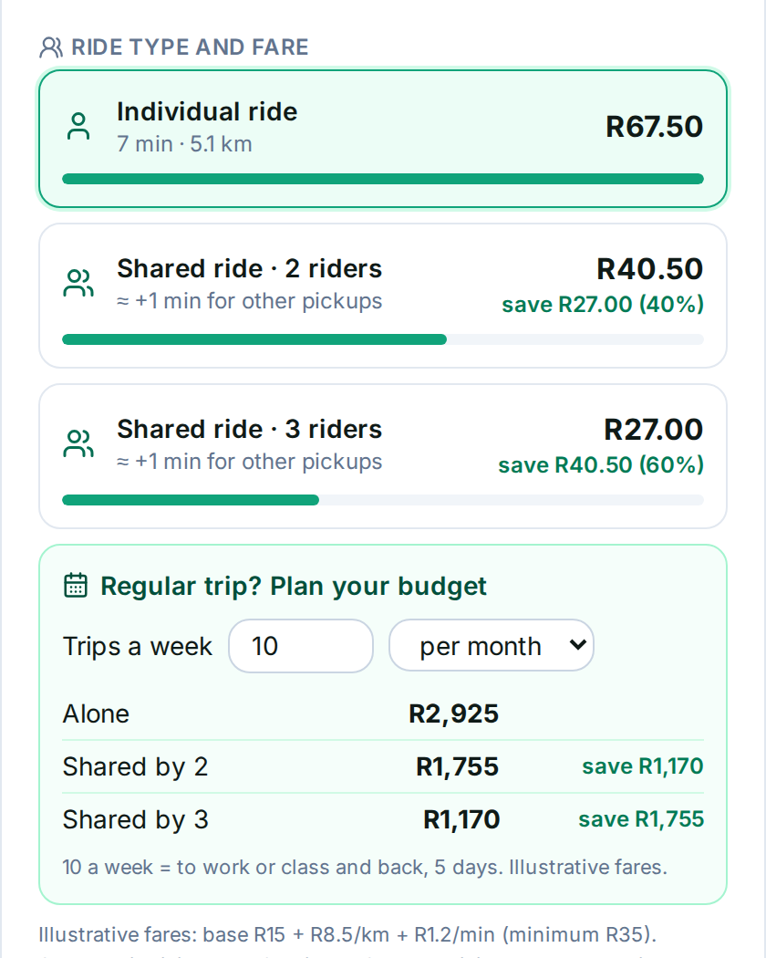
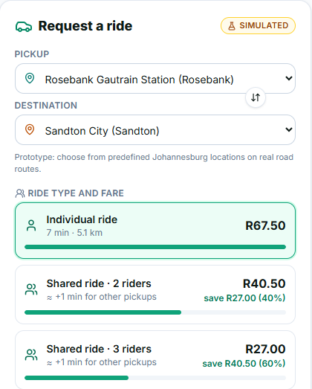
Request a ride, see the saving
R67.50
Individual ride
Rosebank to Sandton, 5.1 km
R40.50
Shared ride, 2 riders
Save R27.00 (40%)
R27.00
Shared ride, 3 riders
Save R40.50 (60%)
Illustrative fares from simple pricing rules: base R15 + R8.50/km + R1.20/min. Simulated trip and sample data.
Notes:
SLIDE 15: REQUEST A RIDE, SEE THE SAVING
Nhlanhla · 9:00 · about 30 seconds
“This is the working frontend. The passenger chooses a pickup and destination from predefined Johannesburg locations on real road routes, and sees the individual fare, R67.50 for this trip, next to the shared options: R40.50 with two riders and R27.00 with three. It’s marked simulated, and the fares are illustrative.”

Slide 16
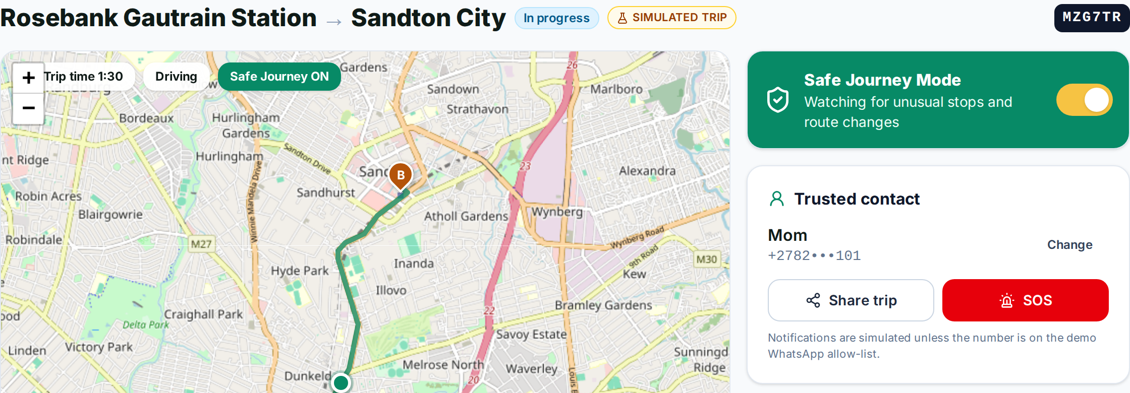



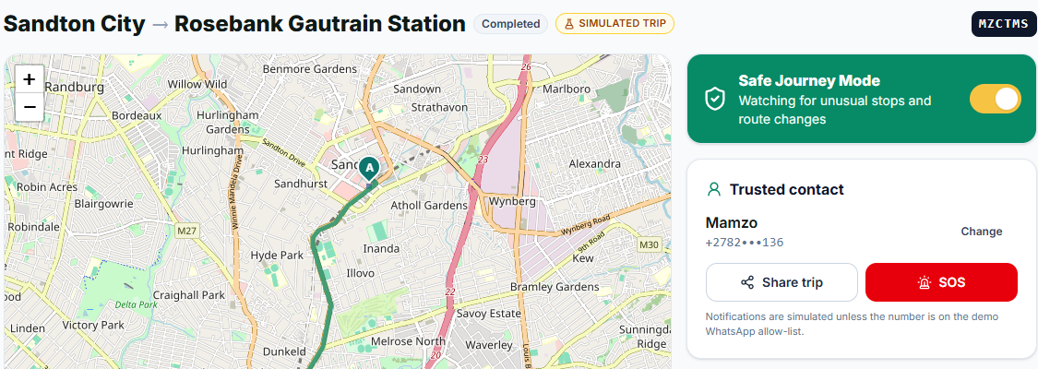
Safe Journey Mode in action
Always watching
Trusted contact
Clearly labelled
Looks for unusual stops and route changes.
Share the trip, or send an SOS in one tap.
Every simulated feature says so on screen.
Notes:
SLIDE 16: SAFE JOURNEY MODE IN ACTION
Nhlanhla · 9:30 · about 30 seconds
“Once the trip starts, Safe Journey Mode is on and watching for unusual stops and route changes. The passenger can see her trusted contact, share her trip, or send an SOS in one tap. The page says plainly that notifications are simulated unless the number is on our demo allow-list, so nothing here is hidden.”

Slide 17
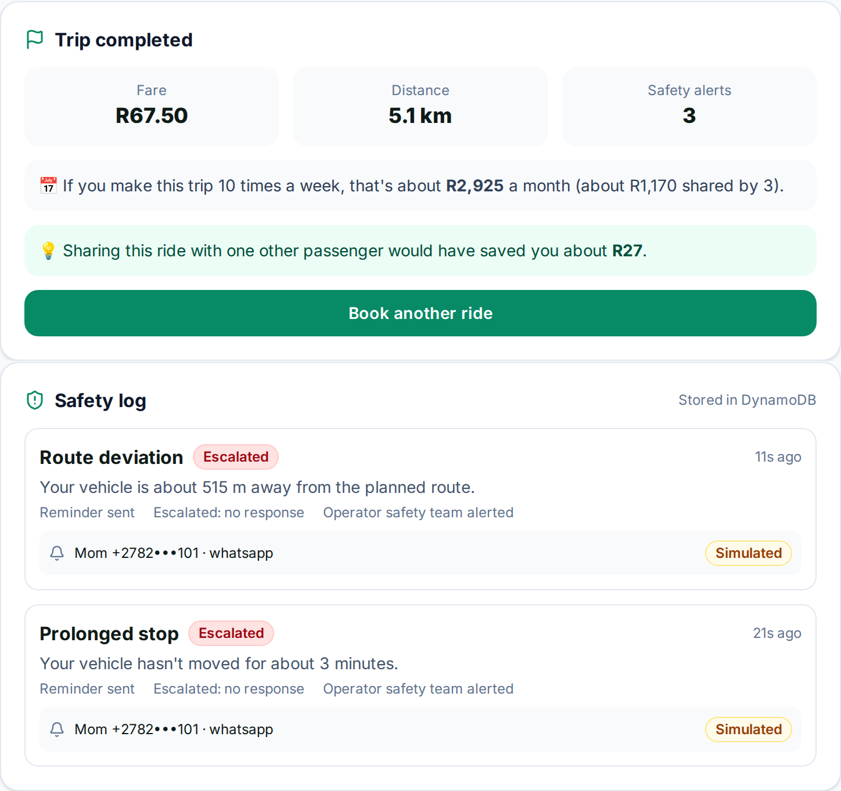
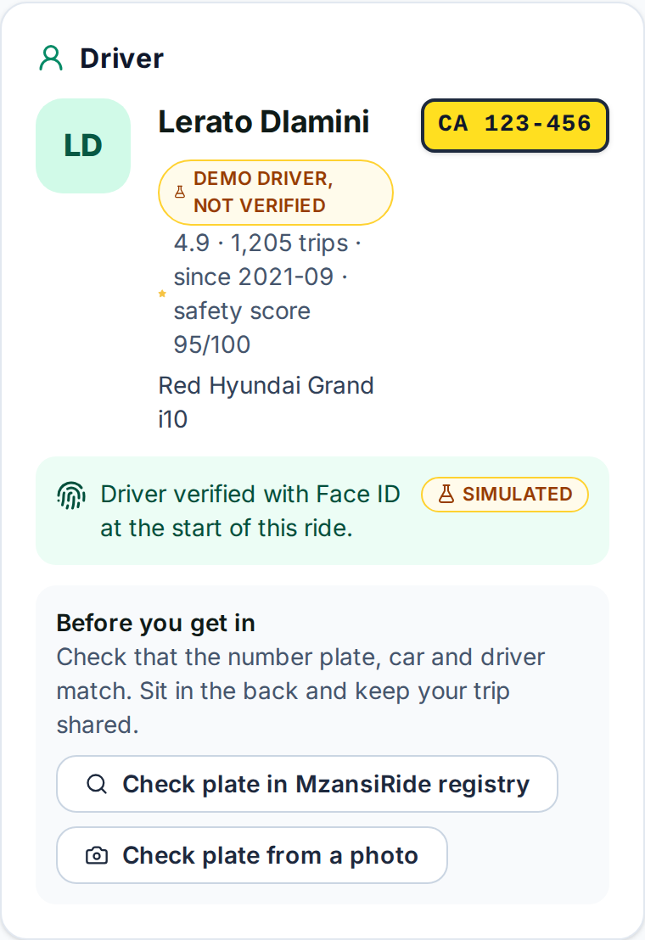
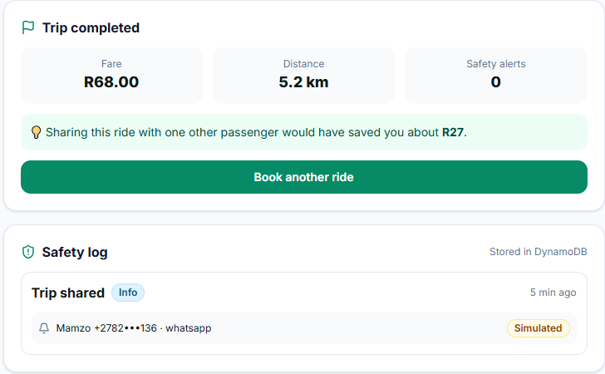
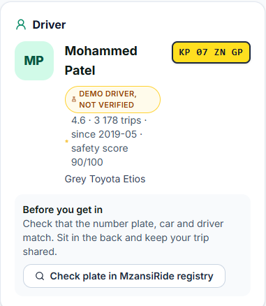
Every trip leaves a record
Fare and saving
Safety log in DynamoDB
Honest about drivers
The trip summary shows the fare and what sharing would have saved.
Every alert and response is stored, giving operators an audit trail.
Labelled “demo driver, not verified”, with a tip to check the plate, car and driver.
Notes:
SLIDE 17: EVERY TRIP LEAVES A RECORD
Nhlanhla · 10:00 · about 30 seconds
“When the trip ends, the summary shows the fare, the distance and the number of safety alerts, plus what sharing would have saved, about R27 on this trip. Below it, the safety log is stored in DynamoDB. On the right, the driver card says ‘demo driver, not verified’ and tells the passenger to check the plate, the car and the driver before getting in.”

Slide 18
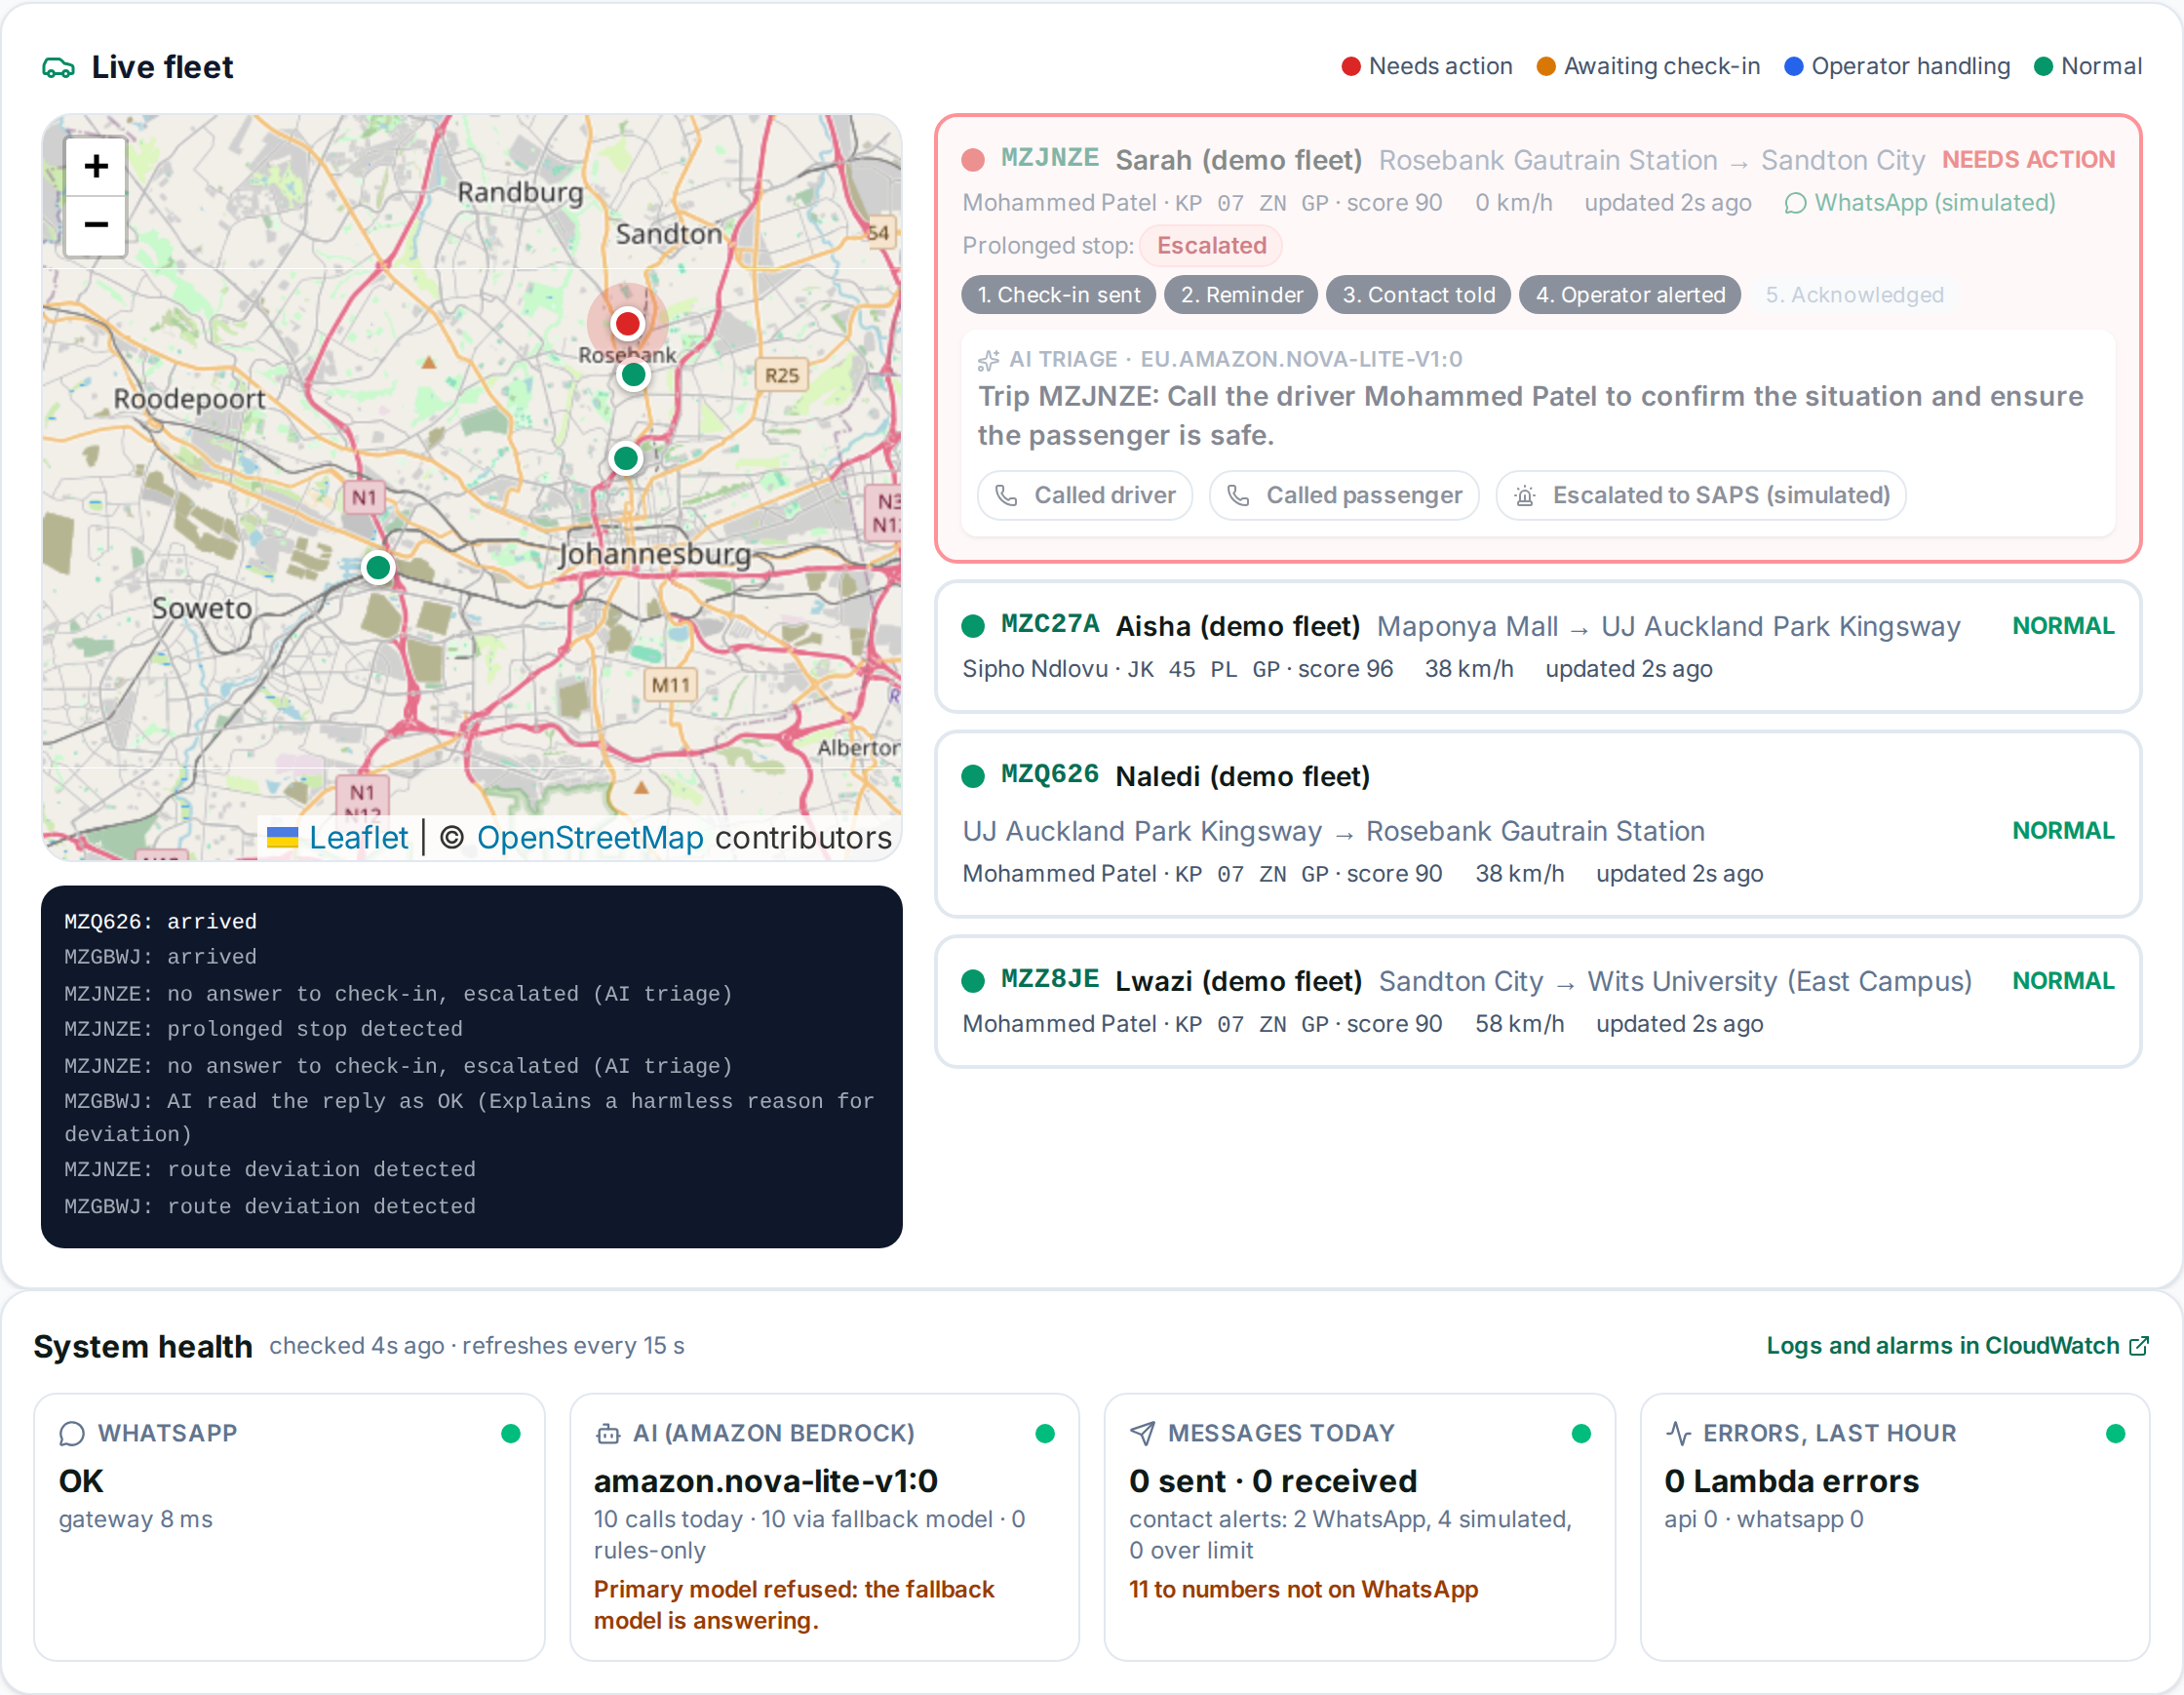



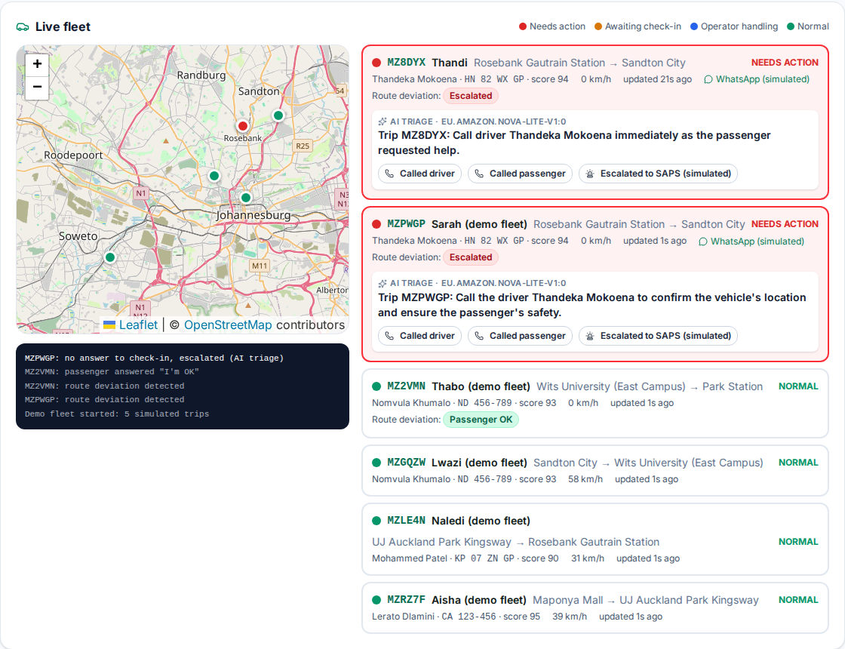
What the operator sees
Live status
Green until something needs a human.
A clear next step
An actionable line, not a raw alert.
System health
WhatsApp, the AI model and errors, watched live.
Notes:
SLIDE 18: WHAT THE OPERATOR SEES
Nhlanhla · 10:30 · about 40 seconds
“This is what the operator sees. Most trips are green. The one that needs attention turns red, with the AI’s one-line next step: stopped off-route, passenger unresponsive on WhatsApp, request an immediate driver voice call. Operators get live status, a clear next step instead of a raw alert, and a full record of every alert and response.”
Handover: “I’ll hand back to Magala to explain the AI.”
Cue: this is a real screenshot of the live Fleet page. The trips are a simulated demo fleet; the AI triage lines are real Amazon Bedrock output.
Point at the bottom panel: “This is system health. Is WhatsApp working, which AI model is answering, what was sent today, and any errors in the last hour. We see a problem before the passenger does.”

Slide 19


What the AI does, and doesn’t
Rules detect. AI explains. People decide.
What the AI does
What the AI never does
Writes a one-line triage action for the fleet manager
Explains to the passenger, in calm plain language, what happened and what her options are
Answers safety questions on WhatsApp and in the app, from approved guidance only
Decide whether someone is in danger
Blame the driver or predict criminal behaviour
Claim to know that a passenger is safe
Replace emergency services
Notes:
SLIDE 19: WHAT THE AI DOES, AND DOESN’T
Magala · 11:10 · about 90 seconds
“Thanks, Nhlanhla. Now the AI, and just as importantly, how we don’t use it. We made one deliberate decision: detection and intelligence are separate. Detection is rule-based. Deterministic rules decide whether an event has occurred, for example a stop beyond a set time and off the planned route. That makes the system predictable, testable and auditable, and we never let a language model decide whether someone is in danger. Once a rule fires, the AI, running on Amazon Bedrock, does three jobs. It writes a one-line triage action for the fleet manager. It explains to the passenger, in calm plain language, what happened and what her options are. And it answers safety questions on WhatsApp and in the app, from approved guidance only. Why AI? Because turning a raw event into a calm, clear sentence in seconds is exactly what language models do well. And the limits: it never decides someone is in danger, never blames the driver or predicts crime, never claims a passenger is safe, and never replaces emergency services. Rules detect. AI explains. People decide.”
Cue: if asked which model, name the Bedrock model you configured. If asked what happens when the AI is wrong: it never makes the safety decision.

Slide 20
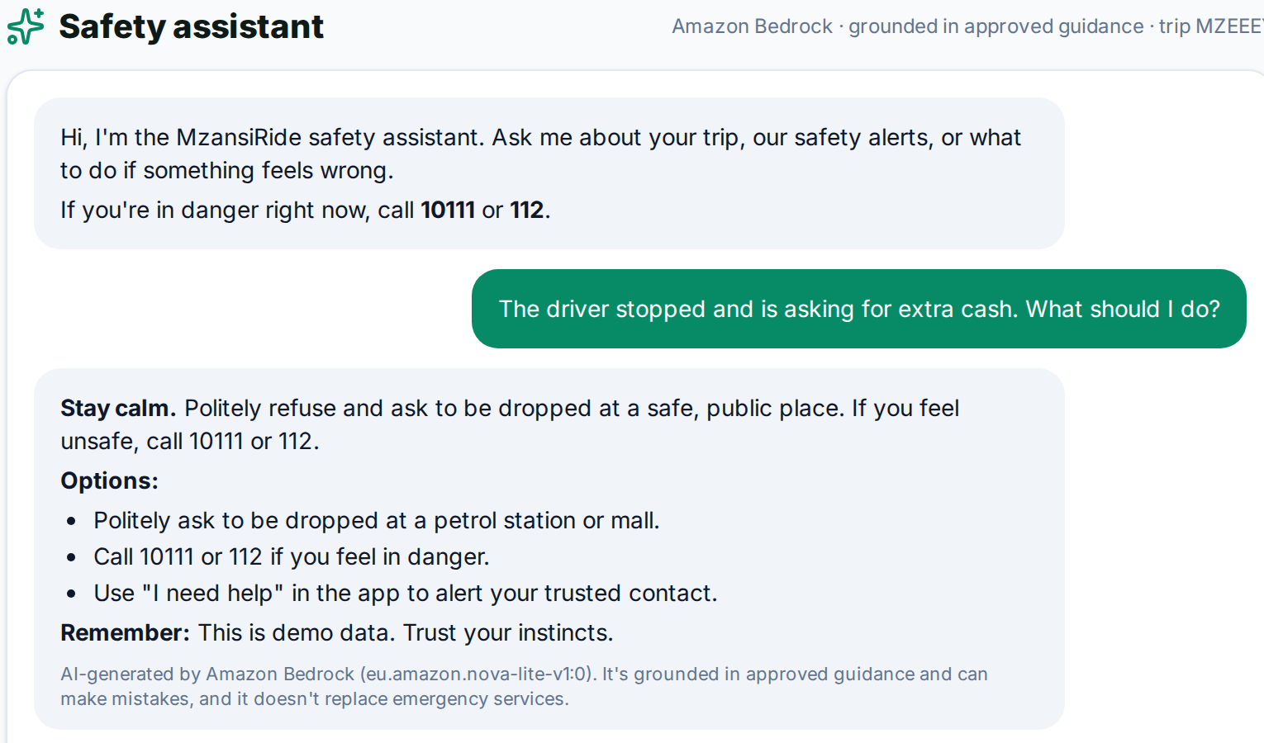
The AI assistant in action
On WhatsApp
In the app
For the operator
A real chat with our number. It stays on topic, says trips are simulated, and greets in isiZulu.
The Assistant tab, one tap away on every page. Here: a driver asking for extra cash.
The AI’s one-line next step appears on the fleet dashboard.
Notes:
SLIDE 20: THE AI ASSISTANT IN ACTION
Magala · 12:40 · about 40 seconds
“Here’s the assistant in a real chat with our prototype number. When we asked what it can do, it explained that it only helps with trip safety and the app. When we asked about Uber, it stayed on topic, said this is a prototype with simulated trips, and said Uber is a different service. In danger, it points to 10111 or 112. It even greets in isiZulu. People use it on WhatsApp by typing or replying 1 or 2, and in the app through the Assistant tab. Operators see the AI’s one-line next step on the fleet dashboard.”
Handover: “Nhlanhla will now explain why we chose each AWS service, and then show you the live demo.”

Slide 21







Why each AWS service
CloudFront + S3
API Gateway
Lambda
Bedrock
Serves the app fast and securely, with no web servers to run.
The front door, including the WhatsApp webhook. Managed and throttled.
Rules, check-ins, escalation and AI calls. Pay only when it runs.
Foundation models as a service, with Guardrails. No model servers.
DynamoDB
CloudWatch
IAM
EC2 (WhatsApp)
Trips, alerts and the safety log: the operator’s audit trail.
Logs, a dashboard and alarms, so we can trace every alert.
Each function gets only the access it needs. No keys in the browser.
Runs the open-source WhatsApp gateway for our real number.
Notes:
SLIDE 21: WHY EACH AWS SERVICE
Nhlanhla · 13:20 · about 60 seconds
“Thanks. Now let me explain why we chose each AWS service. CloudFront serves the app quickly and securely, with no web servers for us to run. API Gateway is the front door, including for WhatsApp, and it’s managed, secure and scales with traffic. Lambda runs our rules, check-ins, escalation and AI calls, and we pay only when it runs, so the same code serves one trip or a national fleet. Bedrock gives us foundation models as a service, with no model servers to build. DynamoDB stores trips, alerts and the safety log, fast and scalable, which gives operators their audit trail. CloudWatch lets us trace and prove what happened. And IAM gives each function only the access it needs. It’s serverless throughout: we pay for what we use, and nothing sits idle.”
Cue: delete the row of any service you haven’t actually wired up before you present.

Slide 22
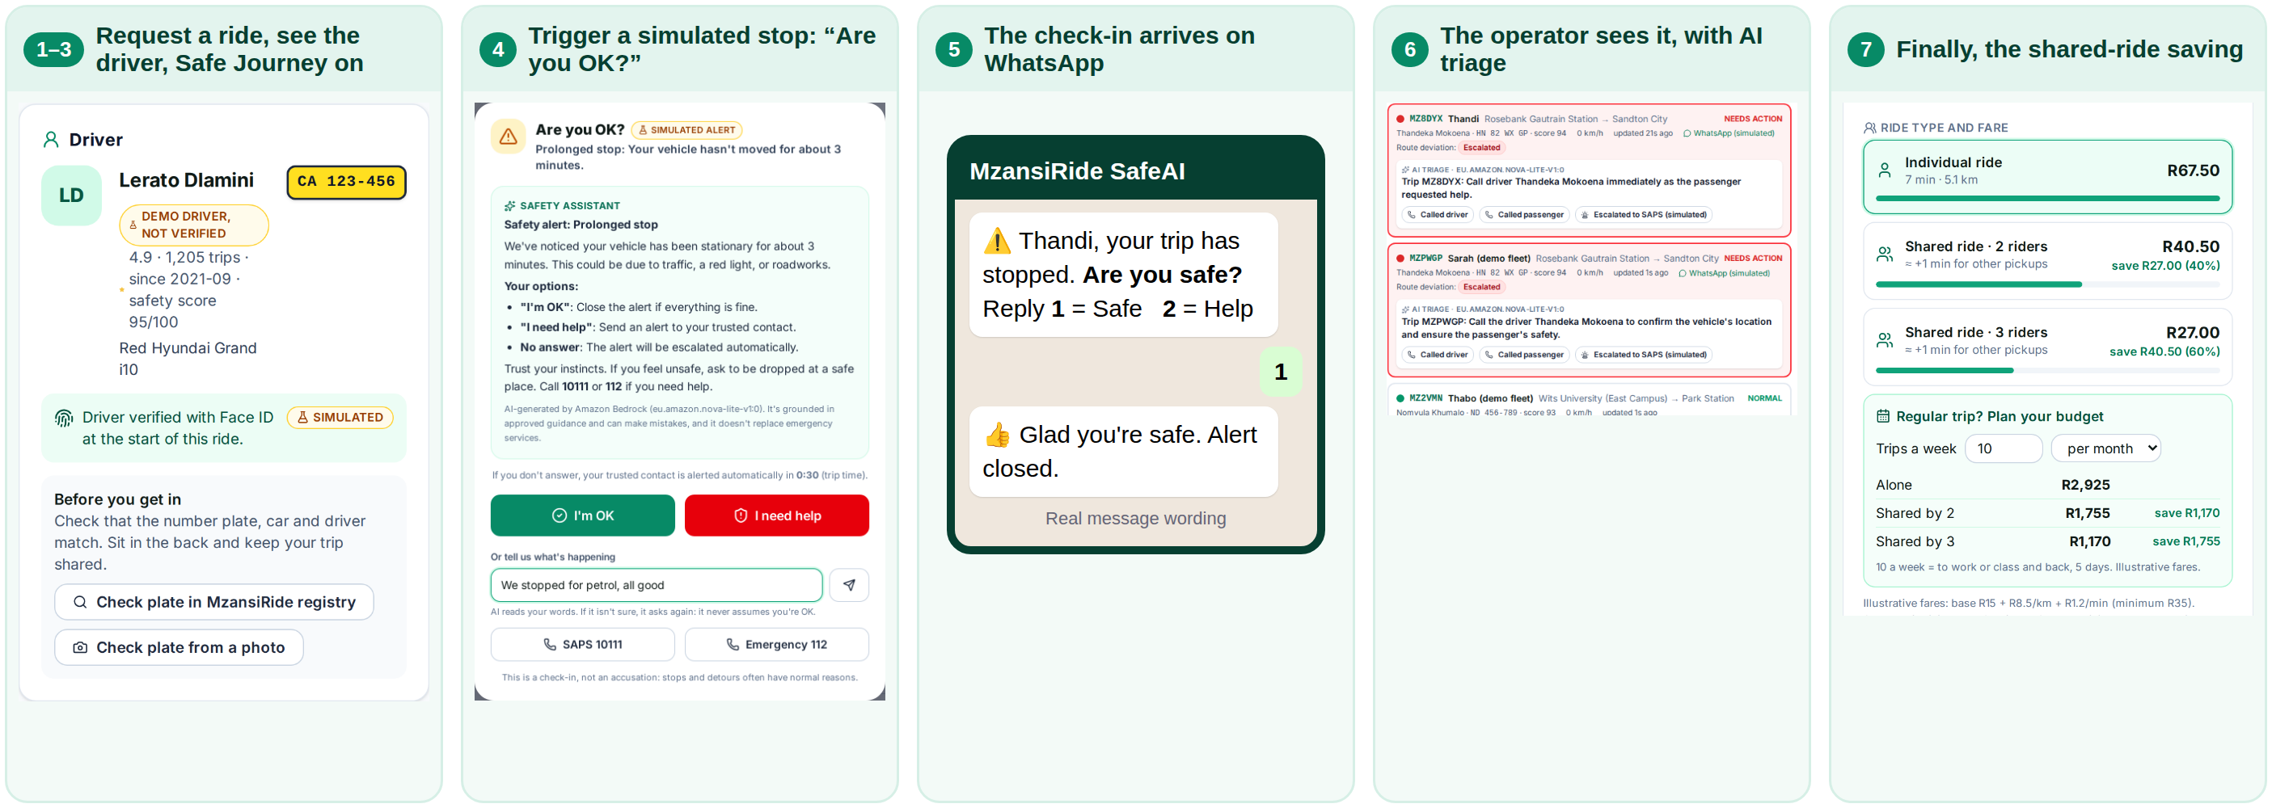
Live demo: the main user journey
Simulated
Real
Real
The trip and its events, on real Johannesburg roads.
The WhatsApp number: check-ins arrive on a phone.
Amazon Bedrock: explanations, triage and answers.
Notes:
SLIDE 22: LIVE DEMO: THE MAIN USER JOURNEY
Nhlanhla · 14:20 · about 3 minutes 15 seconds
“Now let’s see it running. Here is the main user journey. One: I request a ride. Two: here’s the driver and vehicle, a labelled demo driver. Three: I switch on Safe Journey Mode. Four: I trigger a simulated stop. Five: watch the phone. The check-in arrives on WhatsApp.” [Hold up the phone. Reply 1, or deliberately don’t.] “Six: on the operator’s dashboard, the alert appears. Seven: finally, the shared-ride saving. Remember: the trip and events are simulated, the WhatsApp number is real, and the assistant runs on Amazon Bedrock.”
Cue: before you start, set the Fleet wait window to 5 minutes and the simulator to 15× speed, so there is time to reply on the phone. If time allows, show the AWS console in this order: API Gateway, Lambda, DynamoDB, CloudWatch. Keep backup screenshots and a screen recording ready in case anything fails, and switch to them without apologising.

Slide 23

Working, simulated and still to come
Working today
Simulated
Still to come
Ride request, fare comparison and monthly budget
Safe Journey Mode, trusted contact, share trip and SOS
WhatsApp check-ins on a real number: 1, 2 or your own words
No-reply workflow with an operator-set wait window
Fleet dashboard with AI triage
Amazon Bedrock assistant; safety log in DynamoDB
Trips and route events
Driver profiles, labelled “demo driver, not verified”
The Face ID result at the start of a ride
Notifications, unless the number is on the demo allow-list
Live GPS and route tracking
Real driver verification (biometrics and ID check)
Emergency-service integration
Real payments and ride matching
POPIA assessment and an operator pilot
We do not claim to prevent crime, guarantee safety, or verify drivers. In danger, call 10111 or 112.
Notes:
SLIDE 23: WORKING, SIMULATED AND STILL TO COME
Nhlanhla · 17:35 · about 40 seconds
“Here’s an honest view of where we are. Working today: ride request with the fare comparison and a monthly budget; Safe Journey Mode with trusted contact, share trip and SOS; proactive WhatsApp check-ins on a real number, answered with 1, 2 or in your own words; the no-reply workflow with an operator-set wait window; the fleet dashboard with AI triage; the Amazon Bedrock assistant; and the safety log in DynamoDB. Simulated: trips and route events, driver profiles and the Face ID result, and notifications unless the number is on the demo allow-list. Still to come: live GPS, real driver verification, emergency-service integration, real payments, and a POPIA assessment with an operator pilot. We do not claim to prevent crime, guarantee safety or verify drivers.”

Slide 24




Outstanding work
Six things we planned to finish before Tuesday: all six are built and in today’s demo.
Mobile friendly and resizeable
Instant AI assistant button
Weekly and monthly fares
Built: works on a phone, tablet or desktop, and installs to the home screen.
Built: an “Ask AI” button on every page, one tap away.
Built: 10 trips a week is R2,925 a month alone, or R1,170 shared by three (illustrative).
Operator sign-in (Cognito)
Full no-reply workflow
Driver check each ride
Built: operators sign in with Amazon Cognito; only they can open the fleet dashboard.
Built: an operator-set wait window, a reminder, then the trusted contact and the operator.
Built (simulated): the driver card shows “verified with Face ID” or “not verified”.
Notes:
SLIDE 24: OUTSTANDING WORK
Nhlanhla · 18:15 · about 40 seconds
“We set ourselves six things to finish before Tuesday. All six are built and in today’s demo: the app is mobile friendly and can be installed on a phone; the AI assistant button is on every page; fares show weekly and monthly totals; the full no-reply workflow runs with an operator-set wait window; and the driver’s Face ID check shows at the start of each ride, simulated for noAnd operators now sign in with Amazon Cognito, so only the operator’s safety team can open the fleet dashboard.”d.”

Slide 25



Expected impact
Passengers
Operators
Communities
Calm, clear support in the moment
A one-tap check-in
A trusted contact can be told
Real-time visibility of every trip
Faster response to incidents
A record of every alert and reply
Cheaper shared travel
Helps students and daily commuters
Safety that makes sharing feel possible
Illustrative saving: a 5 km trip at R67.50 alone drops to R27.00 each when three riders share.
Notes:
SLIDE 25: EXPECTED IMPACT
Nhlanhla · 18:55 · about 30 seconds
“Three groups benefit. Passengers get calm, clear support and a one-tap check-in. Operators get real-time visibility, faster response and a record of every alert. Communities get cheaper shared travel: a trip at R67.50 alone drops to R27.00 each when three riders share. Those are illustrative fares.”
Handover: “I’ll hand back to Magala to close.”

Slide 26
Safety shouldn’t depend on a button
1
2
3
Proactive, not reactive
Rules detect. AI explains. People decide.
Built on AWS to scale
We don’t wait for the worst moment to ask a passenger to act.
AI helps. It never judges, and it never blames.
Serverless, so one operator or a national fleet runs on the same design.
Get there safely. Someone’s always checking in.
Thank you
Notes:
SLIDE 26: CLOSING
Magala · 19:25 · about 70 seconds
“Let’s go back to that car.” [Pause for a full beat.] “It’s night. It has stopped somewhere you don’t recognise. In most apps today, what happens next depends on you finding a button.
In MzansiRide SafeAI, it doesn’t. Your phone buzzes on WhatsApp: ‘Are you safe? Reply 1 or 2.’ One tap. And if you can’t reply, that silence isn’t ignored. The operator already has a clear next step on their screen, and every alert and response is on record. What you’ve seen today isn’t a mock-up of an idea. It’s a working prototype on AWS: a real WhatsApp number, an assistant on Amazon Bedrock, and a safety log in DynamoDB. The trips and drivers are simulated, and we’ve said so on every screen. Three things to remember. One: proactive, not reactive. We don’t wait for the worst moment to ask someone to act. Two: rules detect, AI explains, people decide. The AI helps, and it never judges and never blames. Three: it’s built to scale. It’s serverless, so the same design serves one operator or a national fleet, and the cost grows only with use. And safety isn’t only about fear. It’s about access. A student who shares a R67.50 ride and pays R27.00 is only willing to share if she feels safe doing it. Our next steps are live route data, driver verification, a POPIA assessment, and a pilot with a real operator. We’re not asking anyone to hand their safety to AI. We’re showing how AI can mean fewer passengers face that moment alone, and fewer operators find out too late. Safety shouldn’t depend on a button. Thank you.”
Cue: slow down on the last sentence, say “Thank you” quietly, and add nothing after it.

Slide 27
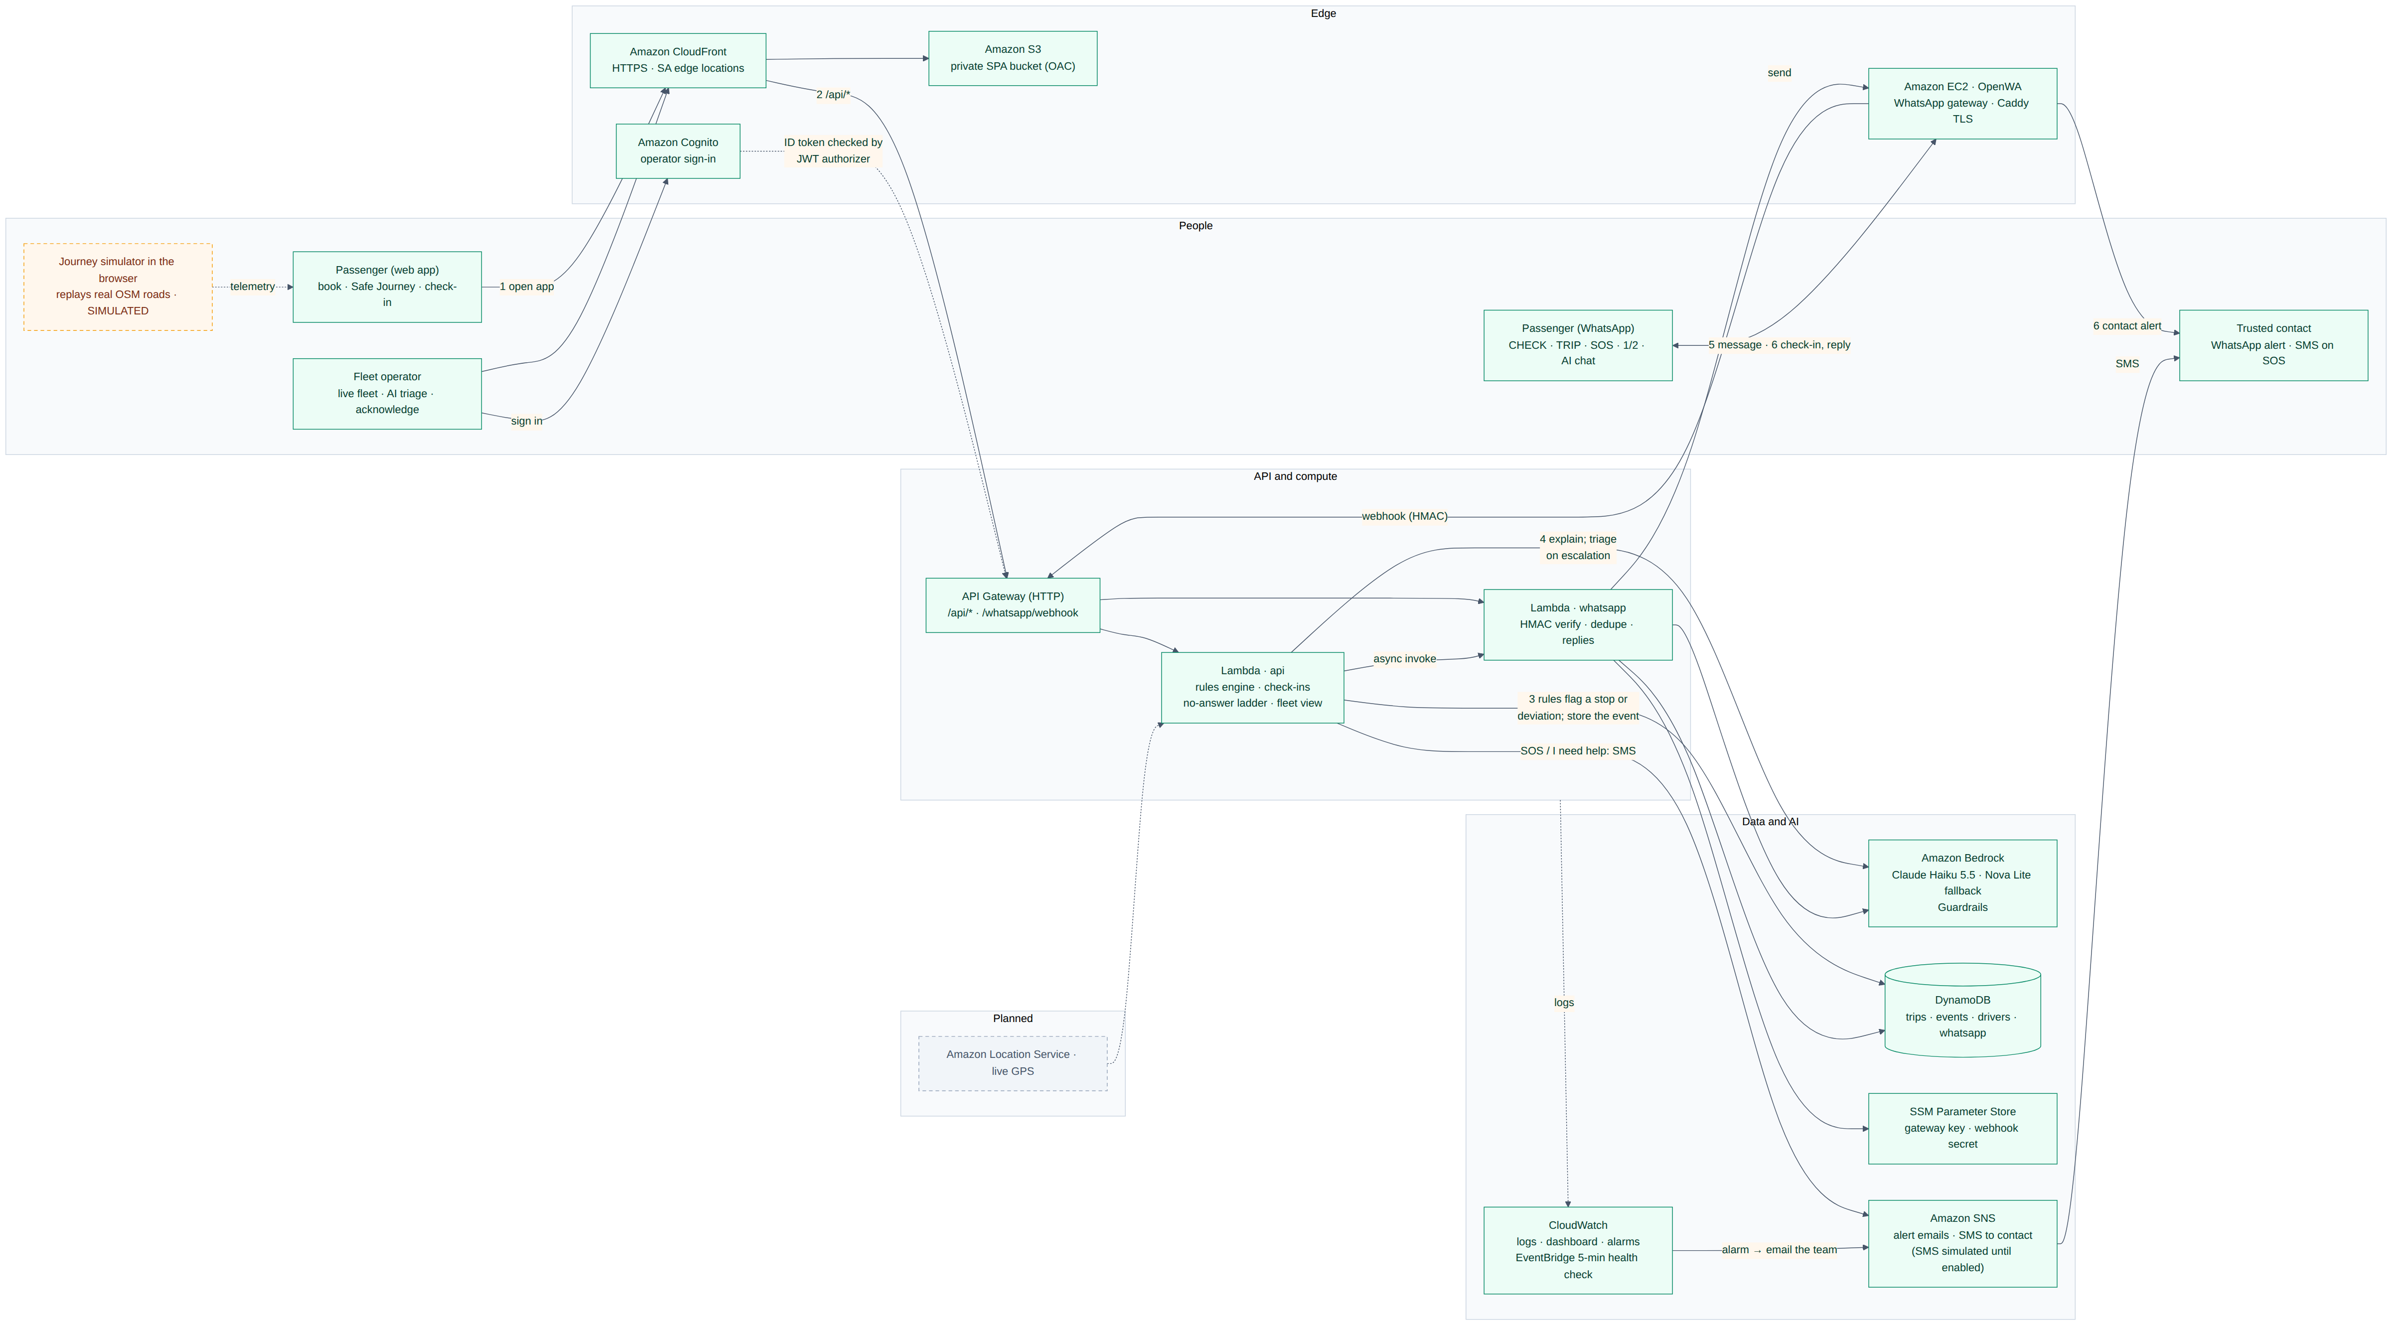
Appendix: the full architecture
Same flow as slide 13, numbered 1–6. Solid = built · dashed orange = simulated · dashed grey = planned. Generated from the Mermaid source in our README, so it stays in sync with the code.
Notes:
APPENDIX: THE FULL ARCHITECTURE (backup slide for questions; not part of the 20-minute run)
Use it if a judge asks how the pieces connect, especially WhatsApp. Walk it left to right:
"People reach us two ways: the web app through CloudFront, and WhatsApp through our open-source gateway on EC2. Both arrive at API Gateway. The api Lambda runs the rules and the no-answer ladder and stores everything in DynamoDB; the whatsapp Lambda verifies each webhook's signature and replies through the gateway. Bedrock explains alerts and writes the operator's triage line. Secrets are in SSM Parameter Store and every step is logged in CloudWatch. Operators sign in with Cognito, CloudWatch alarms email the team through SNS, and Location Service is planned."
Point out the dashed boxes: the journey simulator is simulated; Location Service is planned. Cognito (operator sign-in) and SNS (alert emails to the team) are built; the SMS to the trusted contact is built but simulated until AWS enables SMS on our account.

