Slide 1
Customer Churn Analysis: ABC Communications
AnalystLab Africa – Data Analytics Internship Omolade | August 2026

Slide 2
The Problem
26.58% of customers churn annually
1,869 of 7,032customers lost
Approximately $20M in preventable revenue loss

Slide 3
Our Dataset
7,032 customer records analyzed
21 different data points per customer
Data quality score: 95/100
Analyzed demographics, services, contracts, and billing

Slide 4
Finding #1: Contract Commitment Matters Most
Month-to-month contracts: 42.71% churn rate
One-year contracts: 11.28% churn rate
Two-year contracts: 2.85% churn rate
Month-to-month customers are 15x more likely to churn

Slide 5
Finding #2: Fiber Optic Service Issues
Fiber optic customers: 41.89% churn rate
DSL customers: 19.00% churn rate
No internet customers: 7.43% churn rate
Fiber represents 70% of all company churn
Despite premium pricing ($91.50 vs $58.09), Fiber customers leave more

Slide 6
Finding #3: The First 6 Months Are Critical
50% of all churn happens in the first 6 months
31% of customers are newer than 12 months
Suggests onboarding and early experience issues
New customer acquisition cost is wasted if they churn early

Slide 7
Finding #4: Premium Customer Are At Risk
High-price customers ($70-118/month): 31% churn
Mid-price customers ($40-70/month): 18% churn
Low-price customers ($20-40/month): 15% churn
Premium customers have 2x the churn of budget customers
Losing the most profitable customer segment

Slide 8
Finding #5: Service Bundling Creates Loyalty
Customer with 0 services: 21.5% churn
Customer with 1 services: 45.8% churn (highest risk)
Customer with 5 services: 12.5% churn
Customer with 6 services: 5.3% churn (most loyal)
More services = exponentially lower churn

Slide 9
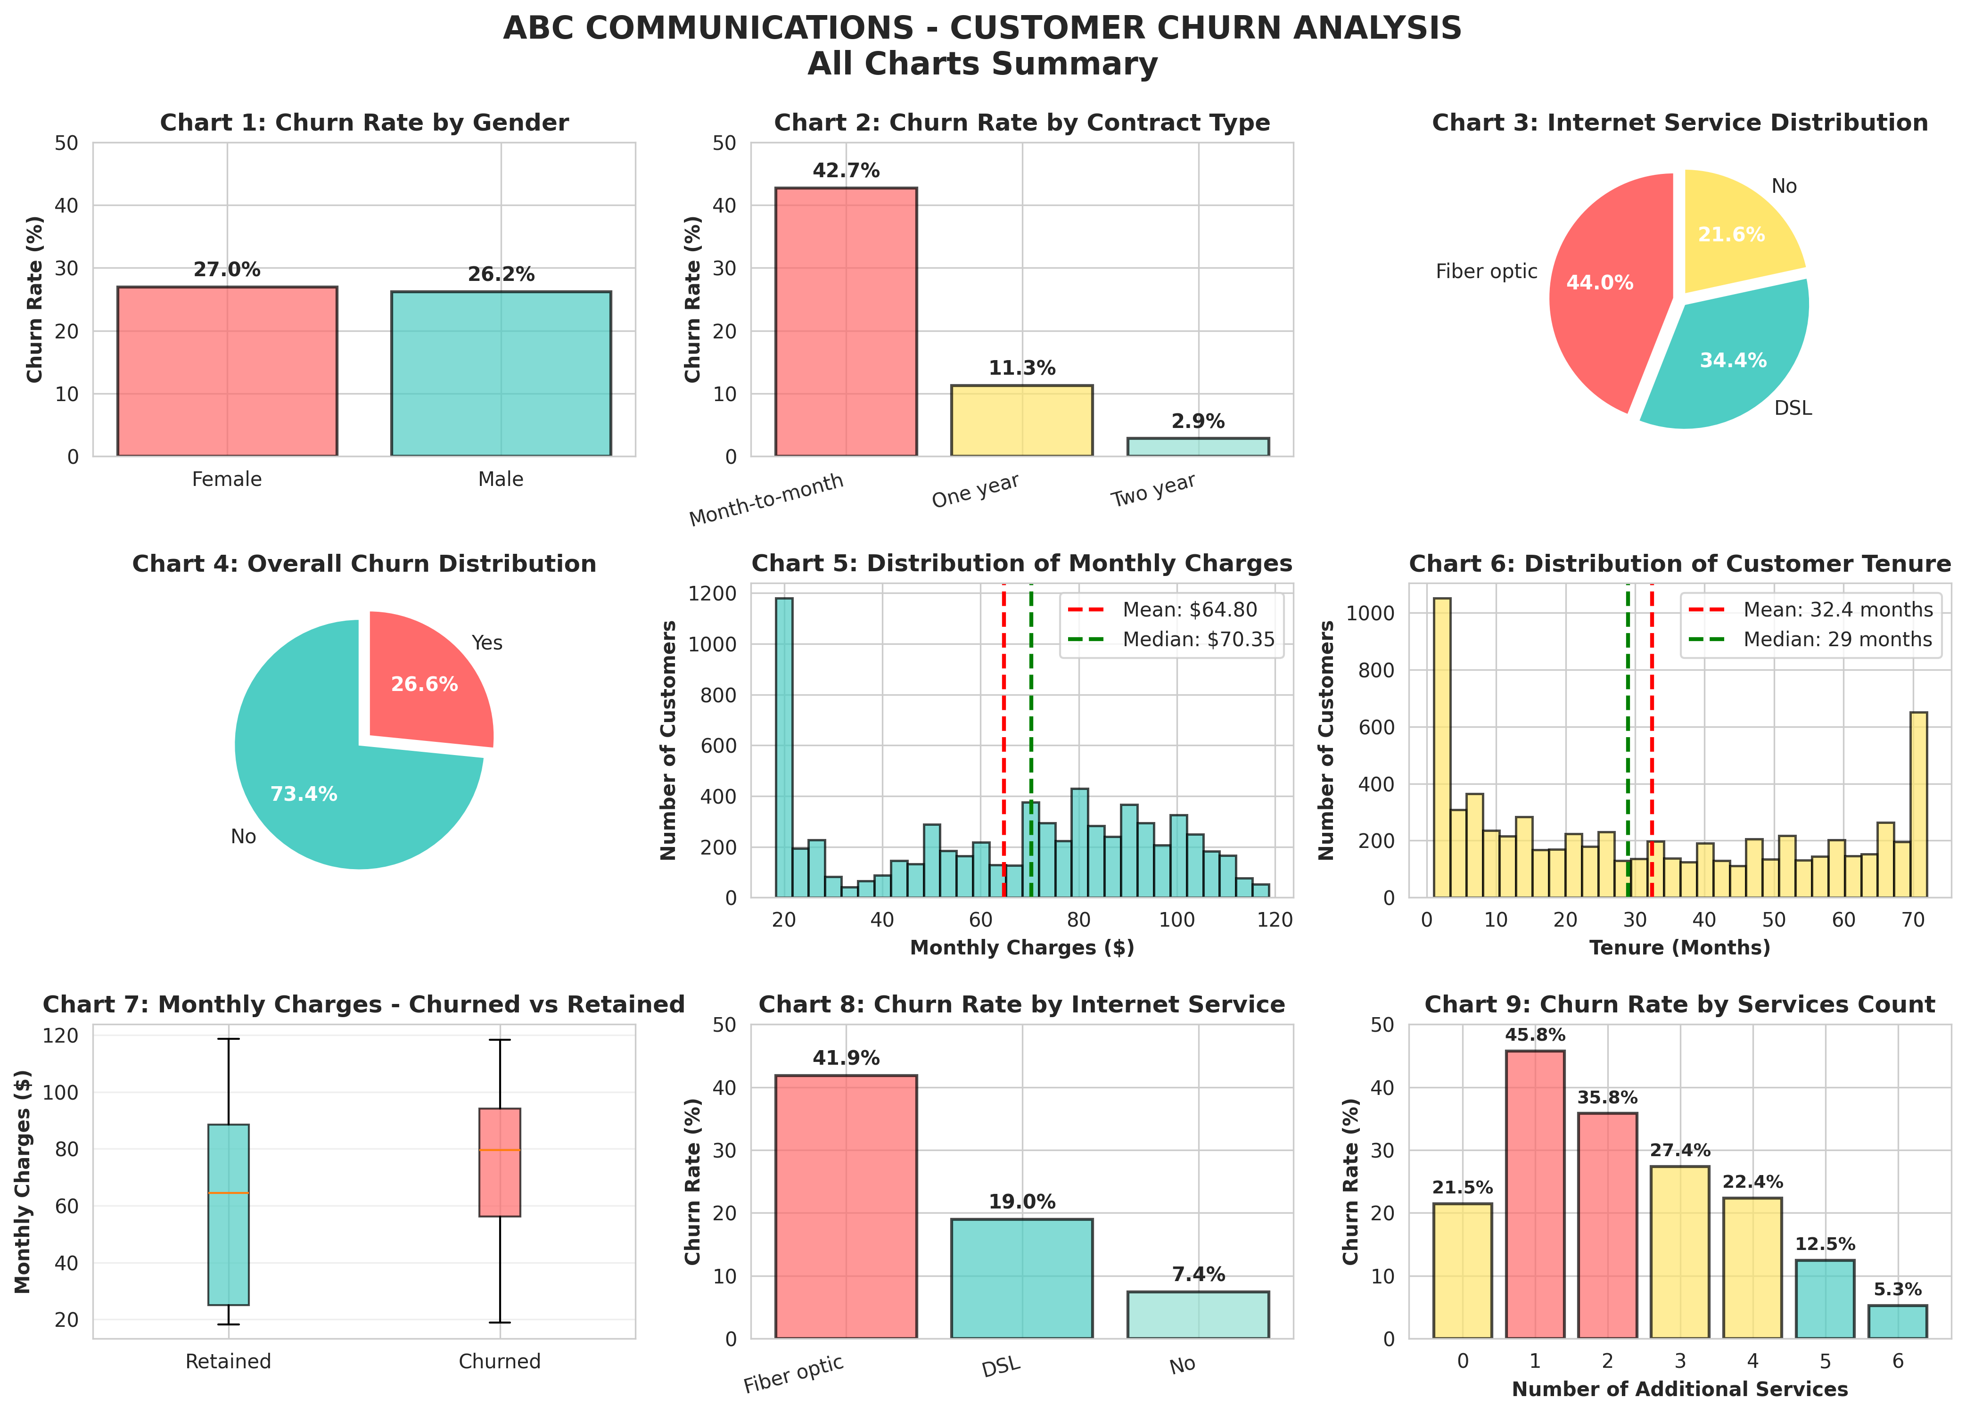
Visual Summary: All Key Charts

Slide 10
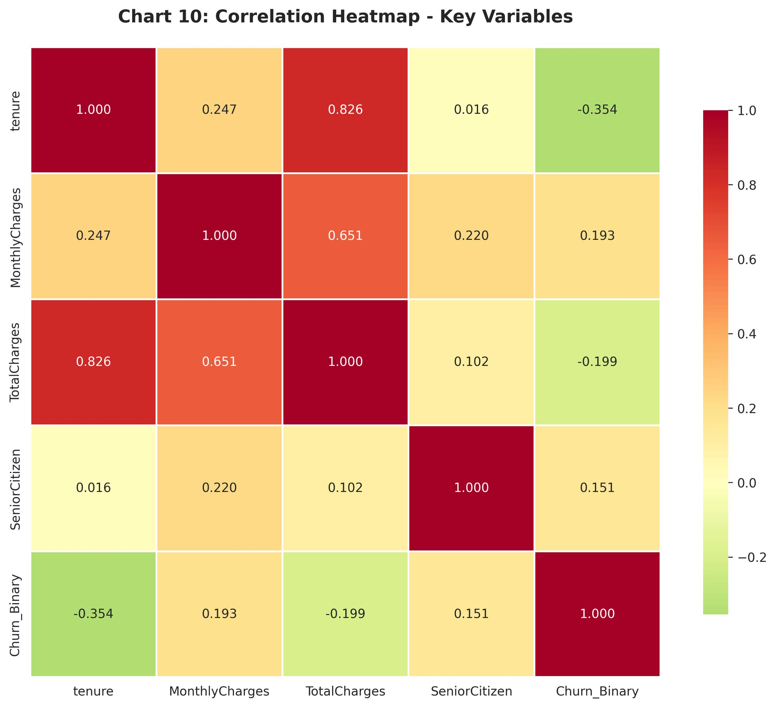
Bonus Analysis: Correlation Heatmap

Slide 11
Three Critical Business Risks
Risk 1: Month-to-month contract vulnerability ($15.2M at risk)
Risk 2: Fiber optic infrastructure under threat ($18M/year)
Risk 3: Premium customer segment exodus ($9.2M at risk)

Slide 12
Three Strategic Opportunities
Opportunity 1: Contract commitment program (+$7.5M)
Opportunity 2: Fiber optic recovery program (+$6.0M)
Opportunity 3: Service bundling strategy (+$3.2M)

Slide 13
Recommendation #1: Fiber Optic Recovery
Action: Investigate and fix Fiber optic service quality
Why: Source of 70% of total churn
Impact: $6.0M revenue protection
Timeline: 60-90 days

Slide 14
Recommendation #2: Contract Commitment Program
Action: Offer discounts for annual contract commitments
Why: Month-to-month churn is 15X higher than 2-year
Impact: $7.5M revenue protection
Timeline: 30-45 days

Slide 15
Recommendation #3: Service Bundling Strategy
Action: Create attractive multi-service bundles
Why: Customers with 5+ services have only 5.3% churn
Impact: $3.2M revenue protection
Timeline: 60-90 days

Slide 16
Recommendation #4: Premium Customer VIP Program
Action: Dedicated account managers for high-value customers
Why: Premium customers churn at 31% (losing top earners)
Impact: $1.8M revenue protection
Timeline: 30 days

Slide 17
Recommendation #5: New Customer Onboarding Excellence
Action: Proactive outreach and support in first 90 days
Why: 50% of churn happens in first 6 months
Impact: $1.0M revenue protection
Timeline: 45-60 days

Slide 18
Recommendation #6: Payment Method Incentive Program
Action: Incentivize switch from electronic check to autopay
Why: Electronic check users churn at 45.29% (highest risk)
Impact: $1.0M revenue protection
Timeline: 30 days

Slide 19
The Bottom Line
Total Year 1 Impact: $20.5M revenue protection
Total Program Investment: $4.0M
Net Year 1 Benefit: $16.5M
Year 1 ROI: 512%
Target: Reduce churn from 26.58% to under 15% within 12 months

