Slide 1

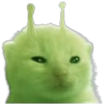

Gamers Be Gamin’ Consulting
August 26th, 2024
The Team
Ryan Ponticelli
Madison Outland
Nate Sheibley

Slide 2
Introduction
We are presenting as Gamers Be Gamin’, a consulting company and we are presenting to the board of an investment company.
They’re aware that word of mouth is important to get people to purchase games, and are asking us: how do we build word of mouth in a digital market?
To start, Steam reviews are a traditional metric, and Twitch engagement is the new metric of community.
Combined, the two can lead to great success in marketing and the longevity of a game.

Slide 3

Define Steam
Define
Why we care
What we’ll see
Steam is an online storefront and review aggregator
Similar to Amazon
They were initially a game developer
Users submit genre tags
Larger of two game storefronts with power of exclusives
Extensive discovery algorithms that low capital game companies rely on
Genre tag groups are used to categorize games
Titles of games on platform
Active player count
Average review ratings
Total reviews count

Slide 4

Define Twitch
Define
Why we care
What we’ll see
Video game streaming platform
Similar to YouTube with a focus on live-streaming
General streaming service initially and pivoted to primarily games in 2011
Streamer engagement fosters out-of-game community and is a proxy for longevity of a game Twitch Drops are one method for a game company to engage with streamers and community
Total hours streamed per game
Total hours watched per game
Top 200 games on twitch per month
Notes:
Twitch engagement events promote word of mouth advertisement and out of game
Stream engagement is a proxy for how much people think of a game when not playing it

Slide 5
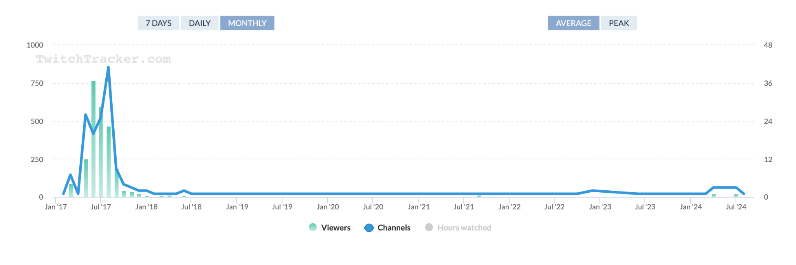
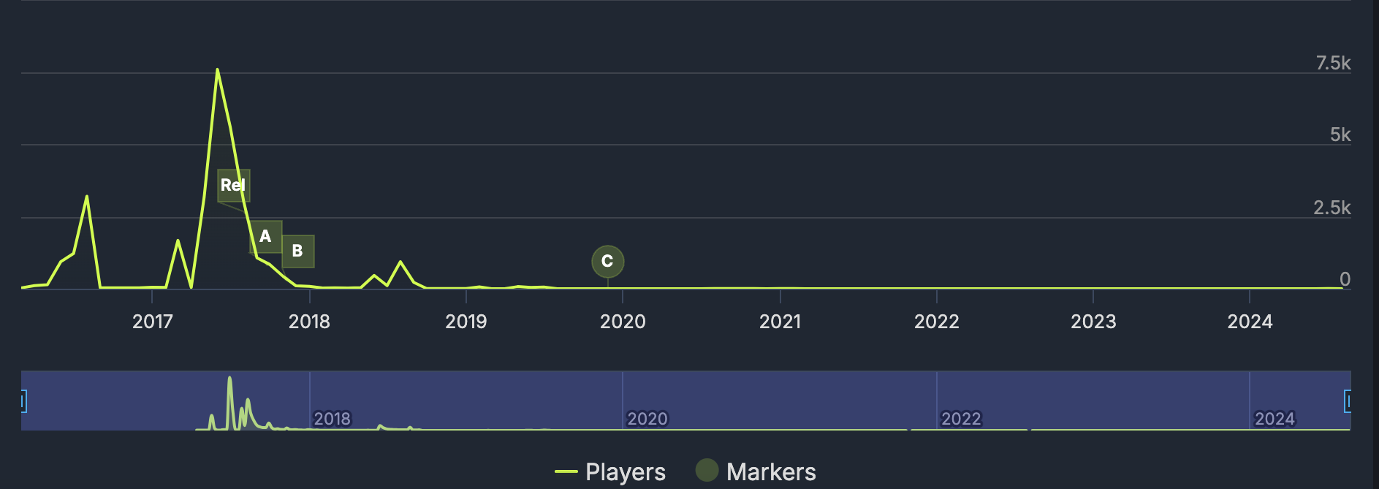
Lawbreakers Case Study
Stats using online visualizations
Twitch Viewers and Channel count
Findings:
Did not take advantage of Twitch engagement to grow the game’s community
No longevity or sustained interest in the game
The peak in the graph spans 1 year
Steam Active Players
Notes:
Abc ARE FREE WEEKENDS.
Rel is release date on steam

Slide 6
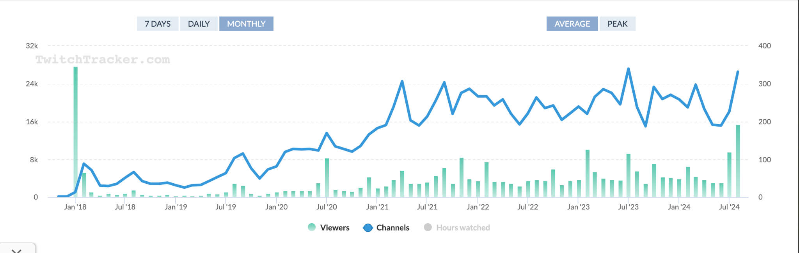
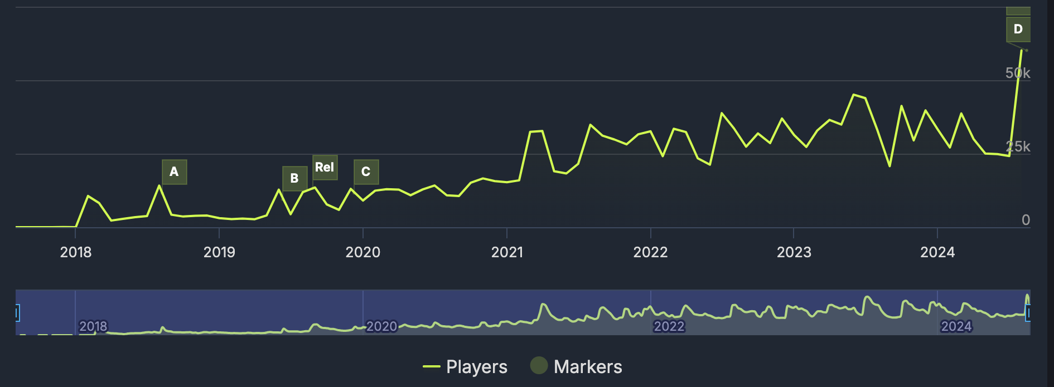
Hunt: Showdown 1896
Stats using online visualizations
Twitch Viewers and Channel count
Findings
The game had a huge initial interest, but quickly lost a significant amount of viewership
This was followed by a period of stagnation
Twitch campaign investments greatly increased interest
Steam Active Players
Notes:
ABCD are free weekends
Rel is release date

Slide 7
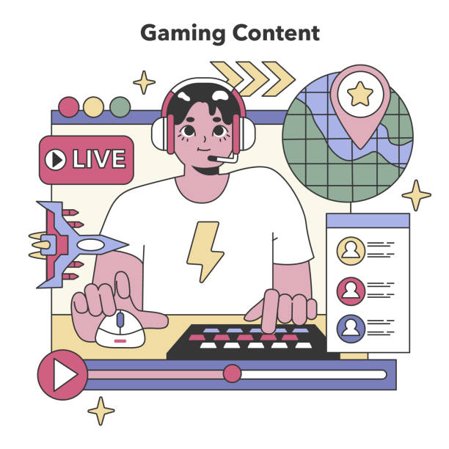
Approach
How companies can grow their community and interactivity on Twitch
How the Twitch community is a good indicator of game longevity
Looking at Twitch interactivity within a specific genre
For our study, the genre of the two previous games are described by the tags:
Multiplayer, FPS, Shooter, Difficult, Action
35
25
22
15

Slide 8
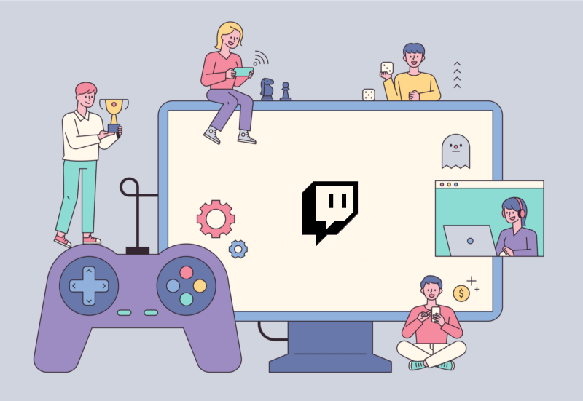
Techniques
Gamers Be Gamin’ (pro) strategies:
Aggregate Twitch data and add to aggregate Steam data
Filter by genre, according to tags (4+ of 10 tags matches is “same genre”)
Order by games with highest avg streamed hours (while in top 200 streamed)
Visualize Twitch interaction and hours streamed across top games
35
25
22
15

Slide 9
Explore Interactive Visualizations
https://youtu.be/ylPggY9rhrc

Slide 10
Project objective:

Slide 11
Overview/Presentation Outline (can delete after)
This is the first 10 minutes of what would be a 60 minute presentation of marketing. Why do we care about twitch and what does the competitor market look like for twitch community for our genre.
1 slide. Define Steam wrt online storefront w/ reviews. Game consulting company that is advising on how to grow a new game in the genre described by tags: ['Multiplayer', 'FPS', 'Shooter', 'Difficult', 'Action']
1 slide - Define Twitch wrt youtube/live stream and how twitch relates to growth.
1 slide lawbreakers stats use online visualizations
1 slide didn't use twitch
1 slide hunt stats use online visualizations
1 slide hunt visualization showing twitch and engagement points (if possible as a flask page with interactivity, if not with png on slide and arrows)
Then explore our dashboard loaded with only the games that have 4+ tag match?

