Slide 1
ANALYSIS OF CLIMATE CHANGE IMPACT TO GLOBAL WINE PRODUCTION

Slide 2
UCB Data Bootcamp Project 1
June 17th, 2024
Brenda M., Theresa F., Rinal S., Jeff K,, Madison O.

Slide 3
Research questions
Which were the top wine producing countries in year X?
Which are the current top wine producing countries in year Y?
What is the correlation between temperature and wine production?

Slide 4
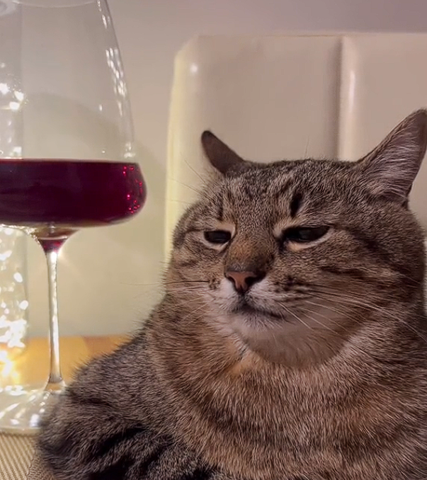
Research questions cont.
What is the correlation between precipitation and wine production?
What is the optimal temperature for maximum production?
What is the optimal precipitation level for maximum wine production?
For which countries has the climate changed to favorably or unfavorably impact wine production?

Slide 5
DATASETS
International Organization of Vine and Wine
Statistics https://www.oiv.int/what-we-do/statistics
Database Discovery Tool https://www.oiv.int/what-we-do/data-discovery-report?oiv
NOAA National Centers for Environmental Information
Data access https://www.ncei.noaa.gov/access
NCEI Data Service API User Documentation https://www.ncei.noaa.gov/support/access-data-service-api-user-documentation
Climate Data Online: Web Services Documentation https://www.ncdc.noaa.gov/cdo-web/webservices/v2#gettingStarted

Slide 6








Data Extraction / Cleaning
Extraction | Cleaning
Excel
Wine Data
csv
mapping
Cleaned file
Python
Climate Data
merge
Cleaned file
API
csv
mapping
preparation
Cleaned file
Python
preparation
Dataframe/Starter Code

Slide 7
Discussion & findings

Slide 8
[INSERT]
…
…

Slide 9
[insert]
…
…
…
…
…
…
…
…

Slide 10
[INSERT]
19XX: …
20XX: …
20XX: …

Slide 11
overview
20XX
20XX
20XX
20XX

Slide 12
Solution

Slide 13
References & resources

Slide 14

Thank you!
Q&A

