Slide 1
Knowledge Distillation for Scalable Deployment of Mixture-of-Experts Models
By Stanley Odour and Tyler Manrique Mentors: Rakene Chowdhury and Jishan Desai

Slide 2
Motivation - Scaling bottleneck in LLMs
Billion Parameter LLMs are expensive and unwieldy
Inference on MOE systems only activates a fraction of the model
MOE systems are more scalable, cheaper, and more efficient than traditional models
MoE enables higher FLOPS throughput than traditional models

Slide 3
Problem Definition
Expert Placement: Which transformer layers benefit most from expert specialization? Should all layers be converted to MoE, or is selective placement more effective?
Expert Configuration: What is the optimal number of experts and routing strategy? Does having more experts improve performance? Does Top-2 routing outperform Top-1?
Knowledge Preservation: Can knowledge from pre-trained dense models be effectively transferred to MoE architectures? Does Knowledge Distillation stabilize training, improve accuracy, or potentially constrain beneficial expert specialization?
Practical Deployment: What are the real-world trade-offs between FLOPs reduction and actual throughput? Where are the implementation bottlenecks that prevent theoretical efficiency gains from materializing?

Slide 4
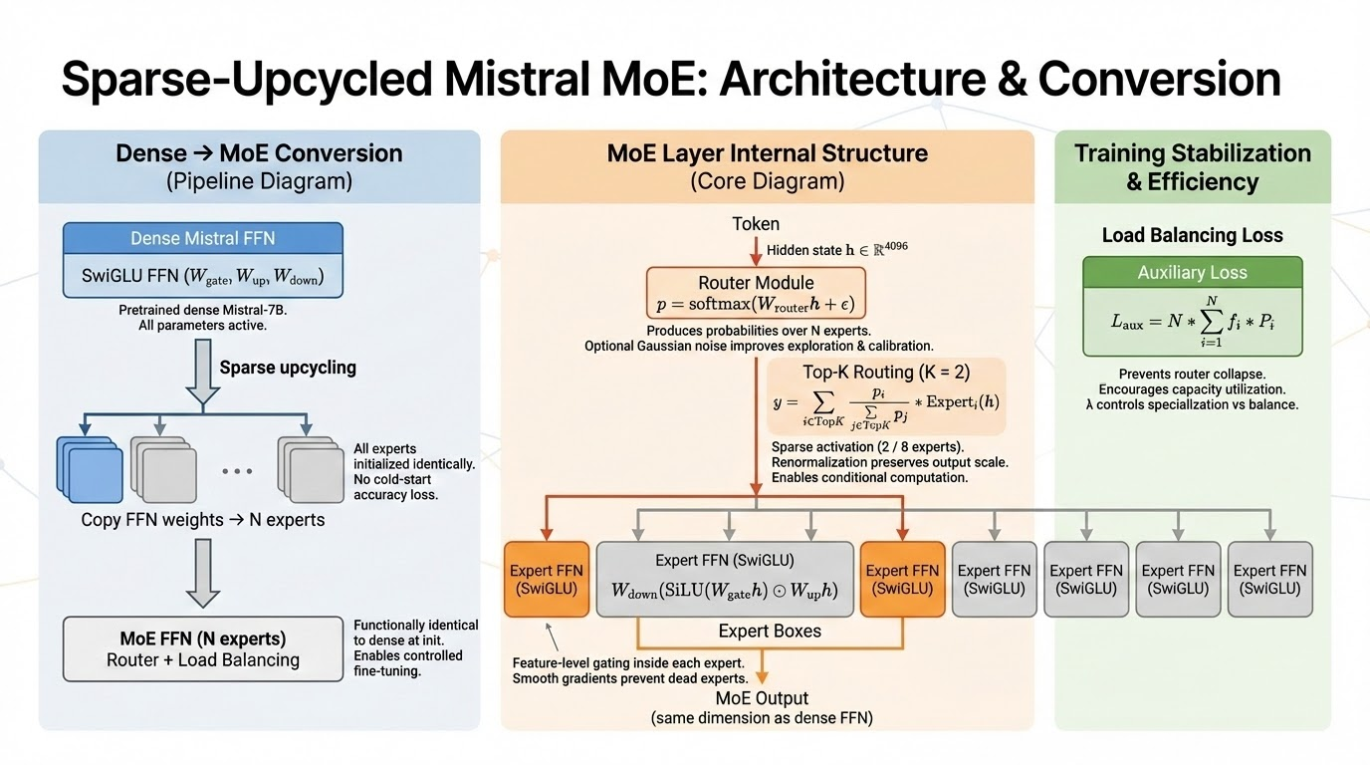

Slide 5
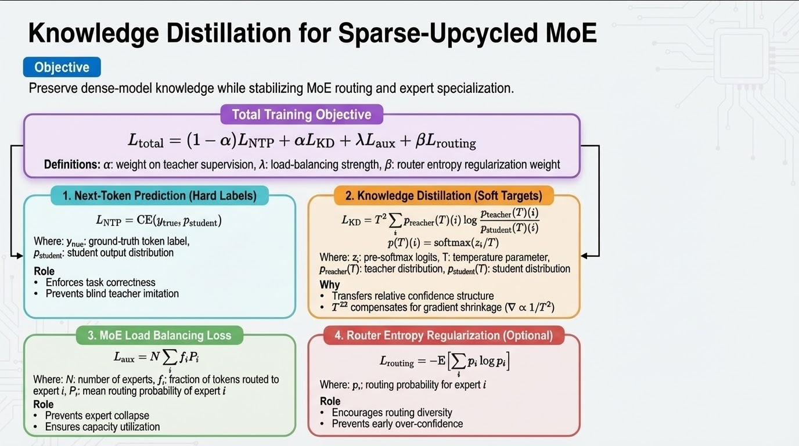

Slide 6
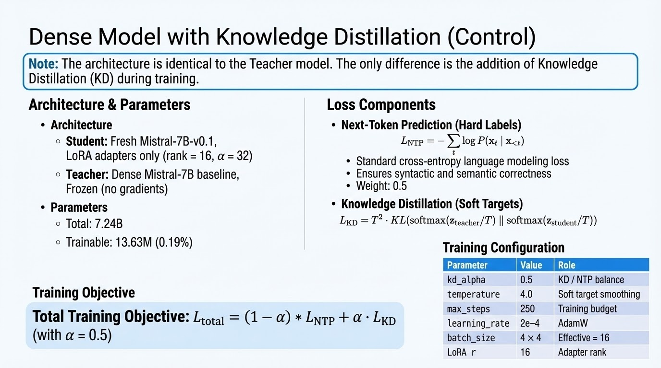

Slide 7
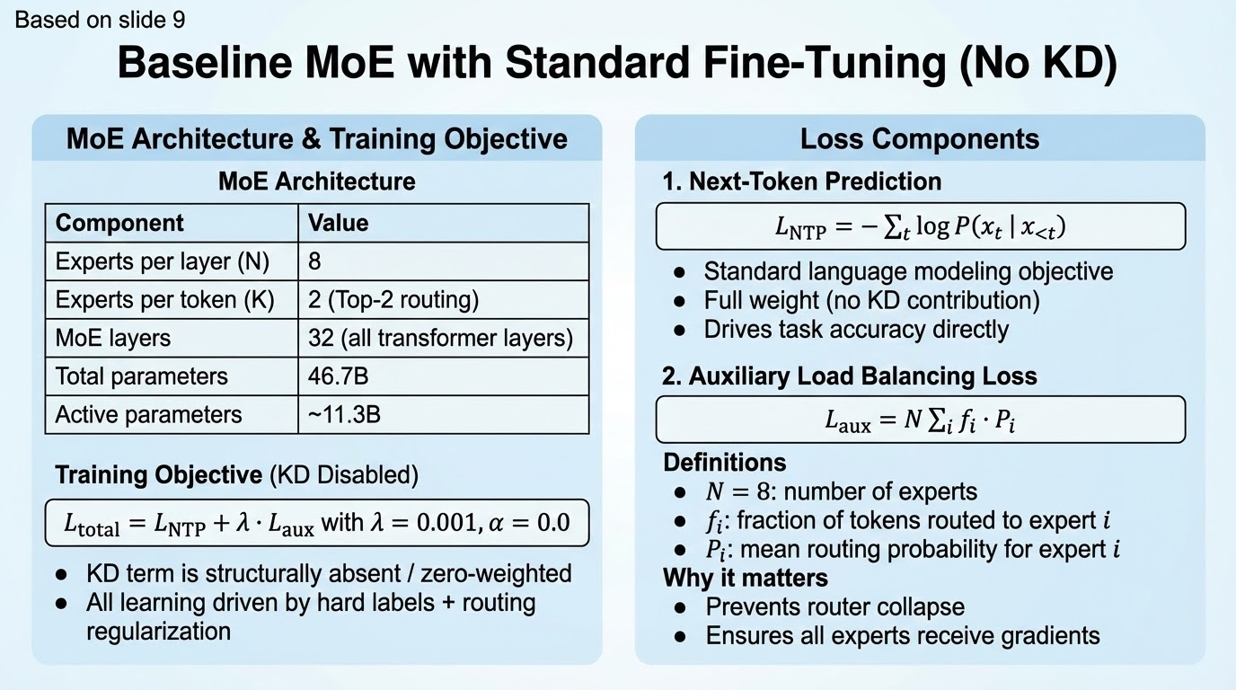

Slide 8
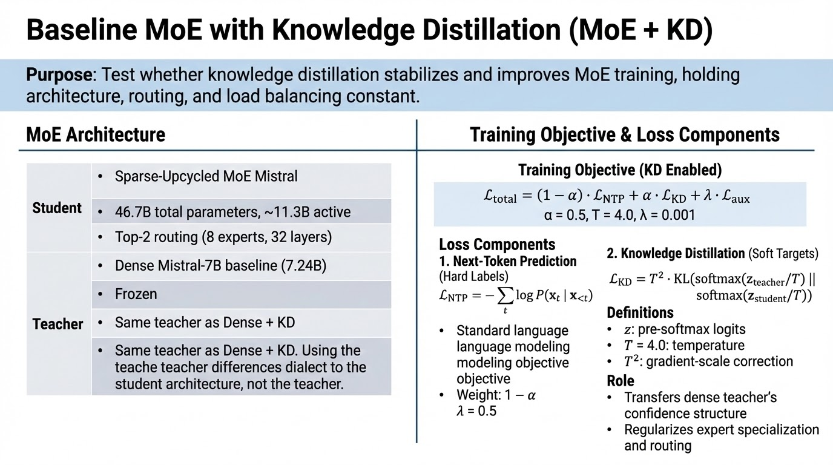

Slide 9
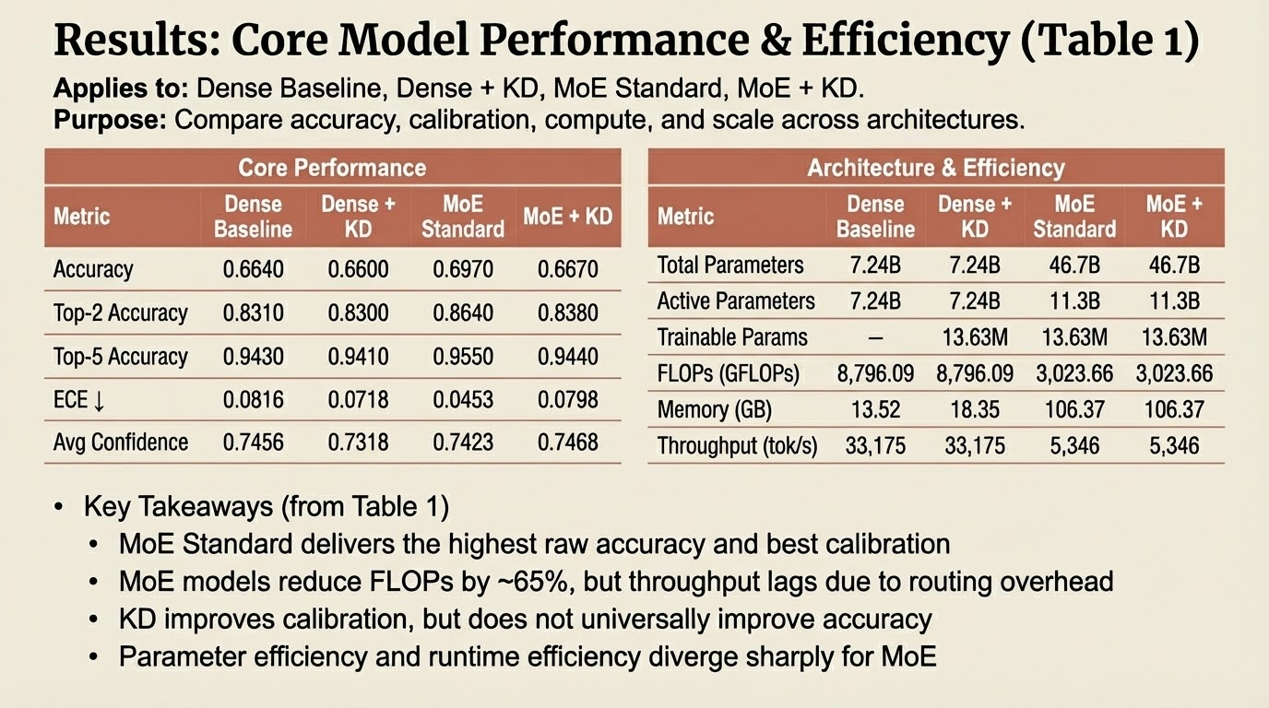

Slide 10
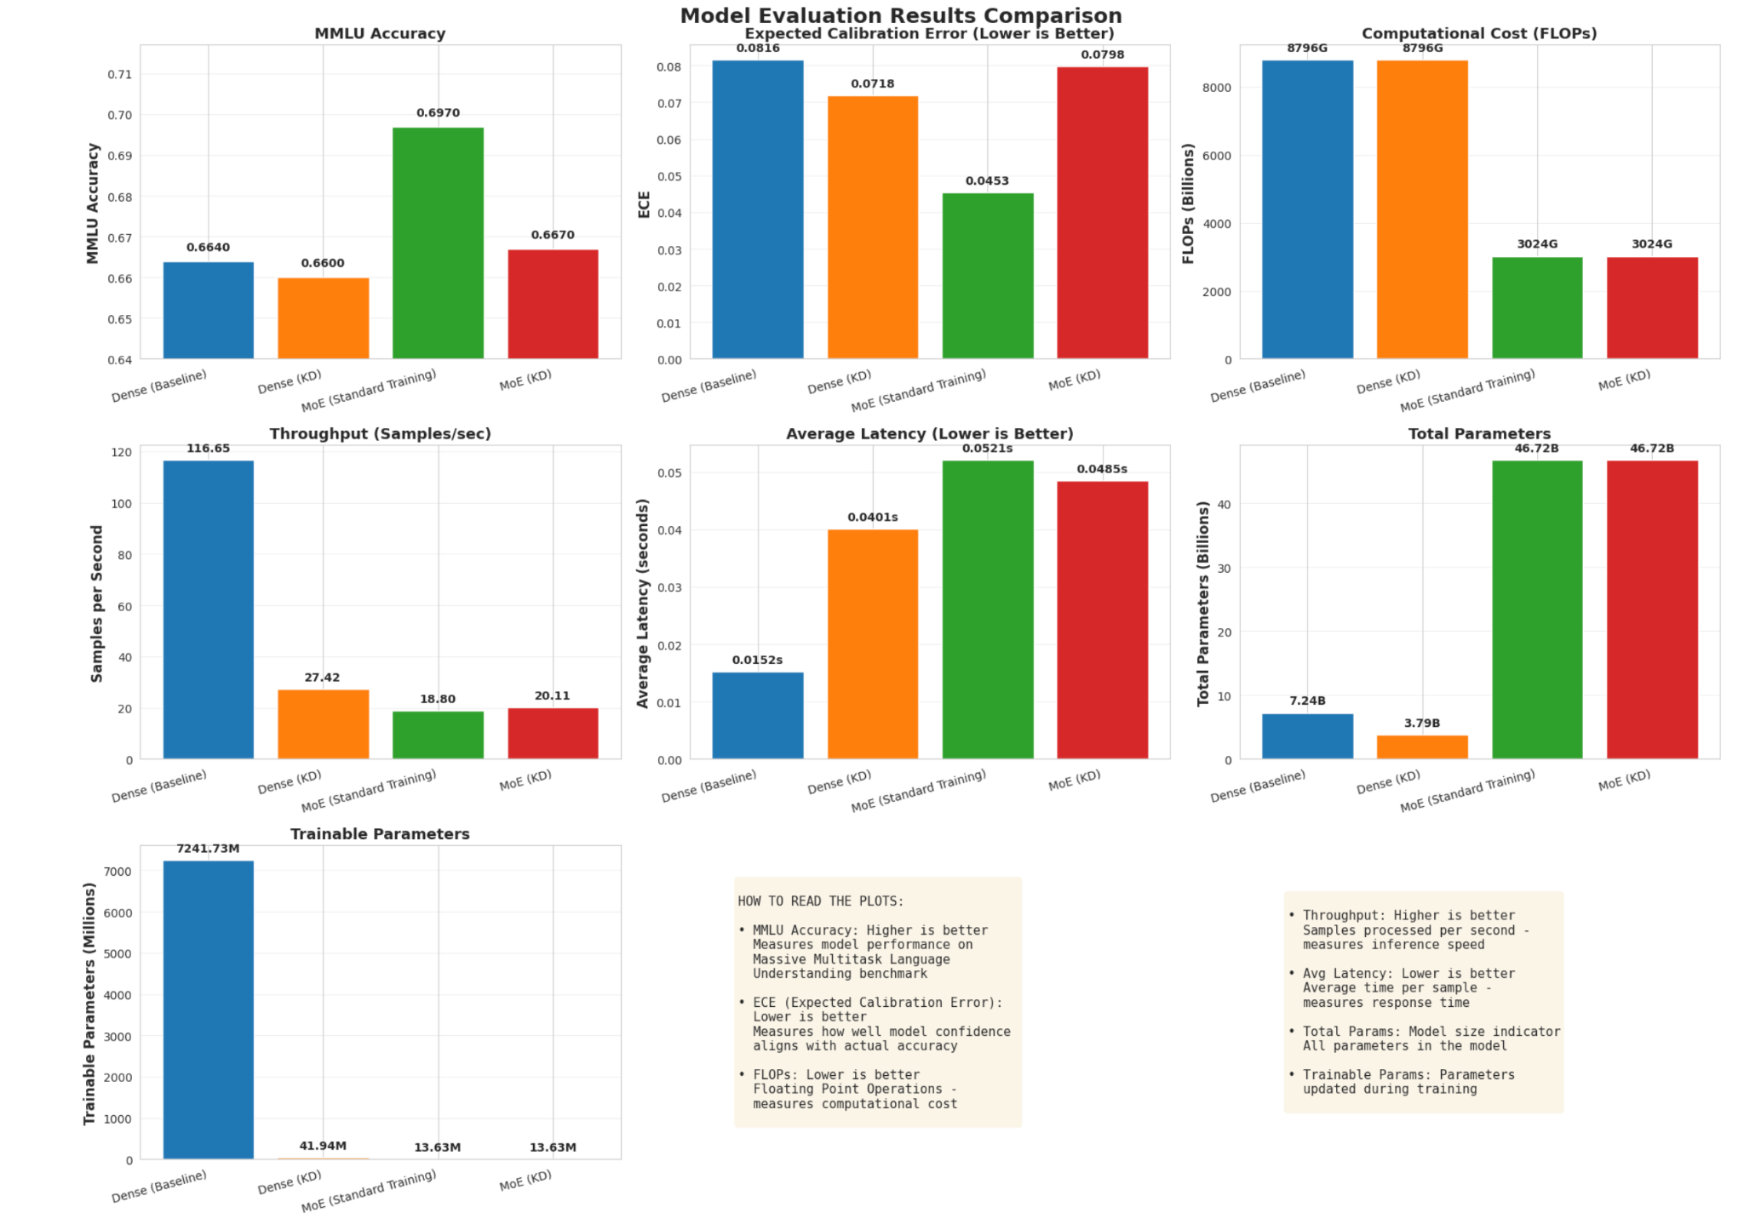

Slide 11
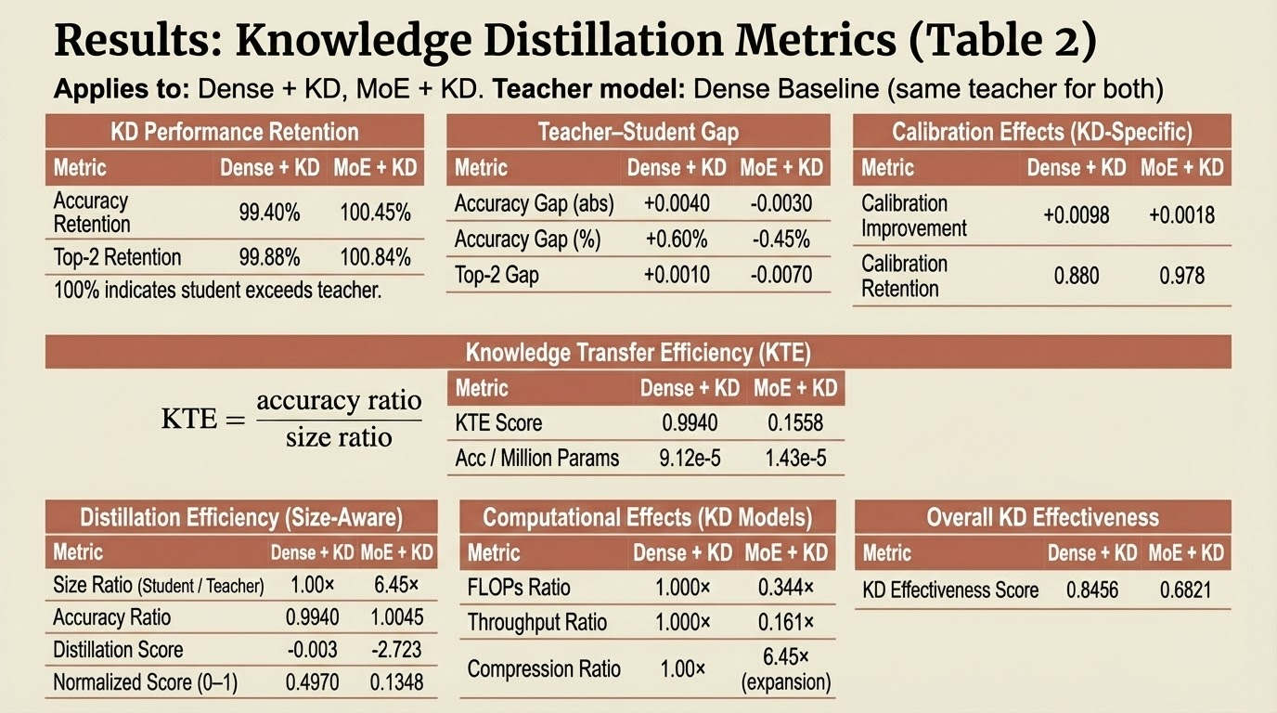

Slide 12
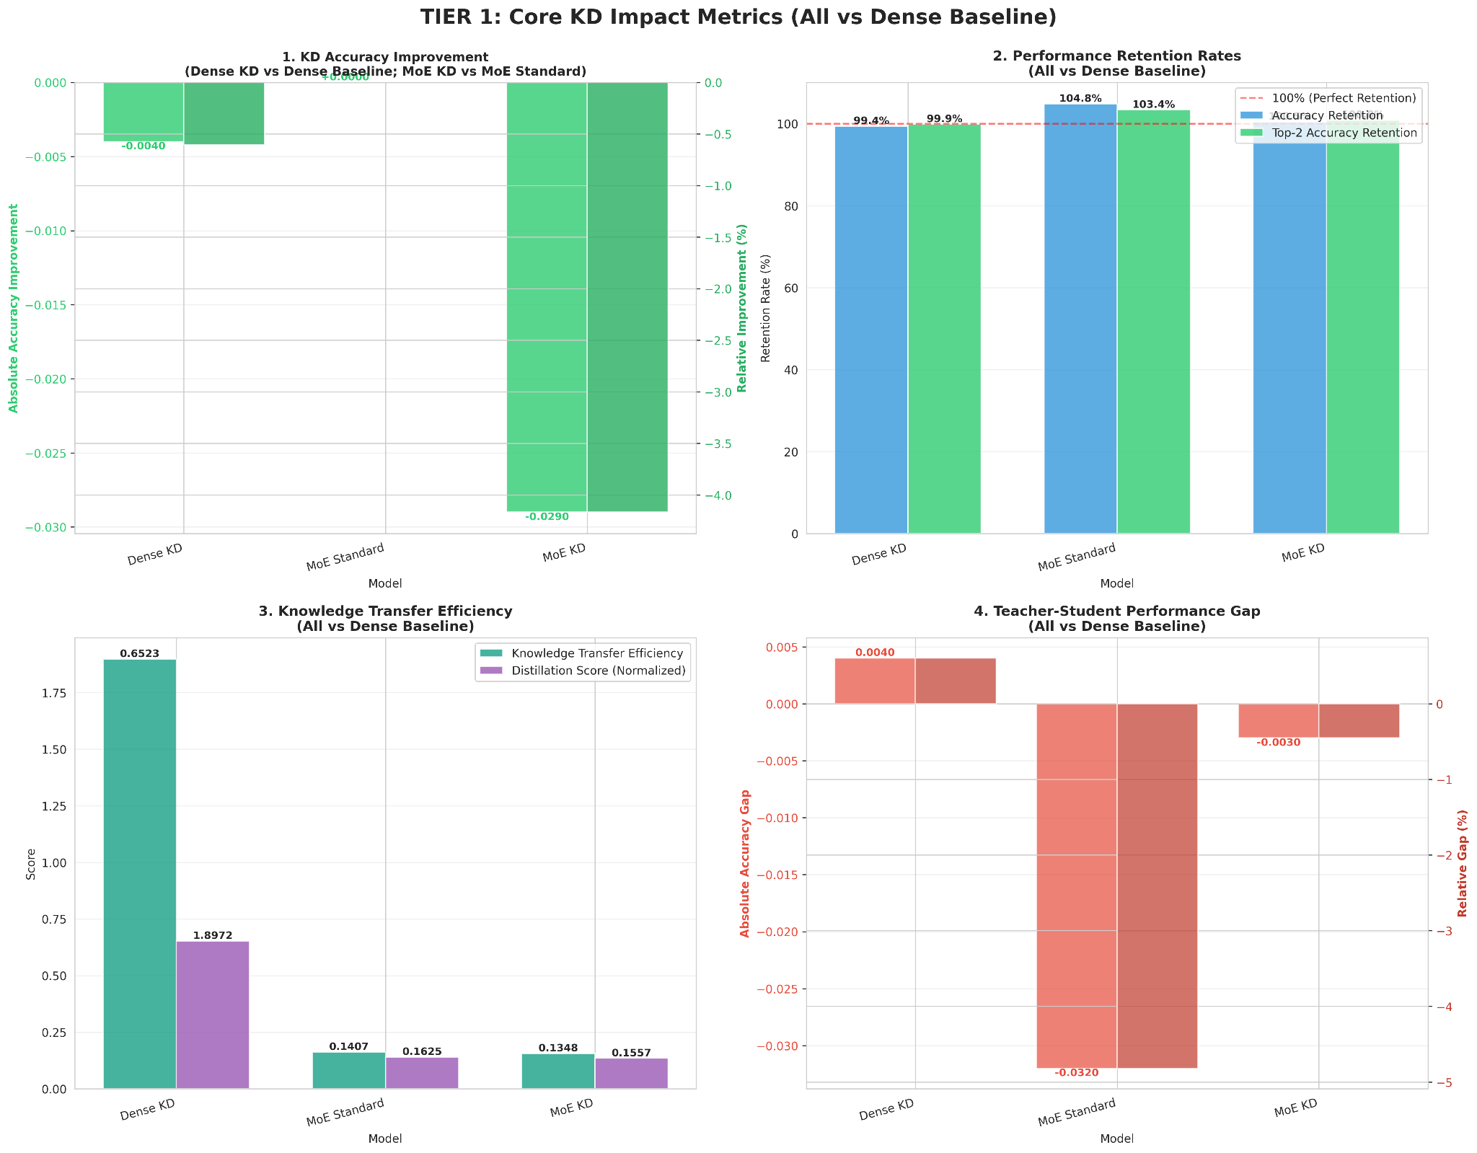

Slide 13
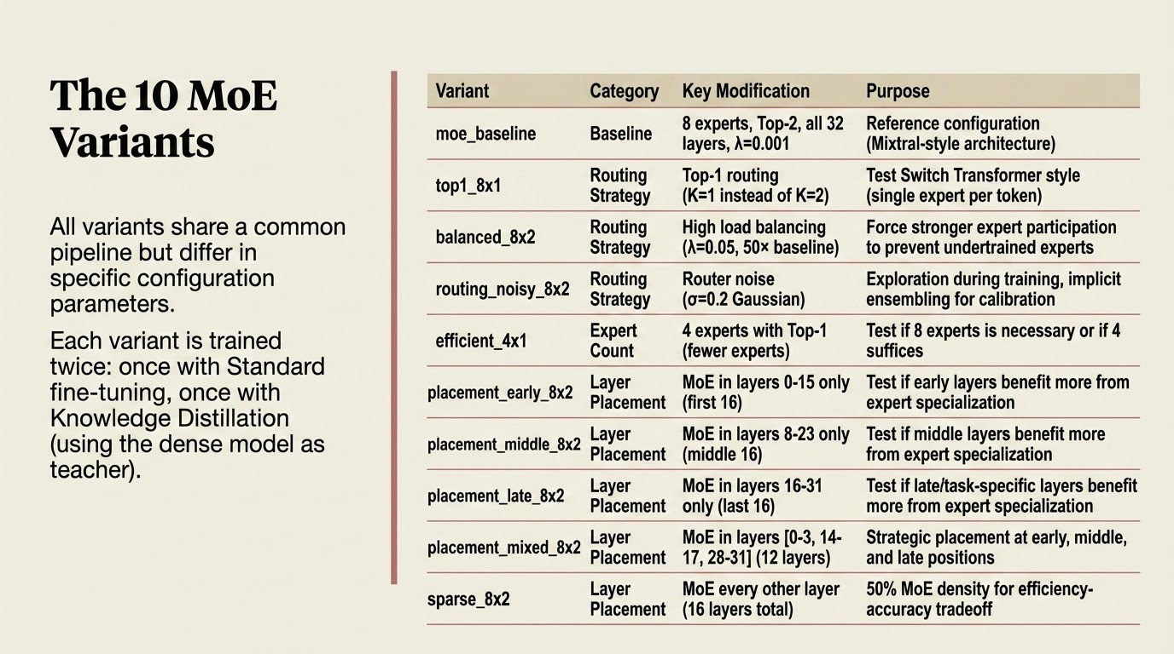

Slide 14
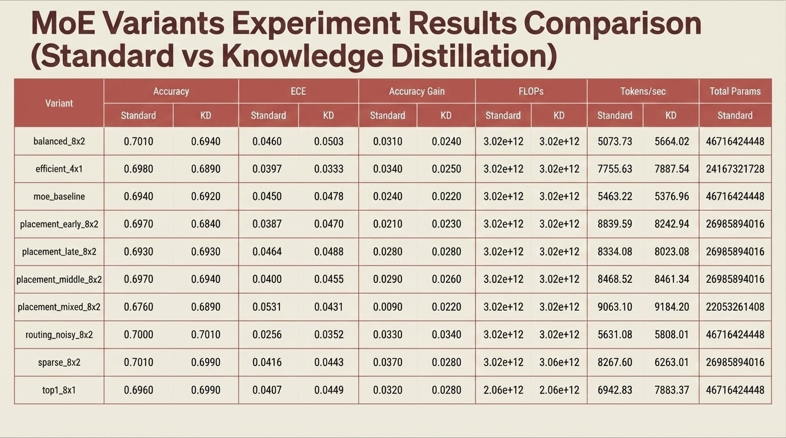

Slide 15
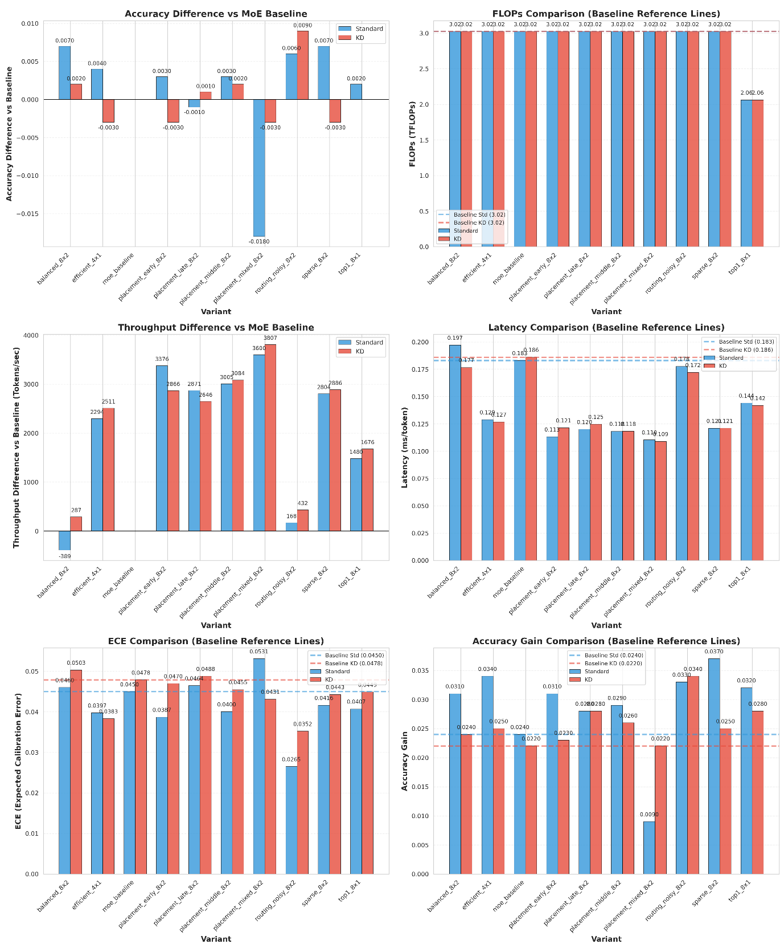

Slide 16
Conclusions and Lessons Learned
Conclusions
MoE outperforms/maintains the dense model on accuracy and reduces the compute costs while having a substantially larger capacity
Sequential processing of an MoE model lowers its throughput and latency, improved by expert parallelization
Knowledge distillation stabilizes the training of a model
MoE models performance is heavily influenced by the routing and expert configurations on both standard fine tuning and knowledge distillation
Lessons Learned
Impact of different architectures on the MoE models and performance on standard fine tuning and Knowledge Distillation
Adaptive Knowledge Distillation on MoE models
Impact of parallelization on improving model latency and throughput
LoRA fine-tuning and quantization

Slide 17
Next Steps
Using Micro-NAS instead of manual configurations for better search space navigation for better MoE architecture
Experimenting with adaptive Knowledge Distillation making it architecture specific
Experimenting with progressive knowledge distillation across layers and routing-aware knowledge distillation
Experimenting with expert parallelism and merging for scalability and deployment optimizations
Cross testing with other models to test the validity of our results

