Slide 1
Student Dropout Prediction Analysis
Machine Learning Project Presentation
By
Omonigho Egbo

Slide 2
Project Overview
Analysis of student success and dropout rates based on academic and socioeconomic factors.
- Dataset: 10,000 (students) records
- Features: Demographics, Academic records, Economics.

Slide 3
Data Cleaning/Re-engineering
Initial data shape: (10000, 19)
- Removed duplicates: No duplicate
- Handled missing values in Age via median imputation.
- Created feature: Academic performance.

Slide 4
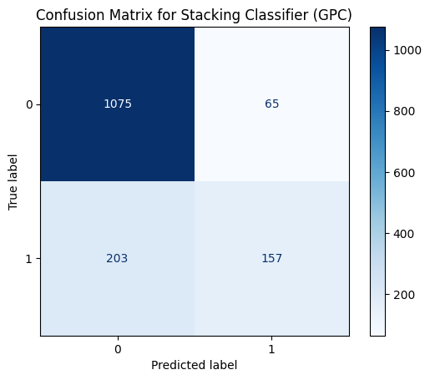
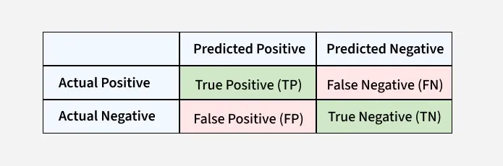
Evaluation Outcome(CM)-1
True Negative (Top-Left): Correctly predicted non-dropout students.
False Positive (Top-Right):Incorrectly predicted dropout students (Type I error).
False Negative (Bottom-Left):Incorrectly predicted non-dropout students (Type II error).
True Positive (Bottom-Right):Correctly predicted dropout students.

Slide 5
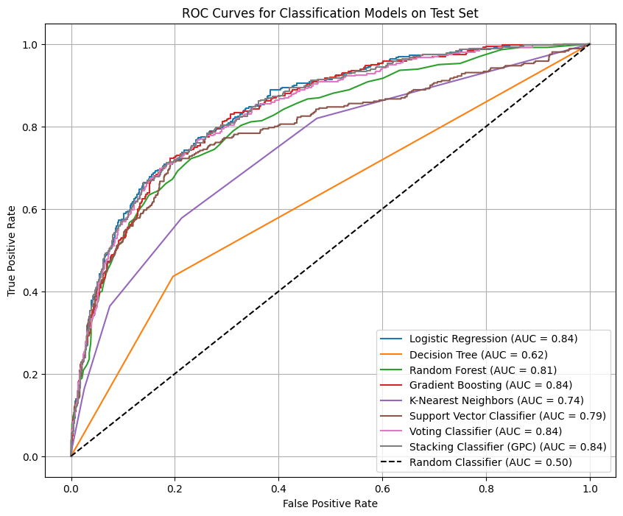
Evaluation Outcome(ROC Curves)-2
ROC curve plots the True Positive Rate (TPR) against the False Positive Rate (FPR) at various threshold settings.
It provides an aggregate measure of performance across all possible classification thresholds.
An AUC of 1.0 represents a perfect classifier, while an AUC of 0.5 represents a random classifier (the dashed line).

Slide 6
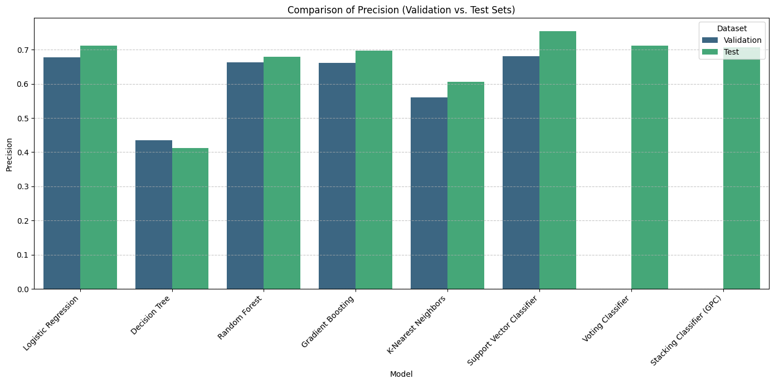
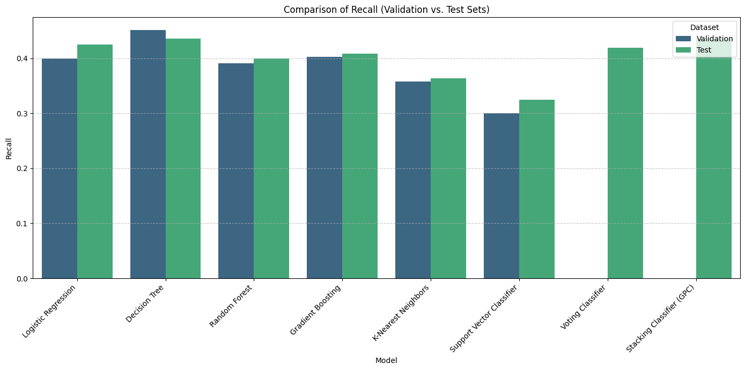
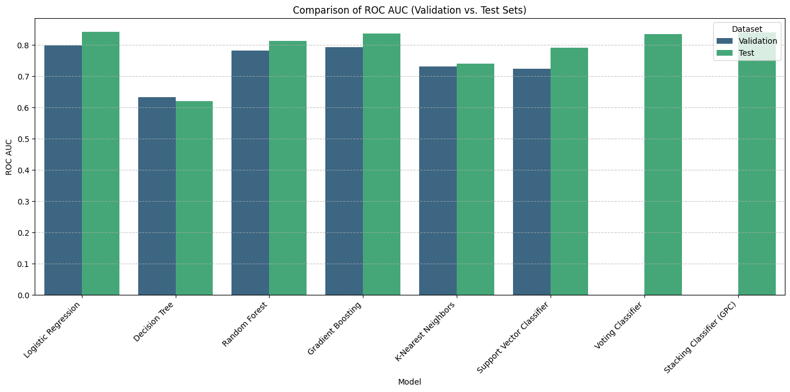
Finding 3:Model Performance

Slide 7
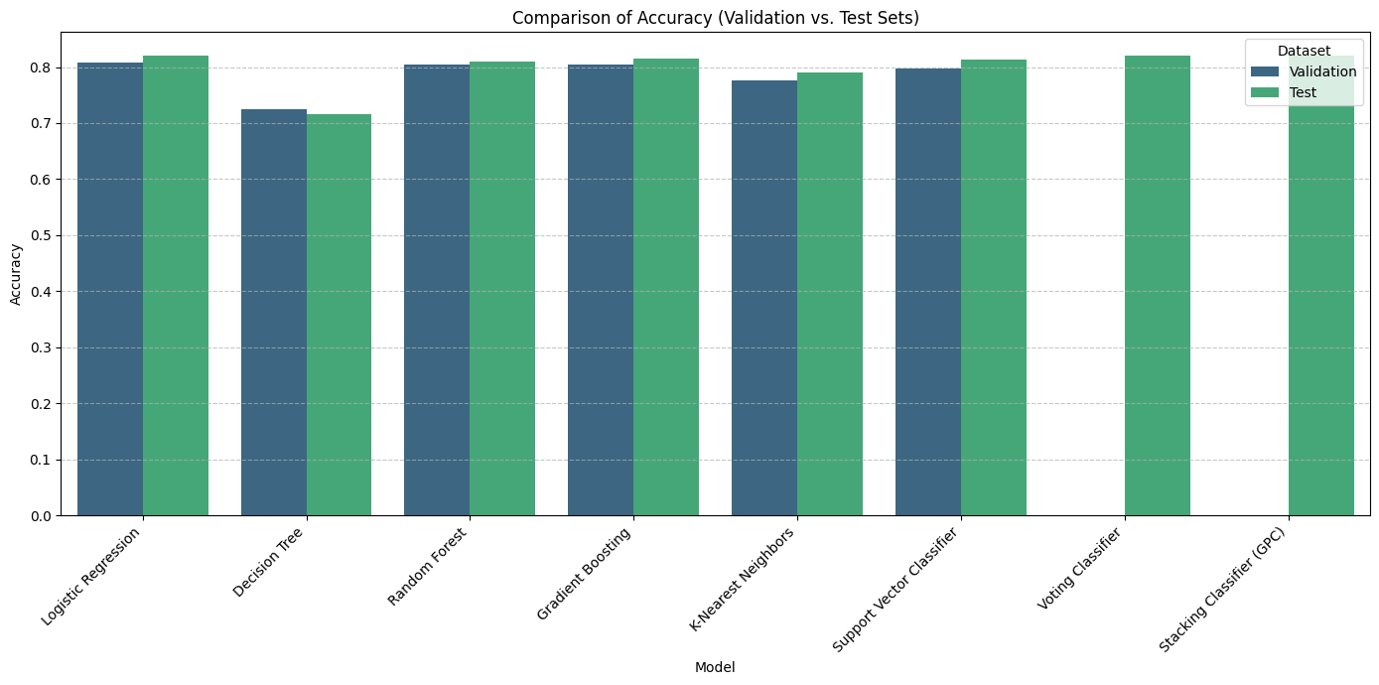
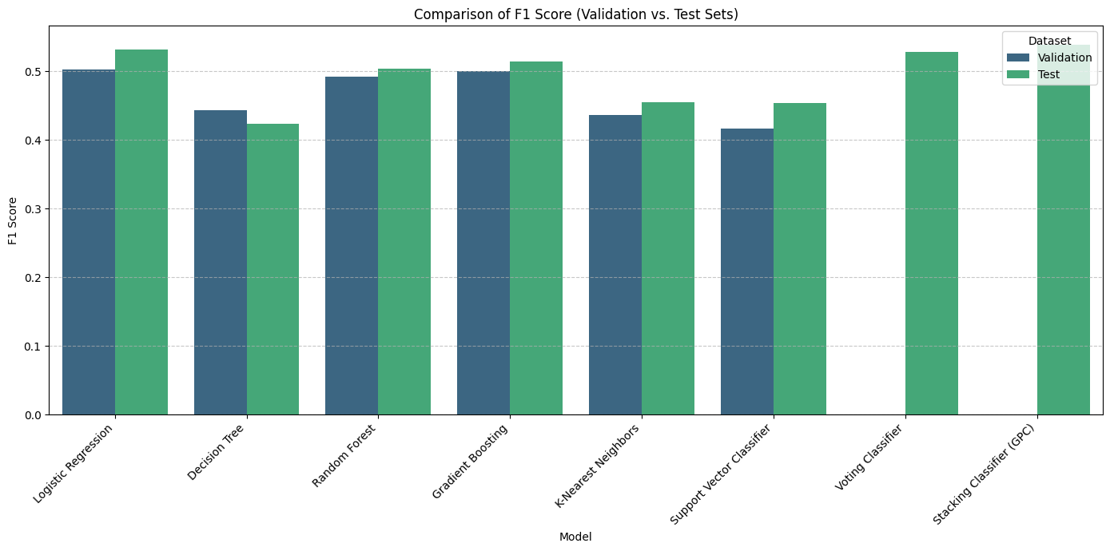

Slide 8
Conclusion
The study suggests that large performance drops from validation to test sets may indicate overfitting, especially when validation scores are much higher than test scores.
These visualizations are crucial for identifying the most robust and best-performing models, as well as for detecting potential issues like overfitting before deploying a model.
This visualization helps to understand the types of errors the model is making, which is crucial for evaluating its effectiveness in a real-world scenario.
Thank you

