Slide 1
Introduction to Artificial Intelligence
Ben Paechter
Dimitra Gkatzia

Slide 2
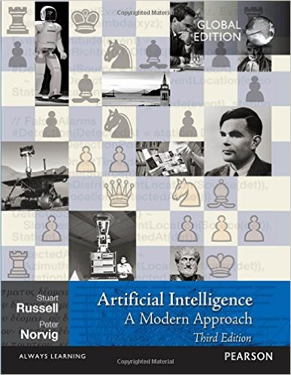
Module Book (Ben’s Lectures)
Available in the library as PDF
Doesn’t matter
Matters
e.g. Amazon £45
Website: aima.cs.berkeley.edu

Slide 3
Teaching
Two hours of lecture each week – not this week as you have extra homework to do to prepare for next week.
Our hour tutorial – exercises, discussion, plus chance to ask about lecture material
Practical – some lab exercises or things to look at on the web. Coursework help. Homework – each week read the book chapter in advance of the next week’s lecture. Two chapters to read this week. Sometimes other work as well.
Quizzes and end of module tests questions will be based around the lecture material – book gives wider context, further information, and a different way of explaining.

Slide 4
Module Synopsis
One topic a week Lecture, Tutorial and Practical.
Tutorials and Practicals Support the Lecture that they follow.
Lecture Plan:
Week 2 – Lecture on 14.9 - Chapter 1 of book - Introduction to Artificial Intelligence (BP)
Week 3 – Lecture on 21.9 - Chapter 2 of book - Intelligent Agents (BP)
Week 4 – Lecture on 28.9 – Introduction to Machine Learning (DG)
Week 5 – Lecture on 5.10 - Chapter 3 of book - Solving Problems by Searching (BP)
Week 6 – Lecture on 12.10 – Introduction to Neural Networks (DG)
Week 7 – Lecture on 19.10 - Convolutional Neural Networks (DG)
Week 8 – Lecture on 26.10 – Chapters 5 and 6 of book Adversarial Search and CSPs- (BP)
Week 9 – Lecture on 2.11 - Chapters 7 and 8 of book - Logical Agents and Inference (BP)
Week 10 - Lecture on 9.11 – Natural Language Processing
Week 11 – Lecture on 16.11 Introduction to Nature Inspired Computing and Revision (BP)

Slide 5
Assessment
10 multiple choice quizzes at the end of each week starting next week – each is worth 1%
2 courseworks each worth 30% one from me, one from Dimitra.
Mine:
Programming exercise to solve a problem or alternative non-programming version.
Given out week 6 (this is week 2) Submitted week 10.
Dimitra’s is likely to be due in week 13.
Class test – end of trimester 30%

Slide 6
What is Artificial Intelligence?
Thinking Humanly
Thinking Rationally
Acting Humanly
Acting Rationally

Slide 7
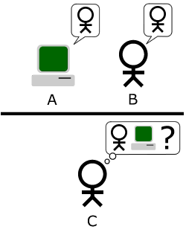
Acting Humanly
Turing Test – 1950 (The Imitation game)
Communication is written
Can C tell which of A or B is the human?
Turing predicted that by 2000 with a five minute conversation C would only be right 70% of the time?

Slide 8
Thinking Humanly
How do humans think? Three ways to find out:
Introspection
Psychological Experiments
Brain Imaging
Cognitive Science brings together computer models from AI and experiments from psychology to construct precise and testable theories of the human mind.

Slide 9
Thinking Rationally
Aristotle – Greek Philosopher – “Right Thinking”
Aristotle's syllogisms - deductive reasoning.
“Socrates is a man; all men are mortal; therefore, Socrates is mortal”
The start of logic.
1965 – programs written that could in principle solve any problem expressed as logic.
But:
How do you express problems as logic?
What about uncertainty?
How long will it take?

Slide 10
Acting Rationally
The rational agent approach – an agent is something that acts.
A rational agent is an agent that acts so as to achieve the best possible outcome (or, with uncertainty, the best expected outcome).
May include rational thinking.
May be inspired or helped by thinking or acting humanly
Acting perfectly rationally not always possible due to amount of processing needed – limited rationality

Slide 11
Contribution to AI: Philosophy
Can formal rules be used to draw valid conclusions (Aristotle)?
How does the mind arise from the physical brain (free will?, dualism, materialism)
Where does knowledge come from (empiricism, logical positivism)?
How does knowledge lead to action (or does the need for action lead to thought?)?

Slide 12
Contribution to AI: Mathematics
What are the formal rules to draw valid conclusions?
Various forms of logic and logical algebra
What can be computed?
Theoretically, what can we actually calculate and how long might it take. How does the time to calculate change with the size of the problem?
How do we reason with uncertain information?
Probability
Bayes’ Theorem

Slide 13
Contribution to AI: Economics
How should we make decisions so as to maximise payoff?
How should we do this when others might not go along?
How should we do this when the payoff may be far in the future?
Decision theory
Game Theory- utility of randomised decisions
Operations Research
Concept of satisficing – good enough decisions

Slide 14
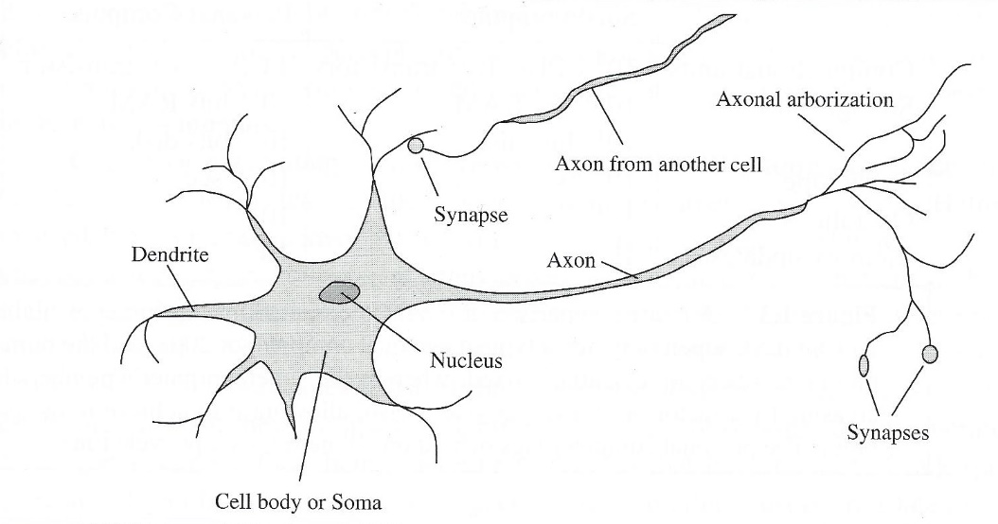
Contribution to AI: Neuroscience
How do brains process information?
Brains have comparable processing power to the most powerful computers – but work in very different ways.
A collection of simple cells can lead to thought action and consciousness – “brain cause minds”(discuss…)

Slide 15
Contribution to AI: Psychology
How do humans and animals think and act?
Problem of gathering data – introspection – live human subjects
Behaviourism – studied stimulus and response (percepts and actions)
Cognitive Psychology – seeing the brain as an information processing device

Slide 16
Contribution to AI: Computer Engineering
How can we build an efficient computer?
Artificial Intelligence requires intelligence and artefact – the computer is the artefact we use.
First operational computer was electromechanical – built by Alan Turing’s team to crack German war codes (Film Imitation Game)
Vacuum tubes
Transistor
Integrated Circuit
Computer on a chip
Multi-core processors
Highly Parallel Cloud computing

Slide 17
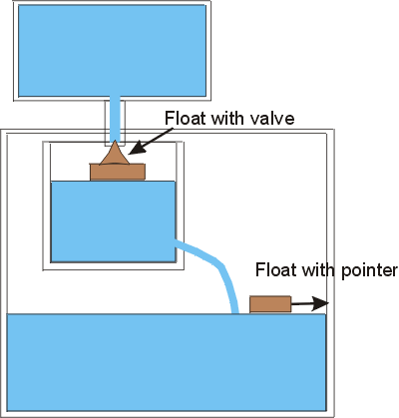
Contribution to AI: Control Theory and Cybernetics
First self-regulating device – Ktesibios of Alexandria (250 BCE)
Control theory uses concept of “objective function”
Control theory and AI have similar roots but look at things in different ways.

Slide 18
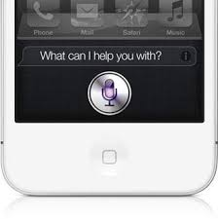
Contribution to AI: Linguistics
How does language relate to thought?
Language understanding and production requires knowledge about the world, about context – not just about sentence structure
Natural language processing is essential for modern intelligent interfaces such as Siri, Alexa, Google Assistant, and Cortana.

Slide 19
State of the ART in AI: Videos
Oren Etzioni, CEO of the Allen Institute for AI, shares his vision for deploying AI technologies for the common good.
http://events.technologyreview.com/video/watch/oren-etzioni-ai-for-common-good/
Peter Norvig, author of the book and now Director of Research for Google, on developing state-of-the-art AI solutions for building tomorrow's intelligent systems.
http://events.technologyreview.com/video/watch/peter-norvig-state-of-the-art-ai/
Andrew Ng, Chief Scientist with Baidu, on deploying deep learning solutions in practice with conversational AI and beyond – and the panel discussion.
http://events.technologyreview.com/video/watch/andrew-ng-deep-learning/

