Slide 1
Artificial Intelligence : Intelligent Agents 21 September 2020
Original Slides by: Tom Lenaerts
Institut de Recherches Interdisciplinaires et de Développements en Intelligence Artificielle (IRIDIA)
Université Libre de Bruxelles
Adapted for Edinburgh Napier by Ben Paechter

Slide 2
Outline
Agents and environments.
The vacuum-cleaner world
The concept of rational behavior.
Environments.
Agent structure.

Slide 3
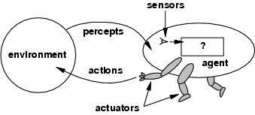
Agents and environments
Agents include human, robots, softbots, thermostats, etc.
The agent function maps percept sequence to actions
An agent can perceive its own actions, but not always its effects.

Slide 4
Agents and environments
The agent function will internally be represented by the agent program.
The agent program runs on the physical architecture to produce f.

Slide 5
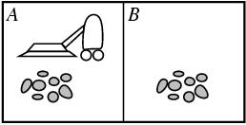
The vacuum-cleaner world
Environment: square A and B
Percepts: [location and content] e.g. [A, Dirty]
Actions: left, right, suck, and no-op

Slide 6
The vacuum-cleaner world
Percept sequence | Action
[A,Clean] | Right
[A, Dirty] | Suck
[B, Clean] | Left
[B, Dirty] | Suck
[A, Clean],[A, Clean] | Right
[A, Clean],[A, Dirty] | Suck
… | …

Slide 7
The concept of rationality
A rational agent is one that does the right thing.
Every entry in the table is filled out correctly.
What is the right thing?
Approximation: the most successful agent.
Measure of success?
Performance measure should be objective
E.g. the amount of dirt cleaned within a certain time.
E.g. how clean the floor is.
…
Performance measure according to what is wanted in the environment instead of how the agents should behave.

Slide 8
Rationality
What is rational at a given time depends on four things:
Performance measure,
Prior environment knowledge,
Actions,
Percept sequence to date (sensors).
DEF: A rational agent chooses whichever action maximizes the expected value of the performance measure given the percept sequence to date and prior environment knowledge.

Slide 9
Rationality
Rationality ≠ omniscience
An omniscient agent knows the actual outcome of its actions.
Rationality ≠ perfection
Rationality maximizes expected performance, while perfection maximizes actual performance.
Example: Space junk falling on your head crossing the road

Slide 10
Rationality
The proposed definition requires:
Information gathering/exploration
To maximize future rewards
E.g. Find new piles of dirt
Learn from percepts
Extending prior knowledge
E.g. New dirt arrives at the left square every nine iterations
E.g. Sucking for one iteration doesn’t always clear all the dirt
This gives us : Agent autonomy
Compensate for partial or incorrect prior knowledge

Slide 11
Task Environments
To design a rational agent we must specify its task environment.
PEAS description of the environment:
Performance
Environment
Actuators
Sensors
There may also be internal communication within the agent – which might be physically distributed.

Slide 12
Task Environments – Part-Picking Robot
PEAS description of the environment:
Performance
Percentage of parts in correct bins
Environment
Conveyor belts with parts
Actuators
Jointed arm and hand
Sensors
Camera, joint angle sensors

Slide 13
Task Environments – Chess
PEAS description of the environment:
Performance
Number of games won, drawn, lost
Environment
Other player
Actuators
Display, robot arm, or audio output
Sensors
Keyboard, camera, or audio input

Slide 14
Task Environments – Medical Diagnosis System
PEAS description of the environment:
Performance
Healthy patient, reduced costs
Environment
Patient, hospital staff,
Actuators
Display of questions, treatments, referrals
Sensors
Test results, touch input, keyboard, imaging equipment, audio input….

Slide 15
Task Environments – Taxi (e.g Uber Self-driving Car)
PEAS description of the environment:
Performance
Safety, profits, legality, comfort, time-taken,
Environment
Streets/motorways, other traffic, pedestrians, weather,, …
Actuators
Steering, engine, gearbox, brake, horn, display, audio output…
Sensors
Video, sonar, lasers, speedometer, engine sensors, touch-screen, GPS, audio input, …

Slide 16
Environment types
 | Part-picking | Chess | Diagnosis | Taxi
Observable??
Deterministic??
Episodic??
Static??
Discrete??
Single-agent??

Slide 17
Environment types
Fully vs. partially observable: an environment is fully observable when the
sensors can detect all aspects that are relevant to the choice of action.
 | Part-picking | Chess | Diagnosis | Taxi
Observable??
Deterministic??
Episodic??
Static??
Discrete??
Single-agent??
Notes:
Volledige observeerbare omgevingen zijn handig omdat de agent geen
Interne staat moet bijhouden over de omgeving
Partieel observeerbare omgevingen door noise of niet goed afgestelde sensoren of ontbrekende informatie

Slide 18
Environment types
Fully vs. partially observable: an environment is fully observable when the
sensors can detect all aspects that are relevant to the choice of action.
 | Part-picking | Chess | Diagnosis | Taxi
Observable?? | Partially | Fully | Partially | Partially
Deterministic??
Episodic??
Static??
Discrete??
Single-agent??

Slide 19
Environment types
Deterministic vs. stochastic: if the next environment state is completely
determined by the current state the executed action then the environment is
deterministic.
 | Part-picking | Chess | Diagnosis | Taxi
Observable?? | Partially | Fully | Partially | Partially
Deterministic??
Episodic??
Static??
Discrete??
Single-agent??
Notes:
Als de omgeving gedeeltelijk observeerbaar is kan deze stochastisch lijken.
Dus het is beter om te kijken of de omgebing determinitisch of stochastisch is vanuit het standpunt van de agent.
Als de omgeving deterministisch is behalve de acties van de andere agenten dan is de omgeving strategisch.

Slide 20
Environment types
Deterministic vs. stochastic: if the next environment state is completely
determined by the current state the executed action then the environment is
deterministic.
 | Part-picking | Chess | Diagnosis | Taxi
Observable?? | Partially | Fully | Partially | Partially
Deterministic?? | Stochastic | Deterministic | Stochastic | Stochastic
Episodic??
Static??
Discrete??
Single-agent??

Slide 21
Environment types
Episodic vs. sequential: In an episodic environment the agent’s experience
can be divided into atomic steps where the agents perceives and then performs
A single action. The choice of action depends only on the episode itself
 | Part-picking | Chess | Diagnosis | Taxi
Observable?? | Partially | Fully | Partially | Partially
Deterministic?? | Stochastic | Deterministic | Stochastic | Stochastic
Episodic??
Static??
Discrete??
Single-agent??

Slide 22
Environment types
Episodic vs. sequential: In an episodic environment the agent’s experience
can be divided into atomic steps where the agents perceives and then performs
A single action. The choice of action depends only on the episode itself
 | Part-picking | Chess | Diagnosis | Taxi
Observable?? | Partially | Fully | Partially | Partially
Deterministic?? | Stochastic | Deterministic | Stochastic | Stochastic
Episodic?? | Episodic? | Sequential | Sequential | Sequential
Static??
Discrete??
Single-agent??

Slide 23
Environment types
Static vs. dynamic: If the environment can change while the agent is choosing
an action, the environment is dynamic. Semi-dynamic if the agent’s performance
changes even when the environment remains the same.
 | Part-picking | Chess | Diagnosis | Taxi
Observable?? | Partially | Fully | Partially | Partially
Deterministic?? | Stochastic | Deterministic | Stochastic | Stochastic
Episodic?? | Episodic? | Sequential | Sequential | Sequential
Static??
Discrete??
Single-agent??
Notes:
If the agent performance score changes ahen time passes, the environment is semi-dynamic.

Slide 24
Environment types
Static vs. dynamic: If the environment can change while the agent is choosing
an action, the environment is dynamic.
 | Part-picking | Chess | Diagnosis | Taxi
Observable?? | Partially | Fully | Partially | Partially
Deterministic?? | Stochastic | Deterministic | Stochastic | Stochastic
Episodic?? | Episodic? | Sequential | Sequential | Sequential
Static?? | Dynamic | Static | Dynamic | Dynamic
Discrete??
Single-agent??
Notes:
If the agent performance score changes ahen time passes, the environment is semi-dynamic.

Slide 25
Environment types
Discrete vs. continuous: This distinction can be applied to the state of the
environment, the way time is handled and to the percepts/actions of the agent.
 | Part-picking | Chess | Diagnosis | Taxi
Observable?? | Partially | Fully | Partially | Partially
Deterministic?? | Stochastic | Deterministic | Stochastic | Stochastic
Episodic?? | Episodic? | Sequential | Sequential | Sequential
Static?? | Dynamic | Static | Dynamic | Dynamic
Discrete??
Single-agent??
Notes:
If the agent performance score changes ahen time passes, the environment is semi-dynamic.

Slide 26
Environment types
Discrete vs. continuous: This distinction can be applied to the state of the
environment, the way time is handled and to the percepts/actions of the agent.
 | Part-picking | Chess | Diagnosis | Taxi
Observable?? | Partially | Fully | Partially | Partially
Deterministic?? | Stochastic | Deterministic | Stochastic | Stochastic
Episodic?? | Episodic? | Sequential | Sequential | Sequential
Static?? | Dynamic | Static | Dynamic | Dynamic
Discrete?? | Continuous | Discrete | Continuous | Continuous
Single-agent??
Notes:
If the agent performance score changes ahen time passes, the environment is semi-dynamic.

Slide 27
Environment types
Single vs. multi-agent: Does the environment contain other agents who
are also maximizing some performance measure that depends on the
current agent’s actions?
 | Part-picking | Chess | Diagnosis | Taxi
Observable?? | Partially | Fully | Partially | Partially
Deterministic?? | Stochastic | Deterministic | Stochastic | Stochastic
Episodic?? | Episodic? | Sequential | Sequential | Sequential
Static?? | Dynamic | Static | Dynamic | Dynamic
Discrete?? | Continuous | Discrete | Continuous | Continuous
Single-agent??
Notes:
If the agent performance score changes ahen time passes, the environment is semi-dynamic.

Slide 28
Environment types
Single vs. multi-agent: Does the environment contain other agents who
are also maximizing some performance measure that depends on the
current agent’s actions? Are the other agents co-operating or competing?
 | Part-picking | Chess | Diagnosis | Taxi
Observable?? | Partially | Fully | Partially | Partially
Deterministic?? | Stochastic | Deterministic | Stochastic | Stochastic
Episodic?? | Episodic? | Sequential | Sequential | Sequential
Static?? | Dynamic | Static | Dynamic | Dynamic
Discrete?? | Continuous | Discrete | Continuous | Continuous
Single-agent?? | Single | Multi | Single? | Multi
Notes:
If the agent performance score changes ahen time passes, the environment is semi-dynamic.

Slide 29
Environment types
The simplest environment is
Fully observable, deterministic, episodic, static, discrete and single-agent.
Most real situations are:
Partially observable, stochastic, sequential, dynamic, continuous and multi-agent.

Slide 30
Answer to Last Week’s Tutorial Question 5
Choose team of 5 from 500 taking into account how team will work together
Assume there are 5 named positions
Position 1 can be chosen from 500
Position 2 can be chosen from 499
Position 3 can be chosen from 498
Position 4 can be chosen from 497
Position 5 can be chosen from 496
Total number of possibilities to consider = 500*499*498*497*496 = 30,629,362,512,000
Divide by 1,000,000 = 30,629,362 seconds
Just under a year

Slide 31
Answer to Last Week’s Tutorial Question 5
Choose team of 5 from 5000 taking into account how team will work together
Assume there are 5 named positions
Position 1 can be chosen from 5000
Position 2 can be chosen from 4999
Position 3 can be chosen from 4998
Position 4 can be chosen from 4997
Position 5 can be chosen from 4996
Total number of possibilities to consider = 5000*4999*4998*4997*4996 = 3,118,754,373,750,120,000
Divide by 1,000,000 = 3,118,754,373,750 seconds
About 100,000 years

Slide 32
Answer to Last Week’s Tutorial Question 5
Choose team of 11 from 5000 taking into account how team will work together
Assume there are 11 named positions
Position 1 can be chosen from 5000
Position 2 can be chosen from 4999
Position 3 can be chosen from 4998
Position 4 can be chosen from 4997
Position 5 can be chosen from 4996
Total number of possibilities to consider = 5000*4999*4998*4997*4996*4995*4994*4993*4992*4991*4990 =
Approx: 482,935,866,724,700,000,000,000,000,000,000,000,000,000,000,000,000
Combinatorial Explosion
Position 6 can be chosen from 4995
Position 7 can be chosen from 4994
Position 8 can be chosen from 4993
Position 9 can be chosen from 4992
Position 10 can be chosen from 4991
Position 11 can be chosen from 4990

Slide 33
Agent types
How does the inside of the agent work?
Agent = architecture + program
All agents have the same skeleton:
Input = current percepts
Output = action
Program= manipulates input to produce output
Note difference with agent function – the agent function takes account of the entire percept sequence.

Slide 34
Agent types
Function TABLE-DRIVEN_AGENT(percept) returns an action
static: percepts, a sequence initially empty
table, a table of actions, indexed by percept sequence
append percept to the end of percepts
action ← LOOKUP(percepts, table)
return action
This approach is doomed to failure – why?

Slide 35
Why the table approach doesn’t work
Chess Estimate:
Approx 20 different moves each turn.
Table would have 20 entries for what to do after one move.
20x20 = 400 entries for what to do after two moves
20x20x20 = 8000 entries for what to do after three moves
20x20x20x20 = 160,000 entries for what to do after four moves
20x20x20x20x20x20x20x20x20x20 = 10,240,000,000,000 entries for wat to do after 10 moves (five each)
10¹⁵⁰ Entries would be needed to complete a game.

Slide 36
Why the table approach doesn’t work
There are only 10⁸⁰ atoms in the observable universe
The table for chess couldn’t be held in any computer
No-one would have time to fill in all the entries
No agent would have time to learn all the entries
Chess is relatively small – compare to percept sequence that includes a video feed – 27mbits second
The table does the job but is impractical - We need a smallish program – not vast table

Slide 37
Agent types
Four basic kind of agent programs will be discussed:
Simple reflex agents
Model-based reflex agents
Goal-based agents
Utility-based agents
All these can be turned into learning agents.

Slide 38
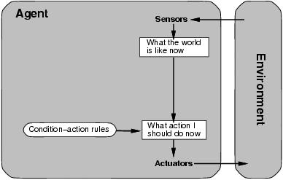
Agent types; simple reflex
Select action on the basis of only the current percept.
E.g. the vacuum-agent
Large reduction in possible percept/action situations(next page).
Implemented through condition-action rules
If dirty then suck
If car-in-front-is-breaking then initiate-braking

Slide 39
The vacuum-cleaner world
function REFLEX-VACUUM-AGENT ([location, status]) return an action
if status == Dirty then return Suck
else if location == A then return Right
else if location == B then return Left
Reduction from 4^{T} to 4 entries

Slide 40
Agent types; simple reflex
function SIMPLE-REFLEX-AGENT(percept) returns an action
static: rules, a set of condition-action rules
state ← INTERPRET-INPUT(percept)
rule ← RULE-MATCH(state, rules)
action ← RULE-ACTION[rule]
return action
Will only work if the environment is fully observable (no history is kept)
If not fully observable infinite loops may occur. E.g what if the vacuum doesn’t know where it is?
Randomisation can help break out of infinite loops

Slide 41
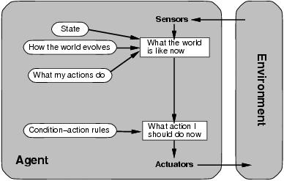
Agent types; reflex and state
To tackle partially observable environments.
Maintain internal state
Over time update state using world knowledge
How does the world change.
How do actions affect world.
⇒ Model of World

Slide 42
Agent types; reflex and state
function REFLEX-AGENT-WITH-STATE(percept) returns an action
static: rules, a set of condition-action rules
state, a description of the current world state
model, how the next state depends on current state and actions
action, the most recent action.
state ← UPDATE-STATE(state, action, percept, model)
rule ← RULE-MATCH(state, rules)
action ← RULE-ACTION[rule]
return action

Slide 43
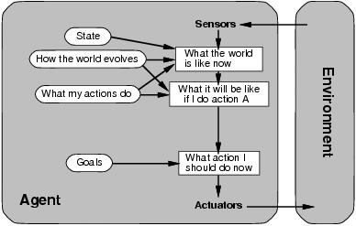
Agent types; goal-based
The agent needs a goal to know which situations are desirable.
Things become difficult when long sequences of actions are required to find the goal.
Typically investigated in search and planning research.
Major difference: future is taken into account
What will happen if I do this?
Will that make me happy?
Is more flexible since knowledge is represented explicitly and can be manipulated.

Slide 44
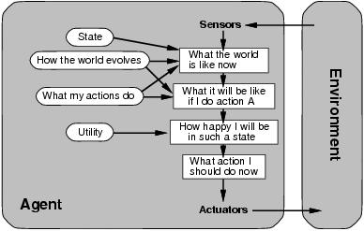
Agent types; utility-based
Certain goals can be reached in different ways.
Some are better, have a higher utility.
How happy will I be?
Utility function maps a (sequence of) state(s) onto a real number.
Improves on goals:
Selecting between conflicting goals
Select appropriately between several goals based on likelihood of success.

Slide 45
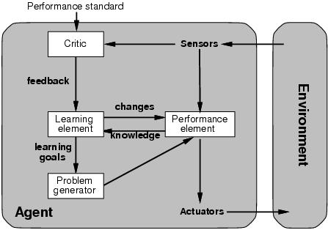
Agent types; learning
All previous agent-programs describe methods for selecting actions.
We have not explained how these programs come into being.
Learning mechanisms can be used to perform this task.
Teach them instead of instructing them.
Advantage is the robustness of the program toward initially unknown environments.

Slide 46
Agent types; learning
Learning element: introduce improvements in performance element.
Critic provides feedback on agent’s performance based on fixed performance standard.
Performance element: selecting actions based on percepts.
Corresponds to the previous agent programs
Problem generator: suggests actions that will lead to new and informative experiences.
Exploration vs. exploitation

