Slide 1
SET09102: Software Engineering
Teaching Team
Module leader: Xiaodong Liu (C55, x.liu@napier.ac.uk )
Zakwan Jaroucheh (C39,z.jaroucheh@napier.ac.uk)
Oluwaseun Bamgboye (o.bamgboye@napier.ac.uk)
Xi Wang (x.wang@.napier.ac.uk)
Erik Sanne (40276539@live.napier.ac.uk)
Timetable:
Lectures Friday 9:00-11:00 WebEx
Tutorials Tues 10:00-12:00 WebEx
Weds 10:00-11:00 WebEx
Thurs 11:00-12:00 WebEx
Practicals Tue 11:00-13:00, WebEx Tue 14:00-16:00 WebEx
Fri 15:00-17:00 WebEx

Slide 2
Lecture 1
Module Introduction
Development methodologies, focusing on agile approach
Requirement Engineering 1

Slide 3
Topics
Focus – advanced SE topics
Lifecycles: summary on Traditional, advanced observation on Agile
Requirement Engineering
Model-driven Development
Version Control
Modularity
Software Testing
Software Evolution
Inversion of Control and Dependency Injection
Software Quality
All united through development using Visual Studio - C# and design tools

Slide 4
Assessment
One Coursework:
Requirement
Design
Implementation
Testing
Version Control
Evolution
Total 50%
Examination 50%
Mix of theory and practical questions

Slide 5
Software Project Failure Rates
Source. CHAOS Study (Standish Group)

Slide 6
Layers of Software Engineering
Tools
Methods
Process
Quality

Slide 7
The layered model
Software engineering thus encompasses:
a Process that will be followed when designing and building systems,
Methods for managing and engineering software at each stage,
Tools whether these be modelling, development, process management,
The whole is underpinned on the bedrock of a quality framework.
Pressman asserts that the foundation for software engineering is the process layer that is “the glue that holds the technology layers together and enables rational and timely development of computer software”.

Slide 8
The software engineering process
A set of activities and associated results that produce a software product:
Pressman:
Five generic “framework” activities:
Communication
Planning
Modelling
Construction
Deployment
Sommerville:
Four fundamental process activities
Software Specification
Software Development
Software Validation
Software Evolution
Both views useful in understanding the techniques, skills and resources necessary for successful software development

Slide 9
Models of the software process
Historically there have been many attempts to formalise the software engineering process. Some of the commonest are:
Waterfall model: development is managed as a series of stages each of which feeds into the next.
V Model:
Spiral Model:
Incremental development etc.
At the abstraction/modelling aspect, there have been many approaches: functional decomposition, data-driven design (e.g. Jackson Structured Programming), object-orientation, service-orientation, microservices.

Slide 10
Traditional Waterfall Life-cycle
Requirements
Analysis
Design
Implementation
Testing
Maintenance
At each stage problems may be discovered, or new features defined, that require a return to earlier stages in the life-cycle.

Slide 11
Problems of traditional life-cycle
developments are rarely sequential
users often do not know what they want
errors in design may not be obvious until very late in the project
is not the best model for modern development tools
addresses technical rather than user needs

Slide 12
Alternative approaches to SD
A number of approaches have been developed over the last 30 years to address the problems of the software “Crisis”:
Structured methods (SSADM, etc. – largely what was done in SE Methods last session)
Object-oriented development
Computer-aided software engineering (CASE)
End-user development (inc. 4GLs)
Application software packages & outsourcing
Prototyping
Rapid Application Development (RAD)
Dynamic or Agile methods (DSDM, Scrum etc.)
Frameworks
Service-Oriented Architecture (SOA)
Web services
Microservices

Slide 13
Agile Definition
Agile refers to a group of software development methodologies based on iterative development, where requirements and solutions evolve through collaboration between self-organizing cross functional teams.
Agile methods are defined in the Agile Manifesto
Agile methods have much in common with the earlier Rapid Application Development (RAD)

Slide 14
Agile Manifesto
“We are uncovering better ways of developing software by doing it and helping others do it.
Through this work we have come to value:
Individuals and interactions over processes and tools
Working software over comprehensive documentation
Customer collaboration over contract negotiation
Responding to change over following a plan
That is, while there is value in the items on the right, we value the items on the left more”

Slide 15
Agile Methodologies
Several “flavours” of Agile Development
Extreme Programming (XP)
Dynamic Systems Development Method (DSDM)
SCRUM
Others: Crystal Clear, Lean Development, Feature Driven Development (FDD) and many others

Slide 16
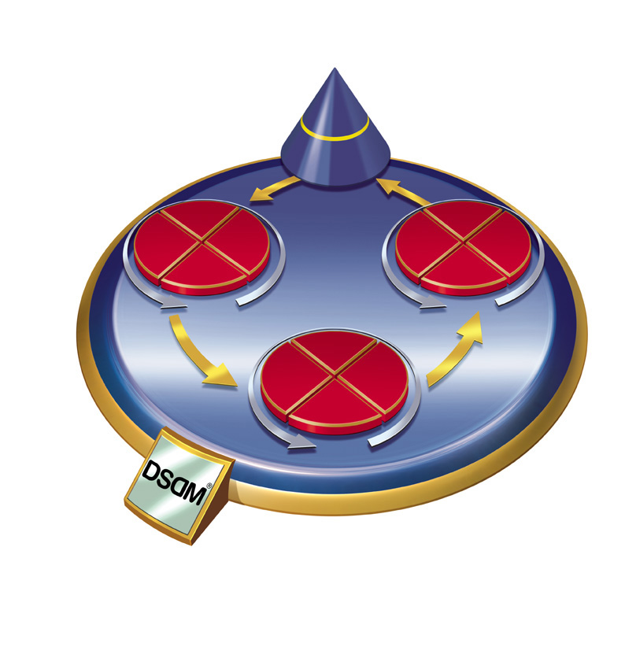
Traditional SD vs Agile
Functionality
Time Resource
Fixed
Traditional
Vary
Time Resource
Functionality
© DSDM

Slide 17
Extreme programming (XP)
http://www.extremeprogramming.org/index.html
Developed by Kent Beck (then software developer for Crysler)
Aim to deliver high-quality software quickly and continuously,
promotes high customer involvement,
rapid feedback loops,
continuous testing,
continuous planning,
close teamwork to deliver working software at very frequent intervals, typically every 1-3 weeks.

Slide 18
Values of XP
Simplicity: We will do what is needed and asked for, but no more.
Communication: Everyone is part of the team and we communicate face to face daily.
Feedback: We will take every iteration commitment seriously by delivering working software. We demonstrate our software early and often then listen carefully and make any changes needed.
Respect: Everyone gives and feels the respect they deserve as a valued team member.
Courage: We will tell the truth about progress and estimates.
Rules: http://www.extremeprogramming.org/rules.html

Slide 19
XP techniques
User stories: XP project begins by having the end users of the software create user stories describing what the new applications need to do.
Team delivers highest priority user stories as working, tested software on an iteration by iteration basis
Testing is central to XP:
All code must have unit tests.
All code must pass all unit tests before it can be released.
When a bug is found tests are created to identify it.
Acceptance tests are run often and the score is published.
Refactoring: frequent streamlining of design and improving of code is a core doctrine.
Pair programming: programmers work in pairs – 2 to a computer

Slide 20
DSDM
Projects managed/delivered in short, fixed-length chunks called “timeboxes” or “iterations” (typically 1 – 6 weeks)
“a process by which defined objectives are reached at pre-determined and immovable dates through continuous prioritisation and flexing of requirements.” (DSDM)
In each time-box requirements are specified using “MoSCoW” rules:
M – Must have requirements
S – Should have if at all possible
C – Could have but not critical
W - Won’t have this time, but potentially later
Not every requirement in a project or time-box is critical so in each time-box less critical items can be shelved to ensure essential (“M”) targets can be achieved.

Slide 21
SCRUM
http://www.scrumalliance.org/pages/what_is_scrum
A “process skeleton,” that contains sets of practices and predefined roles.
Work is structured in cycles of work called sprints, iterations of work that are typically two to four weeks in duration.
During each sprint, teams pull from a prioritized list of customer requirements (user stories). Features developed first are of the highest value to the customer.
At the end of each sprint, a potentially shippable product is delivered.

Slide 22
SCRUM roles
the “Scrum Master”, who maintains the processes
the “Product Owner”, who represents the stakeholders
the “Feature Team”, a cross-functional group of about 7 people who do the actual analysis, design, implementation, testing, etc.

Slide 23
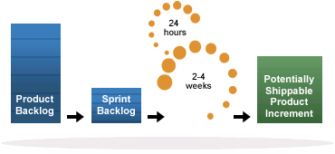
SCRUM process

Slide 24
Summary of Agile
Common features:
Highest priority is on user involvement – why?
Best suited to interface driven systems – why?
Frequent delivery of tested deliverables that meet essential business needs
All use variations of timeboxes – defined short iterations
Testing integrated throughout lifecycle – why?

Slide 25
Agile Case studies
http://damonpoole.blogspot.com/2008/05/agile-case-study-litle-co.html
http://www.infoworld.com/d/developer-world/bt-case-study-in-agile-programming-112

Slide 26
References/Reading List
Bennett, S., McRobb, S. and Farmer, R. 2010. Object-Oriented Systems Analysis and Design Using UML. 4th ed. London: McGraw Hill.
Sommerville, I. (2015). Software engineering. 10th edition. Reading, MA: Addison-Wesley.
Sommerville, I. (2017). Software engineering. 10e edition. Reading, MA: Addison-Wesley.
Pressman, R. (2014) Software Engineering: A Practitioner's Approach (8th Edition). McGraw Hill.
Fowler, M. (2004), UML Distilled: Addison Wesley

