Slide 1
Unit 10:
Object-Relational Mapping and
Data Access Frameworks

Slide 2
Enterprise Java Beans (EJB)
A Java standard architecture for writing distributed enterprise applications.
  J2EE – most successful platform for large scale enterprise applications
Types of EJBs
  Session Beans
  Entity Beans
  Message-driven Beans

Slide 3
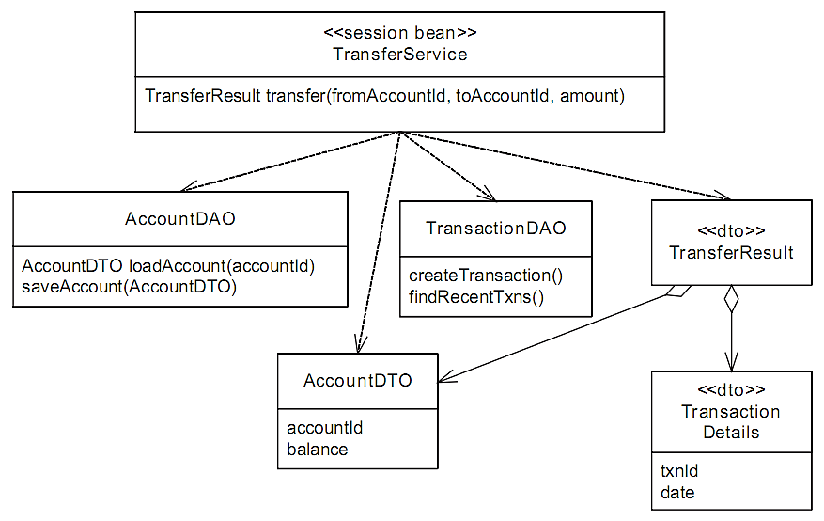
The money transfer service implemented in typical EJB design

Slide 4
The pain of EJB development
Annoyingly long edit-compile-debug cycles
Lack of separation of concerns
Very complex infrastructure
Verbosity

Slide 5
Plain Old Java Objects (POJOs)
POJOs are an especially compelling alternative to EJBs.
A POJO is simply a Java object that does not implement any special interfaces such as those defined by the EJB framework.
JDO, JPA and Hibernate are popular lightweight data persistence frameworks, which map POJOs to a relational database.

Slide 6

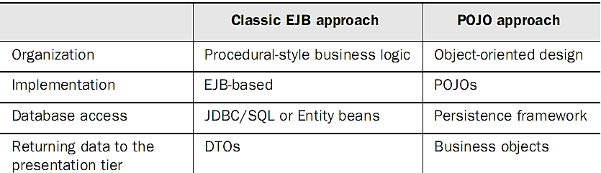
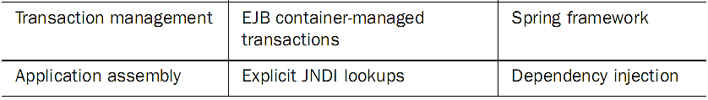
Comparing EJB and POJO approaches

Slide 7
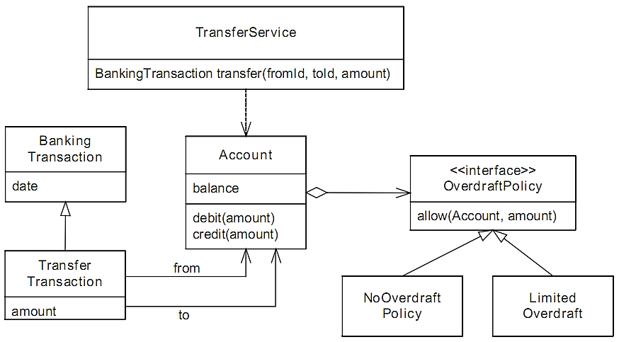
An object model for the money transfer application

Slide 8
Generic advantages endowed with by POJOs
Easier development
Faster development
Improved portability

Slide 9
Deploying a POJO application in a web container
A POJO-based web application is simply packaged as a Java Web Archive (*.war), and then deployed in a Java EE web container

Slide 10
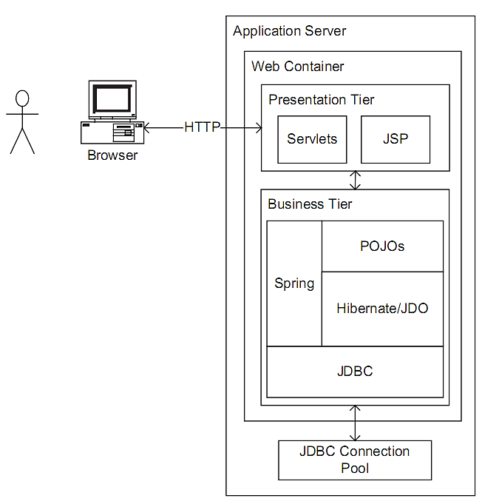
Deploying a POJO application in a web container

Slide 11
Object Relational Mapping (ORM)
Persisting objects is a remarkably challenging problem because of the significant differences between a domain model and a database schema
Transparent persistence is desired
If the domain model is extremely simple and used in a very straightforward way, you might be able to persist it yourself using JDBC
Otherwise, you need ORM frameworks

Slide 12
Benefits of ORM framework
Improved productivity
Improved performance
Improved portability

Slide 13
Popular Java ORM frameworks
JDO (Section 2),
JPA (Section 3), and
Hibernate (Section 4)

Slide 14
Java Data Objects (JDO)
JDO Types
  Persistence Capable
  Persistence Aware
  Normal
JDO API
  PersistenceManagerFactory
  PersistenceManager
JDO Meta-Data
  JDO requires the persistence of classes to be defined via Meta-Data

Slide 15
JPA ORM
In JPA, object-relational mapping can be approached in 3 ways:
  Forward Mapping – Here you have a set of domain model classes, and want to design the datastore schema that will store represent these classes.
  Reverse Mapping – Here you have an existing datastore schema, and want to design your domain model classes to represent this schema.
  Meet in the Middle Mapping – Here you have a set of domain model classes and you have an existing datastore schema, and you want to match them up.

Slide 16
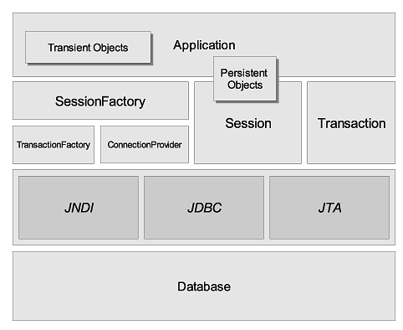
Hibernate Architecture

Slide 17
Contact Details
Lecturer: Xiaodong Liu
Email: x.liu@napier.ac.uk
Office: C55
Phone: 455 2747

