Slide 1
Unit 3 – Model Driven Software Engineering
Models + Transformations = Software

Slide 2
What is MDSE?

Slide 3
Models
What is a model?
Model
System
represents
Mapping Feature | A model is based on an original (=system)
Reduction Feature | A model only reflects a (relevant) selection of the original‘s properties
Pragmatic Feature | A model needs to be usable in place of an original with respect to some purpose
Purposes:
descriptive purposes
constructive purposes

Slide 4
Motivation
What is Model Engineering?
Model as the central artifact of software development
Related terms
Model Driven Engineering (MDE),
Model Driven [Software] Development (MDD/MDSD),
Model Driven Architecture (MDA)
Static analysis
Documentation
Rapid prototyping
Model
Refactoring/ Transformation
Code generation
Automated testing
[Illustration by Bernhard Rumpe]

Slide 5
Motivation
Why Model Engineering?
Increasing complexity of software
Increasing basic requirements, e.g., adaptable GUIs, security, network capabilities, …
Complex infrastructures, e.g., operating system APIs, language libraries, application frameworks
Technological progress …
Integration of different technologies and legacy systems, migration to new technologies
… leads to problems with software development
Software finished too late
Wrong functionality realized
Software is poorly documented/commented
and can not be further developed, e.g., when the technical environment changes, business model/ requirements change, etc.

Slide 6
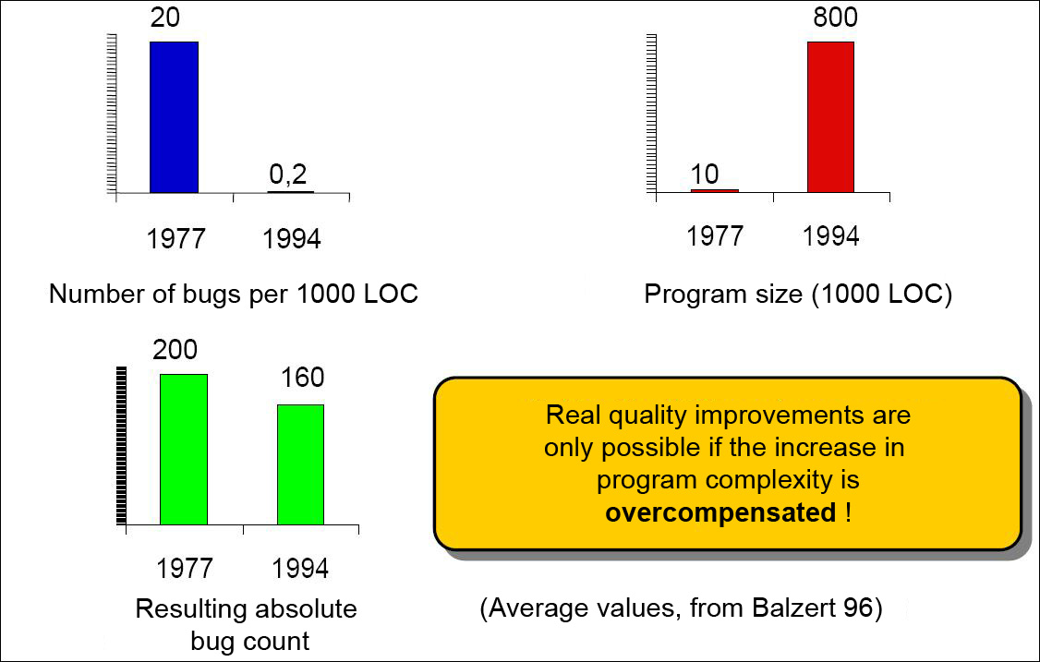
Motivation
[Balzert, H.: Lehrbuch der Softwaretechnik: Software-Entwicklung, Spektrum, Akad. Verlag, 1996]
Why Model Engineering?
Quality problems in software development
[Slide by Bernhard Rumpe]

Slide 7
Motivation
Why Model Engineering?
Traditional usage of models in software development
Communication with customers and users (requirement specification, prototypes)
Support for software design, capturing of the intention
Task specification for programming
Code visualization, for example in TogetherJ
What is the difference to Model Engineering?

Slide 8
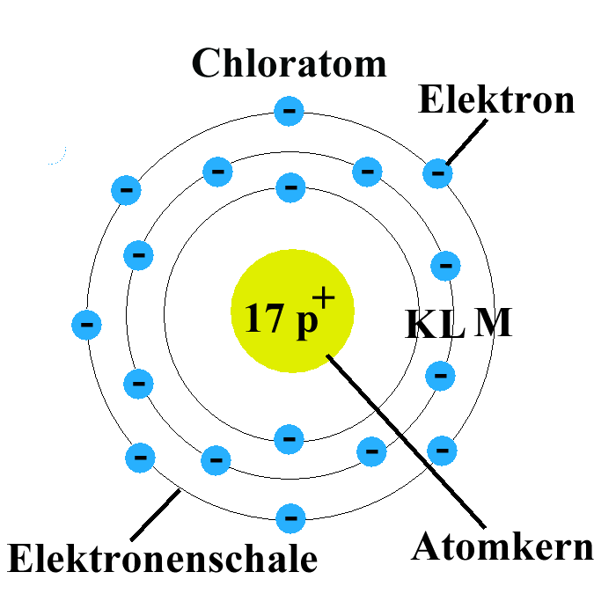
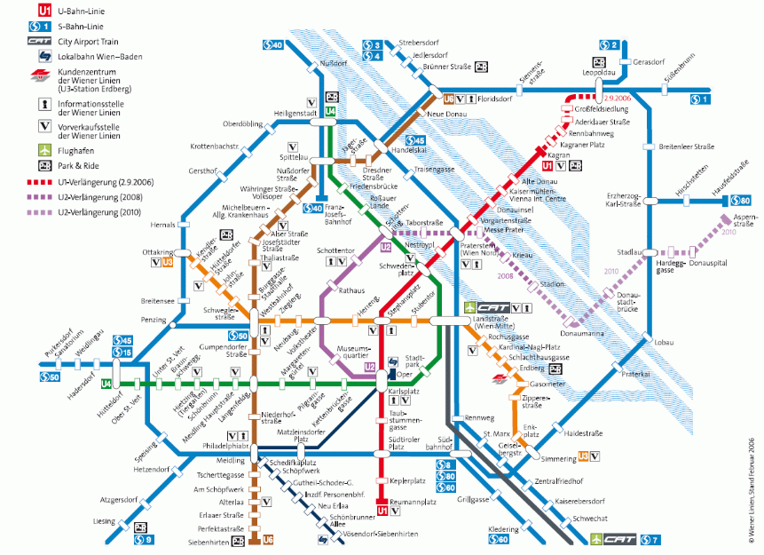
Motivation
Usage of models
Do not apply models as long as you have not checked the underlying simplifications and evaluated its practicability.
Never mistake the model for the reality.
Attention: abstraction, abbreviation, approximation, visualization, …
chlorine atom
electron
electron shell
atom nucleus

Slide 9
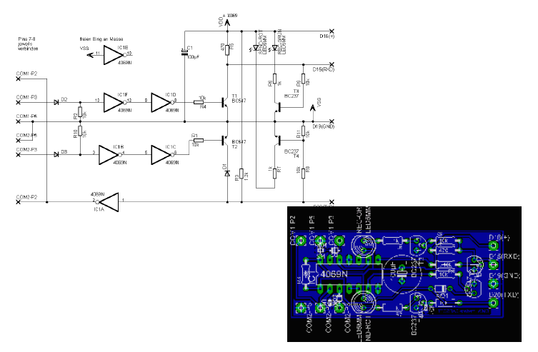
Motivation
Constructive models (Example: Electrical Engineering)
[Slide by Bernhard Rumpe]

Slide 10
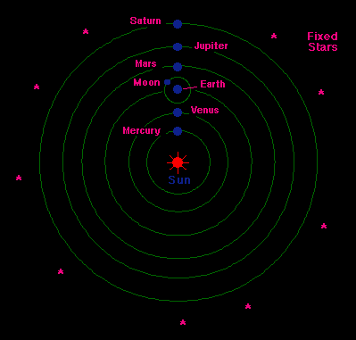
Motivation
Declarative models (Example: Astronomy)
Heliocentric model by Kopernikus

Slide 11
Motivation
Application area of modeling
t
Models as drafts
Communication of ideas and alternatives
Objective: modeling per se
Models as guidelines
Design decisions are documented
Objective: instructions for implementation
Models as programs
Applications are generated automatically
Objective: models are source code and vice versa

Slide 12
Motivation
Increasing abstraction in software development
The used artifacts of software development slowly converge to the concepts of
the application area
Business objects
(course, account, customer)
Components (provided/required interface)
Libraries (GUI, lists)
Procedural constructs
(while, case, if)
Assembler and mnemonic
abbreviations (MV, ADD, GET)
Assembler (001001)
[Illustration by Volker Gruhn]

Slide 13
MDSE PRINCIPLES

Slide 14
MDSE Principles
Contents
Concepts
Approaches
Adoption
Notes:
Author: Gerhard Kramler (Sept. 2005)

Slide 15
MDSE aim at large
MDSE considers models as key drive in software engineering
The way in which models are defined and managed is based on the actual needs they address.
MDSE defines sound engineering approaches to
models
transformations
development process.

Slide 16
Concepts
Principles and objectives
Abstraction from specific realization technologies
Requires modeling languages, which do not hold specific concepts of realization technologies (e.g., Java EJB)
Improved portability of software to new/changing technologies – model once, build everywhere
Interoperability between different technologies can be automated (so called Technology Bridges)
Automated code generation from abstract models
e.g., generation of Java-APIs, XML Schemas, etc. from UML
Requires expressive and precise models
Increased productivity and efficiency (models stay up-to-date)
Separate development of application and infrastructure
Separation of application-code and infrastructure-code (e.g. Application Framework) increases reusability
Flexible development cycles as well as different development roles possible

Slide 17
MDSE methodology ingredients
Concepts: The components that build up the methodology
Notations: The way in which concepts are represented
Process and rules: The activities that lead to the production of the final product
Tools: Applications that ease the execution of activities or their coordination

Slide 18
MDSE Equation
Models + Transformations = Software

Slide 19
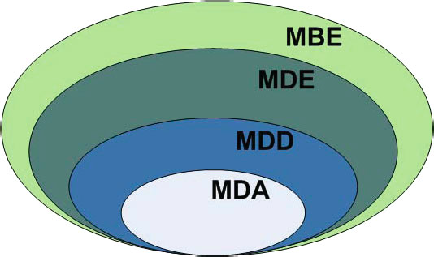
The MD* Jungle of Acronyms
Model-Driven Development (MDD) is a development paradigm that uses models as the primary artifact of the development process.
Model-driven Architecture (MDA) is the particular vision of MDD proposed by the Object Management Group (OMG)
Model-Driven Engineering (MDE) is a superset of MDD because it goes beyond of the pure development
Model-Based Engineering (or “model-based development”) (MBE) is a softer version of MDE, where models do not “drive” the process.

Slide 20
Modeling Languages
Domain-Specific Languages (DSLs): languages that are designed specifically for a certain domain or context
DSLs have been largely used in computer science. Examples: HTML, Logo, VHDL, Mathematica, SQL
General Purpose Modeling Languages (GPMLs, GMLs, or GPLs): languages that can be applied to any sector or domain for (software) modeling purposes
The typical examples are: UML, Petri-nets, or state machines

Slide 21
Metamodeling
To represent the models themselves as “instances” of some more abstract models.
Metamodel = yet another abstraction, highlighting properties of the model itself
Metamodels can be used for:
defining new languages
defining new properties or features of existing information (metadata)

Slide 22
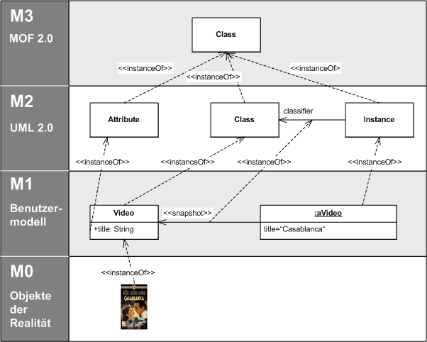
Illustration of the Meta-Object Facility

Slide 23
Concepts
Model Engineering basic architecture
Application
Application domain
Meta-Level
Model
Modeling
language
Meta-
modeling
language
Modeling
Reuse
Abstraction (bottom-up)
Transformation definition
Transformation
language
Automation
Transformation / Code generation
Construction (top-down)
Artifacts (e.g. code)
Platform
Realization
defined using
defined by
uses

Slide 24
Modelware vs. Grammarware
Two technical spaces

Slide 25
Types of models
Static models: Focus on the static aspects of the system in terms of managed data and of structural shape and architecture of the system.
Dynamic models: Emphasize the dynamic behavior of the system by showing the execution
Just think about UML!

Slide 26
Model Driven Architecture
The Object Management Group (OMG) has defined its own comprehensive proposal for applying MDE practices to system’s development:
MDA (Model-Driven Architecture)

Slide 27
Four principles of MDA
Models must be expressed in a well-defined notation, so as to enable effective communication and understanding
Systems specifications must be organized around a set of models and associated transformations
implementing mappings and relations between the models.
multi-layered and multi-perspective architectural framework.
Models must be compliant with metamodels
Increase acceptance, broad adoption and tool competition for MDE

Slide 28
Definitions according to MDA
System: The subject of any MDA specification (program, computer system, federation of systems)
Problem Space (or Domain): The context or environment of the system
Solution Space: The spectrum of possible solutions that satisfy the reqs.
Model: Any representation of the system and/or its environment
Architecture: The specification of the parts and connectors of the system and the rules for the interactions of the parts using the connectors
Platform: Set of subsystems and technologies that provide a coherent set of functionalities for a specified goal
Viewpoint: A description of a system that focuses on one or more particular concerns
View: A model of a system seen under a specific viewpoint
Transformation: The conversion of a model into another model

Slide 29
Approaches
MDA development cycle
Base Level: UML Platform-Independent Model of Business Functionality & Behavior
Modeling in a technology- independent UML profile allows a precise representation of business process/rules
Executed by MDA tool which follows OMG standard mappings. Resulting PSM may need some hand adjustments based on infrastructure decisions
Automated Transformation
Modeling Space
Intermediate Level UML Platform-Specific Model|s| on
selected platforms generated from PIM
Modeled in a technology- specific UML profile. Represents every aspect of a coded application, but still as a model
Automated Transformation
Executed by MDA tool. Many tools on the market execute this step very well today
Code Space
Implementation generated from PSMs
Generated code and auxiliary files ready for compilation, linking with legacy or other code, and deployment

Slide 30
Modeling Levels
CIM, PIM, PSM
Computation independent (CIM): describe requirements and needs at a very abstract level, without any reference to implementation aspects (e.g., description of user requirements or business objectives);
Platform independent (PIM): define the behavior of the systems in terms of stored data and performed algorithms, without any technical or technological details;
Platform-specific (PSM): define all the technological aspects in detail.

Slide 31
CIM, PIM and PSM

Slide 32
CIM
MDA Computation Independent Model (CIM)
E.g., business process

Slide 33
PIM
MDA Platform Independent Model (PIM)
specification of structure and behaviour of a system, abstracted from technologicical details
Using the UML(optional)
Abstraction of structure and behaviour of a system with the PIM simplifies the following:
Validation for correctness of the model
Create implementations on different platforms
Tool support during implementation

Slide 34
PSM
MDA Platform Specific Model (PSM)
Specifies how the functionality described in the PIM is realized on a certain platform
Using a UML-Profile for the selected platform, e.g., EJB

Slide 35
CIM – PIM – PSM mappings

Slide 36
Approaches
MDA Reverse Engineering / Roundtrip Engineering
Re-integration onto new platforms via Reverse Engineering of an existing application into a PIM and subsequent code generation
MDA tools for Reverse Engineering automate the model construction from existing code
Reverse-engineer existing application into a model and redeploy
PIM (UML)
Legacy
App
COTS
App
Other Model
Other

Slide 37
Approaches
Excursus: OMG Standards
CORBA - Common Object Request Broker Architecture
Language- and platform-neutral interoperability standard (similar to WSDL, SOAP and UDDI)
UML - Unified Modeling Language
Standardized modeling language, industry standard
CWM - Common Warehouse Metamodel
Integrated modeling language for Data Warehouses
MOF – Meta Object Facility
A standard for metamodels and model repositories
XMI - XML Metadata Interchange
XML-based exchange of models
QVT – Queries/Views/Transformations
Standard language for Model-to-Model transformations

Slide 38
Approaches
MDA with UML
Problems when using UML as PIM/PSM
Method bodies?
Incomplete diagrams, e.g. missing attributes
Inconsistent diagrams
For the usage of the UML in Model Engineering special guidelines have to be defined and adhered to
Different requirements to code generation
get/set methods
Serialization or persistence of an object
Security features, e.g. Java Security Policy
Using adaptable code generators or PIM-to-PSM transformations
Expressiveness of the UML
UML is mainly suitable for “generic” software platforms like Java, EJB, .NET
Lack of support for user interfaces, code, etc.
MDA tools often use proprietary extensions

Slide 39
MDSE industry
Adoption and acceptance (hype)
Not yet mainstream in all industries
Strong in core industry (defense, avionics, …)

Slide 40
MDSE Industry (2)
Adoption

Slide 41
Tool support
Drawing vs. modeling

Slide 42


Eclipse and EMF
Eclipse Modeling Framework
Full support for metamodeling and language design
Fully MD (vs. programming-based tools)

Slide 43
Use Case 1 – Model driven deveopment

Slide 44



MDD contribution: Productivity
MDD (semi)automates software development
In MDD, software is derived through a series of model-to-model transformations (possibly) ending with a model-to-text transformations that produces the final code
Original model
1st refinement
n^{th} refinement
...
Model-to-model Transformation
Model-to-text Transformation

Slide 45
Code Generation
Goal: generating running code from higher level models
Like compilers producing executable binary files from source code
Also known as model compilers
Once the source code is generated state-of-the-art IDEs can be used to manipulate the code

Slide 46
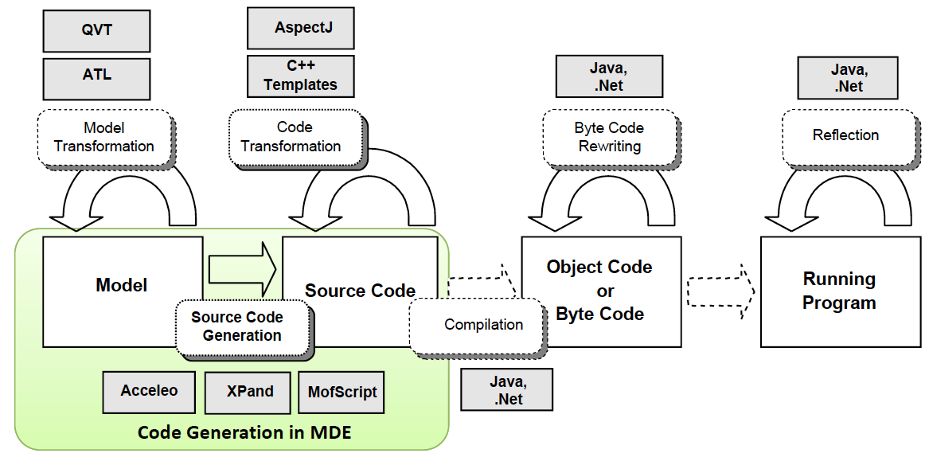
Code Generation: Scope

Slide 47
Code Generation: Benefits
Intellectual property
Separation of modeling and execution
Multi-platform generation
Generators simpler than interpreters
Reuse of existing artefacts
Adaptation to enterprise policies
Better performances

Slide 48
Code Generation: Partial Generation
Input models are not complete & code generator is not smart enough to derive or guess the missing information
Programmers will need to complete the code manually
Caution! Breaking the generation cycle is dangerous
Solutions:
Defining protected areas in the code, which are the ones to be manually edited by the developer
Using round-trip engineering tools (not many available)
Better to do complete generation of parts of the system instead of partial generation of the full system

Slide 49
USE CASE 2 – Model driven reverse engineering

Slide 50
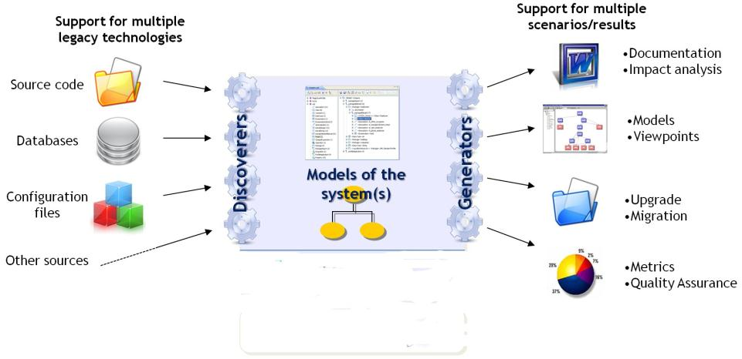
Need for reverse engineering

Slide 51


Model-driven reverse engineering
Why? Models provide an homogeneous and interrelated representation of all legacy components.
No information loss: initial models have a 1:1 correspondance with the code
Discover
Understand
Regenerate
Legacy artifacts :
- source code
- configuration files
- tests
- databases
- etc.
Models
Viewpoints
New
Software Artifacts

Slide 52
Model-To-Text Transformations

Slide 53
Code Generation – Basic Questions
How much is generated?
Which parts can be automatically generated from models?
Full or partial code generation?
What is generated?
Which kind of source code to generate?
The less code to generate the better!
How to generate?
Which languages and tools to use for developing code generators?
GPLs vs. DSLs
Notes:
Terminologie:
XSL-FO: Transformation (Strukturierung)
XSLT: vs. Stil- und Formatierung (Presentation, Layout)
BEIDE verwenden XML als Syntax!!!!! Um Transformation u. Formatierung zu beschreiben
Diese Trennung ist sinnvoll, da es viele Anwendungsbereiche gibt, die keine Formatierung brauchen sondern nur eine Umstrukturierung
Hauptziel XSLT: Transformation XML2XML, NICHT zur primär Erzeugung von Non-XML-Formaten!!
XSL-FO:
XML-Elemente werden verwendet um die Präsentation von Inhalten zu beschreiben, nicht dessen Semantik!!!
hat demnach nicht mehr Semantik als eine HTML-Seite!
XSL-Dokument:
<block> This is an <wrapper style="bold">XSL</wrapper> document.</block>
HTML-Dokument:
<P>This is an <B>HTML</B> document.</P>

Slide 54
Code Generation in MDA (just an example)
Rational Unified Process
MDA Artifacts
Requirements
CIM
CIM
Manual Development + Model2Model Transformation
Analysis
PIM
PIM
Model2Model Transformation
Design
PSM
Web Model
DAO Model
SQL
Model
Implementation
Model2Text Transformation
Code
JSP Code
DAO Code
SQL Code
Test&Deployment
Feedback
Notes:
Terminologie:
XSL-FO: Transformation (Strukturierung)
XSLT: vs. Stil- und Formatierung (Presentation, Layout)
BEIDE verwenden XML als Syntax!!!!! Um Transformation u. Formatierung zu beschreiben
Diese Trennung ist sinnvoll, da es viele Anwendungsbereiche gibt, die keine Formatierung brauchen sondern nur eine Umstrukturierung
Hauptziel XSLT: Transformation XML2XML, NICHT zur primär Erzeugung von Non-XML-Formaten!!
XSL-FO:
XML-Elemente werden verwendet um die Präsentation von Inhalten zu beschreiben, nicht dessen Semantik!!!
hat demnach nicht mehr Semantik als eine HTML-Seite!
XSL-Dokument:
<block> This is an <wrapper style="bold">XSL</wrapper> document.</block>
HTML-Dokument:
<P>This is an <B>HTML</B> document.</P>

Slide 55
What kind of code is generated?
Model-to-Text, whereas text may be distinguished in
Program code
Documentation
Test cases
Model serialization (XMI)
Direct translation to machine code possible, but inconvenient, error-prone and hard to optimize
Reuse existing code generators
Using existing functionality (frameworks, APIs, components)
Motto: The less code to generate, the better!
Notes:
Terminologie:
XSL-FO: Transformation (Strukturierung)
XSLT: vs. Stil- und Formatierung (Presentation, Layout)
BEIDE verwenden XML als Syntax!!!!! Um Transformation u. Formatierung zu beschreiben
Diese Trennung ist sinnvoll, da es viele Anwendungsbereiche gibt, die keine Formatierung brauchen sondern nur eine Umstrukturierung
Hauptziel XSLT: Transformation XML2XML, NICHT zur primär Erzeugung von Non-XML-Formaten!!
XSL-FO:
XML-Elemente werden verwendet um die Präsentation von Inhalten zu beschreiben, nicht dessen Semantik!!!
hat demnach nicht mehr Semantik als eine HTML-Seite!
XSL-Dokument:
<block> This is an <wrapper style="bold">XSL</wrapper> document.</block>
HTML-Dokument:
<P>This is an <B>HTML</B> document.</P>

Slide 56
Example: Platform for Web application development
Example: developing a code generator for Web applications
What options exist for the to be generated code?
Dimensions of Web applications: Content, Hypertext, Presentation
Programming languages: Java, C#, Ruby, PHP, …
Architectures: 2-layer, 3-layer, MVC, ActiveRecords, …
Frameworks: JSF, Spring, Struts, Hibernate, Ruby on Rails, ASP, …
Products: MySQL, Tomcat, WebLogic, …
Which combinations are appropriate?
Experience gained in earlier projects
What has proven useful?
Reference architectures

Slide 57
What kind of code is generated?
Sequence diagrams
Class diagrams
State charts
Object diagrams
e‘
z3
b1:B
a:A
b:B
c:C
A
1
*
B
e
c1:C
m1
m2
1
0..1
z1
z2
b2:B
m3
1..*
e‘
z4
c2:C
C
1
OCL
Production code
Test code
Picture based on Berhard Rumpe: Agile Modellierung mit UML. Springer, 2012.

Slide 58
Why code generation?
Code generation enables
Separation of application modeling and technical code
Increasing maintainability, extensibility, portability to new hardware, operating systems, and platforms
Rapid prototyping
Early and fast feedback due to demonstrations and test runs
Code generation enables to combine redundant code fragments in one source
Example: DDL, Hibernate, and Java Beans → may be specified in one Class Diagram

Slide 59

Example: MiniUML_2_MiniJava
MiniUML Metamodell
«enumeration» Type
MiniJava Grammar
NamedElement
ClassDec := Modifier “class” Identifier [“extends” Identifier] ClassBody;
AttributeDec := Modifier Type Identifier“;”;
MethodDec := Modifier ReturnType Identifier “(” ParamList “)” “{” MethodBody “}”;
Identifier := {“a”-”z” | “A”-”Z” | “0”-”9”};
name: String
String
Boolean
Integer
Float
*
*
Relationship
Class
Attribute
minCard: Eint maxCard: EInt
superClass
0..1
type: Type
type
0..1
MiniUML Modell
MiniJava Code
Model2Text
class Student extends Person{ private String regNo; public void setRegNo(…){ … } public String getRegNo(){ … } }
Person
Student
regNo:String
Notes:
Terminologie:
XSL-FO: Transformation (Strukturierung)
XSLT: vs. Stil- und Formatierung (Presentation, Layout)
BEIDE verwenden XML als Syntax!!!!! Um Transformation u. Formatierung zu beschreiben
Diese Trennung ist sinnvoll, da es viele Anwendungsbereiche gibt, die keine Formatierung brauchen sondern nur eine Umstrukturierung
Hauptziel XSLT: Transformation XML2XML, NICHT zur primär Erzeugung von Non-XML-Formaten!!
XSL-FO:
XML-Elemente werden verwendet um die Präsentation von Inhalten zu beschreiben, nicht dessen Semantik!!!
hat demnach nicht mehr Semantik als eine HTML-Seite!
XSL-Dokument:
<block> This is an <wrapper style="bold">XSL</wrapper> document.</block>
HTML-Dokument:
<P>This is an <B>HTML</B> document.</P>

Slide 60
Reference
Marco Brambilla, Jordi Cabot, Manuel Wimmer. Model-Driven Software Engineering in Practice, 2nd edition, Morgan & Claypool, USA, 2017.
Sommerville, I. (2017). Software engineering. 10e edition. Reading, MA: Addison-Wesley.

