Slide 1
Unit 4: Version Control
Software Engineering
SET09102
Notes:
My overall scheme: how to deal with change?
Change of requirements, design and implementation.

Slide 2
Outline
Introduction
  What is version control
  Types of version control systems
Key Concepts
  Repository, Revision & Workspace
  Branching & Merging
Representative Products
  CVS & SVN
  Git
  Team Foundation Server

Slide 3
Introduction
What is version control
“A version control system is a software package that monitors your files for changes and allows you to tag the changes at different levels so that you can revisit those tagged stages whenever needed”
Capabilities:
  A place to store source code, images, build scripts and so on
  To track the history of changes to those files
  To view the state of the file at various points
  Mechanisms and tooling to facilitate a team of developers to work on the same set of files in parallel

Slide 4
Introduction
Types of version control systems
  Local
  Centralised
  Distributed

Slide 5
Introduction
Types of version control systems
  Local
    Works by keeping patch sets (i.e. the difference between a file's content at progressive stages)
    Recreates the file's contents by adding up all the relevant patches in order
    “Checking it out” = Reproducing a user’s workspace at any given point in time

Slide 6
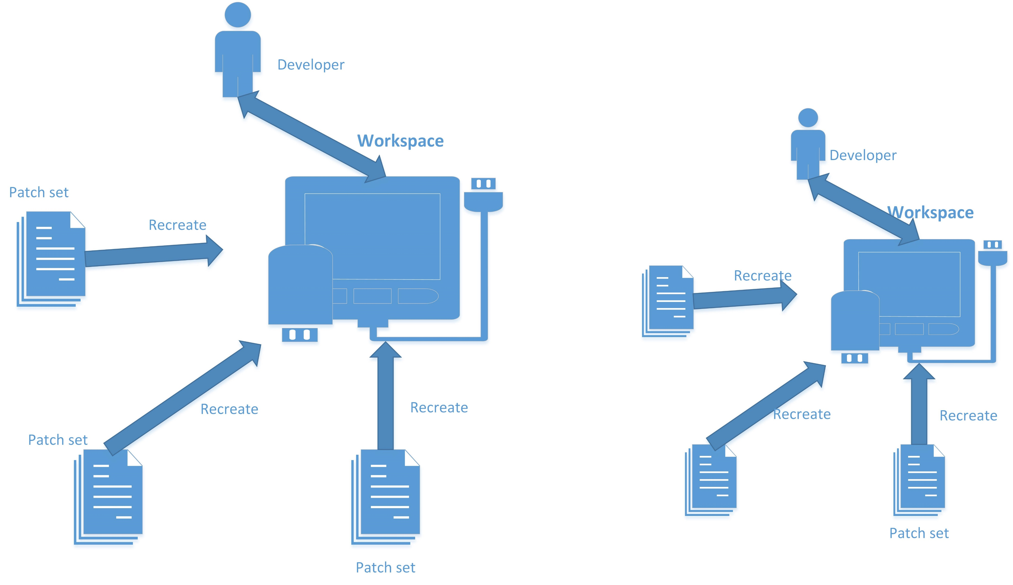
Local Version Control Systems

Slide 7
Introduction
Types of version control systems
  Centralised
    Works by keeping all the files in a common place (server) that everybody has access to from their local machines
    Whenever people want to edit single or multiple files only the last version of the files are retrieved
    Files being edited are temporarily locked
    Any changes made to the files are automatically shared with other individuals

Slide 8
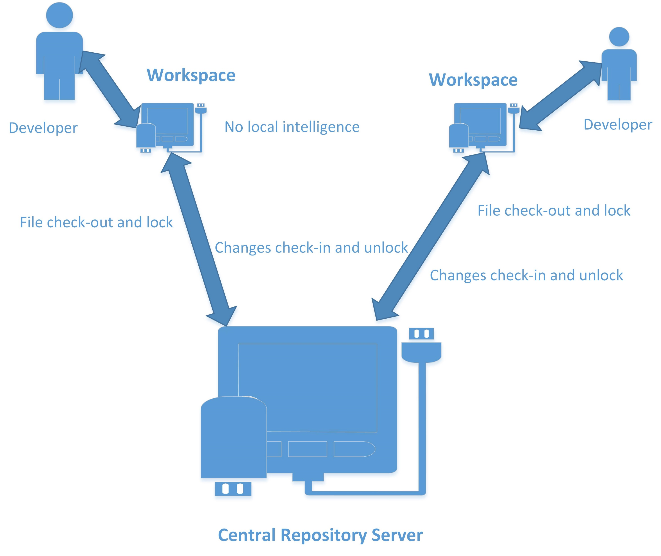
Centralised Version Control Systems

Slide 9
Introduction
Types of version control systems
  Distributed
    Combines the characteristics of local and centralised version control systems
    Stores the entire history of files on every machine locally
    Synchronises the local changes made by the user back to the server whenever required
    Helps resolve conflicts and thus provides a collaborative working environment
    Offers better usability and performance than centralised version control systems
Notes:
Almost every version control system we use today is distributed.

Slide 10
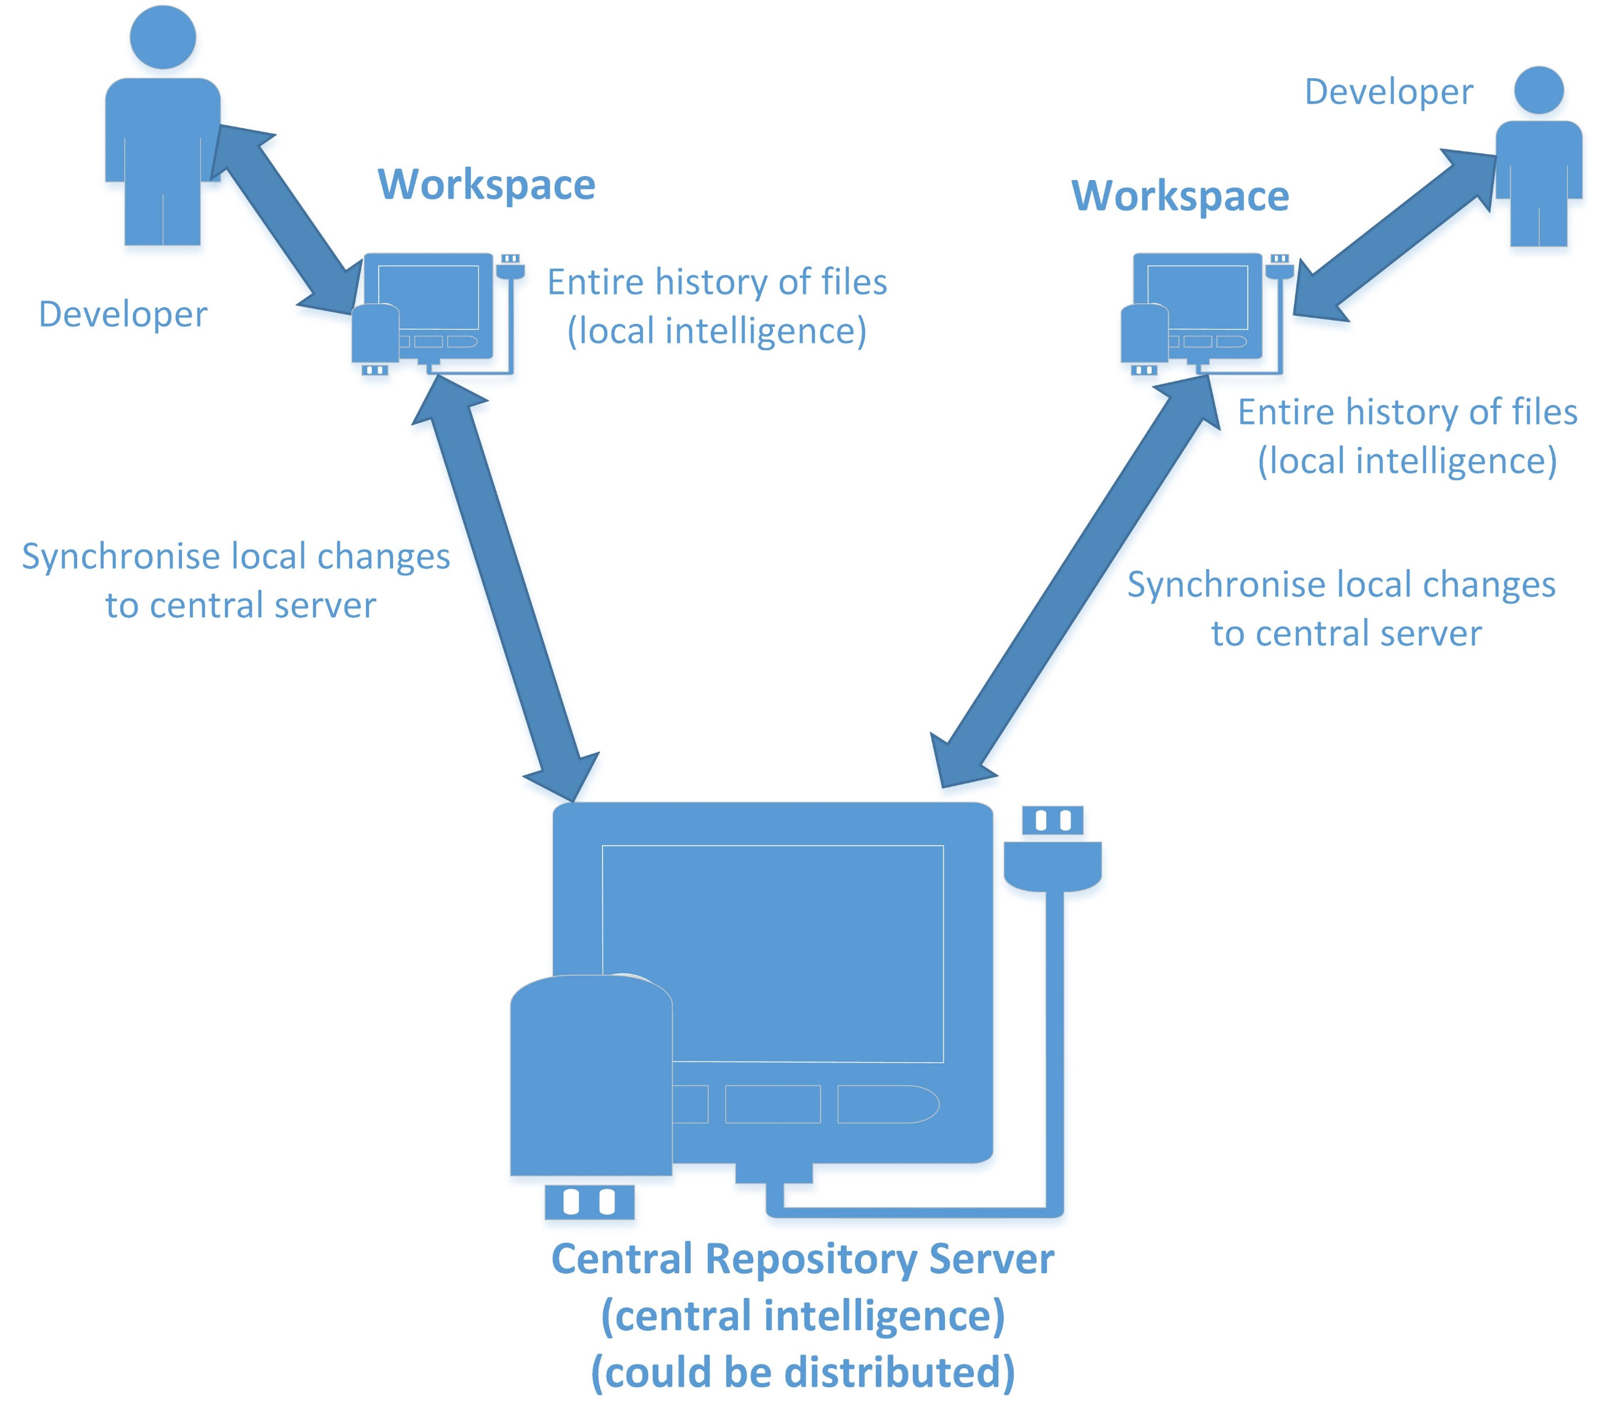
Distributed Version Control Systems

Slide 11
Key Concepts
Repository
  A central place that holds the master copy of all versions of your project’s ﬁles
  File-based, or database-based, or a combination of the two
  Supports network operations, i.e. the repository acts as a server and the version control tools act as clients
  Be efficient with storage, e.g. various delta-fication optimisations store the initial version of a file, and then store the changes between each version
  Be high performance, e.g. cache frequently accessed files in a ready-to-download state to avoid computationally expensive rebuilding of the file

Slide 12
Key Concepts
Revision
  Most version control systems use a numbering system for the versions of a file, e.g. 1.0, 1.1, 1.2…
  May associate a revision number with date and time when the file was checked in, and an optional comment
  May assign tag names to a group of files at a particular point in time, e.g. “Beta”, “RC1” and etc.
  Allows developers to undo mistakes, e.g. restore a specific revision of a file, rollback to a specific date and time
  Helps highlight changes in a particular file among different versions
Notes:
These are the anchor points of change.
Revision numbers may have different conventions.

Slide 13
Key Concepts
Workspace
  A local copy of everything you need from the repository to work on your part of the project, a.k.a. the working copy of the code
  To populate the workspace initially, you need to get things out of the repository, i.e. checking out
  You make changes to the code in your local workspace, and save them back to the repository in a batch, i.e. committing
  Other team members may also commit their changes, but you will only see these after checking out an update
  What if you and a colleague both changed the same file at the same time?
  What if my codes stop compiling after I checked out an update?
Notes:
The checkout process ensures that you get up-to-date copies of the files you request, and that these files are copied into a directory structure that mirrors that of the repository.
You would need to resolve a conflict, and different version control systems may have different ways of dealing with the situation. Anyway, you'll be surprised at just how rarely conflicts arise.
How about an recent update of other people’s codes makes my codes stop compiling? That’s why programmers have to learn Design by Contract and make sure the contract never changes. You may mark an old version “deprecated”, but you cannot remove it. Be considerate and guarantee that your updates don’t break other people’s codes.

Slide 14
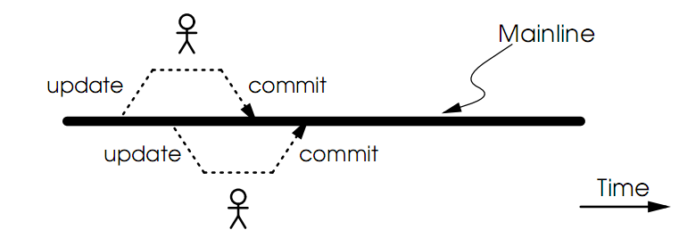
Key Concepts
Branching
  In the normal course of development, most folks work on a common code base, a.k.a. the mainline
  People check stuff out, make revisions, commit the changes back in, and update their local workspaces
Notes:
The mainline is always a pool of dirty codes, full of bugs and risks. A release branch (associated with a version number) cleans things up for a bug-free roll-out.

Slide 15
Key Concepts
Branching
  A vital period in the software lifecycle is when a new release is about to be rolled out
  A sub-team of developers are assigned to prepare the release, fixing last minute bugs
  The QA team needs stability
  One option is to freeze new development while the release is being generated – not a wise decision of course
  A far better option is to create a “parallel universe” for the rest of the team to continue adding new features, i.e. branching

Slide 16
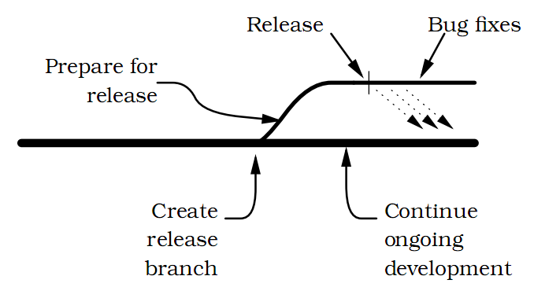
Branching
  A branch is almost like having a totally separate repository
  People using a branch see the source code it contains and operate independently of people working on other branches
  File revision numbers within a branch have extra levels in their numbers, e.g. 1.0, 1.1, 1.1.1, 1.1.2, 1.1.3… 1.2…
Notes:
The team working on the release will have a stable code base to polish up and ship. In the meantime, the main group of developers can continue making changes to the main line of code; there's no need for a code freeze while the release takes place. And when customers report problems in the release, the team will have access to the code in the release branch so they can fix the bugs and ship updated releases without including any of the newly developed code in the mainline.
You can create branches off of other branches, but it is not encouraged – try to avoid unnecessary complexity.

Slide 17
Key Concepts
Merging
  Say you fixed a bug in the release branch and realised that the same bug will be present in the mainline code – it would be nice to merge the change back to the mainline code
  It is likely to result in conflicts, as the mainline has evolved
    Strict Locking: All files that are checked out are flagged as being “read only”, until they are checked back in.
    Optimistic Locking: Every developer gets to edit any checked out file. However, the repository will not allow you to check in a file that has been updated since you last checked it out. Instead, it asks you to update your local copy of the file to include the latest repository changes before checking it in.

Slide 18
Key Concepts
Merging
  In reality, strict locking turns out to be a lot of extra hassle with no particular payback
  The normal ways of dividing up work on a team mean that people work on different areas of the code, and thus they don't bump in to each other that often
  When they do need to edit the same file, typically they are working on different parts of it, and thus the conflict shall be easily resolvable
  Hence, Optimistic Locking is strongly recommended!

Slide 19
Products
Concurrent Versioning System (CVS)
  One of the best-known version control systems
  Originally developed by Dick Grune between 1984 and 1985
  “I created CVS to be able to cooperate with my students on the ACK C compiler project.”
  Adopted by Brian Berliner and other contributors in April, 1989
  Submitted to the Free Software Foundation in November, 1990
  The latest version was released in May, 2008

Slide 20
Products
Main features
  Centralised architecture
    Server runs on Unix, clients available on any OS
    Server only accepts changes made to the most recent version of a file (optimistic locking)
  Revision functions such as automatic increment of version numbers, logging, tracking, snapshot and rollback
  Delta compression for efficient storage
  Introduced branching into version control systems
  IDE integration, e.g. Eclipse and Visual Studio
Notes:
Lead to a very popular project management system called redmine.

Slide 21
Products
Subversion (SVN)
  Founded by CollabNet in 2000 as an effort to write an open-source version control system like CVS with more features
  Version 1.0 was released in 2004; accepted into Apache Incubator in 2009; became a top-level project in 2010
Main features:
  A better CVS, i.e. matched or exceeded CVS's feature set
  Directories, symbolic links, copying, deleting and renaming are all versioned
  Atomic commits, i.e. no part of a commit takes effect until the entire commit has succeeded

Slide 22
  Branching and tagging become cheap operations
  Automated assistance with managing the flow of changes between lines, and with the merging of branches
  Interactive conflict prompting and resolution
  Good supports for both strict and optimistic locking
  HTTP-based protocols for network communications, repository integrated with Apache Web Server
  A master repository with multiple push- or pull-based slave repositories
  Advanced binary diffing algorithm that is equally efficient on binary as on text files
  Introduced Changelists which allow a user to put modified files into named groups
Notes:
Technical specs do not mean everything – just like iPhone vs. Android phones. In practice, SVN does not work better than CVS, and you can find a lot of criticisms online.

Slide 23
Products
Global Information Tracker (Git)
  Designed and developed by Linus Torvalds for Linux kernel development in 2005 (to replace BitKeeper)
  “I'm an egotistical bastard, and I name all my projects after myself. First 'Linux', now 'git'.”
  The primary requirement was performance:
  Torvalds took an example of a version control system requiring 30 seconds to apply a patch and update all associated metadata, and noted that this would not scale to the needs of Linux kernel development, where syncing with fellow maintainers could require 250 such actions at a time.
  The most widely adopted distributed version control system
Notes:
BitKeeper is a proprietary distributed version control system, but its performance was poor, e.g. 30 seconds for a patch operation, which Linus wanted to be 3 seconds.

Slide 24
Products
Main features
  Take CVS as an example of what not to do; if in doubt, make the exact opposite decision
  Distributed architecture – allow independent and simultaneous development in private repositories without the need for constant synchronisation with a central repository to avoid bottleneck
  Handle a very large number of developers whether they were working on the same or different parts of a common project, and be able to integrate all of their work reliably
  Perform quickly and efficiently using extremely fast update operations and delta techniques
Notes:
Ensure that each repository have a complete copy of all historical revisions of every file, so that individual developers needn’t query a centralised repository server for historical revision information.

Slide 25
  Server runs on Linux, Solaris, OS X and Windows
  Use hashing functions to maintain integrity and trust
  Ensure an accountability trail for all changes made to files
  Use an immutable database for version control history, i.e. once objects have been created and placed in the database, they cannot be modified
  Atomic transactions, i.e. related changes are performed either all together or not at all
  Encourage branching and facilitate clean, fast and easy merging
  Be free

Slide 26
Git data structure
  Blobs (binary large objects): Files that can contain any data and whose internal structure is treated as being opaque.
  Trees: A tree represents one level of directory information. It records blob identifiers, path names, and metadata. It refers to other (sub)tree objects recursively and thus build a complete hierarchy of files and subdirectories.
  Commits: A commit holds metadata for each change introduced into the repository. It points to a tree object that captures the state of the repository at the time the commit was performed.
  Tags: A tag assigns an arbitrary yet presumably human readable name to a specific object, usually a commit.
Notes:
A good solution is always a simple solution.

Slide 27
A sample Git session:
  Create a new repository
  $ mkdir ~/public_html
  $ cd ~/public_html
  $ git init
  Initialized empty Git repository in .git/
  Add a file into the repository
  $ echo 'My website is alive!' > index.html
  $ git add index.html
  Commit the change
  $ git commit -m “Front Page" --author="Joe <joe@example.com>"
  Created initial commit 9da581d: Front Page
  1 files changed, 1 insertions(+), 0 deletions(-)
  create mode 100644 index.html
Notes:
Using a command line client.
May start a repository from a local folder.

Slide 28
  Remove a file
  $ ls
  index.html poem.html foo.html
  $ git rm poem.html
  $ git commit -m "Remove poem"
  Created commit 364a708: Remove poem
  0 files changed, 0 insertions(+), 1 deletions(-)
  delete mode 100644 poem.html
  Rename a file
  $ git mv foo.html bar.html
  $ git commit -m "Rename foo to bar"
  Created commit 8805821: Rename foo to bar
  1 files changed, 0 insertions(+), 0 deletions(-)
  rename foo.html => bar.html (100%)
  Make a copy of the repository
  $ git clone public_html my_website
Notes:
Don’t worry, for most of the time you would communicate with a Git server using a graphical client, rather than issuing the commands.

Slide 29
Demo

Slide 30
Products
Team Foundation Server (TFS)
  Microsoft’s source code management product supporting Team Foundation Version Control (TFVC) and Git protocols
  Adopts SOA and built using WCF, hence can be consumed by any clients over the Internet
  TFVC is a centralised version control system built on top of SQL Server 2012
  Tightly integrated with Visual Studio 2013, also provides Eclipse plug-ins
  Offers on-premises and online versions, the latter is referred to as “Visual Studio Online” or “Hosted Team Foundation Service”

Slide 31
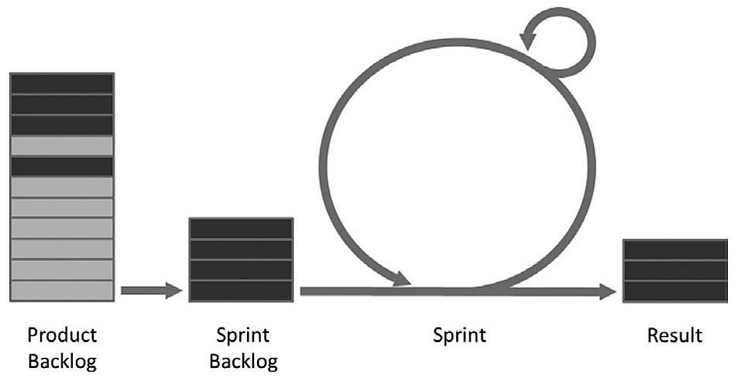
The Scrum Process
  The requirements from the business side of an organization are put on a backlog as Product Backlog Items (PBIs)
  The backlog itself is an ordered list with the most important requirements at the top – a product owner (PO) is responsible for ordering the PBIs
  The development team, together with the PO, selects a number of PBIs for the Sprint Backlog (SP)

Slide 32
  A sprint is between 2 and 4 weeks and is divided into 24-hour increments (check-in -> nightly build -> check-out)
  Every day the development team and the scrum master (SM) meet in a meeting going over the three magic questions:
    What have you done since the last meeting?
    What will you do until the next meeting?
    Do you have any impediments stopping your work?
  The end result of a sprint should be a potentially shippable increment of the software.
  At the end of each sprint, there are also two meetings:
    Sprint Review – The PO signs off on the delivery
    Sprint Retrospective – The team assesses what was good and what can be improved for the next sprint
Notes:
The daily meeting is time-boxed to 15 minutes.

Slide 33
Q & A

