Slide 1
Building Modular Applications
SET09102
Software Engineering

Slide 2
Outline
Background
Modularity
Java-based Modular Solutions
  OSGi
.NET-based Modular Solutions
  MEF

Slide 3
Background
Fundamental issues in software engineering

Slide 4
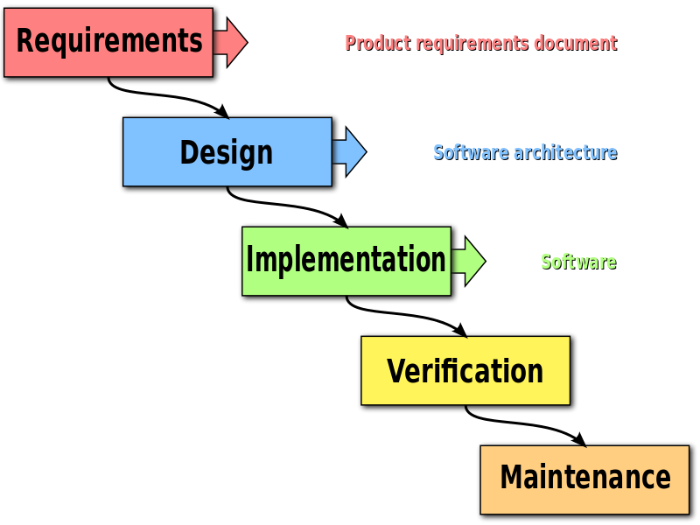
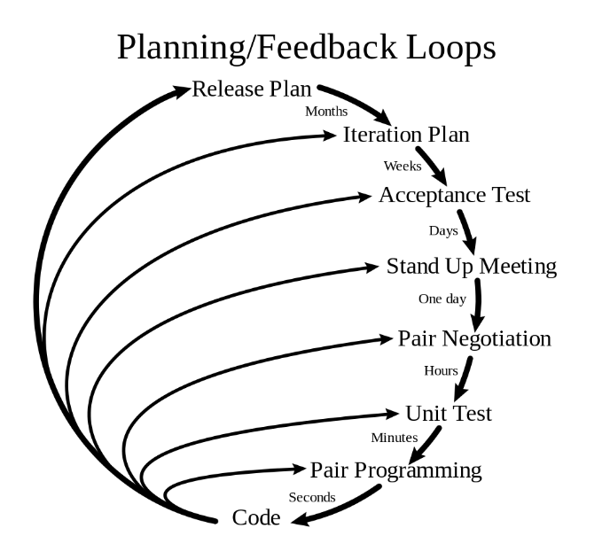
Dealing with Change
Why is it so hard?
  Traditional software processes did not plan
  to cope with change
  Once the design is created, it is carved in stone
  Recent agile methodologies perform
  activities in short iterations, which lead
  to better transparency and flexibility
  However, change is usually an architectural
  issue, whereas smaller iterations keep you
  from seeing the entire effect of a decision.

Slide 5
Dealing with Change
The keys are:
  To predict where change is coming
  To delay any permanent architectural decisions until we have all necessary information
  Truly, there are many ways of delaying architectural decisions, but they will likely cause a lot of abstractions and complexities, which equally increase the cost of a software

Slide 6
Dealing with Complexity
Moore’s Law:
  “The number of transistors on a CPU doubles every 18 months”
Wirth’s law, a.k.a. the great Moore’s law compensator:
  “Software is getting slower more rapidly than hardware becomes faster”
  People are building bigger applications using more diverse technologies ever
  More complexity means spending more time understanding what the application actually does, not to mention maintaining it for a long time
  Complexity is rising at such a disturbing pace that we have to put mechanisms in place to bring it to a halt

Slide 7
Modularity
  Can we deal with change without introducing much complexity?

Slide 8
Modularity
The “spaghetti code” problem
  It is very difficult to maintain a large code base over many years
  It is very difficult to see what the code really does without understanding all of it
  Bugs are introduced once you change the code that you only partly comprehend
  A small change can be enough to cause big problems
Here came the OO principles
  Encapsulation
  Abstraction
  Polymorphism
  Inheritance
Notes:
In the 1979 book “Structured programming for the COBOL programmer”, author Paul Noll uses the terms spaghetti code and rat's nest as synonyms to describe poorly structured source code.

Slide 9
Modularity
It was believed that “Design by Contract” would mark the end of spaghetti code, and to an extent it did
  Allows changes to implementations without breaking the interface
  Promotes cohesion – code that logically belongs together should be cohesive
  Prevents coupling – related classes do not have to know internal details of each other
  OO principles and design patterns only gave us the tools to deal with cohesion and coupling at the finest level of single classes and interfaces
  There’s no more granular modularity for groups of classes and interfaces
    Incorrect – software architecture is a solution to this
  “Spaghetti code” becomes “Object minestrone” – objects are thrown together like vegetables in a soup
Notes:
Objects are highly modular, but there’s no structure beyond individual objects.
[Macaroni code mixes two or more computer languages together in a single document, e.g. embedding regular expressions or SQL queries in a programming language, and embedding CSS or JavaScript in HTML.]

Slide 10
Modularity
From time to time,
  We don’t know which interfaces and classes belong together and should be seen as one piece when looking at the bigger picture
  We don’t know how to communicate and enforce cohesion in separated parts of the code base
  We need something at a higher level to identify separate parts of a system and strictly separate them from each other
  Modularity refers to logical partitioning of a system design into independent, interchangeable and dynamically loaded modules
Notes:
Communicate cohesion = define dependencies
Enforce cohesion = fulfil dependencies dynamically
A Java package is merely a mechanism for organising Java classes into namespaces.

Slide 11
Modularity
How about SOA?
  It represents a separation of concerns
  It improves maintainability by enforcing logical boundaries between components
In fact, SOA is on a very different architectural level
  Its primary goal is interoperability
  It is viable for integrating and reusing heterogeneous distributed systems
  It is not fit for use within a single system
  It is an extreme form of over-engineering in this context, and thus will incur significant development and runtime overhead
Notes:
Services are unassociated, loosely coupled units of functionality that are self-contained.
Within an SOA, services use defined protocols that describe how services pass and make sense of messages.
SOA makes it easy for computers connected over a network to cooperate and to form ad-hoc applications without knowledge of the services’ technical platforms.

Slide 12
Enforcing Modularity
Modularity can be subdivided in
  Design time modularity
    Job for system architects to come up with a logical separation of modules
    No silver bullet – trade-offs to be made on all levels of the system
  Runtime modularity
    Enforce module isolation – the runtime should make sure that a module is only used via an explicitly defined API
    Enforce module dependencies – making sure that modules only depend on a well-defined set of other modules
    Provide a service framework – typically a service registry using Dependency Injection
Notes:
Now we understand why modularity is needed, but how to actually achieve it?

Slide 13
Enforcing Modularity
Packaging of modules
  Packaging of the deployment artefact is an important aspect of runtime modularity
  Java uses JAR files to hold packages of classes and other resources
  The Java runtime treats all JAR files as equal, and loads all of them in the class path, regardless of their metadata
  However, a module should not load when its dependencies are not resolved
  Hence, a modular container is needed

Slide 14
Java Modular Solutions

Slide 15
Java Modular Solutions
Jigsaw
  A core component of Java SE 9, scheduled for 2016, released in Sept 2017
  Trying to solve two problems at the same time:
    Modularising the JDK itself
    Pushing the same programming model to developers
  Key benefits:
    Splitting the JDK into smaller pieces, which is especially useful for running Java on small and mobile devices
    Offering new language constructs to define modules

Slide 16
Modularity Solutions
JBoss Modules
  The modularity solution developed by RedHat as the basis of JBoss AS7 (2011)
  A very specific goal:
    To optimise start-up speed of the application server
    This made JBoss AS7 one of the fastest application servers to start up
  However, it is inadequate for general use
    JBoss Modules are not usable outside of JBoss
    Documentation and real-life examples are very limited

Slide 17
Modularity Solutions
Maven
  Achieves compile time modularity by separating a code base in smaller projects
  APIs and corresponding implementations are typically separate Maven projects
  Unfortunately, compile time modularity is only half of the solution, no runtime modularity is supported
  Hence, many people use Maven with OSGi (although Maven is not needed at all)
  Maven is often remarked “difficult to learn”, “slow to run”, and “painful to use”

Slide 18
Modularity Solutions
OSGi (Open Service Gateway initiative)
  The OSGi Alliance was founded in 1999
  OSGi (JSR 8) was an early candidate, but never adopted due to political reasons
  The specifications have evolved beyond the original focus of service gateways and applied in a much broader field
  OSGi Framework 5.0 was released in June 2012
  It’s the only mature modularity solution for Java today, and that is unlikely to change any time soon
  The most popular implementations are Apache Felix and Eclipse Equinox

Slide 19
OSGi Criticism
“My own experience with OSGi, which is matched by that of colleagues in the industry, is that even with good teams it is easy for OSGi to become a much bigger source of complexity than its benefits warrant.”
Sam Newman – technologist at ThoughtWorks
Notes:
OSGi lacked good IDE integration and tooling.

Slide 20
OSGi Tooling
Eclipse Equinox
  A little more heavyweight
  Many implementation choices only make sense for Eclipse usage
Apache Felix
  An open-source implementation of OSGi Framework 4.0
  Good community support, latest version 4.2.1 released in March 2013
  Lightweight and proven good performance
  Comes with BND, a library and set of command line tools to facilitate OSGi development
  BNDtools – an Eclipse plug-in that satisfies most of the requirements
Notes:
So, we use Apache Felix and BNDtools in this training course.

Slide 21
OSGi Concepts
How it works in practice.

Slide 22
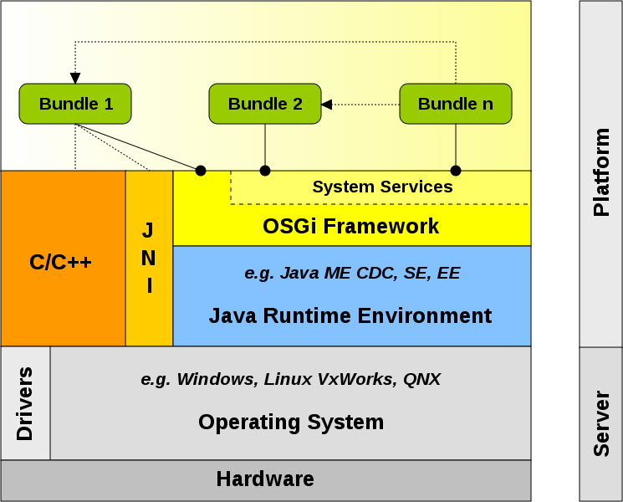
OSGi Infrastructure
Notes:
Green part is developer’s area; blue part is offered by OSGi container; grey part is the infrastructure.
A Bundle may provide multiple Services. A Module defines multiple dependencies, which can be fulfilled by multiple services.
A Module requires a collection of Services, which are in turn implemented by Bundles.

Slide 23
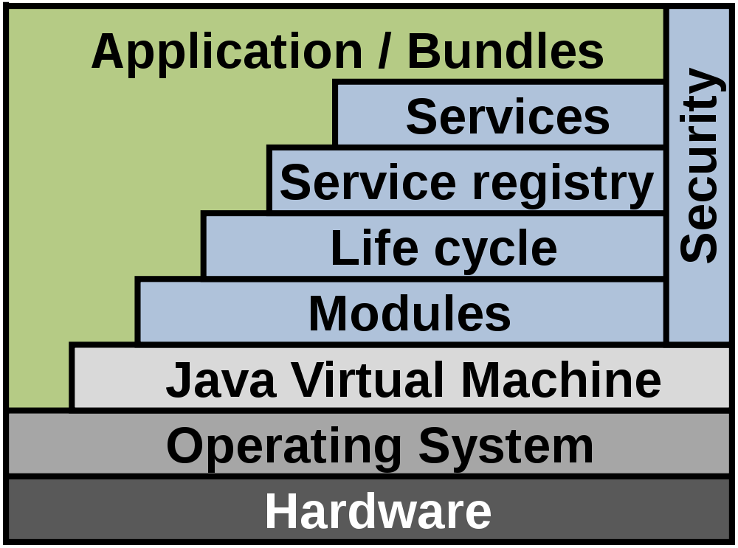
OSGi Architecture
The OSGi framework is conceptually
divided into the following layers:
  Bundles – normal JARs with manifest headers
  Modules – define encapsulation and declaration
  of dependencies, e.g. imports and exports
  Life-cycle – APIs for Bundle management, e.g.
  install, start/stop, update and delete
  Service Registry – APIs for Service management,
  e.g. registration, tracking and reference
  Services – Bundles that have properties registered with the Service Registry
  Security – limits Bundle functionalities to pre-defined capabilities
Notes:
Green part is developer’s area; blue part is offered by OSGi container; grey part is the infrastructure.
A Bundle may provide multiple Services. A Module defines multiple dependencies, which can be fulfilled by multiple services.
A Module requires a collection of Services, which are in turn implemented by Bundles.

Slide 24
OSGi – another view of the layers
Bundles – Bundles are the OSGi components made by the developers.
Services – The services layer connects bundles in a dynamic way by offering a publish-find-bind model for plain old Java objects.
Life-Cycle – The API to install, start, stop, update, and uninstall bundles.
Modules – The layer that defines how a bundle can import and export code.
Security – The layer that handles the security aspects.
Execution Environment – Defines what methods and classes are available in a specific platform.
Notes:
Green part is developer’s area; blue part is offered by OSGi container; grey part is the infrastructure.
A Bundle may provide multiple Services. A Module defines multiple dependencies, which can be fulfilled by multiple services.
A Module requires a collection of Services, which are in turn implemented by Bundles.

Slide 25
Bundles
A Bundle is a group of POJOs with a Menifest.MF file providing OSGi headers
  Bundle-Name: A human-readable name for this bundle
  Bundle-SymbolicName: The only mandatory header that specifies a unique identifier for a bundle (typically a reverse domain name)
  Bundle-Description: A short description of the bundle's functionality
  Bundle-ManifestVersion: The OSGi specification for reading this bundle
  Bundle-Version: The version number of the bundle
  Bundle-Activator: The class name to be invoked once a bundle is activated
  Export-Package: The Java packages made available to the outside world
  Import-Package: The Java packages required from the outside world

Slide 26
Bundle format – an example of Manifest.MF
Bundle-Name: Hello World
Bundle-SymbolicName: org.wikipedia.helloworld
Bundle-Description: A Hello World bundle
Bundle-ManifestVersion: 2
Bundle-Version: 1.0.0
Bundle-Activator: org.wikipedia.Activator
Export-Package: org.wikipedia.helloworld;version="1.0.0"
Import-Package: org.osgi.framework;version="1.3.0"

Slide 27
Bundle format - Import-Package
With an import, you define a dependency on a specific package and make the classes and interfaces in that package available to your bundle.
Only explicitly exported packages (see Export-Package below) are available for import.
When importing a package, we can specify a version range. Only exported packages that are within the version range will be used by the resolver.

Slide 28
Bundle format - Export-Package
Used to make a package available to be imported by other bundles.
A package export is always versioned (0.0.0 by default).
The syntax of an Export-Package is as follows:
Export-Package: com.example.api; version="1.0"
An Export-Package can specify a uses constraint. This can be used to define transitive dependencies on other packages so that an importing bundle knows about the extra package requirements imposed by importing a specific package. E.g.:
Export-Package: com.example.api;
version="1.0"; uses:="com.someother.api"

Slide 29
Bundle format - Activator
A Bundle-Activator is a class that implements the BundleActivator interface and will be instantiated and invoked by the OSGi framework when the bundle is started or stopped.
import org.osgi.framework.BundleActivator;
import org.osgi.framework.BundleContext;
public class Activator implements BundleActivator {
@Override
public void start(BundleContext context) throws Exception {
System.out.println("Bundle starting");
}
@Override
public void stop(BundleContext context) throws Exception {
System.out.println("Bundle stopping");
}
}

Slide 30
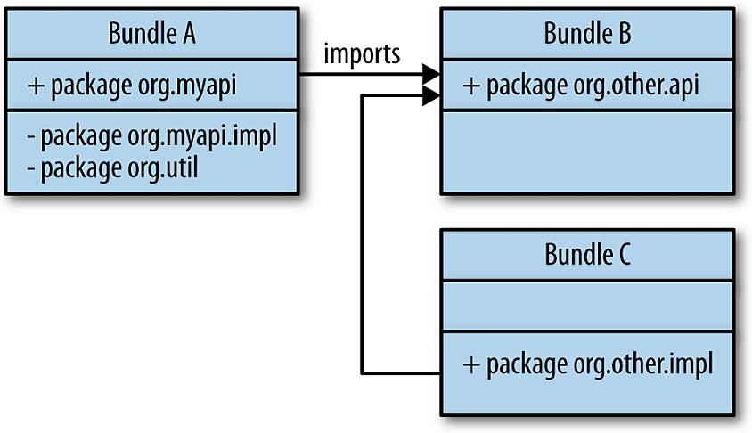
Bundles
Bundle A
  Exports an API package
  Also contains some private packages
  Imports Bundle B to fulfil dependencies
Bundle B
  Only exports a package
  Common for API Bundles
Bundle C
  Only contains a private implementation package
  Common for Service Bundles
-

Slide 31
Bundles
The rules of the game:
  Service APIs and API classes are exported
  Implementation classes are not exported and are not visible to other modules
  A service provider registers an implementation in the Service Registry using a DI framework
  A service consumer uses a DI framework to inject service implementations, using only service APIs
Note:
  Unlike SOA, there is no remoting or any kind of inter JVM communication
  Service invocations are always direct method calls, no proxies are used
  There’s no performance penalty, could easily have hundreds of services

Slide 32
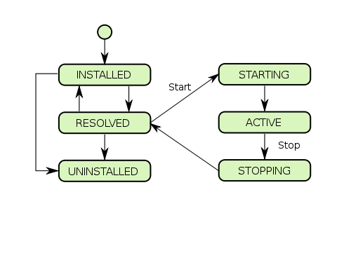
Bundles Life Cycle

Slide 33
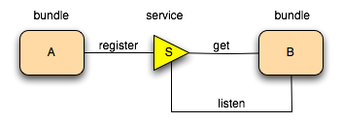
Register a service
A bundle can therefore register a service.
It can get a service, and it can listen for a service to appear or disappear.

Slide 34
Service dynamics
Having a modular runtime, it is possible to activate and deactivate modules (bundles) at runtime.
One example where this could happen is when a bundle is being updated; it must be restarted to activate changes.
Hence, OSGi services are dynamic, which means that a service can be registered or deregistered at any moment during runtime
We have to deal with the possibility that a service disappears during invocation.
A service invocation can throw an exception during invocation if the underlying service has become deregistered, and our code has to handle this correctly.

Slide 35
Running an OSGi Application
When starting an OSGi application, the following happens:
  The OSGi container is started
  Bundles are installed into the container
  Services are resolved by the container
  Bundle activators are invoked
An OSGi container can be started
  Automatically by IDE
  Manually from command line
  Manually from web interface
  Programmatically from code

Slide 36
public class LauncherExample {
public static void main(String args[]) throws BundleException {
FrameworkFactory frameworkFactory = ServiceLoader
.load(FrameworkFactory.class).iterator().next();
Map<String, String> config = new HashMap<>();
Framework framework = frameworkFactory.newFramework(config);
framework.start();
BundleContext context = framework.getBundleContext();
List<Bundle> bundles = new ArrayList<>();
bundles.add(context.installBundle(
"file:org.apache.felix.gogo.command-0.10.0.jar"));
bundles.add(context.installBundle(
"file:org.apache.felix.gogo.runtime-0.10.0.jar"));
bundles.add(context.installBundle(
"file:org.apache.felix.gogo.shell-0.10.0.jar"));
for (Bundle bundle : bundles) {
bundle.start();
}
}
}

Slide 37
Demo

Slide 38
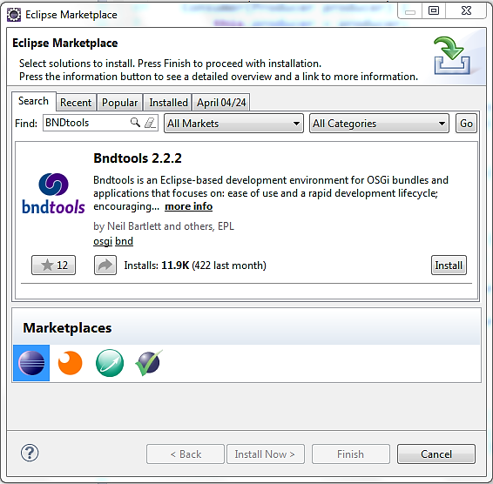
Step1: Install BNDTools

Slide 39
Step2: Create an API Bundle
Project name org.dict.api, type Empty Project
Create a new package org.dict.api, with the following interface:
package org.dict.api;
public interface Dictionary {
public boolean checkWord(String word);
}
Export the package from the Contents tab, and save the changes to bnd.bnd

Slide 40
Step3: Create an Impl Bundle
Project name eng.osgi.dict.impl, type Component Development (Declarative)
Add the Dict API project to the build path as a build-time dependency
Create a new package eng.osgi.dict.impl, with the following class:
package eng.osgi.dict.impl;
import org.dict.api.Dictionary;
import aQute.bnd.annotation.component.Component;
@Component
public class DictionaryComponent implements Dictionary {
String[] en_dictionary = {"welcome", "to", "osgi"};
@Override
public boolean checkWord(String word) {
word = word.toLowerCase();
for (int i = 0; i < en_dictionary.length; i++) {
if (en_dictionary[i].equals(word))
return true;
}
return false;
}
}
Notes:
If junit dependency is missing, replace the default one with the actual one provided by BndTools Build, or simply delete the test package.

Slide 41
Step3: Create an Impl Bundle
Create an Activator class:
package eng.osgi.dict.impl;
import org.dict.api.Dictionary;
import java.util.Hashtable;
import org.osgi.framework.BundleActivator;
import org.osgi.framework.BundleContext;
public class DictionaryActivator implements BundleActivator {
@Override
public void start(BundleContext context) throws Exception {
Hashtable<String, String> props = new Hashtable<String, String>();
props.put("Language", "Eng");
context.registerService(Dictionary.class.getName(), new DictionaryComponent(), props);
System.out.println("Dictionary (Eng) service is started.");
}
@Override
public void stop(BundleContext context) throws Exception {
System.out.println("Dictionary (Eng) service is stopped.");
}
}
Notes:
Remember to wire the Activator eng.osgi.dict.impl.DictionaryActivator

Slide 42
Step4: Create another Impl Bundle
Project name chn.osgi.dict.impl, type Component Development (Declarative)
Add the Dict API project to the build path as a build-time dependency
Create a new package chn.osgi.dict.impl, with the following class:
package chn.osgi.dict.impl;
import org.dict.api.Dictionary;
import aQute.bnd.annotation.component.Component;
@Component
public class DictionaryComponent implements Dictionary {
String[] ch_dictionary = {"欢迎", "使用", "osgi"};
@Override
public boolean checkWord(String word) {
word = word.toLowerCase();
for (int i = 0; i < ch_dictionary.length; i++) {
if (ch_dictionary[i].equals(word))
return true;
}
return false;
}
}
Notes:
If junit dependency is missing, replace the default one with the actual one provided by BndTools Build, or simply delete the test package.

Slide 43
Step4: Create another Impl Bundle
Create an Activator class:
package chn.osgi.dict.impl;
import org.dict.api.Dictionary;
import java.util.Hashtable;
import org.osgi.framework.BundleActivator;
import org.osgi.framework.BundleContext;
public class DictionaryActivator implements BundleActivator {
@Override
public void start(BundleContext context) throws Exception {
Hashtable<String, String> props = new Hashtable<String, String>();
props.put("Language", "Chn");
context.registerService(Dictionary.class.getName(), new DictionaryComponent(), props);
System.out.println("Dictionary (Chn) service is started.");
}
@Override
public void stop(BundleContext context) throws Exception {
System.out.println("Dictionary (Chn) service is stopped.");
}
}
Notes:
Remember to wire the Activator chn.osgi.dict.impl.DictionaryActivator

Slide 44
Step5: Create a Client App
Project name org.dict.client, type Empty Project
Add org.dict.api and osgi.core (under Bndtools Hub) to Build Path
Create a package org.dict.client, and add it to the Private Packages from the Contents tab
Save the changes to bnd.bnd
Create the Activator class of the client app:
package org.dict.client;
import org.dict.api.Dictionary;
import java.io.BufferedReader;
import java.io.InputStreamReader;
import org.osgi.framework.BundleActivator;
import org.osgi.framework.BundleContext;
import org.osgi.framework.InvalidSyntaxException;
import org.osgi.framework.ServiceReference;
import org.osgi.framework.ServiceListener;
import org.osgi.framework.ServiceEvent;
Notes:
Remember to wire the Activator

Slide 45
public class Activator implements BundleActivator, ServiceListener {
private BundleContext _context = null;
private ServiceReference _ref = null;
private Dictionary _dictionary = null;
private SpellChecker _checker = null;
@Override
public synchronized void serviceChanged(ServiceEvent event) {
// If a dictionary service was registered, see if we need one. If so, get a reference to it.
if (event.getType() == ServiceEvent.REGISTERED) {
if (_ref == null) {
_ref = event.getServiceReference();
_dictionary = (Dictionary)_context.getService(_ref);
System.out.println("Changed to " + _ref.getProperty("Language") + " Dictionary.");
}
action();
}
// If a dictionary service was unregistered, see if it was the one being used. If so, try to get another one.
else if (event.getType() == ServiceEvent.UNREGISTERING) {
if (event.getServiceReference() == _ref) {
System.out.println("Unloading " + _ref.getProperty("Language") + " Dictionary.");
_context.ungetService(_ref);
_ref = null;
_dictionary = null;
ServiceReference[] refs = null;
try {
refs = _context.getServiceReferences(Dictionary.class.getName(), "(Language=*)");
} catch (InvalidSyntaxException ex) { }
if (refs != null) {
_ref = refs[0];
_dictionary = (Dictionary)_context.getService(_ref);
System.out.println("Changed to " + _ref.getProperty("Language") + " Dictionary.");
}
action();
}
}
}

Slide 46
@Override
public void start(BundleContext context) throws Exception {
_context = context;
synchronized (this) {
// Listen for events pertaining to dictionary services.
_context.addServiceListener(this, "(&(objectClass=" + Dictionary.class.getName() + ")" + "(Language=*))");
// Query for any service references matching any language.
ServiceReference[] refs = _context.getServiceReferences(Dictionary.class.getName(), "(Language=*)");
// If we found any dictionary services, then just get a reference to the first one so we can use it.
if (refs != null) {
_ref = refs[0];
_dictionary = (Dictionary)_context.getService(_ref);
System.out.println("Using " + _ref.getProperty("Language") + " Dictionary.");
}
}
action();
}
@Override
public void stop(BundleContext context) throws Exception { }
private void action() {
if(_checker != null)
_checker.stop();
_checker = new SpellChecker(_dictionary);
}
}

Slide 47
class SpellChecker extends Thread {
private Dictionary _dictionary = null;
public SpellChecker(Dictionary _dictionary) {
this._dictionary = _dictionary;
start();
}
@Override
public void run() {
try {
System.out.println("Enter a blank line to exit.");
String word = "";
BufferedReader in = new BufferedReader(new InputStreamReader(System.in));
while (true) {
System.out.print("Enter word: ");
word = in.readLine();
if (_dictionary == null)
System.out.println("No dictionary service available at the moment.");
else if (_dictionary.checkWord(word))
System.out.println("Correct.");
else
System.out.println("Incorrect.");
}
} catch (Exception ex) {
ex.printStackTrace();
}
}
}

Slide 48
Step6: Run the Application
Right-click on the client project and create a Bndtools -> Run Descriptor
Choose Apache Felix 4 with Web Console and Gogo as the template
Choose OSGi Framework Felix 4.4.x for JDK 1.7/1.8
Add org.dict.client, slf4j.api, org.apache.felix.http.jetty, eng.osgi.dict.impl and chn.osgi.dict.impl to Run Requirements
Tick the checkbox Auto-resolve on save
Expand VM Arguments and add the following line:
-Dgosh.args=--nointeractive
Switch to the Source mode of the editor, scroll down to the bottom of the file, and uncomment the following line:
-runproperties: org.osgi.service.http.port=XXXX
Save all the changes to the run descriptor, and then click the Run OSGi button
Visit http://localhost:XXXX/system/console to manage the services
Notes:
JDK 1.7 and 1.8 work fine with Felix 4.4.x (used 4.4.1)
Slf4j = Simple Logging Façade for Java, required by Jetty
Default username ‘admin’, password ‘admin’.

Slide 49
OSGi Case Studies
WSO2 Carbon & Eclipse IDE

Slide 50
WSO2 Carbon
WSO2 Inc.
  A vendor for enterprise middleware platforms
  Open-source products include Application Server, Elastic Load Balancer, Enterprise Service Bus, Stratos Cloud and etc.
Carbon
  All WSO2 products are built on top of the Carbon architecture
  Carbon’s kernel is OSGi, which makes it extensible, dynamic and flexible

Slide 51
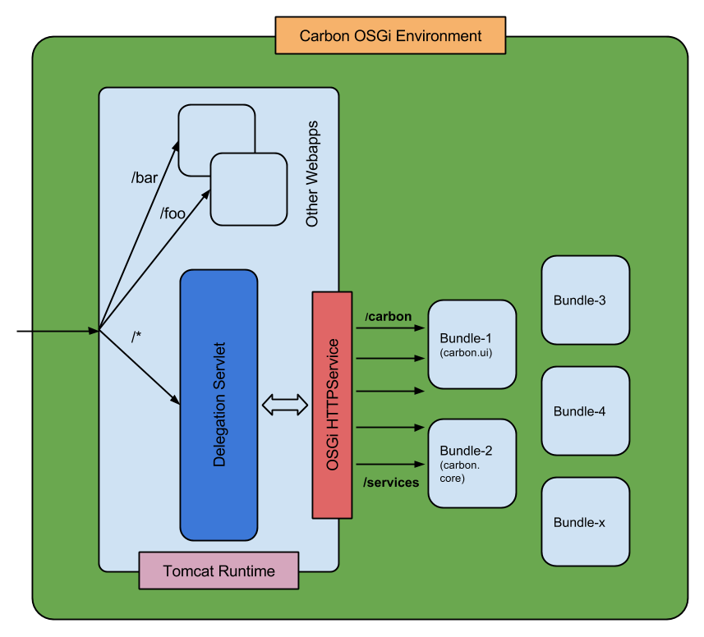
How requests get dispatched
A root context Web App is deployed when the tomcat server starts;
A delegation servlet is registered with the root context Web App, listening to all the requests to /*;
The requests are then passed to an OSGi HttpService, which routes them to the corresponding contexts registered in the OSGi environment;
Server extension modules can be installed, started, stopped, updated and deleted as OSGi Bundles.

Slide 52
Eclipse IDE
One of the most successful open-source projects
  Eclipse 3.6 Helios, released in June 2010, comprised 39 sub-projects and 490 committers from over 40 companies world wide
  Today, there are almost 1000 committers from more than 170 companies
  Eclipse is in fact a proof-of-concept product for its modular architecture
Equinox
  An implementation of the OSGi Framework, and thus Eclipse plugins are also known as Bundles
  Each plugin provides a modular subset of functionality that describes itself with metadata in a manifest, namely plugin.xml
  A bundle that consumes a service imports the service contract package, and the service implementation is determined by the service registry

Slide 53
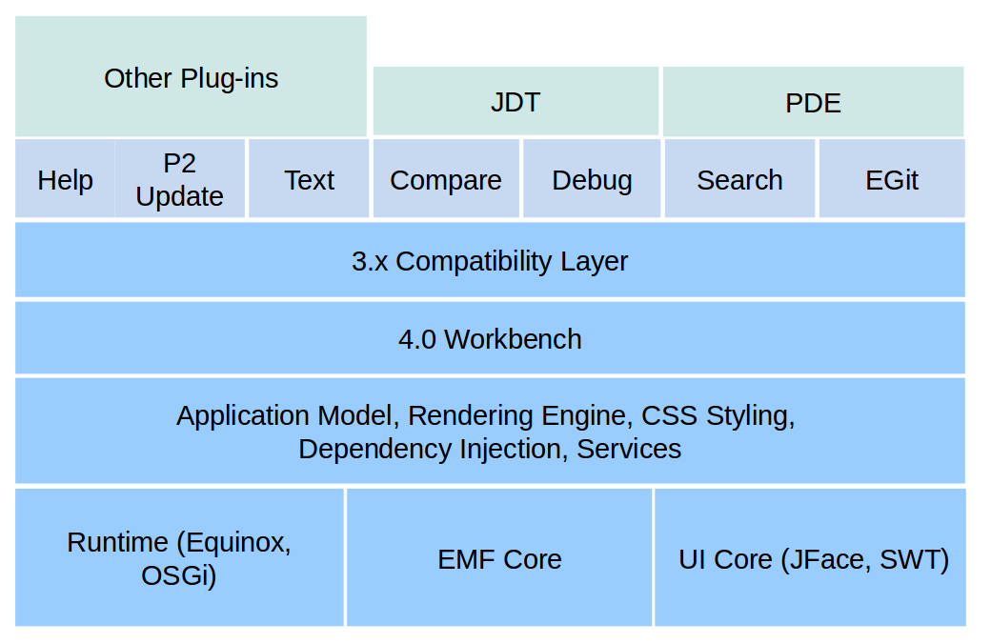
Eclipse IDE
Architecture of Eclipse 4.x
Notes:
EMF = Eclipse Modelling Framework, a common standard for data models.

Slide 54
.NET Modular Solutions

Slide 55
.NET Modular Solutions
Managed Extensibility Framework (MEF)
  An integral part of .NET Framework 4.0
  Applies to any kind of .NET applications
  Allows programmers to develop lightweight, extensible and reusable applications with no configuration required
Key problems addressed:
  Programmers not being able to add new components without modifying the source code
  Applications not being able to discover available components on its own

Slide 56
.NET Modular Solutions
MEF’s approach
  A MEF component (part), declaratively specifies both its dependencies (imports) and capabilities (exports)
  When a part is created, the MEF engine (composition) satisfies its imports with what is available from other known parts
  An application can make use of parts without either hard-coded references or fragile configuration files
  MEF performs a dynamic discovery of parts from a number of locations (catalogs), such as assemblies and directories

Slide 57
.NET Modular Solutions
Summary of MEF concepts:
  Part – An object that can be imported or exported to the application
  Catalog – An object that discovers available parts from assemblies or directories
  Contract – An Interface or predefined data type for imported and exported parts to talk among themselves
  Import Attribute – It defines the need that a part has
  Export Attribute – It exposes those parts that will participate in the composition
  Composition – The area where the exported parts will be assembled with the imported ones

Slide 58
Q & A

