Slide 1
Testing Software Systems (2)
Tip
Software verification is crucial
in assurance of defect-free systems

Slide 2
Reuse and Testing
Software components are often reused in similar applications
Providing evidence based on the component’s:
  Contracts,
  Experience accumulated,
And concluding:
  That a component can be reused immediately,
  That only parts can be reused, or
  That it cannot be reused.
SET09102 SE3
Unit 4

Slide 3
Do we need to re-test reused components
For components reused in a new application, is re-testing necessary?
May save time and costs if re-testing is avoided
But, re-testing cannot be eliminated in general
  Ariane 5
SET09102 SE3
Unit 4

Slide 4
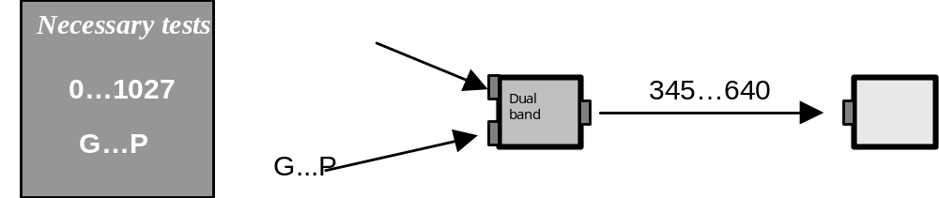
First use of a sample component
SET09102 SE3
Unit 4

Slide 5
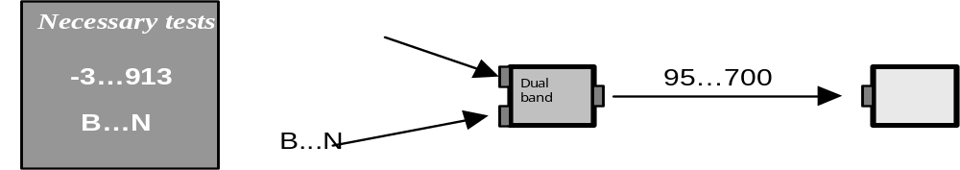
New environment with overlapping input domain
SET09102 SE3
Unit 4

Slide 6
Lower Reliability Requirements
R(c)
C(c)
0
1027
I(c)
A component reused in a context with lower reliability requirements
SET09102 SE3
Unit 4

Slide 7
Previously Experienced Reliability
R(c)
C(c)
0
1027
I(c)
Previously experienced reliability cannot be utilized if
input domains are outside historical use of the component
SET09102 SE3
Unit 4

Slide 8
Failure Behaviors
R(c)
C(c)
Addressing failure
Failure behavior
The confidence in the measured reliability is decreased
when new failure behaviors can develop
SET09102 SE3
Unit 4

Slide 9
Timing Failure Behavior
This failure mode yields a correct result (value), although the procurement of the result is time-wise incorrect.
  For example, deadline violations, start of task too early, incorrect period time, too much jitter, too many interrupts.
SET09102 SE3
Unit 4

Slide 10
Deadline Requirements
If we reuse a component with only a deadline requirement in a new environment in which the execution time is shorter, the component can be reused without re-testing.
SET09102 SE3
Unit 4

Slide 11
Deadline Requirements
R(c)
C(c)
New
old
Worst case execution time
The deadline requirement is still fulfilled
since the new execution time is shorter
SET09102 SE3
Unit 4

Slide 12
Response Time
R(c)
C(c)
Tol min
Tol Max
Response time
The response time for the reused component
is within the tolerance
SET09102 SE3
Unit 4

Slide 13
Test Documentation
Test documentation includes all test programme documents from overall test plan to the final test report.
Test documentation is a parallel effort with development. The related process is known as the V-model of development
SET09102 SE3
Unit 4

Slide 14
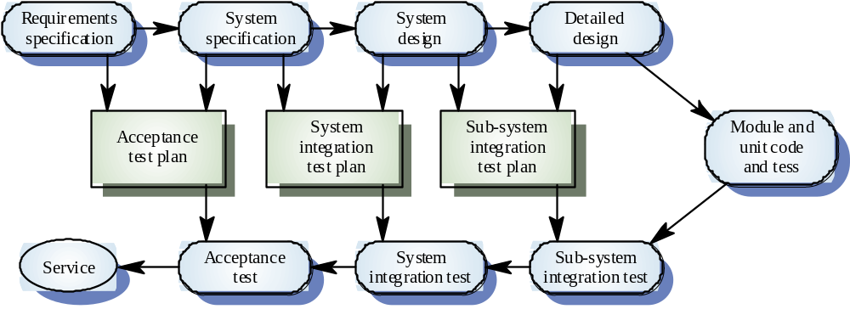
V-Model
SET09102 SE3
Unit 4

Slide 15
Test-driven development
Test-driven development (TDD) is an approach to program development in which you inter-leave testing and code development.
Tests are written before code and ‘passing’ the tests is the critical driver of development.
You develop code incrementally, along with a test for that increment. You don’t move on to the next increment until the code that you have developed passes its test.
TDD was introduced as part of agile methods such as Extreme Programming. However, it can also be used in plan-driven development processes.

Slide 16

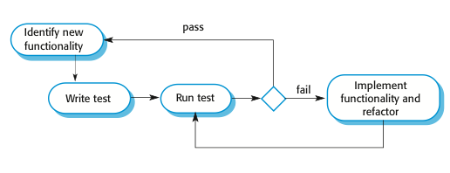
Test-driven development

Slide 17
TDD process activities
Start by identifying the increment of functionality that is required. This should normally be small and implementable in a few lines of code.
Write a test for this functionality and implement this as an automated test.
Run the test, along with all other tests that have been implemented. Initially, you have not implemented the functionality so the new test will fail.
Implement the functionality and re-run the test.
Once all tests run successfully, you move on to implementing the next chunk of functionality.

Slide 18
Benefits of test-driven development
Code coverage
  Every code segment that you write has at least one associated test so all code written has at least one test.
Regression testing
  A regression test suite is developed incrementally as a program is developed.
Simplified debugging
  When a test fails, it should be obvious where the problem lies. The newly written code needs to be checked and modified.
System documentation
  The tests themselves are a form of documentation that describe what the code should be doing.

Slide 19
Contents of test document
Test Plan
Test Cases
Test Procedures
Test Report
SET09102 SE3
Unit 4

Slide 20
Test Plan
Test plan describes the whole planned test process. It is first set up during requirement phase, and keeps evolving throughout the life cycle.
Contents
  Objectives and Scope
  Test Items, Tasks and Deliverables
  Testing Approaches
  Environmental Needs: Hardware, Software, Security, Tools
  Staffing and Training Needs
  Schedule
  Risks and Solutions
SET09102 SE3
Unit 4

Slide 21
Test Cases
Test cases are situations that simulate actual use of the software. They should be small enough to be manageable.
A sample outline of test case:
  Test Case Identifier
  Test Items
  Input Specification
  Output Specification
  Environmental Needs: Hardware, Software, Others
  Special Procedural Requirements
  Intercase Dependencies
SET09102 SE3
Unit 4

Slide 22
Test procedure
A test procedure is a set of step-by-step instructions for the execution of a test case. It is tied to the test case and its test data.
SET09102 SE3
Unit 4

Slide 23
Test report
After practical testing and test analysis, a test report should be completed to summarise the test results.
SET09102 SE3
Unit 4

Slide 24
A sample outline of test report based on IEEE Standard 829-1983
1.Test Report Identifier
2. Summary
2.1 Tested Items
2.2 Environment
2.3 Documentation References
3. Variances (Information of Defects found)
3.1 Item tested
3.2 Defect location
3.3 Defect description
SET09102 SE3
Unit 4

Slide 25
A sample outline of test report based on IEEE Standard 829-1983
3.4 Defect impact
3.5 Defect Type
4. Evaluation
4.1 Test Item Limitation
4.2 Test Item Pass/Fail
4.3 Risk of Future Failure
4.4 Resource Consumption
5. Approvals
SET09102 SE3
Unit 4

Slide 26
Test Tools
Automated and manual test tools are available to assist in various test activities.
A summary according to the application domain
  Test data provision
    Commercially available software packages to help in the creation and insertion of test data.
    Test data generator, simulator
  Data recording
    Event recorder
    Test result recorder
  Path analysers
SET09102 SE3
Unit 4

Slide 27
Automated testing
Whenever possible, unit testing should be automated so that tests are run and checked without manual intervention.
In automated unit testing, you make use of a test automation framework (such as JUnit) to write and run your program tests.
Unit testing frameworks provide generic test classes that you extend to create specific test cases. They can then run all of the tests that you have implemented and report, often through some GUI, on the success of otherwise of the tests.

Slide 28
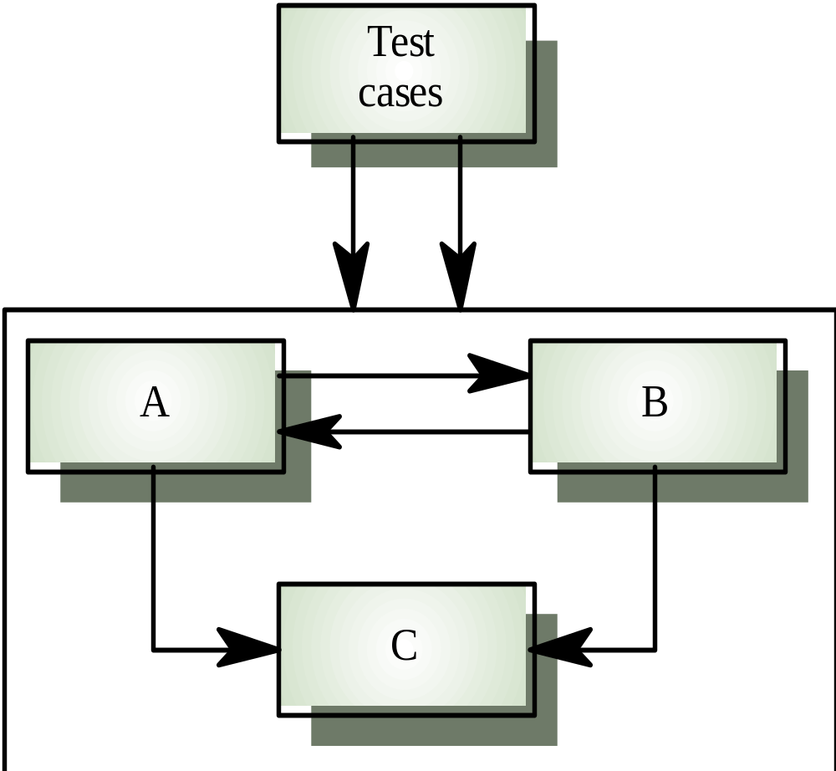
Interface testing
SET09102 SE3
Unit 4

Slide 29
Interface testing
Takes place when modules or sub-systems are integrated to create larger systems
Objectives are to detect faults due to interface errors or invalid assumptions about interfaces
Particularly important for component-based development as components are defined and connected by their interfaces
SET09102 SE3
Unit 4

Slide 30
Typical interfaces types
Parameter interfaces
  Data passed from one procedure to another
Shared memory interfaces
  Block of memory is shared between procedures
Procedural interfaces
  Sub-system encapsulates a set of procedures to be called by other sub-systems
SET09102 SE3
Unit 4

Slide 31
Typical interfaces types
Message passing interfaces
  Sub-systems or objects request services from other sub-systems or objects
SET09102 SE3
Unit 4

Slide 32
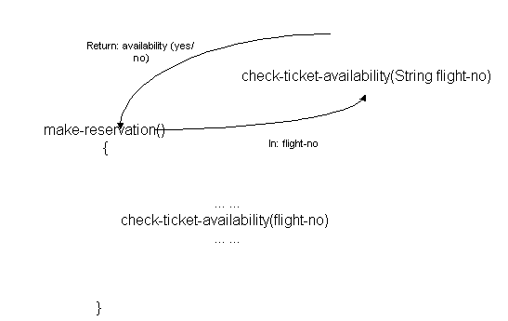
Parameter interface
SET11109 EC
Unit 7

Slide 33
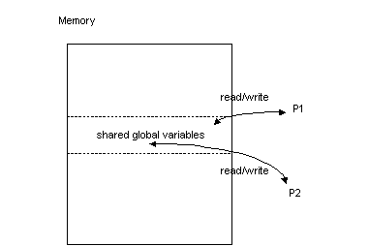
Shared memory interface
SET09102 SE3
Unit 4

Slide 34
Common interface errors
Interface misuse
  A calling component calls another component and makes a syntax error in its use of its interface e.g. parameters in the wrong order
  Example 1:
    Definition: register(int price, string owner)
    Call: register(“J Smith”, 50000)
  Example 2:
    Definition: purchase(int price, int amount)
    Call: purchase(100, 3000), if price is 3000 and amount is 100
SET09102 SE3
Unit 4

Slide 35
Common interface errors
Interface misunderstanding
  A calling component makes incorrect assumptions about the behaviour of the called component
SET09102 SE3
Unit 4

Slide 36
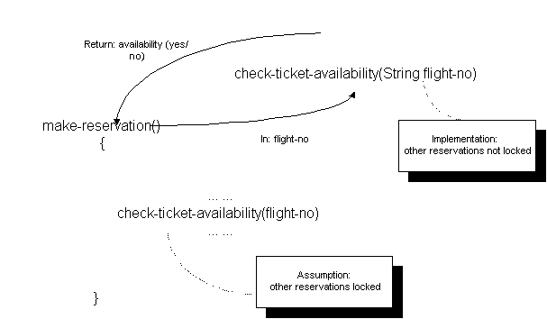
Interface misunderstanding
SET09102 SE3
Unit 7

Slide 37
Common interface errors
Timing errors
  The called and the calling component operate at different speeds and out-of-date information is accessed
SET09102 SE3
Unit 4

Slide 38
Interface testing guidelines
Design tests so that parameters to a called procedure are at the extreme ends of their ranges
Always test pointer parameters with null pointers
Design tests which cause the component to fail
Use stress testing in message passing systems
In shared memory systems, vary the order in which components are activated
SET09102 SE3
Unit 4

Slide 39
System Testing
To ensure that it performs as described in the requirements document.
Often been derived in close consultation with the customer and often performed in the presence of the customer
Acceptance Testing: An additional level of system testing. The user and its agent are allowed to perform a set of their own tests on the system separate to the developer.
SET09102 SE3
Unit 4

Slide 40
System Testing
Installation Tests: ensure that the software can be installed and run smoothly at the user/agent's site.
Alpha Testing: is usually conducted at the developer's site often by an end-user. The tests are undertaken in a controlled environment.
Beta testing: is undertaken at selected customer's sites by the end-user. This is effectively a 'live' system and the developer has no control over what happens.
SET09102 SE3
Unit 4

Slide 41
Deriving Test Cases
Boundary value technique
Equivalence partitioning technique
SET09102 SE3
Unit 4

Slide 42
Boundary values
To derive test cases for an execution path, to engage boundary values is particularly important.
Unexpected, borderline and erroneous conditions or data should be covered by test data.
This is because boundary values tend to reveal errors of a software system.
SET09102 SE3
Unit 4

Slide 43
Boundary values--examples
Think program while (x>=10 and x<100)
It is essential to include “x=10” and “x=100” in test cases.
For string operations, it is important to test the case when the strings are empty.
SET09102 SE3
Unit 4

Slide 44
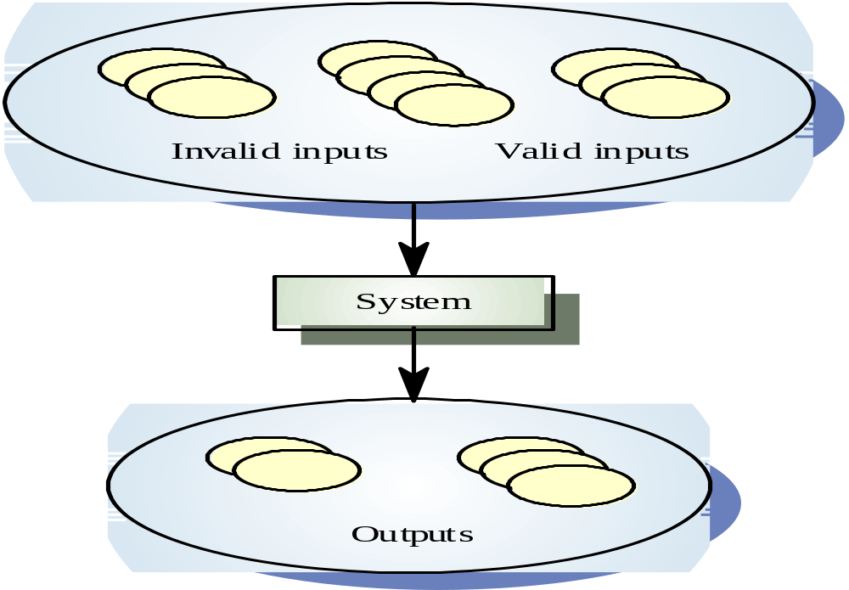
Equivalence partitioning
SET09102 SE3
Unit 4

Slide 45
Equivalence partitioning
Partition system inputs and outputs into
‘equivalence sets’
  If input is a 5-digit integer between 10,000 and 99,999,
  equivalence partitions are <10,000, 10,000-99, 999 and > 100,000
Choose test cases at the boundary of these
sets
  9999, 10000, 50000, 99999, 100000
SET09102 SE3
Unit 4

Slide 46
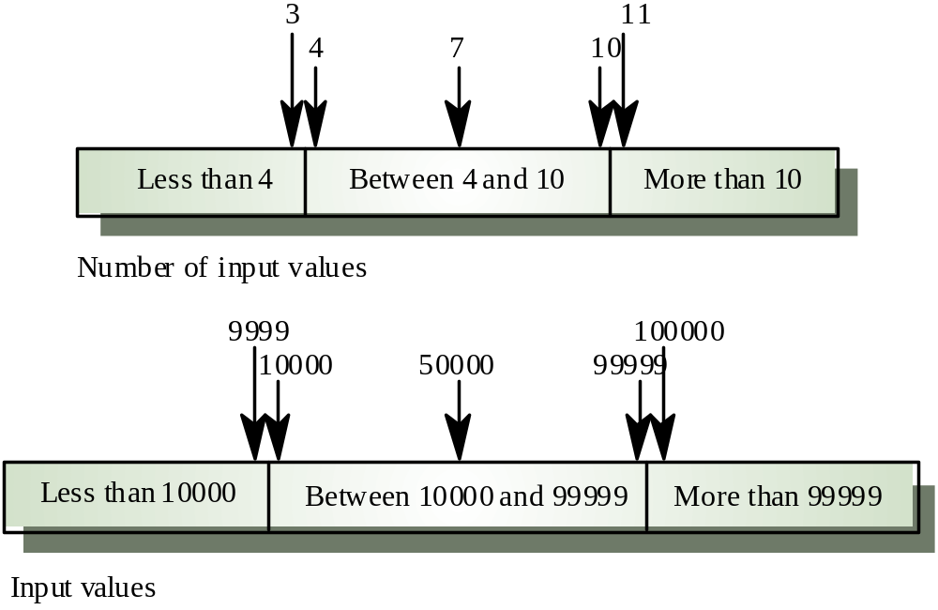
Equivalence partitions
SET09102 SE3
Unit 4

Slide 47
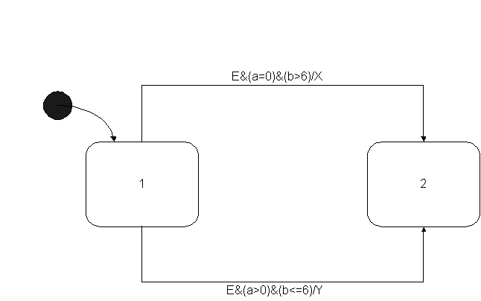
An example of Statecharts testing
SET09102 SE3
Unit 4

Slide 48
An example of Statecharts testing
Test cases:
  1. event E occurs when a=0 and b=7
  2. event E occurs when a=1 and b=7
  3. event E occurs when a=0 and b=6
  4. event E occurs when a=1 and b=6
SET09102 SE3
Unit 4

Slide 49
An example of Statecharts testing
Expected transition and actions if the code is correct:
  1. transition 1 to 2 and action X
  2. no transition and no action
  3. no transition and no action
  4. transition 1 to 2 and action Y
SET09102 SE3
Unit 4

