Slide 1
Unit 10 – Software Quality

Slide 2
What is quality?
Quality, simplistically, means that a product should meet its specification
This can be problematic for software systems
Software specifications are usually incomplete and often inconsistent
Some quality requirements are difficult to specify in an unambiguous way
Tension between customer quality requirements (efficiency, reliability, etc.) and developer quality requirements (maintainability, reusability, etc.)

Slide 3
The quality compromise
We cannot wait for specifications to improve before paying attention to quality management
Must put procedures into place to improve quality in spite of imperfect specification
Quality management is therefore not just concerned with reducing defects but also with other product qualities

Slide 4
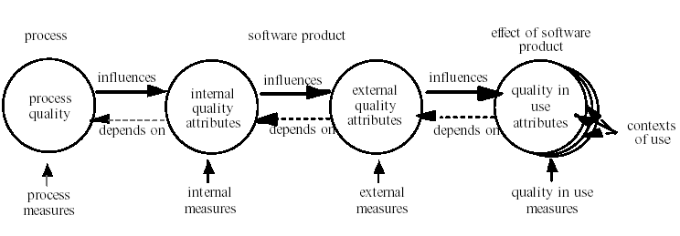
Quality in the life cycle

Slide 5
Quality Measurement
Easy to offer qualitative ideas of software “goodness”
Reliable
Easy to use
Easy to understand
Too complex
“Buggy”
…
But for reliable, repeatable quality management we need to be able to measure.
Measurement → Metrics

Slide 6
Internal and External Metrics
Internal Metrics
Measure internal attributes, eg, static properties of design diagrams or source code
External Metrics
Measure behaviour of code in operation by testing and observing it
Quality in use Metrics
The extent to which users’ expectations are met.

Slide 7
Quality management activities
Quality assurance
Establish organisational procedures and standards for quality
Quality planning
Select applicable procedures and standards for a particular project and modify these as required
Quality control
Ensure that procedures and standards are followed by the software development team
Quality management should be separate from project management to ensure independence

Slide 8
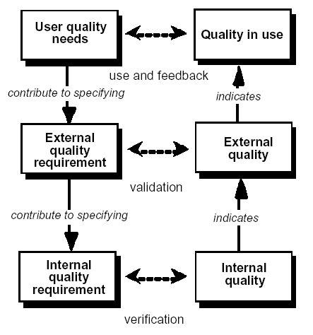
Quality in the software lifecycle
Notes:
User quality needs can be specified as quality requirements by quality in use metrics, by external metrics, and sometimes by internal metrics. These requirements specified by metrics should be used as criteria when a product is validated. Achieving a product which satisfies the user’s needs normally
requires an iterative approach to software development with continual feedback from a user perspective.
External Quality Requirements specify the required level of quality from the external view. They include requirements derived from user quality needs, including quality in use requirements. External quality requirements are used as the target for validation at various stages of development. External quality requirements for all the quality characteristics defined in this part of ISO/IEC 9126 should be stated in the quality requirements specification using external metrics, should be transformed into internal quality requirements, and should be used as criteria when a product is evaluated.
Internal Quality Requirements specify the level of required quality from the internal view of the product. Internal quality requirements are used to specify properties of interim products. These can include static and dynamic models, other documents and source code. Internal quality requirements can be used as targets for validation at various stages of development. They can also be used for defining strategies of development and criteria for evaluation and verification during development. This may include the use of additional metrics (e.g. for reusability). Specific internal quality requirements should be specified quantitatively using internal metrics.
Internal quality is the totality of characteristics of the software product from an internal view. Internal quality is measured and evaluated against the internal quality requirements. Details of software product quality can be improved during code implementation, reviewing and testing, but the fundamental nature of the software product quality represented by internal quality remains unchanged unless redesigned.
Estimated (or Predicted) External Quality is the quality that is estimated or predicted for the end software product at each stage of development for each quality characteristic, based on knowledge of the internal quality.
External Quality is the totality of characteristics of the software product from an external view. It is the quality when the software is executed, which is typically measured and evaluated while testing in a simulated environment with simulated data using external metrics. During testing, most faults should
be discovered and eliminated. However, some faults may still remain after testing. As it is difficult to correct the software architecture or other fundamental design aspects of the software, the fundamental design usually remains unchanged throughout testing.
Estimated (or Predicted) Quality in Use is the quality that is estimated or predicted for the end software product at each stage of development for each quality in use characteristic, and based on knowledge of the internal and external quality.
NOTE External quality and quality in use can be estimated and predicted during development for each quality characteristic defined in this part of ISO/IEC 9126 when proper technologies are developed. However as the
current state of the art does not provide all the support necessary for the purposes of prediction, more technology should be developed to show the co-relation between internal quality external quality and quality in use.
Quality in Use is the user’s view of the quality of the software product when it is used in a specific environment and a specific context of use. It measures the extent to which users can achieve their goals in a particular environment, rather than measuring the properties of the software itself .

Slide 9
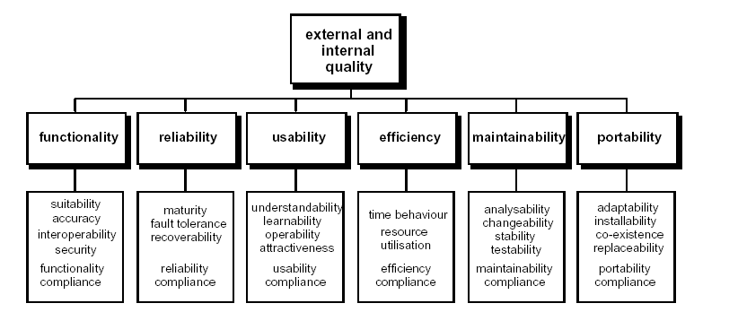
Quality model for external and internal quality (BS ISO 9126)
Notes:
Functionality
The capability of the software product to provide functions which meet stated and implied needs when the software is used under specified conditions.
Reliability
The capability of the software product to maintain a specified level of performance when used under specified conditions.
Usability
The capability of the software product to be understood, learned, used and attractive to the user, when used under specified conditions.
Efficiency
The capability of the software product to provide appropriate performance, relative to the amount of resources used, under stated conditions.
Maintainability
The capability of the software product to be modified. Modifications may include corrections,improvements or adaptation of the software to changes in environment, and in requirements and functional specifications.
Portability
The capability of the software product to be transferred from one environment to another.

Slide 10
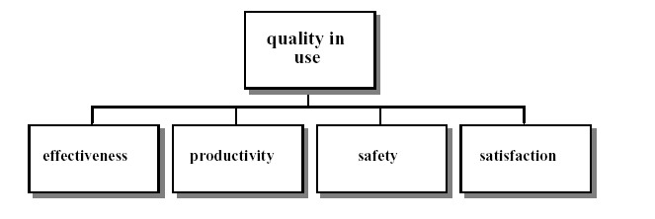
Quality model for quality in use
Notes:
Effectiveness
The capability of the software product to enable users to achieve specified goals with accuracy and completeness in a specified context of use.
Productivity
The capability of the software product to enable users to expend appropriate amounts of resources in relation to the effectiveness achieved in a specified context of use.
NOTE Relevant resources can include time to complete the task, the user’s effort, materials or the financial cost of usage.
Safety
The capability of the software product to achieve acceptable levels of risk of harm to people, business, software, property or the environment in a specified context of use.
NOTE Risks are usually a result of deficiencies in the functionality (including security), reliability, usability or maintainability.
Satisfaction
The capability of the software product to satisfy users in a specified context of use.
NOTE Satisfaction is the user’s response to interaction with the product, and includes attitudes towards use of the product.

Slide 11
Process and product quality
The quality of a developed product is influenced by the quality of the production process
Particularly important in software development as some product quality attributes are hard to assess
However, there is a very complex and poorly understood relationship between software processes and product quality

Slide 12
Process-based quality
Straightforward link between process and product in manufactured goods
More complex for software because:
The application of individual skills and experience is particularly important in software development
External factors such as the novelty of an application or the need for an accelerated development schedule may impair product quality
Care must be taken not to impose inappropriate process standards

Slide 13
Practical process quality
Define process standards such as how reviews should be conducted, configuration management, etc.
Monitor the development process to ensure that standards are being followed
Report on the process to project management and software procurer

Slide 14
Design quality
Design quality is an elusive concept. Quality depends on specific organisational priorities
A 'good' design may be the most efficient, the cheapest, the most maintainable, the most reliable, etc.
The attributes discussed here are concerned with the maintainability of the design
Quality characteristics are equally applicable to function-oriented and object-oriented designs

Slide 15
Why bad design results?
Obvious reasons:
lack of design skills/ design practices, changing technologies, time/ resource constraints, domain complexity etc.
Not so obvious:
Software rot is a slow process .. even originally clean and elegant design may degenerate over the months/ years ..
Unplanned and improper module dependencies creep in; Dependencies go unmanaged.
Requirements often change in the way the original design or designer did not anticipate ..

Slide 16
Cohesion
A measure of how well a component 'fits together'
A component should implement a single logical entity or function
Cohesion is a desirable design component attribute as when a change has to be made, it is localised in a single cohesive component
Various levels of cohesion have been identified

Slide 17
Cohesion levels
Coincidental cohesion (weak)
Parts of a component are simply bundled together
Logical cohesion (weak)
Components which perform similar functions are grouped
Temporal cohesion (weak)
Components which are activated at the same time are grouped
Procedural cohesion (weak)
The elements in a component make up a single control sequence

Slide 18
Cohesion levels
Communicational cohesion (medium)
All the elements of a component operate on the same input or produce the same output
Sequential cohesion (medium)
The output for one part of a component is the input to another part
Functional cohesion (strong)
Each part of a component is necessary for the execution of a single function
Object cohesion (strong)
Each operation provides functionality which allows object attributes to be modified or inspected

Slide 19
Cohesion as a design attribute
Not well-defined. Often difficult to classify cohesion
Inheriting attributes from super-classes weakens cohesion
To understand a component, the super-classes as well as the component class must be examined
Cohesion in a service or a microservice

Slide 20
Coupling
A measure of the strength of the inter-connections between system components
Loose coupling means component changes are unlikely to affect other components
Shared variables or control information exchange lead to tight coupling
Loose coupling can be achieved by state decentralisation (as in objects) and component communication via parameters or message passing
28

Slide 21
Tight coupling

Slide 22
Loose coupling

Slide 23
Coupling and inheritance
Object-oriented systems are loosely coupled because there is no shared state and objects communicate using message passing
However, a sub-class is coupled to its super-classes. Changes made to the attributes or operations in a super-class propagate to all sub-classes. Such changes must be carefully controlled

Slide 24
Design principles
Single Responsibility principle
Open Closed principle
Liskov Substitution principle
Dependency Inversion principle
Interface Segregation principle
Stability principles

Slide 25
The single responsibility principle
There should never be more than one reason for a class/service/microservice to change.
Responsibility is:
A contract or obligation of a class/service/microservice
A contract has pre-conditions and post-conditions
A clear definition of the services of a class/service/microservice
The class/service/microservice carries out the services (is responsible)
Two types of responsibilities
knowing
doing
natural to the notions of state and behaviour

Slide 26
Knowing Responsibilities
• knowing about private encapsulated data
• knowing about related objects
• knowing about things it can derive or calculate
Examples :
– people (person) know their age
– a stack knows the order items came in

Slide 27
Doing Responsibilities
• doing something itself
• initiating action in other objects
• controlling and coordinating activities of other
objects

Slide 28
Single Responsibility Principle
In the context of the SRP a responsibility can be define to be “ a reason for change “
If there is more than one reason for changing a class, then that class has more than one responsibility.

Slide 29
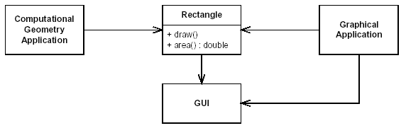
More than one responsibility
Uses only the area method in rectangle
Uses the draw as well as the area method
Notes:
Two different applications use the Rectangle class. One application does computational
geometry. It uses Rectangle to help it with the mathematics of geometric shapes.
It never draws the rectangle on the screen. The other application is graphical in nature. It
may also do some computational geometry, but it definitely draws the rectangle on the
screen.
This design violates the SRP. The Rectangle class has two responsibilities. The first
responsibility is to provide a mathematical model of the geometry of a rectangle. The second
responsibility is to render the rectangle on a graphical user interface.
The violation of SRP causes several nasty problems. Firstly, we must include the GUI
in the computational geometry application. If this were a C++ application, the GUI would
have to be linked in, consuming link time, compile time, and memory footprint. In a Java
application, the .class files for the GUI have to be deployed to the target platform.
Secondly, if a change to the GraphicalApplication causes the Rectangle to
change for some reason, that change may force us to rebuild, retest, and redeploy the
ComputationalGeometryApplication. If we forget to do this, that application may
break in unpredictable ways.

Slide 30
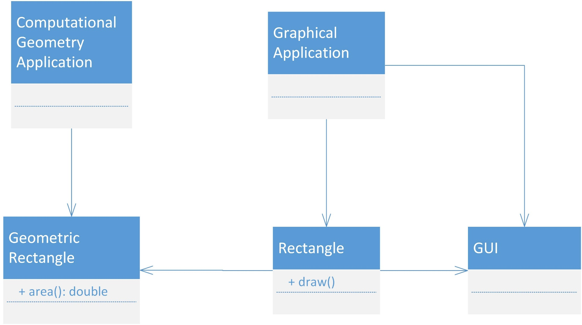
Separated responsibility
Notes:
A better design is to separate the two responsibilities into two completely different
classes as shown in Figure. This design moves the computational portions of
Rectangle into the GeometricRectangle class. Now changes made to the way rectangles
are rendered cannot affect the ComputationalGeometryApplication.

Slide 31
SRP-example
Connection function
interface Modem
{
public void dial(String pno);
public void hangup();
public void send(char c);
public char recv();
}
Communication function
Two responsibilities for two functions with almost nothing in common – should be separated in different classes

Slide 32
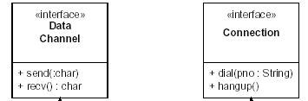
SRP-example

Slide 33
Open Closed principle
A module should be:
Open for extension
means that the behaviour of the module can be extended
Closed for modification
means that no changes to the module is allowed

Slide 34
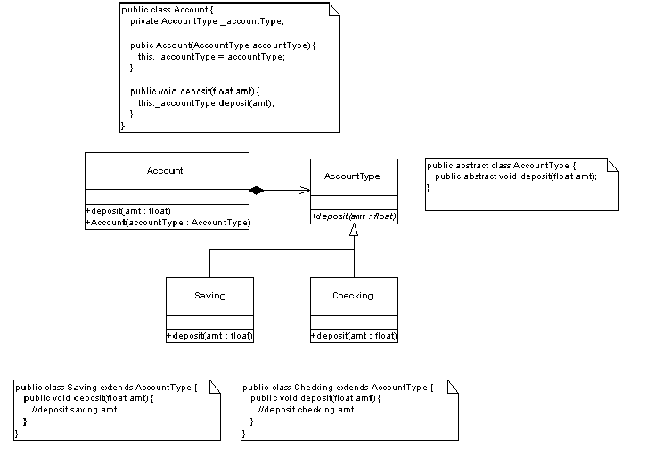
Open Closed Principle - example
Notes:
The diagram illustrates how we can structure our application to accommodate extensibility. The
realization of this flexibility is achieved through inheritance and polymorphism. In the above example, we
see that our Account class has a relationship to an abstract AccountType class. Through dynamic
binding, we are able to substitute descendents of AccountType anywhere that class is referenced.
Subsequently, our Account class has no knowledge of the actual Saving and Checking concrete classes, allowing us to create new AccountType descendents that our Account class may also use.
These relationships are also illustrated in the accompanying code snippets.

Slide 35
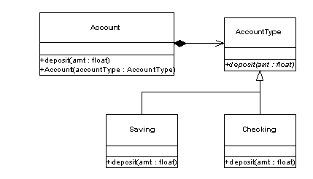
Able to substitute the abstract AccountType with any subtype without Account knowing. Hence can extend AccountType with new subtypes without modifiying Account

Slide 36
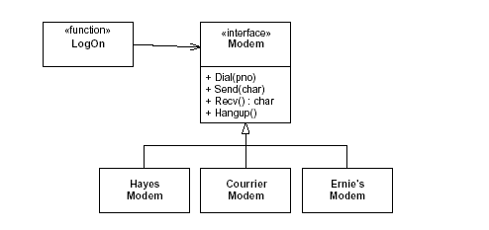
Example: OCP
Notes:
By using these techniques to conform to the
OCP, we can create modules that are extensible, without being changed. This means
that, with a little forethought, we can add new features to existing code, without
changing the existing code and by only adding new code. This is an ideal that can be
difficult to achieve.
Even if the OCP cannot be fully achieved, even partial OCP compliance can make
dramatic improvements in the structure of an application. It is always better if
changes do not propogate into existing code that already works. If you don’t have to
change working code, you aren’t likely to break it.

Slide 37
Liskov Substitution principle
Functions that use pointers or references to base classes must be able to use objects of derived classes without knowing it

Slide 38
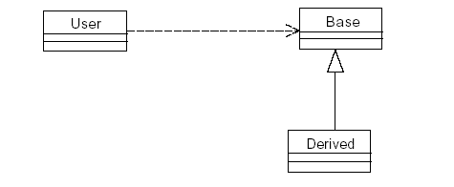
Liskov Substitution principle
Notes:
LSP and Design by Contract.
“Restating the LSP, we can say that, in order to be substitutable, the contract of the
base class must be honored by the derived class.”
“This principle was coined by Barbara Liskov 2 in her work regarding data
abstraction and type theory. It also derives from the concept of Design by Contract
(DBC) by Bertrand Meyer ”
“Derived classes should be substitutable for their base classes. That is, a user of a base
class should continue to function properly if a derivative of that base class is passed to it. In other words, if some function User takes an argument to type Base, then it should be legal to pass in an instance of Derived to that function.”
“To state the contract of a method, we declare what must be true before the method is
called. This is called the precondition. If the precondition fails, the results of the
method are undefined, and the method ought not be called. We also declare what the
method guarantees will be true once it has completed. This is called the postcondition.
A method that fails its postcondition should not return.”
“Restating the LSP once again, this time in terms of the contracts, a derived class is
substitutable for its base class if:
1. the preconditions are no stronger than the base class method.
2. Its postconditions are no weaker than the base class method.
Or, in other words, derived methods should expect no more and provide no less.”

Slide 39
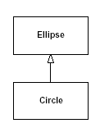
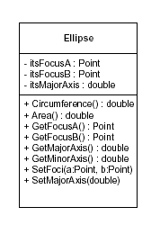
Example 1 : LSP

Slide 40
LSP example 1 cont
Keeping the Circle Foci coincident.
void Circle::SetFoci(const Point& a, const Point& b)
{
itsFocusA = a;
itsFocusB = a;
}

Slide 41
LSP example 1 cont
Client Code:
void f(Ellipse& e)
{
Point a(-1,0);
Point b(1,0);
e.SetFoci(a,b);
e.SetMajorAxis(3);
assert(e.GetFocusA() == a);
assert(e.GetFocusB() == b);
assert(e.GetMajorAxis() == 3);
}
Circle violates this guarantee because it ignores
the second input variable of SetFoci.

Slide 42
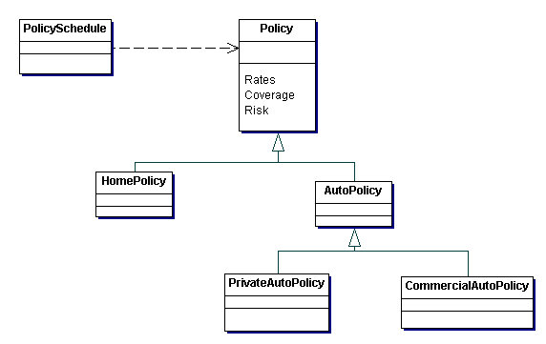
LSP example 2
The PolicySchedule module should be able to accept any of HomePolicy, PrivateAutoPolicy or
CommercialAutoPolicy without breaking.
Violation of the Liskov Substitution Principle also implies violation of the Open Closed principle.

Slide 43
Dependency Inversion principle
High level modules should not depend upon low level modules. Both should depend upon abstraction.
Abstractions should not depend upon details. Details should depend upon abstractions.

Slide 44
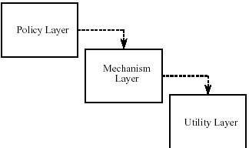
Dependency Inversion principle – simple layers
Notes:
If the OCP states the goal of OO architecture, the DIP states the primary mechanism.
Dependency Inversion is the strategy of depending upon interfaces or abstract
functions and classes, rather than upon concrete functions and classes. This principle
is the enabling force behind component design, COM, CORBA, EJB, etc. Procedural
designs exhibit a particular kind of dependency structure. This structure starts at the
top and points down towards details. High level modules depend upon lower level
modules, which depend upon yet lower level modules, etc. .
A little thought should expose this dependency structure as intrinsically weak. The
high level modules deal with the high level policies of the application. These policies
generally care little about the details that implement them. Why then, must these high
level modules directly depend upon those implementation modules?

Slide 45
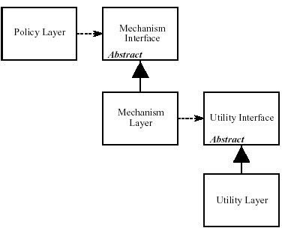
Dependency Inversion principle – abstract layers
Notes:
“An object oriented architecture shows a very different dependency structure, one in
which the majority of dependencies point towards abstractions. Moreover, the modules
that contain detailed implementation are no longer depended upon, rather they
depend themselves upon abstractions. Thus the dependency upon them has been
inverted.”
Figure shows a more appropriate model. Each of the lower level layers are
represented by an abstract class. The actual layers are then derived from these
abstract classes. Each of the higher level classes uses the next lowest layer
through the abstract interface. Thus, none of the layers depends upon any of
the other layers. Instead, the layers depend upon abstract classes. Not only is the transitive dependency of Policy
Layer upon Utility Layer broken, but even the direct dependency of Policy Layer upon Mechanism Layer is broken.

Slide 46
Interface Segregation principle
Clients should not be forced to depend upon interfaces that they do not use.

Slide 47
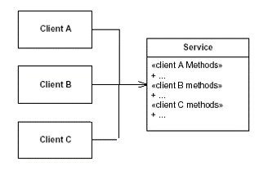
Interface Segregation principle Example- Integrated Interfaces
Notes:
Figure shows a class with many clients, and one large interface to serve them all.
Note that whenever a change is made to one of the methods that ClientA calls,
ClientB and ClientC may be affected. It may be necessary to recompile and
redeploy them.

Slide 48
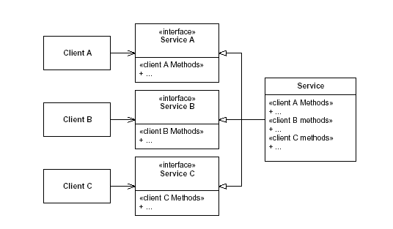
Interface Segregation principle Example- Segregated Interfaces
Notes:
A better technique is shown. The methods needed by each client are
placed in special interfaces that are specific to that client. Those interfaces are multiply
inherited by the Service class, and implemented there.
If the interface for ClientA needs to change, ClientB and ClientC will remain
unaffected. They will not have to be recompiled or redeployed.

Slide 49
Stability
Stability is related to the amount of work required to make a change.
There are many factors that make a software package
hard to change. Its size, complexity, clarity, etc.
One way to make a software package difficult to change, is to make lots of other software packages depend upon it.

Slide 50
The Stable Dependencies Principle:
Depend in the direction of stability

Slide 51
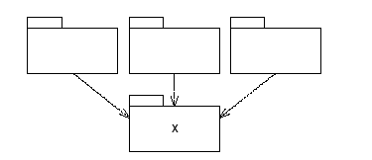
Stable Dependencies Principle : example X is a stable package
Notes:
Figure shows X: a stable package. This package has three packages depending
upon it, and therefore it has three good reasons not to change. We say that it is responsible
to those three packages. On the other hand, X depends upon nothing, so it has no
external influence to make it change. We say it is independent.

Slide 52
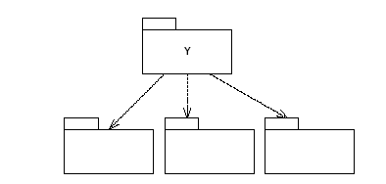
Stable Dependencies Principle : example Y is unstable
Notes:
Figure shows a very instable package. Y has no other packages
depending upon it; we say that it is irresponsible. Y also has three packages that
it depends upon, so changes may come from three external sources. We say that Y is
dependent.

Slide 53
Stable Abstraction Principle Stable packages should be abstract packages
If the stable packages at the bottom (depended upon) are also highly abstract, then they can be easily extended. This means that it is possible to compose our application from instable packages that are easy to change, and stable packages that are easy to extend.

Slide 54
Reference
Ian Sommerville, Software Engineering, 10e Edition, Addison Wesley, 2017.
BS ISO/IEC 9126-1:2001
Information technology – Software product quality
Enhanced/superseded by:
ISO/IEC 25010:2011
Systems and software engineering -- Systems and software Quality Requirements and Evaluation (SQuaRE) -- System and software quality models
http://www.iso.org/iso/catalogue_detail.htm?csnumber=35733
Video here: https://www.youtube.com/watch?v=2aRsIUL48qk

